Slide 1


16
Additional Topics in Differential Equations
P
Copyright © Cengage Learning. All rights reserved.

Slide 2

16.1
Exact First-Order Equations
Copyright © Cengage Learning. All rights reserved.

Slide 3
Objectives
Solve an exact differential equation.
Use an integrating factor to make a differential equation exact.

Slide 4
Exact Differential Equations

Slide 5
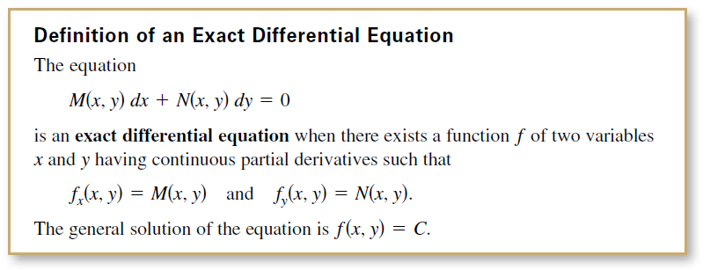
Exact Differential Equations
This section introduces you to a method for solving the first-order differential equation
M(x, y) dx + N(x, y) dy = 0
for the special case in which this equation represents the exact differential of a function z = f (x, y).

Slide 6
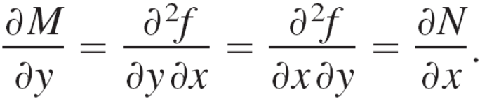
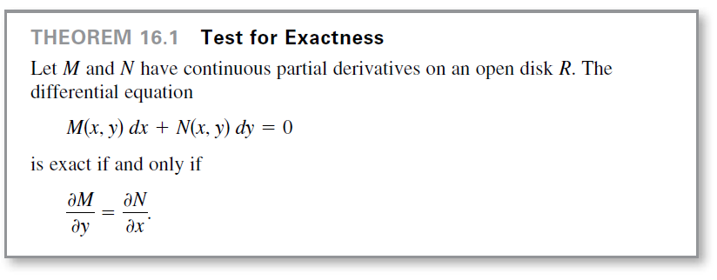
Exact Differential Equations
You know that if f has continuous second partials, then
This suggests the following test for exactness.

Slide 7
Example 1 – Testing for Exactness
Determine whether each differential equation is exact.
a. (xy² + x) dx + x²y dy = 0
b. cos y dx + (y² – x sin y) dy = 0

Slide 8
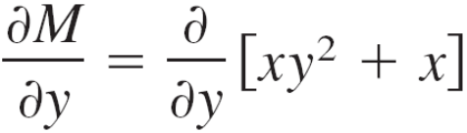

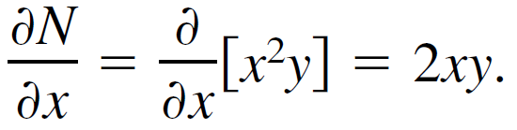
Example 1(a) – Solution
The differential equation is exact because
and
Notice that the equation (y² + 1) dx + xy dy = 0 is not exact, even though it is obtained by dividing each side of the first equation by x.

Slide 9
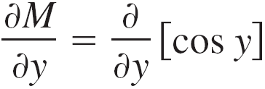



Example 1(b) – Solution
The differential equation is exact because
and
Notice that the equation cos y dx + (y² + x sin y) dy = 0 is not exact, even though it differs from the first equation only by a single sign.

Slide 10
Exact Differential Equations
Note that the test for exactness of
M(x, y) dx + N(x, y) dy = 0 is the same as the test for determining whether F(x, y) = M(x, y)i + N(x, y)j is the gradient of a potential function.
This means that a general solution f(x, y) = C to an exact differential equation can be found by the method used to find a potential function for a conservative vector field.

Slide 11
Integrating Factors

Slide 12
Integrating Factors
When the differential equation M(x, y) dx + N(x, y) dy = 0 is not exact, it may be possible to make it exact by multiplying by an appropriate factor u(x, y), which is called an integrating factor for the differential equation.

Slide 13
Example 4 – Multiplying by an Integrating Factor
a. When the differential equation
2y dx + x dy = 0 Not an exact equation
is multiplied by the integrating factor u(x, y) = x,
the resulting equation
2xy dx + x² dy = 0 Exact equation
is exact—the left side is the total differential of x²y.

Slide 14
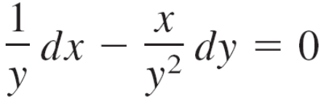
Example 4 – Multiplying by an Integrating Factor
cont’d
b. When the equation
y dx – x dy = 0 Not an exact equation
is multiplied by the integrating factor u(x, y) = 1/y²,
the resulting equation
Exact equation
is exact—the left side is the total differential of x/y.

Slide 15
Integrating Factors
Finding an integrating factor can be difficult. There are two classes of differential equations, however, whose integrating factors can be found routinely—namely, those that possess integrating factors that are functions of either x alone or y alone.

Slide 16
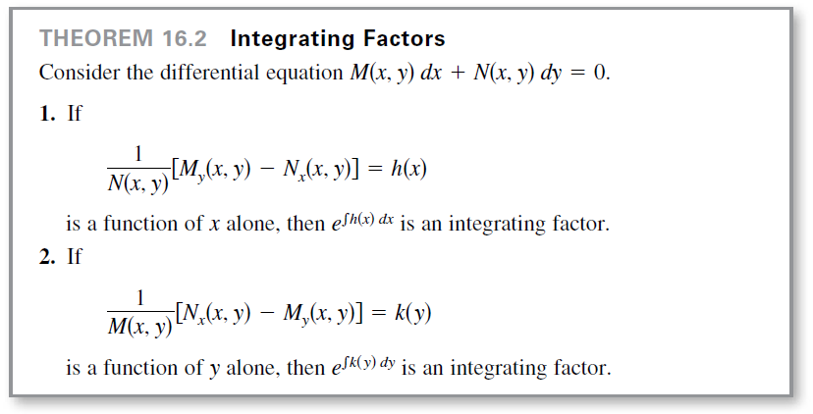
Integrating Factors
The following theorem, outlines a procedure for finding these two special categories of integrating factors.

Slide 17
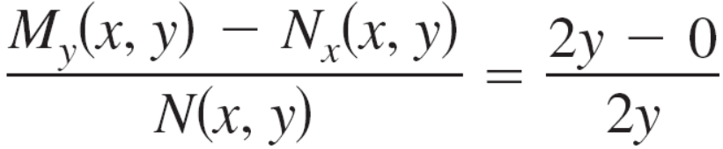


Example 5 – Finding an Integrating Factor
Solve the differential equation (y² – x) dx + 2y dy = 0.
Solution:
This equation is not exact because M_{y}(x, y) = 2y and
N_{x}(x, y) = 0.
However, because
it follows that e^{∫h(x) dx} = e^{∫ dx} = e^{x} is an integrating factor.

Slide 18
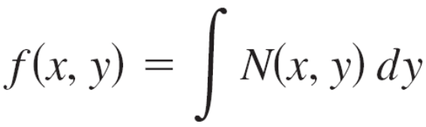
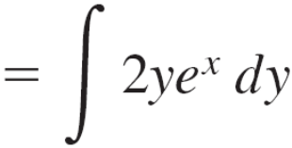

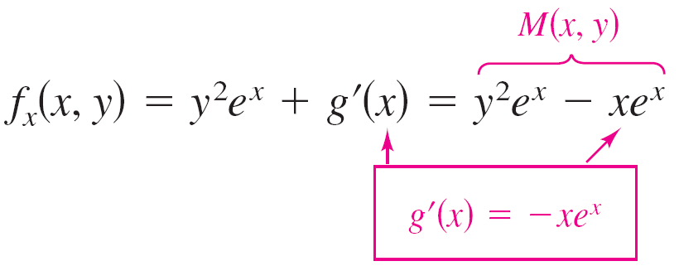
Example 5 – Solution
cont’d
Multiplying the differential equation by e^{x} produces the exact differential equation
(y²e^{x} – xe^{x}) dx + 2ye^{x} dy = 0.
Next, integrate N(x, y), as shown.
Now, find f_{x}(x, y) and compare the result with M(x, y).

Slide 19
Example 5 – Solution
cont’d
Therefore, g′(x) = –xe^{x} and g(x) = –xe^{x} + e^{x} + C₁, which implies that
f(x, y) = y²e^{x} – xe^{x} + e^{x} + C₁.
The general solution is y²e^{x} – xe^{x} + e^{x} = C, or
y² – x + 1 = Ce^{–x}. General Solution

