Slide 1


16
Additional Topics in Differential Equations
P
Copyright © Cengage Learning. All rights reserved.

Slide 2

Second-Order Homogeneous Linear Equations
16.2
Copyright © Cengage Learning. All rights reserved.

Slide 3
Objectives
Solve a second-order linear differential equation.
Solve a higher-order linear differential equation.
Use a second-order linear differential equation to solve an applied problem.

Slide 4
Second-Order Linear Differential Equations

Slide 5
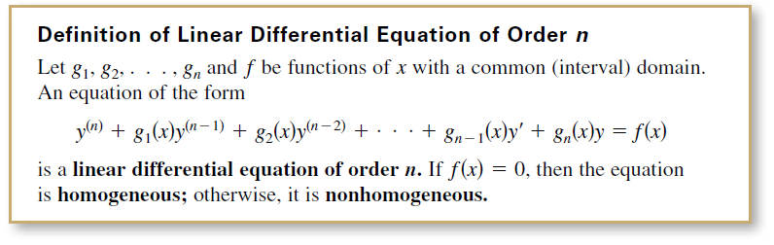
Second-Order Linear Differential Equations
In this section, you will learn methods for solving
higher-order linear differential equations.
Homogeneous equations are discussed in this section.

Slide 6

Second-Order Linear Differential Equations
The functions y₁, y₂,…, y_{n} are linearly independent when the only solution of the equation
is the trivial one, C₁ = C₂ = · · · = C_{n} = 0. Otherwise, this set of functions is linearly dependent.

Slide 7
Example 1 – Linearly Independent and Dependent Functions
Determine whether the functions are linearly independent or linearly dependent.
a. y₁(x) = sin x, y₂(x) = x
b. y₁(x) = x, y₂(x) = 3x
Solution:
a. The functions y₁(x) = sin x and y₂(x) = x are linearly
independent because the only values of C₁ and C₂ for which
C₁ sin x + C₂x = 0
for all x are C₁ = 0 and C₂ = 0.

Slide 8
Example 1 – Solution
cont’d
b. It can be shown that two functions form a linearly
dependent set if and only if one is a constant multiple of
the other.
For example, y₁(x) = x and y₂(x) = 3x are linearly
dependent because
C₁x + C₂(3x) = 0
has the nonzero solutions C₁ = –3 and C₂ = 1.

Slide 9
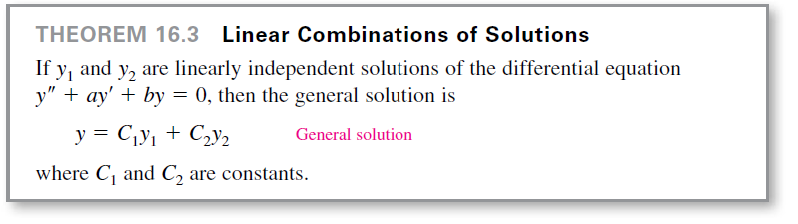
Second-Order Linear Differential Equations
The next theorem points out the importance of linear independence in constructing the general solution of a second-order linear homogeneous differential equation with constant coefficients.

Slide 10
Second-Order Linear Differential Equations
Theorem 16.3 states that when you can find two linearly independent solutions, you can obtain the general solution by forming a linear combination of the two solutions.
To find two linearly independent solutions, note that the nature of the equation y ′′ + ay ′ + by = 0 suggests that it may have solutions of the form y = e^{mx}. If so, then
y ′ = me^{mx} and y ′′ = m²e^{mx}.

Slide 11

Second-Order Linear Differential Equations
So, by substitution, y = e^{mx} is a solution if and only if
y ′′ + ay′ + by = 0
m²e^{mx} + ame^{mx} + be^{mx} = 0
e^{mx}(m² + am + b) = 0.
Because e^{mx} is never 0, y = e^{mx} is a solution if and only if
This is the characteristic equation of the differential equation
y′′ + ay′ + by = 0.

Slide 12
Second-Order Linear Differential Equations
Note that the characteristic equation can be determined from its differential equation simply by replacing y ′′ with m ², y ′ with m, and y with 1.

Slide 13
Example 2 – Characteristic Equation: Distinct Real Zeros
Solve the differential equation
y ′′ – 4y = 0.
Solution:
In this case, the characteristic equation is
m ² – 4 = 0. Characteristic equation
So, m = ±2.
Therefore, y₁ = e^{m}1^{x} = e^{2x} and y₂ = e^{m}2^{x} = e^{–2x} are particular solutions of the differential equation.

Slide 14
Example 2 – Solution
cont’d
Furthermore, because these two solutions are linearly independent, you can apply Theorem 16.3 to conclude that the general solution is
y = C₁e^{2x} + C₂e^{–2x}. General Solution

Slide 15
Second-Order Linear Differential Equations
The characteristic equation in Example 2 has two distinct real zeros.
From algebra, you know that this is only one of three possibilities for quadratic equations.

Slide 16
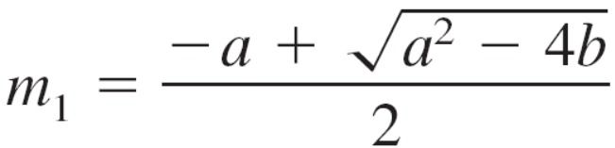
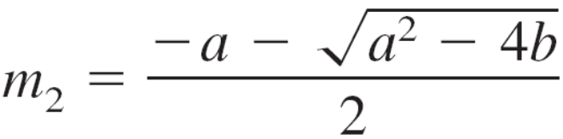
Second-Order Linear Differential Equations
In general, the quadratic equation m² + am + b = 0 has zeros
and
which fall into one of three cases.
1. Two distinct real zeros, m₁ ≠ m₂
2. Two equal real zeros, m₁ = m₂
3. Two complex conjugate zeros, m₁ = α + β i and
m₂ = α – β i
In terms of the differential equation y′′ + ay′ + by = 0, these three cases correspond to three different types of general solutions.

Slide 17
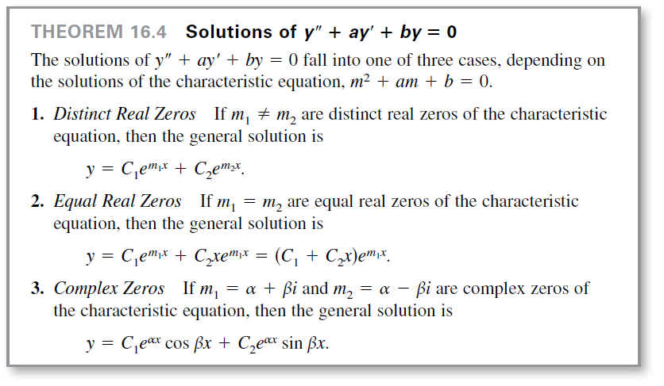
Second-Order Linear Differential Equations

Slide 18
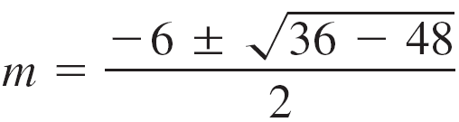
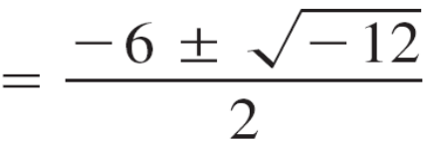
Example 3 – Characteristic Equation: Complex Zeros
Find the general solution of the differential equation
y ′′ + 6y′ + 12y = 0.
Solution:
The characteristic equation m² + 6m + 12 = 0 has two complex zeros, as follows.

Slide 19
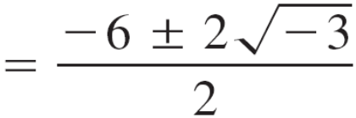



Example 3 – Solution
cont’d
So, α = –3 and β = and the general solution is

Slide 20


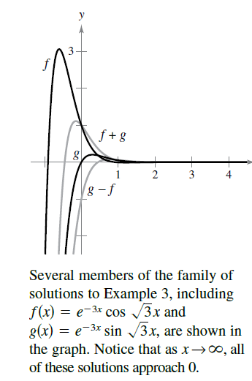
Example 3 – Solution
cont’d
Several members of the family of solutions, including
and , are shown in Figure 16.4.
(Note that although the characteristic
equation has two complex zeros, the
solution of the differential equation is
real.)
Figure 16.4

Slide 21
Higher-Order Linear Differential Equations

Slide 22
Higher-Order Linear Differential Equations
For higher-order homogeneous linear differential equations, you can find the general solution in much the same way as you do for second-order equations.
That is, you begin by determining the n zeros of the characteristic equation. Then, based on these n zeros, you form a linearly independent collection of n solutions.
The major difference is that with equations of third or higher order, zeros of the characteristic equation may occur more than twice.
When this happens, the linearly independent solutions are formed by multiplying by increasing powers of x.

Slide 23
Example 5 – Solving a Third-Order Equation
Find the general solution of y′′′ – y′ = 0.
Solution:
The characteristic equation and its zeros are
m³ – m = 0
m(m – 1)(m + 1) = 0
m = 0, 1, –1.
Because the characteristic equation has three distinct zeros, the general solution is
y = C₁ + C₂e^{–x} + C₃e^{x}. General solution

Slide 24
Application

Slide 25
Application
One of the many applications of linear differential equations is describing the motion of an oscillating spring.
According to Hooke’s Law, a spring that is stretched (or compressed) y units from its natural length L tends to restore itself to its natural length by a force F that is proportional to y.
That is, F(y) = –ky, where k is the spring constant and indicates the stiffness of the spring.

Slide 26
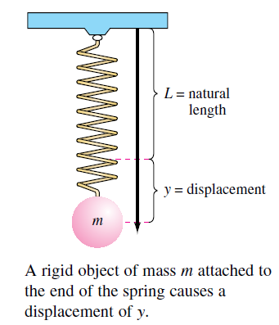
Application
A rigid object of mass m is attached to the end of a spring and causes a displacement, as shown in Figure 16.5.
Assume that the mass of
the spring is negligible
compared with m.
Figure 16.5

Slide 27
Application
When the object is pulled downward and released, the resulting oscillations are a product of two opposing forces—the spring force F(y) = –ky and the weight mg of the object.
Under such conditions, you can use a differential equation to find the position y of the object as a function of time t.
According to Newton’s Second Law of Motion, the force acting on the weight is F = ma, where a = d ²y/dt ² is the acceleration.

Slide 28

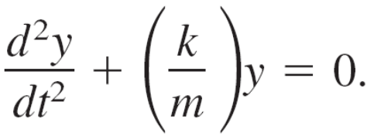
Application
Assuming that the motion is undamped—that is, there are no other external forces acting on the object—it follows that
and you have
Undamped motion of a spring

Slide 29





Example 8 – Undamped Motion of a Spring
A 4-pound weight stretches a spring 8 inches from its natural length. The weight is pulled downward an additional 6 inches and released with an initial upward velocity of
8 feet per second. Find a formula for the position of the weight as a function of time t.
Solution:
The 4-pound weight stretches the spring 8 inches foot from its natural length, so by Hooke’s Law
Moreover, because the weight w is given by mg, it follows that

Slide 30


Example 8 – Solution
cont’d
So, the resulting differential equation for this undamped motion is
The characteristic equation m² + 48 = 0 has complex zeros so the general solution is

Slide 31


Example 8 – Solution
cont’d
When t = 0 seconds, y = 6 inches = foot. Using this initial condition, you have
To determine C₂, note that y ′ = 8 feet per second when
t = 0 seconds.

Slide 32
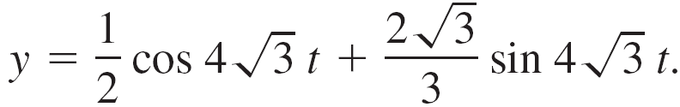
Example 8 – Solution
cont’d
Consequently, the position at time t is given by

Slide 33
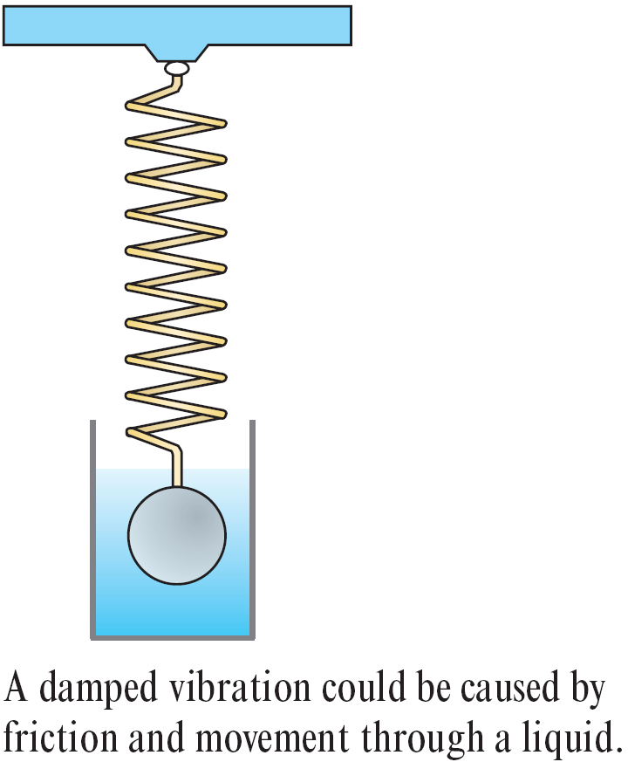
Application
The object in Figure 16.6 undergoes an additional damping or frictional force that is proportional to its velocity.
A case in point would be the damping force resulting from friction and movement through a fluid.
Figure 16.6

Slide 34

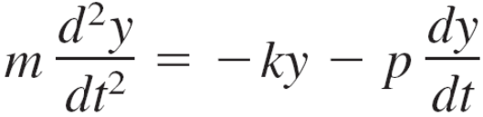
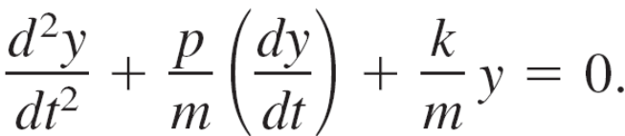
Application
Considering this damping force,
the differential equation for the oscillation is
or, in standard linear form,

