Slide 1


16
Additional Topics in Differential Equations
P
Copyright © Cengage Learning. All rights reserved.

Slide 2

16.3
Second-Order Nonhomogeneous Linear Equations
Copyright © Cengage Learning. All rights reserved.

Slide 3
Objectives
Recognize the general solution of a second-order nonhomogeneous linear differential equation.
Use the method of undetermined coefficients to solve a second-order nonhomogeneous linear differential equation.
Use the method of variation of parameters to solve a second-order nonhomogeneous linear differential equation.

Slide 4
Nonhomogeneous Equations

Slide 5

Nonhomogeneous Equations
Damped oscillations of a spring are represented by the homogeneous second-order linear equation
This type of oscillation is called free because it is determined solely by the spring and gravity and is free of the action of other external forces.

Slide 6

Nonhomogeneous Equations
If such a system is also subject to an external periodic force such as a sin bt, caused by vibrations at the opposite end of the spring, then the motion is called forced, and it is characterized by the nonhomogeneous equation

Slide 7
Nonhomogeneous Equations
In this section, you will study two methods for finding the general solution of a nonhomogeneous linear differential equation.
In both methods, the first step is to find the general solution of the corresponding homogeneous equation.
y = y_{h}
Having done this, you try to find a particular solution of the nonhomogeneous equation.
y = y_{p}

Slide 8
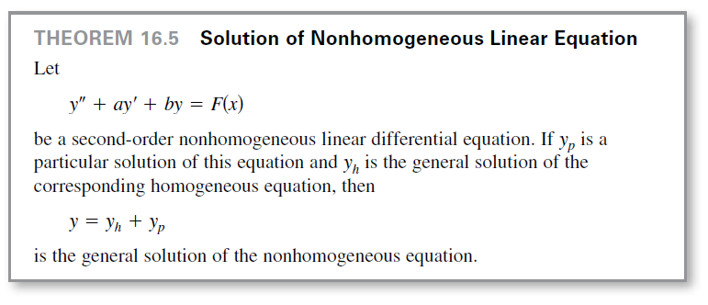
Nonhomogeneous Equations
By combining these two results, you can conclude that the general solution of the nonhomogeneous equation is
y = y_{h} + y_{p}

Slide 9
Method of Undetermined Coefficients

Slide 10
Method of Undetermined Coefficients
You already know how to find the solution y_{h} of a linear
homogeneous differential equation.
The remainder of this section looks at ways to find the
particular solution y_{p}.
When F(x) in
y′′ + ay′ + by = F(x)
consists of sums or products of x^{n}, e^{mx}, cos βx, or sin βx,
you can find a particular solution y_{p} by the method of
undetermined coefficients.
The object of this method is to guess that the solution y_{p} is a
generalized form of F(x).

Slide 11
Method of Undetermined Coefficients
Here are some examples.
1. For F(x) = 3x², choose y_{p} = Ax² + Bx + C.
2. For F(x) = 4xe^{x}, choose y_{p} = Axe^{x} + Be^{x}.
3. For F(x) = x + sin 2x,
choose y_{p} = (Ax + B) + C sin 2x + D cos 2x.
Then, by substitution, determine the coefficients for the
generalized solution.

Slide 12
Example 1 – Method of Undetermined Coefficients
Find the general solution of the equation
y′′ − 2y′ − 3y = 2 sin x.
Solution:
Note that the corresponding homogeneous equation is
y′′ − 2y′ − 3y = 0.
To find the general solution y_{h}, solve the characteristic equation as shown.
m² − 2m − 3 = 0
(m + 1)(m − 3) = 0
m = −1, 3

Slide 13
Example 1 – Solution
cont’d
So, the general solution of the homogeneous equation is
y_{h} = C₁e^{−x} + C₂e^{3x}.
Next, let y_{p} be a generalized form of 2 sin x.
y_{p} = A cos x + B sin x
y_{p}′ = −A sin x + B cos x
y_{p}′′ = −A cos x − B sin x

Slide 14

Example 1 – Solution
cont’d
Substitution into the original differential equation yields
y′′ − 2y′ − 3y = 2 sin x
By equating coefficients of like terms, you obtain the system of two equations
with solutions

Slide 15


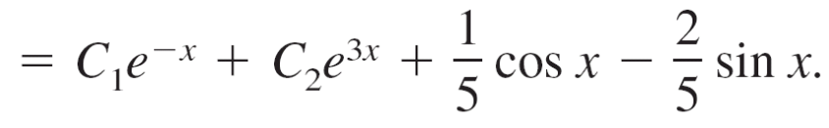
Example 1 – Solution
cont’d
Therefore, a particular solution of the original nonhomogeneous equation is
and the general solution is

Slide 16
Method of Undetermined Coefficients
In Example 1, the form of the homogeneous solution
y_{h} = C₁e^{−x} + C₂e^{3x}
has no overlap with the function F(x) in the equation
y′′ + ay′ + by = F(x).
However, suppose the given differential equation in Example 1 were of the form
y′′ − 2y′ − 3y = e^{−x}.

Slide 17
Method of Undetermined Coefficients
Now it would make no sense to guess that the particular solution was
y = Ae^{−x}
because in the equation y′′ − 2y′ − 3y = e^{−x}, this solution yields .
In such cases, you should alter your guess by multiplying by the lowest power of x that removes the duplication.
For this particular problem, you would guess
y_{p} = Axe^{−x}.

Slide 18
Variation of Parameters

Slide 19
Variation of Parameters
The method of undetermined coefficients works well when
F(x) is made up of polynomials or functions whose
successive derivatives have a cyclical pattern.
For functions such as 1/x and tan x, which do not have such
characteristics, it is better to use a more general method
called variation of parameters.
In this method, you assume that y_{p} has the same form as
y_{h}, except that the constants in y_{h} are replaced by variables.

Slide 20
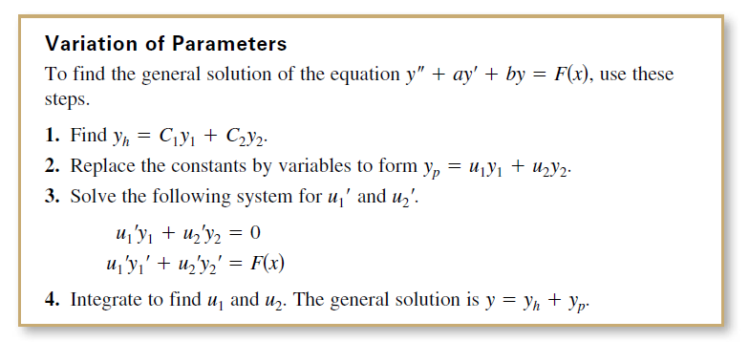
Variation of Parameters

Slide 21

Example 5 – Variation of Parameters
Solve the differential equation
y′′ – 2y′ + y = x > 0.
Solution:
The characteristic equation
has one repeated solution, m = 1.
So, the homogeneous solution is
y_{h} = C₁y₁ + C₂y₂ = C₁e^{x} + C₂xe^{x}.

Slide 22


Example 5 – Solution
cont’d
Replacing C₁ and C₂ by u₁ and u₂ produces
y_{p} = u₁y₁ + u₂y₂ = u₁e^{x} + u₂xe^{x}.
The resulting system of equations is
Subtracting the second equation from the first produces
u₂′ = 1/(2x).

Slide 23

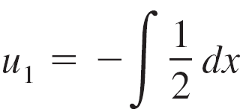
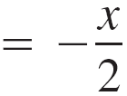
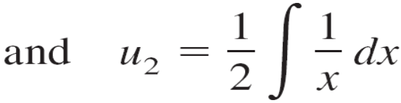
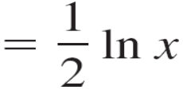

Example 5 – Solution
cont’d
Then, by substitution in the first equation, you have u₁′ =
Finally, integration yields

Slide 24
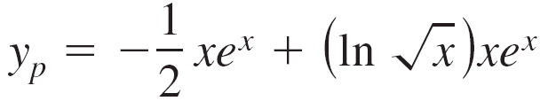
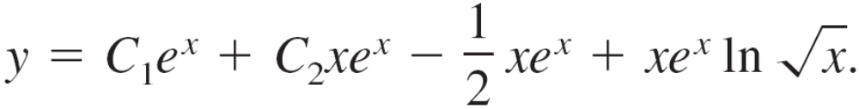
Example 5 – Solution
cont’d
From this result, it follows that a particular solution is
and the general solution is

