Slide 1


16
Additional Topics in Differential Equations
P
Copyright © Cengage Learning. All rights reserved.

Slide 2

Series Solutions of Differential Equations
16.4
Copyright © Cengage Learning. All rights reserved.

Slide 3
Objectives
Use a power series to solve a differential equation.
Use a Taylor series to find the series solution of a differential equation.

Slide 4
Power Series Solution of a Differential Equation

Slide 5
Power Series Solution of a Differential Equation
Power series can be used to solve certain types of differential equations.
This section begins with the general power series solution method.
A power series represents a function f on an interval of convergence and you can successively differentiate the power series to obtain a series for f′, f′′, and so on.
These properties are used in the power series solution method demonstrated in Example 1.

Slide 6


Example 1 – Power Series Solution
Use a power series to solve the differential equation
y′ – 2y = 0.
Solution:
Assume that is a solution.
Then,
Substituting for y′ and –2y, you obtain the following series form of the differential equation.
(Note that, from the third step to the fourth, the index of summation is changed to ensure that x^{n} occurs in both sums.)

Slide 7

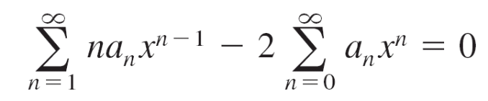
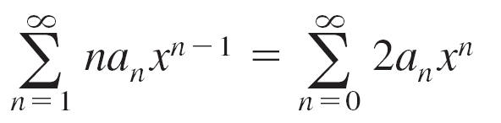
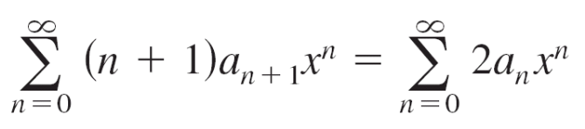
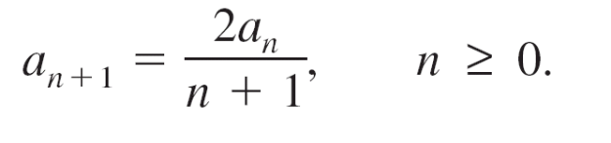
Example 1 – Solution
cont’d
Now, by equating coefficients of like terms, you obtain the
recursion formula (n + 1)a_{n + 1} = 2a_{n} which implies that

Slide 8
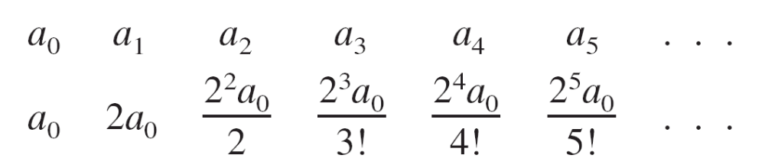
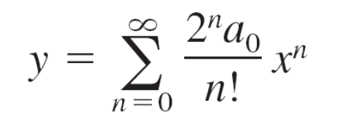
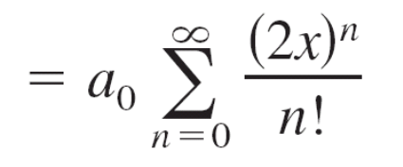
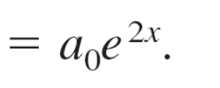
Example 1 – Solution
cont’d
This formula generates the following results.
Using these values as the coefficients for the solution series, you have

Slide 9
Approximation by Taylor Series

Slide 10
Approximation by Taylor Series
A second type of series solution method involves a differential equation with initial conditions and makes use of Taylor series.

Slide 11
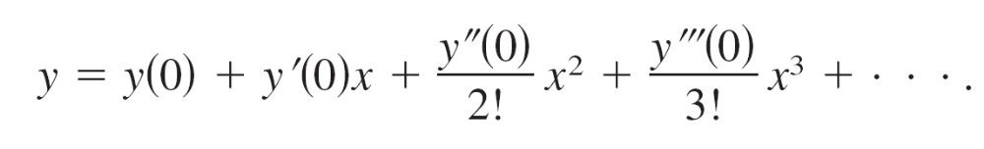
Example 3 – Approximation by Taylor Series
Use a Taylor series to find the first six terms of the series
solution of
y′ = y² – x
for the initial condition y = 1 when x = 0. Then, use this
polynomial to approximate values of y for 0 ≤ x ≤ 1.
Solution:
For c = 0,

Slide 12

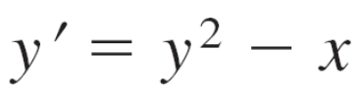








Example 3 – Solution
cont’d
Because y(0) = 1 and y′ = y² – x, you obtain the following.

Slide 13
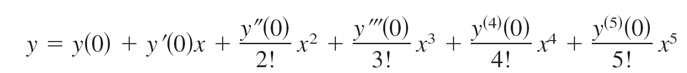
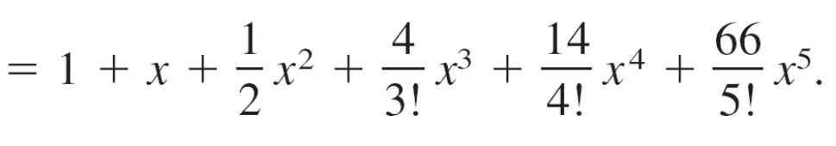
Example 3 – Solution
cont’d
So, y can be approximated by the first six terms of the
series shown below.
Using this polynomial, you can approximate values for y in
the interval 0 ≤ x ≤ 1, as shown in the table below.

Slide 14
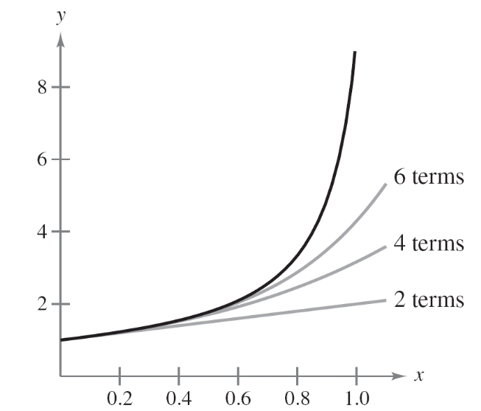
Approximation by Taylor Series
In addition to approximating values of a function, you can also use the series solution to sketch a graph.
In Figure 16.7, the series solutions of y′ = y² − x using the first two, four, and six terms are shown, along with an approximation found using a computer algebra system.
Figure 16.7

Slide 15
Approximation by Taylor Series
The approximations are nearly the same for values of x close to 0.
As x approaches 1, however, there is a noticeable
difference among the approximations.

