Slide 1
Detecting Process Memory Tampering
Implementation & Evaluation
Dennis Fischer
01.04.2016
Final Bachelor’s Thesis Presentation
Supervisor: Prof. Dr. Alexander Pretschner
Advisor: Sebastian Banescu

Slide 2
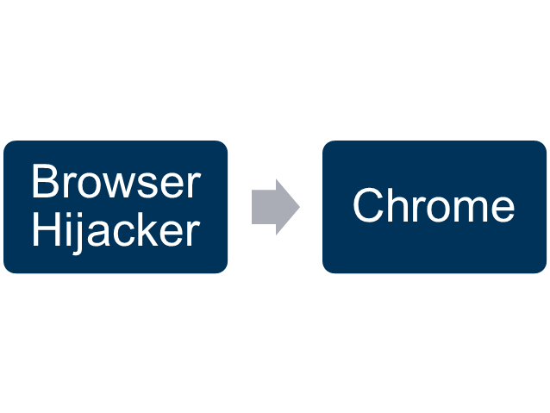
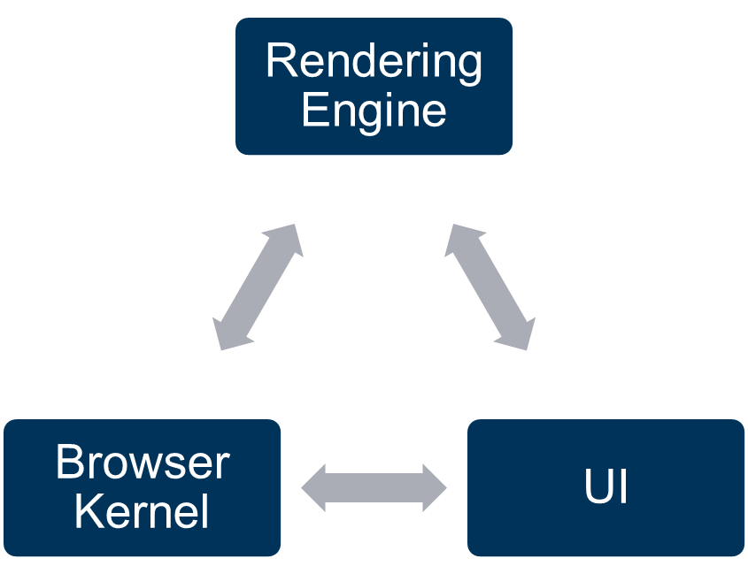
Recap: What was the problem?
Legal Modification (e.g. inside Chrome):
Illegal Modification:
WriteProcessMemory
DLL Injection
WriteProcessMemory

Slide 3
Recap: Thesis Goals
Problem – Process Memory Tampering:
„Illegal modification of a process’ virtual memory by a malicious program“
Find a way to detect illegal virtual memory modifications inside Google Chrome
Prevent modifications / hijacking
Attacks from usermode only
Almost no existing research

Slide 4
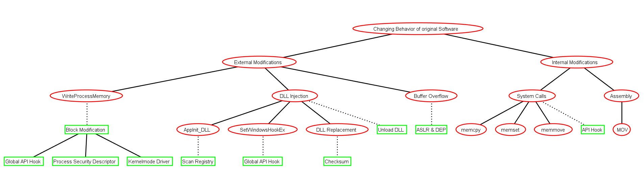
Recap: Attacks and Defenses
Legend
Attack
Countermeasure
WriteProcessMemory
DLL Injections

Slide 5
Design
Attack / Defense tree analysis lead to 2 attack groups:
WriteProcessMemory (WPM)
DLL Injections
One countermeasure for each attack group is sufficient to achieve the thesis goals:
WriteProcessMemory:
Block the execution of WriteProcessMemory
DLL Injections:
Allow only „good“ DLLs to be loaded

Slide 6
Design
The better approach – What do we build?
1) WriteProcessMemory Component:
    Change the security descriptor on the fly
    Allow access to the same process only
2) DLL Component:
    A DLL post load callback exists
    Check DLLs against whitelist
    Deny execution if a “bad” DLL is loaded
3) ProcessTree:
    Maintains strong parent child relationship
    Required by WPM Component
Using this approach ➔ Chrome runs without problems

Slide 7
Design
Overall High-level driver design
Windows
Windows
Windows
Windows
Windows
Windows
WPM Component
WPM Component
WPM Component
WPM Component
WPM Component
WPM Component
DLL Component
DLL Component
DLL Component
DLL Component
DLL Component
DLL Component
↑ Returns parent PID
↓ Checks if PID is existing
↑ Returns parent PID
↓ Checks if PID is existing
↑ Returns parent PID
↓ Checks if PID is existing
↑ Returns parent PID
↓ Checks if PID is existing
↑ Returns parent PID
↓ Checks if PID is existing
↑ Returns parent PID
↓ Checks if PID is existing
→ Checks if PID is existing
← Returns parent PID
→ Checks if PID is existing
← Returns parent PID
→ Checks if PID is existing
← Returns parent PID
→ Checks if PID is existing
← Returns parent PID
→ Checks if PID is existing
← Returns parent PID
→ Checks if PID is existing
← Returns parent PID
← Inserts / Removes Processes
← Inserts / Removes Processes
← Inserts / Removes Processes
← Inserts / Removes Processes
← Inserts / Removes Processes
Process Tree
← Inserts / Removes Processes
Process Tree
Process Tree
Process Tree
Process Tree
Process Tree

Slide 8
Implementation Details
Platform | Windows 7
Language | C
Libraries used | SHA2 (~ 1000 LoC), WDK, SDK
Time spent | ~150 hours
Written LoC | ~22000
Deleted LoC | ~20000
Total LoC | ~2200
WPM Component LoC | ~150
DLL Component LoC | ~500
Process Tree LoC | ~300
Problems faced:
Bluescreens
Deadlocks
Undocumented behavior
Bugs in Windows kernel

Slide 9
Evaluation: Performance
Setup & Experiment 1
Measurements done in a Virtual Machine (1 core @ 3.5 GHz, 4 GB RAM)
VM restarted after every measurement
Configuration options:
Driver Status: Not running, WPM Component, DLL Component, Both Components
Chrome # Tabs: 1, 2, 4, 8, 16
# Minutes: 1, 2, 4, 8, 16
Each configuration was run 10 times
In total 4x5x5x10 = 1000 measurements generated

Slide 10
Evaluation: Performance
What is a Task?
A Task is an asynchronously executed function
Example:
void WriteToFile(const std::string& filename, const std::string& data);
BrowserThread::PostTask(BrowserThread::FILE, FROM_HERE, base::Bind(&WriteToFile, "foo.txt", "hello world!"));
Execution happens in another thread via a so called Task
Tasks are heavily used in Google Chrome
A scheduler is used for queuing and execution order of tasks

Slide 11
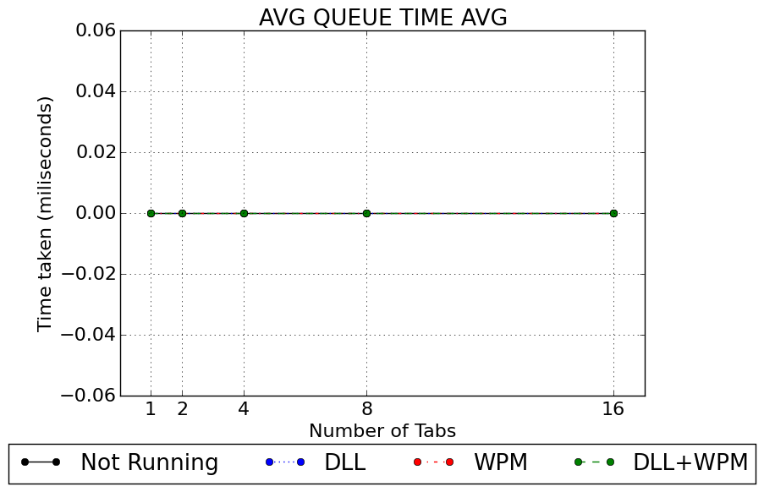
Evaluation: Performance
16 minutes measurement

Slide 12
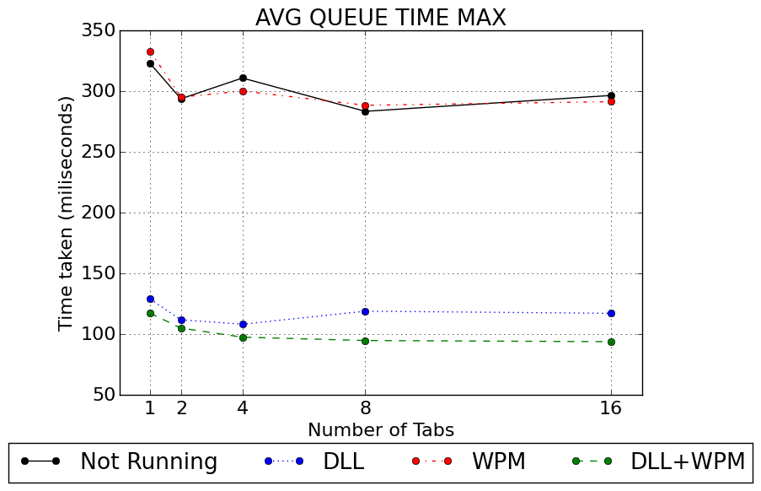
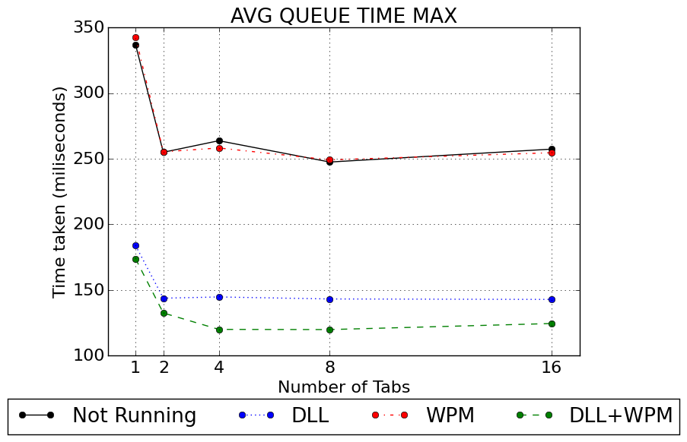
Evaluation: Performance
1 minute
16 minutes

Slide 13
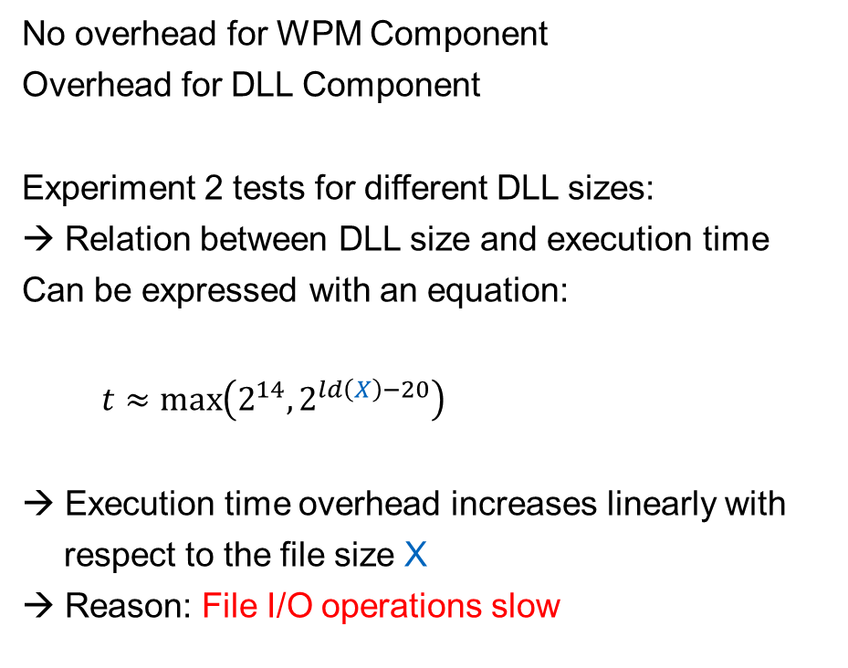
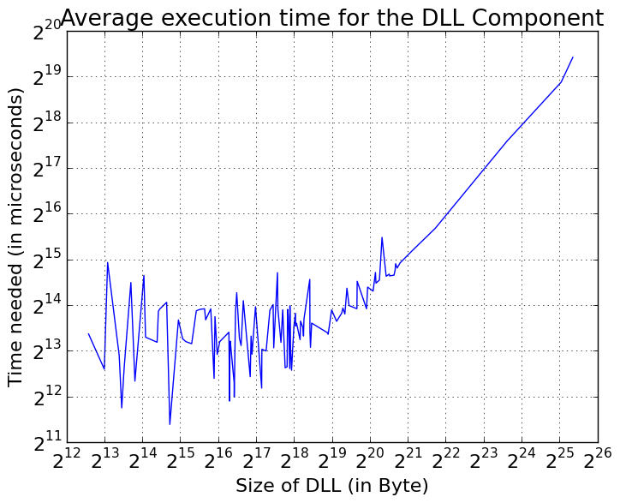
Evaluation: Performance
Experiment 2

Slide 14
Evaluation: Security
Implementation Level
Attacker might spoof the executables name
Rename attacker.exe to chrome.exe → No access, Process Tree
Rename chrome.exe to chrome2.exe → Limitation, Identification not possible
Other than that, attacker has no access to the WPM and DLL Component
WPM will block every forbidden access: → Process Tree
DLL Component is very restrictive: → Whitelist
→ If identification of target process is possible, PMT attacks are prevented

Slide 15
Conclusion
Driver blocks all WriteProcessMemory and DLL Injection attacks
Bypassing not possible from usermode
Exploits of buffer overflows are already prevented by DEP & ASLR
Still existing problems / Limitations:
  What can be done about kernelmode attacks?
  How to identify the running code that we want to protect?
  Can the introduced overhead get further reduced?

Slide 16
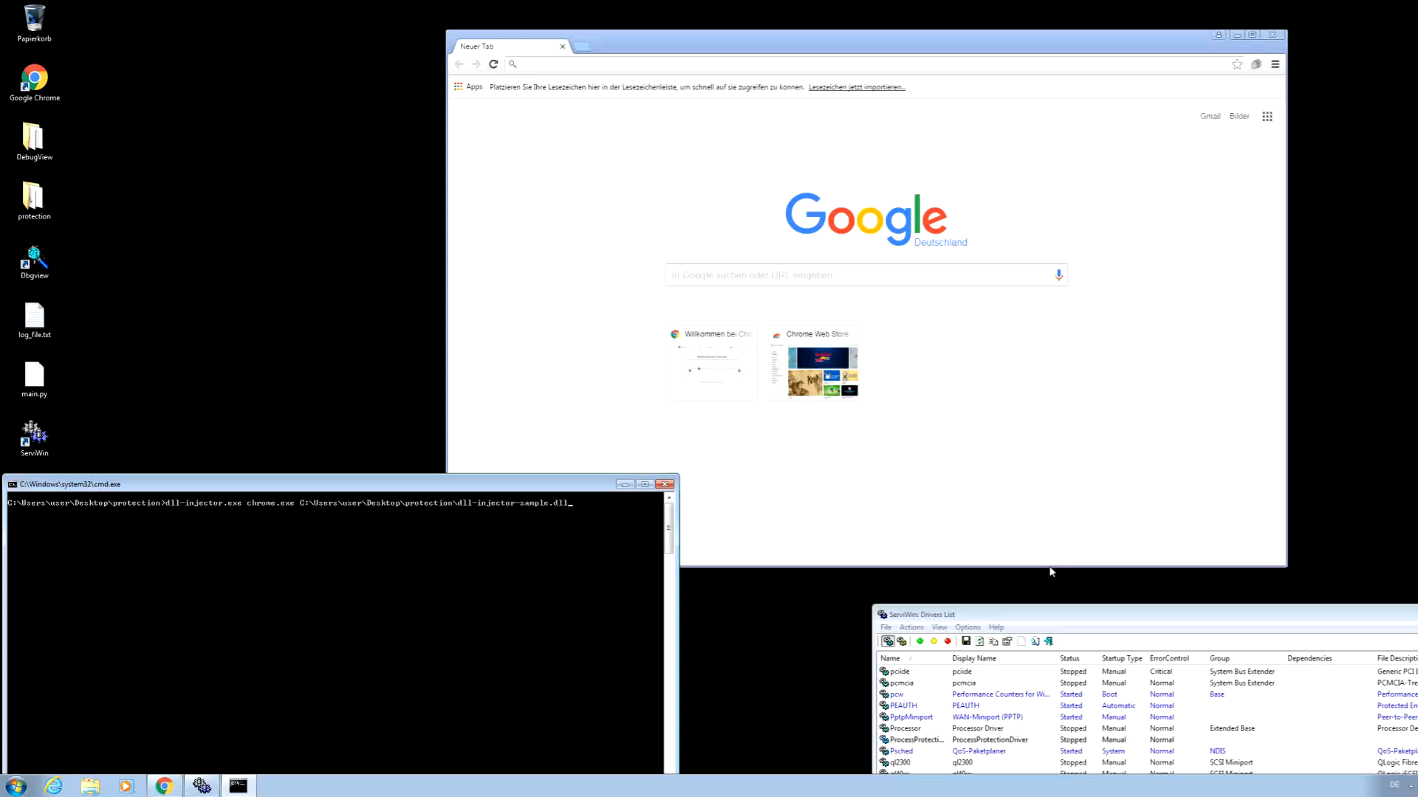
Demo

