Slide 1
An Architecture for Collaborative Virtual Environments
With Enhanced Awareness
Dennis Brown
April 17, 1998

Slide 2
Introduction
What is a virtual environment?
Enhanced Awareness
Related Work
CVE Architecture with Enhanced Awareness (plus implementation)
Sample Application
Conclusions and Future Work

Slide 3
What is a Virtual Environment?
Many different implementations, from MUD to CAVE
As used in this presentation:
  user exists as an object in the environment
  is given a 3D rendering of environment
  is given a means to change his position
  user interacts with other objects in world through collisions which model real-world physics, and verbal communication

Slide 4
What is a Virtual Environment?
As used in this presentation (cont’d)
  VE is collaborative, meaning more than one user can exist in the environment at the same time and can communicate with each other
  VE is distributed, meaning the VE is split somehow into different processes which exist on different machines and communicate over a network

Slide 5
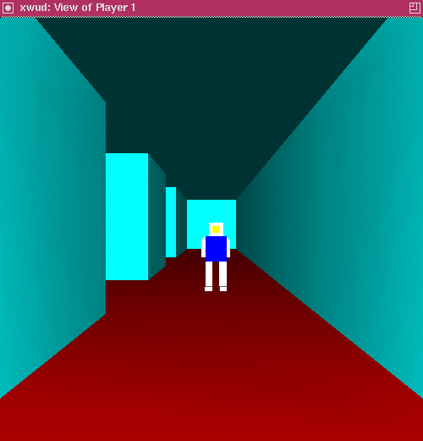
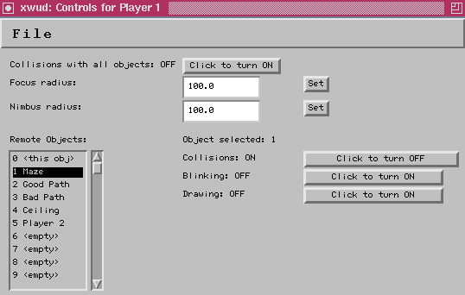
What is a Virtual Environment?
Example display and interface:

Slide 6
What is a Virtual Environment?
Definition covers most VEs used for training simulations:
  modeling the situation realistically is important
  having many users, who many be geographically dispersed, collaborate in the same environment is also important

Slide 7
Enhanced Awareness
Awareness is the “quantification of the subjective importance or relevance of an object to the viewer.” [Greenhalgh, MASSIVE]
We can enhance awareness by allowing the viewer to change properties of objects in his own view of the world that are measured in determining this importance.

Slide 8
Enhanced Awareness
These properties are those that can be sensed: an object’s color, shape, externally visible behaviors, sounds, etc.
An example will be shown, then more examples will be given in the “Sample Application” part of this talk.

Slide 9
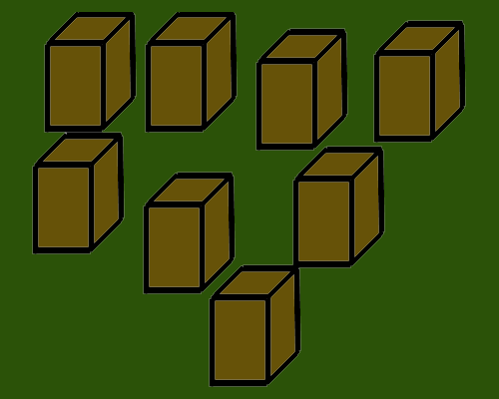
Enhanced Awareness
Which one is the target?

Slide 10
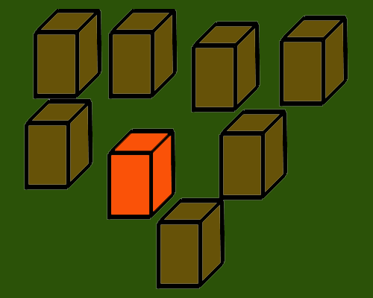
Enhanced Awareness
The user now has “enhanced” awareness of the target.

Slide 11
Enhanced Awareness
So how does one build a VE which is distributed, collaborative, and which supports enhanced awareness?
First, look at some related work...

Slide 12
Related Work: MVC
Model/View/Controller architecture
Introduced in Smalltalk-80
One set of data
Many synchronized views of the same data
Many controllers which can alter this data in a consistent manner

Slide 13
Related Work: MVC
Controller: widgets
View: bar chart
Model: statistical data
View: pie chart
10, 65, 25
Controller: spreadsheet
Example: some data can be viewed in two chart forms; it can be edited via spreadsheet or slider-style GUI widgets.

Slide 14
Related Work: MASSIVE
CVE for teleconferencing by Chris Greenhalgh and Steven Benford at Nottingham (UK)
Based on spatial model of interaction which uses the aura, an area of interest and availability that surrounds the object in the environment

Slide 15
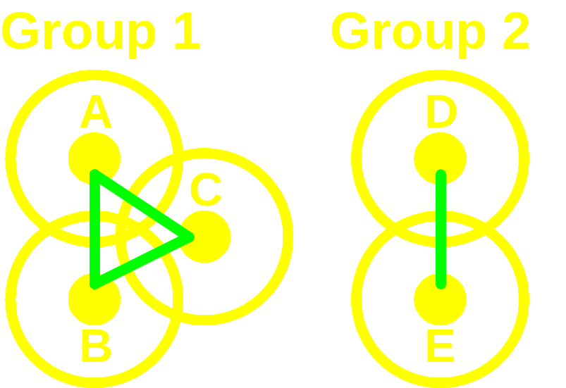
Related Work: MASSIVE
Each object (small circle) is surrounded by an aura (large circle). Communications are set up only between objects with intersecting auras. In this example there are only 4 connections where there would normally be 10, and those 4 can be split into two groups.

Slide 16
Related Work: MASSIVE
Previous slide was a slight simplification
Aura has two parts: Focus and Nimbus
Focus defines area of what an object sees
Nimbus defines area of who can see it
One object “sees” another when its focus intersects the nimbus of the other object

Slide 17
Related Work: NPSNET
Built and used by Naval Postgraduate School to develop battle simulations
Uses IP multicast and object replication with dead reckoning to support thousands of users in one simulation
IP multicast: an object can broadcast information to its copies all at once

Slide 18
Related Work: NPSNET
Object replication: players are users, one per process; ghosts are copies of other users kept in each user’s process space (in addition there are terrain objects replicated in every process).
Dead reckoning: Each process guesses where a ghost will be in the next time step based on previous positions. The original object makes the same guess, compares it to the actual position, and updates each ghost when the difference is above a threshold.

Slide 19
Related Work: SOLVEN
Shared object toolkit for VEs by Gareth Smith at Lancaster (UK)
Uses view-matrices to allow different users to see personalized versions of a shared virtual world
Example: contractors need to see different parts of a model of a house under construction but must jointly view the model.

Slide 20
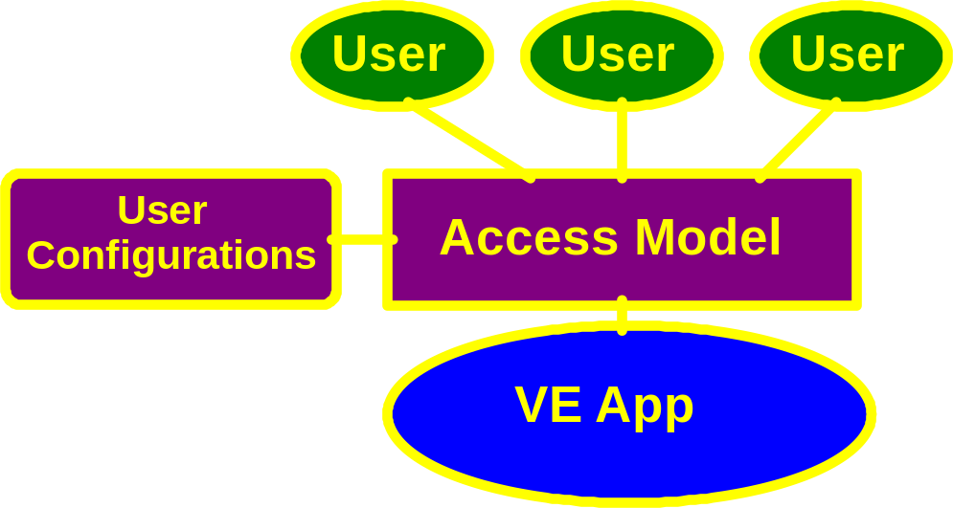
Related Work: SOLVEN
Each “User” blob represents a user and a VE terminal. The VE application data is filtered through a set of user configurations (view matrices).

Slide 21
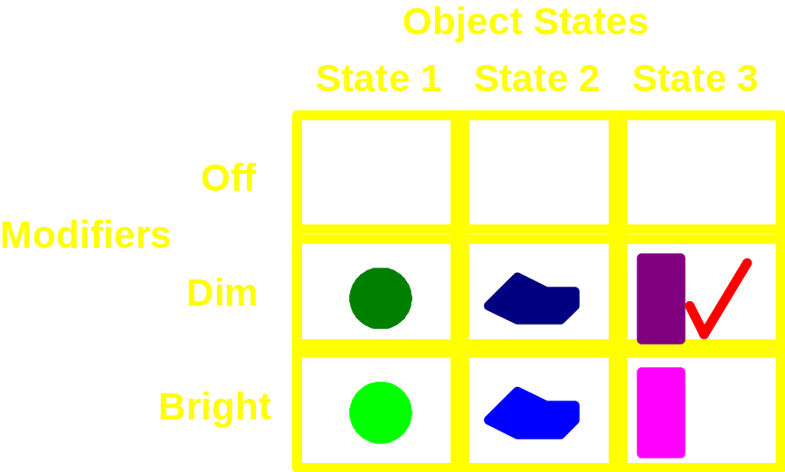
Related Work: SOLVEN
This is a matrix for one object and one user. This object has three states and three brightness levels.
In this case, the user has chosen the third state and dim.
By disallowing some or all entries, access control can be simulated.

Slide 22
Related Work: Ideas
From these four projects, one can pick four good qualities a CVE should have:
From MVC: Objects have state; views of the objects are held by others; others can control the object to some extent.
From MASSIVE: Objects only communicate when their auras intersect, cutting down the number of network connections needed.

Slide 23
Related Work: Ideas
From NPSNET: Objects are replicated within each process that sees the objects; also, multicast groups and dead-reckoning decrease network traffic.
From SOLVEN: Each user can change properties of objects in his view without affecting how other users view the object.

Slide 24
CVE Architecture
Connection Manager
  CM knows position and sizes of focus and nimbus of each object in the VE at each time step (focus and nimbus are spheres).
  when one object’s focus intersects another’s nimbus, the Connection Manager tells the second object to make a copy of itself and send it to the first object.
  when two connected objects’ focus and nimbus no longer intersect, the copy is destroyed.

Slide 25
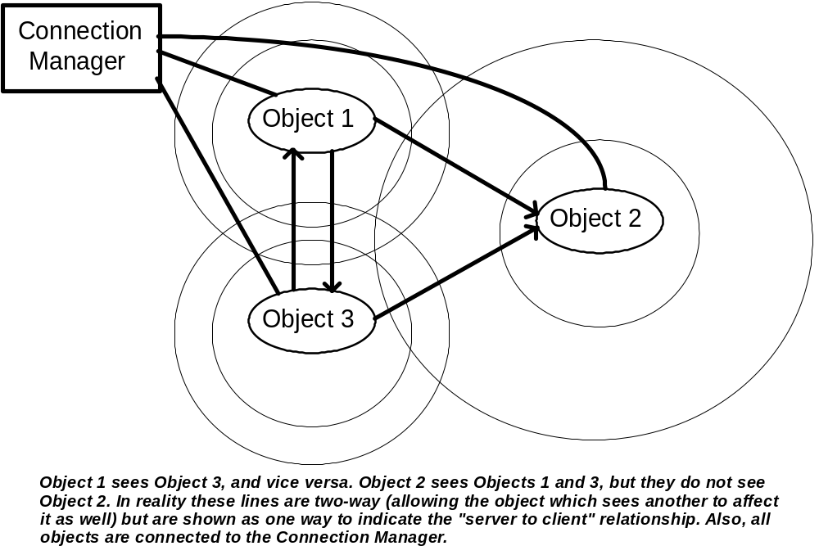
CVE Architecture

Slide 26
CVE Architecture
Objects
Each object exists in its own process.
Each object has state (geometry, behaviors, position, etc.).
Copies of each object in an object’s focus are kept within the local process space. The original objects update these copies.

Slide 27
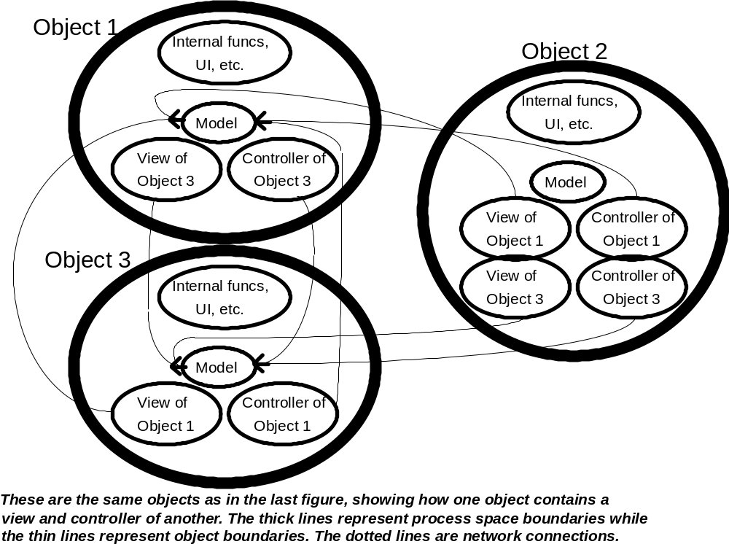
CVE Architecture

Slide 28
CVE Architecture
Enhanced Awareness
A set of user-configurable (via GUI) filters is kept within the local object process.
The user decides which filters to apply to his copies of other objects.
The user also decides which filters to apply to copies of his object in other processes.

Slide 29
CVE Implementation
Java was chosen as implementation language for several reasons:
  Well-designed object model
  Platform independent
  Easy Remote Method Invocation
  Java is used in the Collaboration Bus, and this project is part of work in extending the CB to programs with 3D user interfaces.

Slide 30
CVE Implementation
It’s not ALL Java…
  The 3D rendering is done with OpenGL though Java’s native method invocation feature using a stub object by Leo Chan (U. Waterloo). No Java renderer could be found when needed.
  The collision detection is done though NMI using V-COLLIDE by the UNC Geometry group, because I didn’t want to write my own routines.

Slide 31
CVE Implementation
Connection Manager
  Remote object which registers itself with the RMI registry provided with Java 1.1 as “ConMan.”
  Provides remote methods called by objects to register with the ConMan, report their positions, change focus and nimbus radii, and withdraw from the simulation.

Slide 32
CVE Implementation
Connection Manager (cont’d)
  Runs a loop over each possible pair of VE objects to see if they should be connected, if not already connected, and if they should be disconnected, if already connected, based on distance and sizes of focus and nimbus.
  Calls remote methods provided by VE objects (explained in next section) to accomplish above-mentioned connections.

Slide 33
CVE Implementation
Virtual Objects
  VObject remote interface defines which methods an object in this system must implement to join the simulation.
  BaseObject provides an implementation of those methods.
  AwareObject adds awareness of other objects.
  UserObject adds simple user interface including enhanced awareness controls.

Slide 34
CVE Implementation
BaseObject
  Has geometry, position, and orientation (model).
  Provides “requestRemoteCopy” method, which another is called by ConMan with the argument being a reference to the object receiving the copy; this method calls “makeLocalCopy” in the receiving object which makes a copy of this object (view). [note: similar methods to destroy copies are also provided]

Slide 35
CVE Implementation
BaseObject (cont’d)
  Provides remote methods to change position and orientation (controller).
  When a “controller” method is called, the same method in each remote copy is called to keep the simulation synchronized. Dead-reckoning would help here in reducing the number of such synchronizations, and multicast groups would help in cutting the traffic sent for each synchronization, but neither is implemented.

Slide 36
CVE Implementation
AwareObject
  Adds awareness of other objects: BaseObjects can’t hold copies of other objects and are suitable mainly for terrain-type objects (though they can have blind behaviors to change themselves, and be changed by other objects).
  Provides collision detection between this object and any copies it holds (must override some BaseObject methods to support this).

Slide 37
CVE Implementation
UserObject
  Adds a user interface to AwareObject which renders the virtual environment from the user’s viewpoint and gives GUI components to change this position as well as manipulate enhanced awareness features.

Slide 38
CVE Implementation
UserObject (cont’d)
  Currently only supports basic enhanced awareness functions:
    change color of a remote object
    don’t draw or collide with a remote object
    change this object’s focus and nimbus
    turn off all collisions
  This subset is still enough for a sample application.

Slide 39
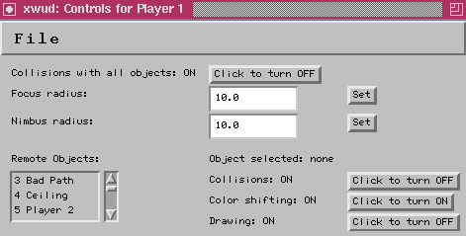
CVE Implementation
UserObject Sample Interface

Slide 40
Sample Application
Capture-the-flag: one or more players navigate a maze to find a flag. However there are many flags identical in appearance and only one is the right one.
Uses Player, Flag, and Maze objects, plus some Unix scripts to start each object with different positions, geometries, etc.

Slide 41
Sample Application
Player object
  Subclass of UserObject.
  Loads a geometry from a file, sets user’s position and orientation, and instantiates a UserObject with those values.
  Overrides the generic collide method to handle maze walls and flags.

Slide 42
Sample Application
Maze and Flag objects
  Subclasses of BaseObject.
  Each loads a geometry from a file, sets position and orientation, and instantiates a BaseObject with those values.
  Maze instantiates three more objects: Ceiling, BadPath, and GoodPath.

Slide 43
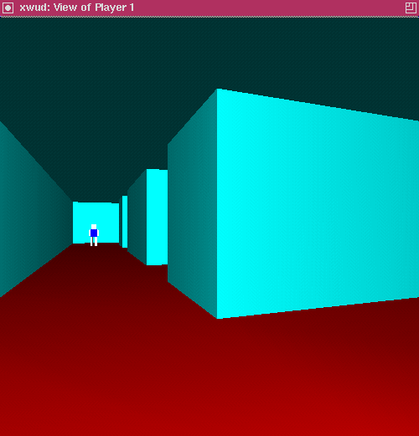
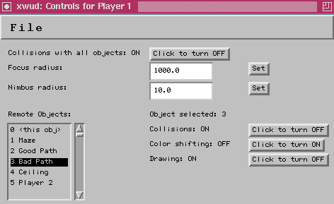
Results
The bad path is visible. The user may not know which path to follow through the maze.

Slide 44
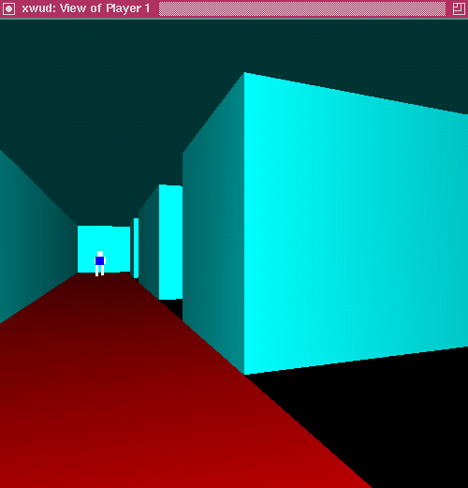
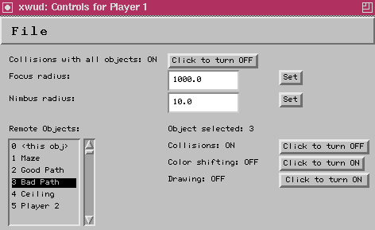
Results
The bad path is no longer drawn. The good path is obvious.

Slide 45
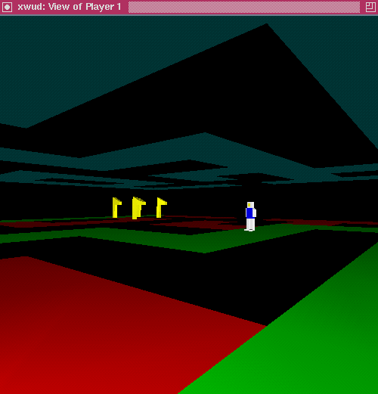
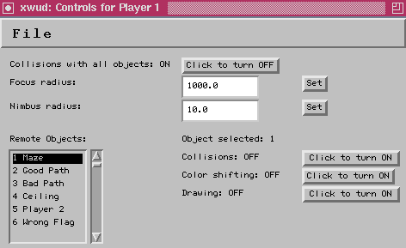
Results
By increasing his focus radius and not drawing the walls, the user can see all objects in the maze.

Slide 46
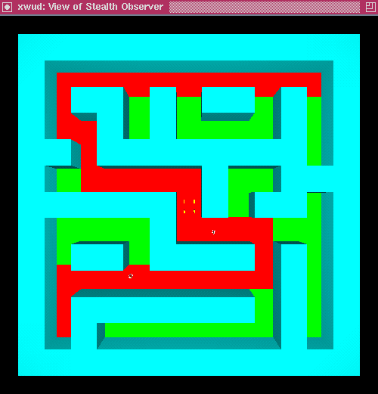
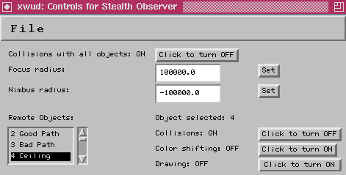
Results
By turning off drawing of and collision with the ceiling, the user can fly out of the maze and see it from the top.

Slide 47
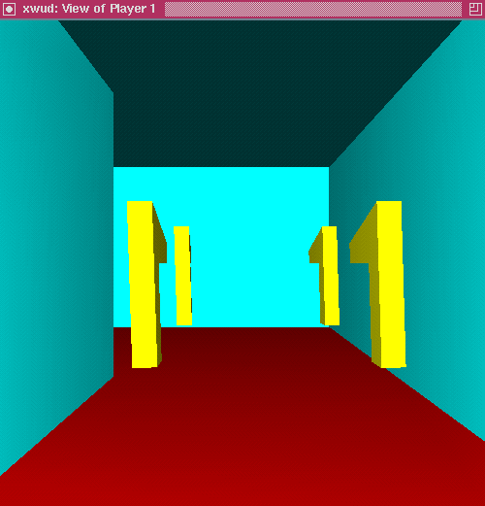
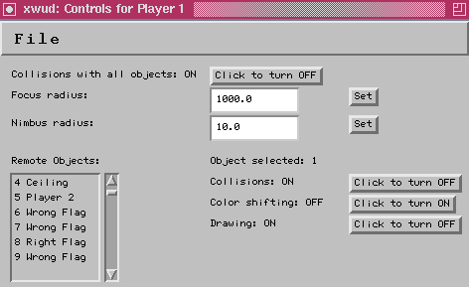
Results
The user finally finds the set of flags. Which is the right one?

Slide 48
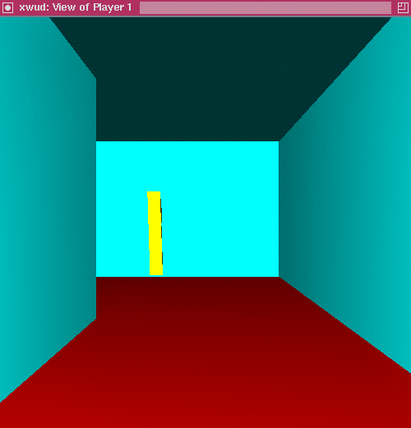
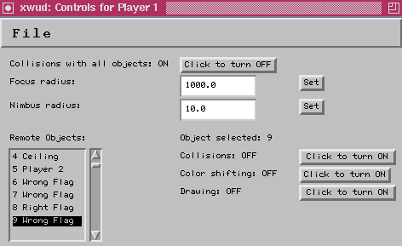
Results
By turning off drawing of and collision with the wrong flags, the right one is obvious.

Slide 49
Conclusions and Future Work
An architecture for a generic distributed and collaborative virtual environment, with support for enhanced awareness, is still full of trade-offs due to limitations in technology (simplified object models, slow or inaccurate communications and physics (your pick!)).

Slide 50
Conclusions and Future Work
Enhanced awareness proved useful in one simple application. It remains to be seen which enhancements are most useful, and if they are useful at all in more realistic training simulations.

