Slide 1
LAB 1

Slide 2
Contents
Reading From Serial Interface

Slide 3
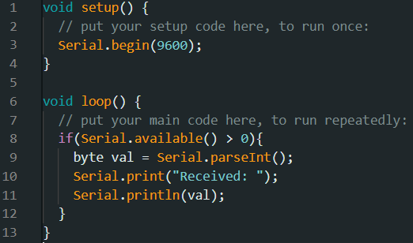
aRDUINO
The code below enables reading from serial interface (UART)

Slide 4
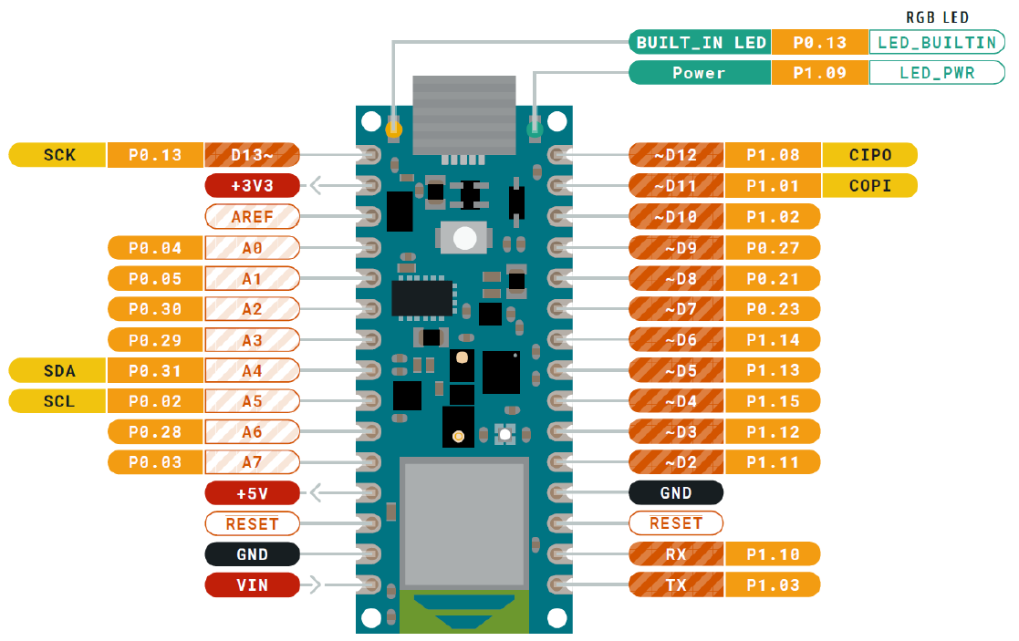
aRDUINO
Modify the code to perform the function below:
Get an input number between 1 and 9 (VAL) through the Serial Monitor
The number (VAL) should be sent to the Arduino board
The inbuilt LED on the Arduino board should be turned ON for VAL seconds and turned OFF

