Slide 1
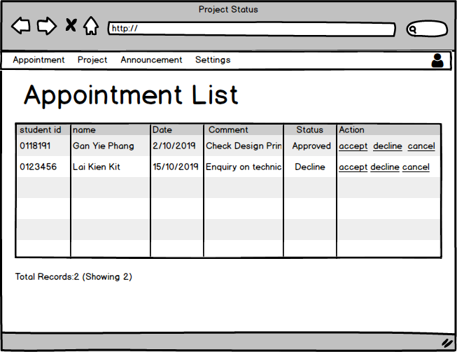
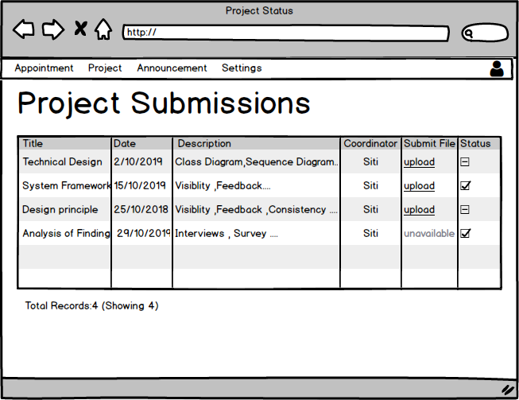

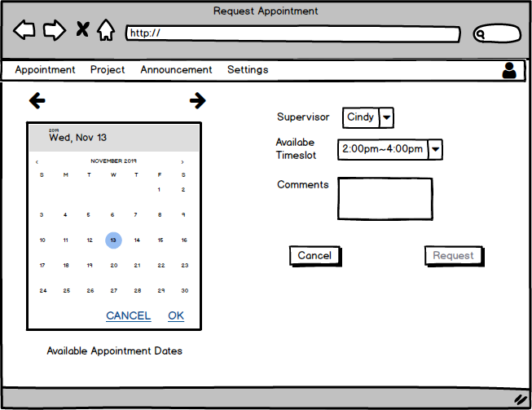
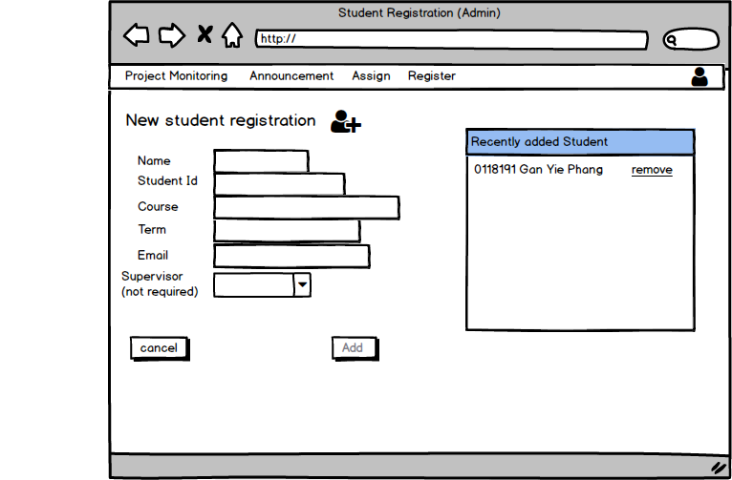
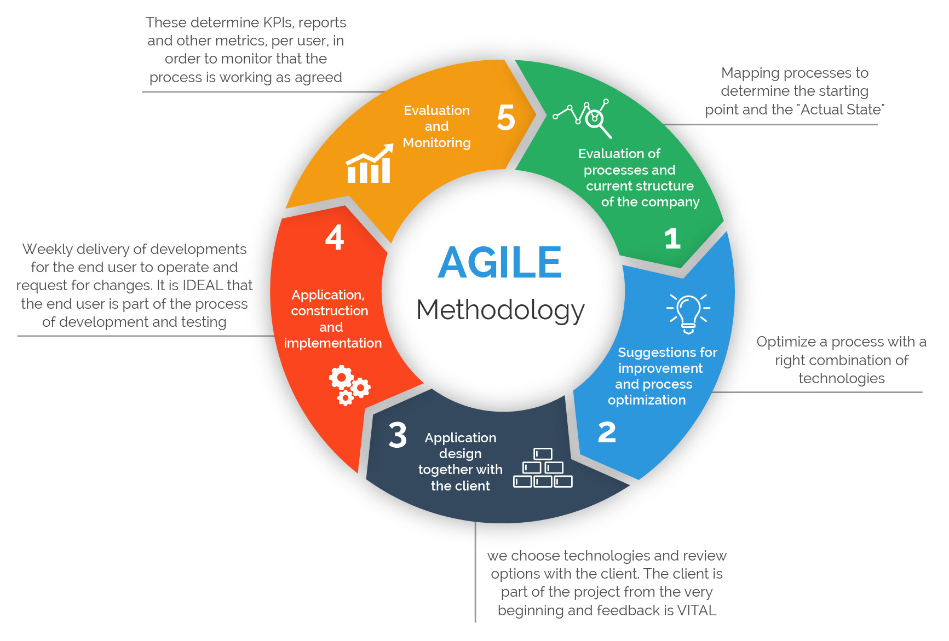
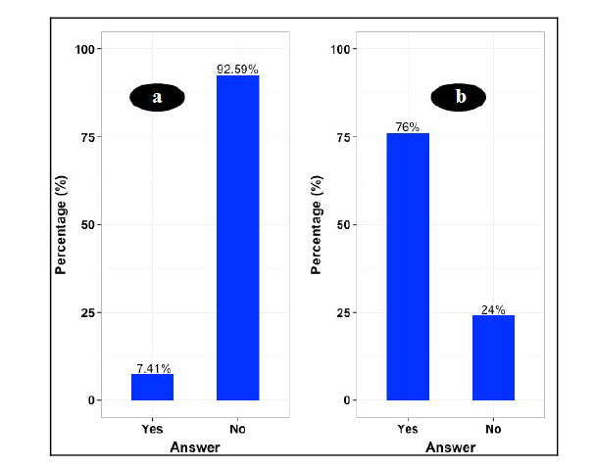
Final Year Project Management System
Gan Yie Phang
I/C:980424107407 Student ID:0118191
Abstract
Objective
Result
In the undergraduate programs run by KDU University College, Malaysia, students are required to develop a software prototype and write a thesis for their final year project. Preliminary observation has shown that many number of students do not meet their supervisors often enough and supervisors/coordinator have no idea of their student’s progress on their FYP Although log sheets are used to log discussion between supervisors and student as a method to monitor student’s project, it does not trigger the student to actually go meet their supervisors and meet their deadlines. Also log sheets do not solve the issue of coordinator and supervisor not being able to keep track of every students progress. Hence to help alleviate some of these issues, a Final Year project management system was designed and developed.
To investigate an appropriate methodology for developing a Final Year Project Management system as a web application.
To design and develop a Final Year Project Management System for KDU that allows better project monitoring for lecturers and scheduling appointments for students.
To validate the functionality of the Final Year Project Management System
Appointment List Mockup
Project Submission Page Mockup
Problem Statement
Methodology
Lack of project management skill by students
(Hazamura and Hairulliza,2010) survey shows that student today lack experience and insight when managing a project.
Inadequate support from supervisors.
(Eugene,2012) survey reported that students find their supervisors relatively inaccessible and difficult to make appointments with.
Difficulty for coordinators to keep up to date on performance of each supervisor and their students.
In (Villamane et al., 2014), 92.59% of lecturers responded that do not have a way to check FYP status without having to ask student themselves
Appointment Page
Mockup
New Student Registration Mockup
Conclusion
After conducting the interviews and performing an analysis. Findings show that lecturers of KDU are open to the idea of having a Final Year Project management system to help monitor FYP students projects more frequently. The students also like the idea of making appointments with supervisors be more easily. The implementation of the project management system as a web application was successful. The objectives were fulfilled as lecturers for able to better monitor their students and students were able to make appointments with supervisor easily.

