Slide 1
Price Prediction for Natural Gas Market
Team Front Left
John ekblad, Todd Fitzgerald, Pete Resnick
Scott Kaufman, Dennis Boston

Slide 2


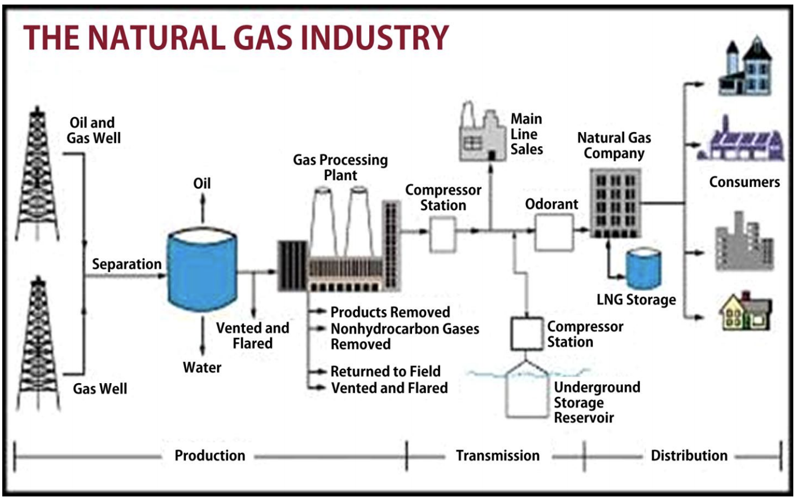
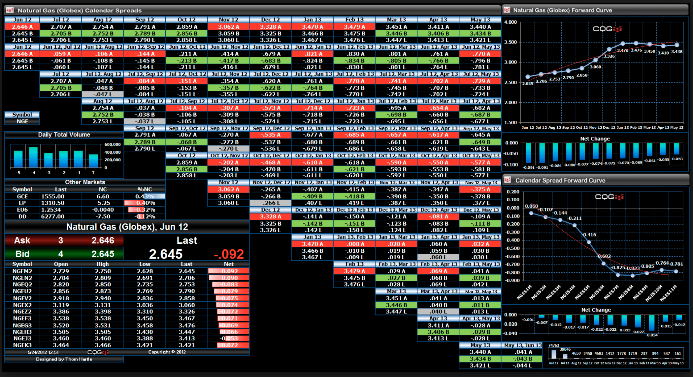
Trading Natural Gas
-Generate Signals
-Data analysis predicting price or direction
-Develop logic to enter/Exit trades -Analyze trading results -Iterate trading logic to optimize profitability
Images - Leonard H. Nelms Tetra Tech, Inc. & CQG

Slide 3
our Approach
Data Sets Utilized
Time and Sales Data for NG contract ~1.8M rows – May & June
Daily NG settlement prices – May & June
Forecast Degree days – May & June
Four runs per day
Production Data for ~5000 points
Technical approach
AWS S3 – storage
Python - Scikit, Pandas, Matplotlib
Linear Regression, Lasso, Ridge, Elastic Net, Random Forest
Excel

Slide 4
Machine learning and findings
Feature Selection
Walk forward Learning
Random forest Trees
Scope management
Factoring resource constraints
 | Test One - All |  | Test Two - 1807 |  | Test Three + Product |  | Test Four + Weather |  | Test Five + Settle |  | Test Six + No Trades
Model | MSE | R2 | MSE | R2 | MSE | R2 | MSE | R2 | MSE | R2 | MSE | R2
LinearRegression | 0.9160 | 0.0831 | 0.9009 | 0.0906 | 0.6320 | 0.3659 | 0.1846 | 0.8147 | 0.1846 | 0.8147 | 6.1929 | -5.9116
Lasso | 0.9162 | 0.0829 | 0.9015 | 0.0954 | 0.6766 | 0.3211 | 0.2214 | 0.7779 | 0.1974 | 0.8019 | 1.0891 | -0.2155
Ridge | 0.9160 | 0.0831 | 0.9009 | 0.0960 | 0.6320 | 0.3659 | 0.1846 | 0.8147 | 0.1846 | 0.8147 | 5.2743 | -4.8864
ElasticNet | 0.9161 | 0.0831 | 0.9012 | 0.0958 | 0.6919 | 0.3058 | 0.2130 | 0.7863 | 0.1933 | 0.8060 | 0.9641 | -0.0760
Random Forest 5 |  | 0.97412500 |  | 0.82750504 |  | 0.99976472 |  | 0.99976310 |  | 0.99975726 |  | -0.00373960
Random Forest 10 |  | 0.97511755 |  | 0.83489867 |  | 0.99977208 |  | 0.99977181 |  | 0.99977066 |  | -0.37993982
Random Forest 25 |  | 0.97511755 |  | 0.83941376 |  | 0.99977735 |  | 0.99977523 |  | 0.99977504 |  | -0.12169998
Random Forest 50 |  | 0.97616727 |  | 0.84076710 |  | 0.99977825 |  | 0.99977744 |  | 0.99775912 |  | -0.15563031
Random Forest 200 |  | 0.97635034 |  | 0.84225507 |  | 0.99977952 |  | 0.99977780 |  | 0.99977784 |  | 0.08832373

Slide 5
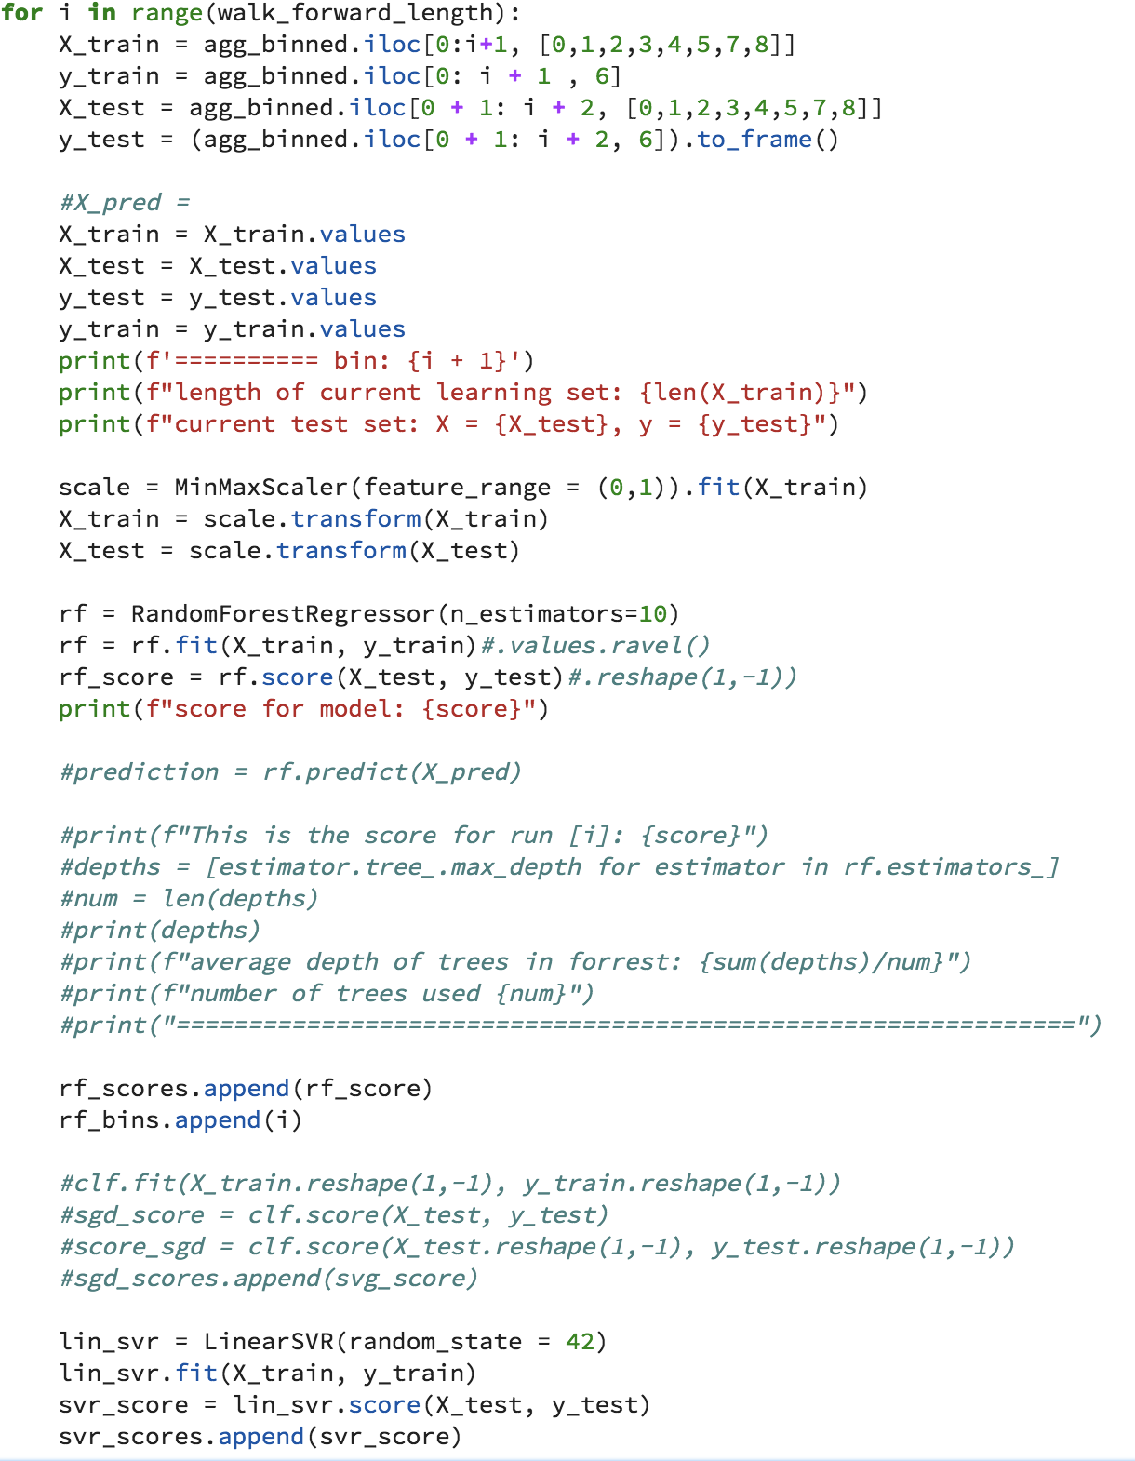
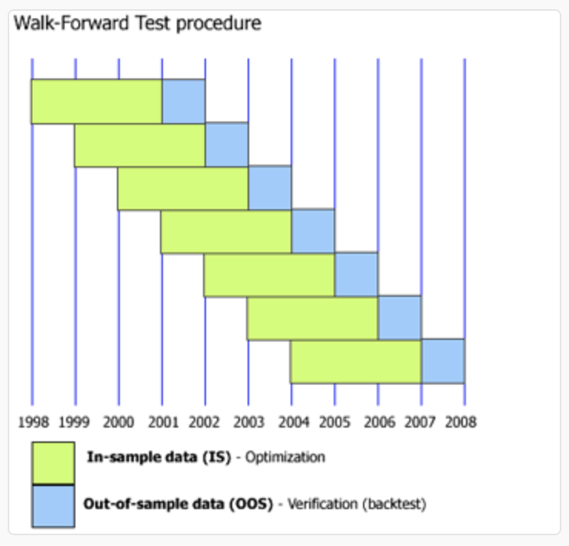
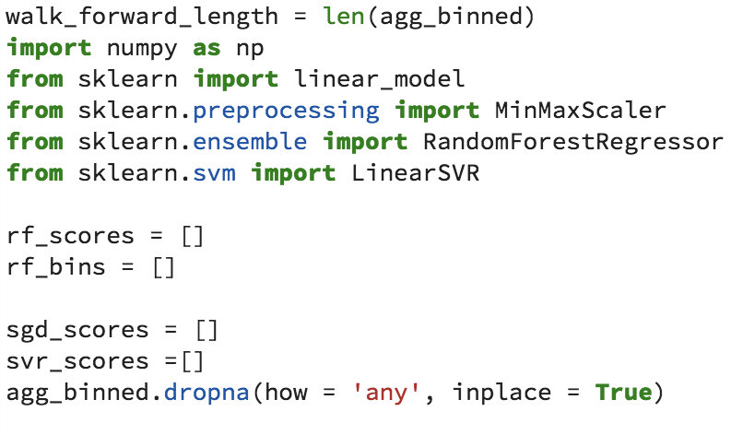
Walk forward COde

Slide 6
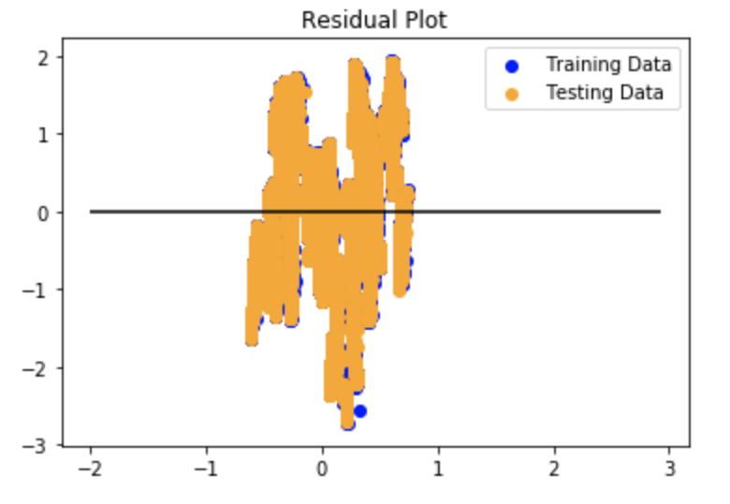
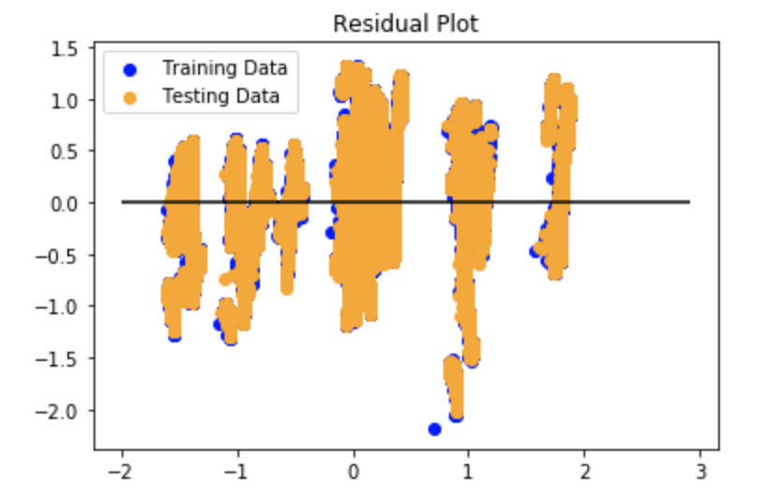
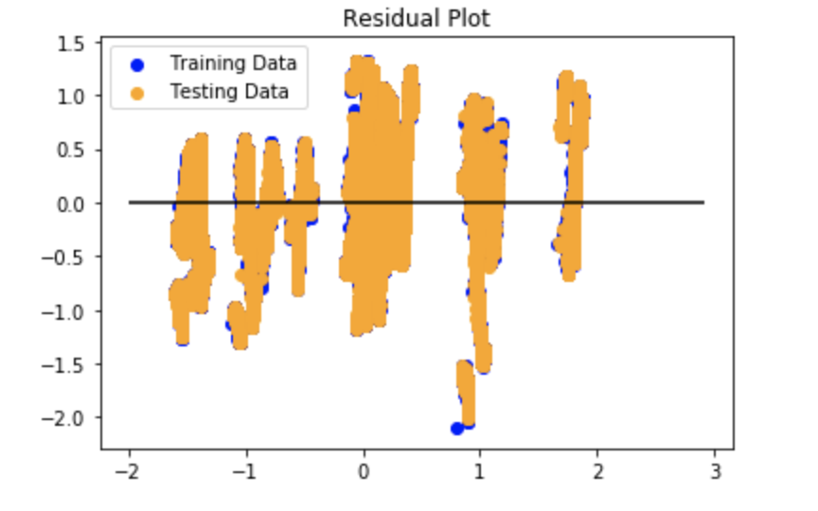
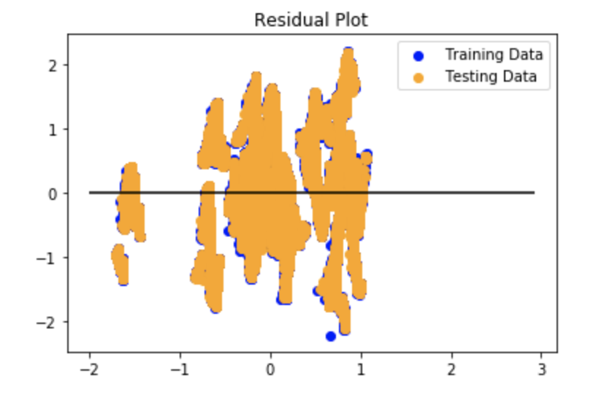
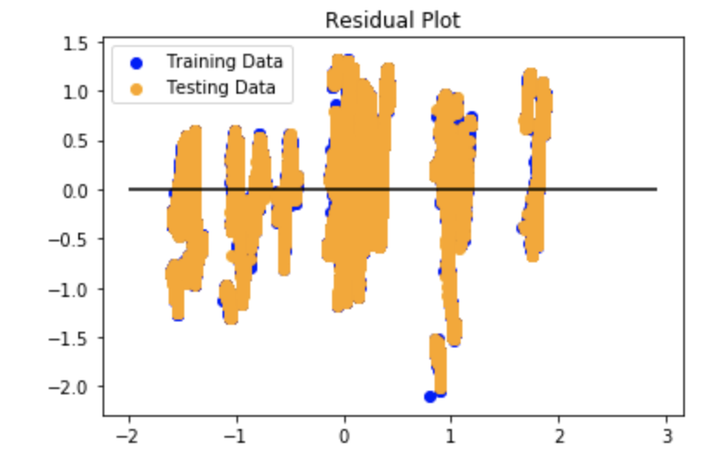
Data Samples
Trade Data only
Trade + Prod + Weather
Prod + Wthr + Settle
Trade + Production
Trade + Prod + Wthr + Settle

