Slide 1
Customer Data Analysis for San Francisco International Airport
Dennis Silva, Hang Yu, Neel Gehlot, Qiuyi Hong, Yinkai Ma, Qian Xu

Slide 2
Agenda
Introduction
Data Cleaning
Overall Trend
Customer Segmentation
Airport Services Usage Analysis
Website Usage Customer Analysis
Recommendation

Slide 3
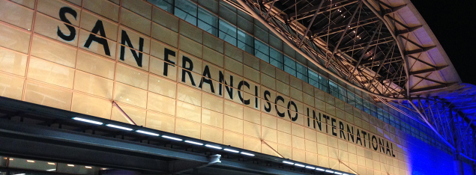
Introduction
San Francisco International Airport, a.k.a SFO, is an international airport 13 miles (21 km) south of downtown San Francisco, California, United States. It is the largest airport in Northern California and the second busiest in California.
SFO as an important transportation junction, has flights to points throughout North America and is a major gateway to Europe and Asia.

Slide 4
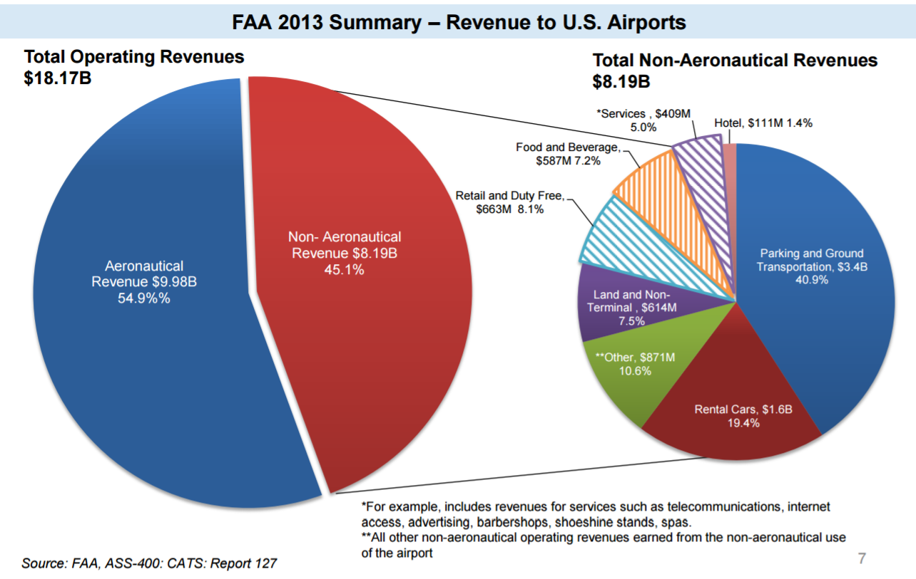
Introduction
In 2013 on Average Airports Generated per customer:
$11.88 in AR
+
$8.14 in NAR
=
$20.02 Total Rev.

Slide 5

Data Cleaning
Replaced missing values with ‘N’ (empty or Null character)
Did not discard surveys for being incomplete, they provide information
Merge questions carried over from 2012 to 2013 into additional dataset
Replace most factors as numbers with their abbreviated description
Image: http://3rdsectorlabs.com/wp-content/uploads/2014/06/TSL-data-shower.png

Slide 6
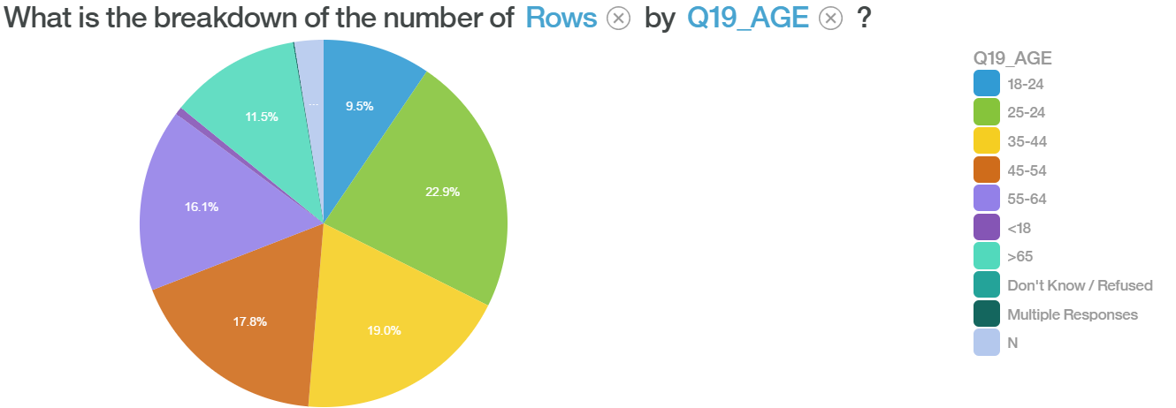
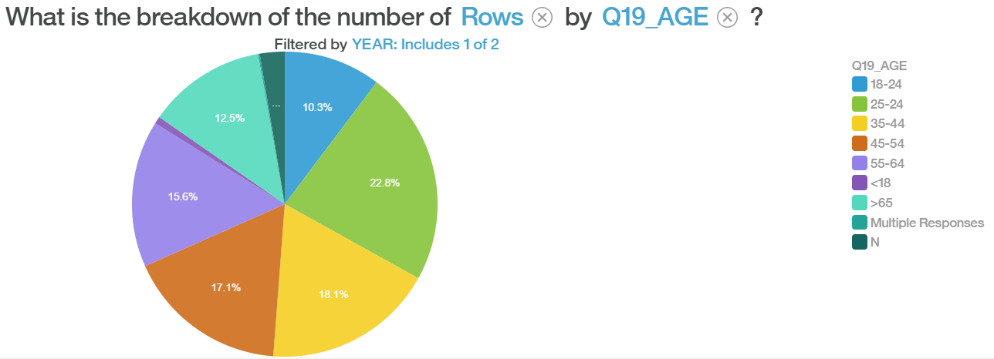
Trend
2012
Age Distribution
2013

Slide 7
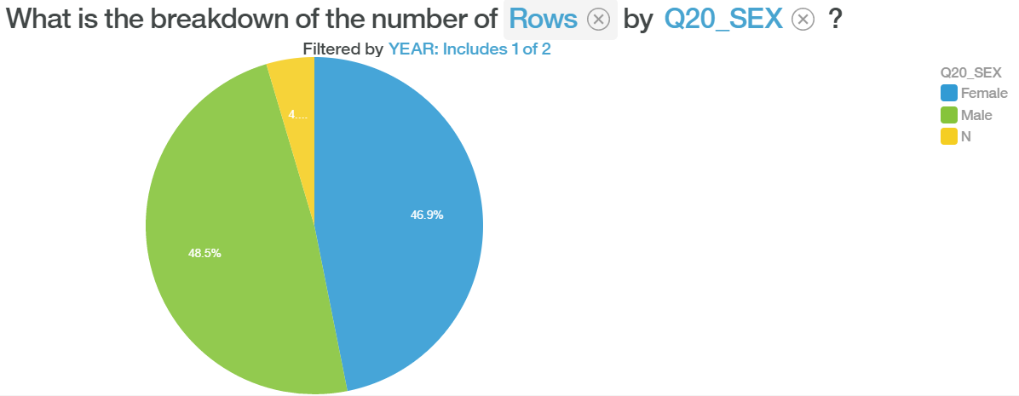
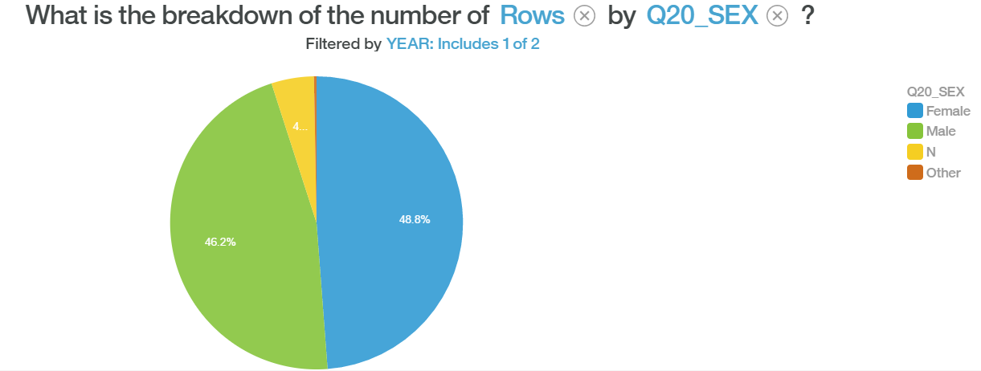
Trend
2012
Gender Distribution
2013

Slide 8
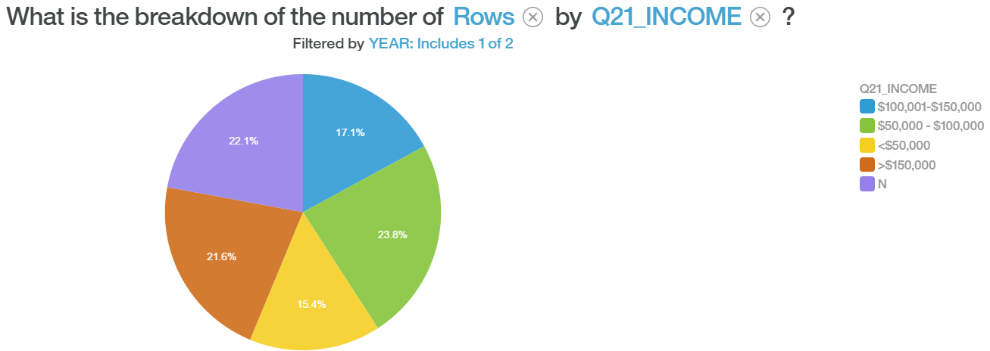
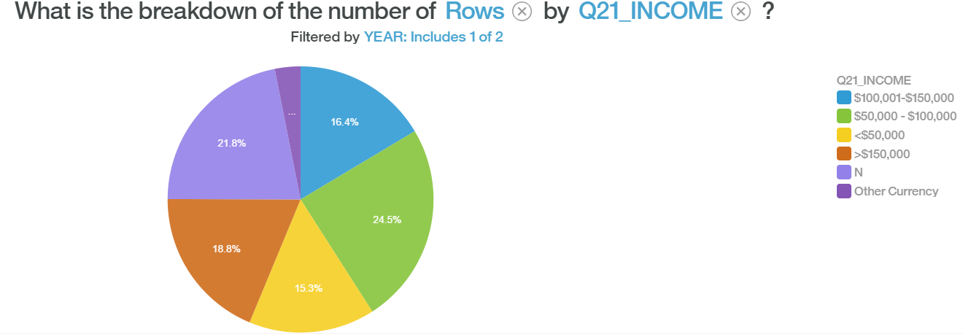
Trend
2012
Income Distribution
2013

Slide 9

Customer Segmentation - Data Science Technique
Demographics Age Gender Country of Residence Income Level
Three Groups
Travel Destination Area Market Size of Destination Airport
Online Web Usage

Slide 10
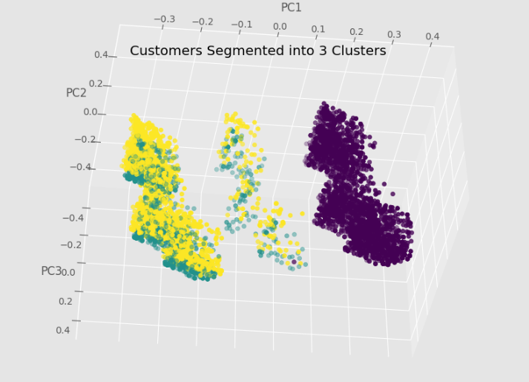
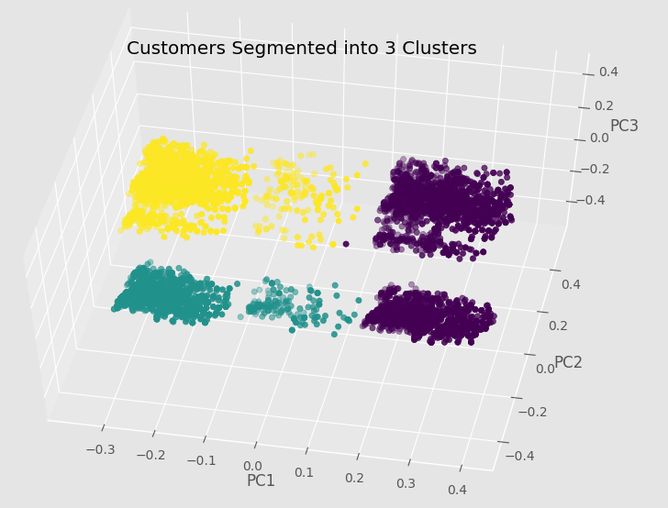
Customer Segmentation - Data Science Technique
Clean and Combine Data
Binarize All Question Responses
Conduct PCA
Conduct k-means clustering
Group 1: 3,344 Customers (47%)
Group 2: 1707 Customers (24%)
Group 3: 2006 Customers (28%)
Notes:
3344 g1
1707 g2
2006 g3
7057

Slide 11
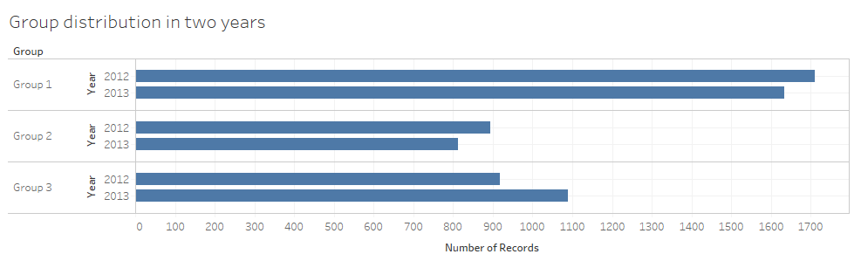
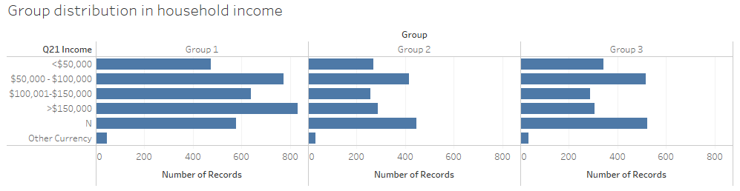
Customer Segmentation - Group Interpretation

Slide 12
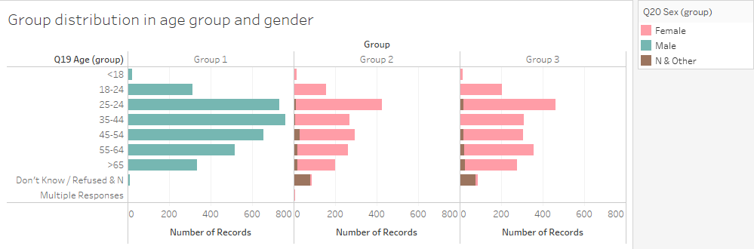
Customer Segmentation - Group Interpretation

Slide 13
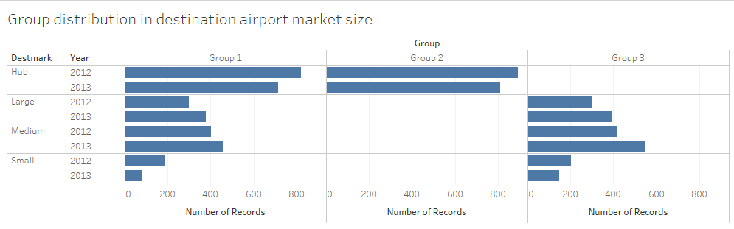
Customer Segmentation - Group Interpretation

Slide 14
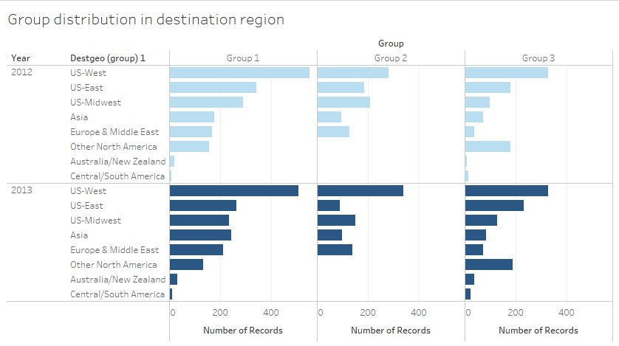
Customer Segmentation - Group Interpretation

Slide 15
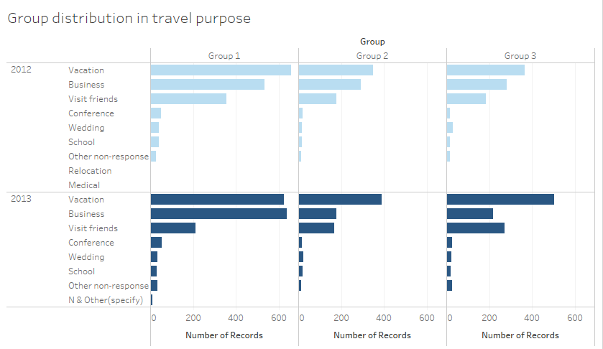
Customer Segmentation - Group Interpretation

Slide 16
Customer Segmentation - Group Interpretation
Dominating factors
Age
Destination airport market size
Relative factors
Destination region
Travel purpose

Slide 17
Airport Services Usage Analysis
Transportation
Parking
AirTrain
Rental Car
Check Bags
Store Purchase
Restaurant Consumption

Slide 18
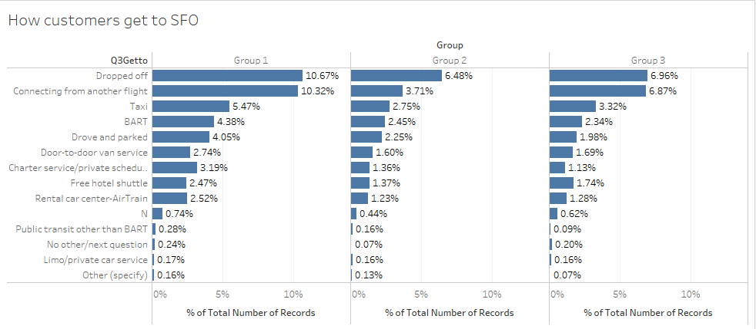
Airport Services Usage Analysis - Transportation
Mostly dropped off and connecting between flights
BART usage is lower than taxi, but increasing year wide
Parking is doing well

Slide 19
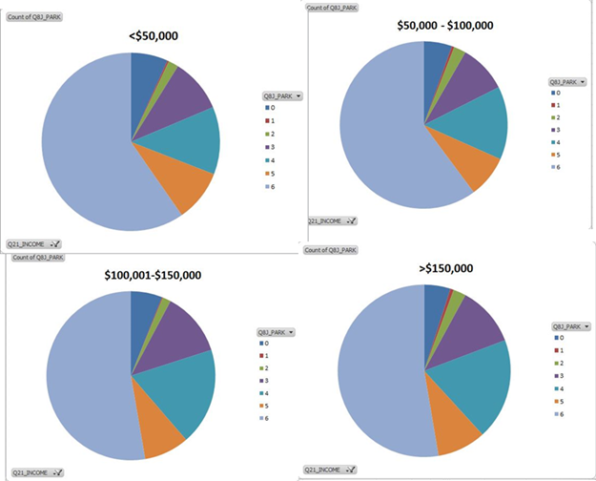
Airport Services Usage Analysis - Parking
Increasing Income group used the parking more
Targeting people with higher income groups for parking would be a good option.
About 60% of the people who have used the parking are satisfied
About 40% people are not satisfied

Slide 20
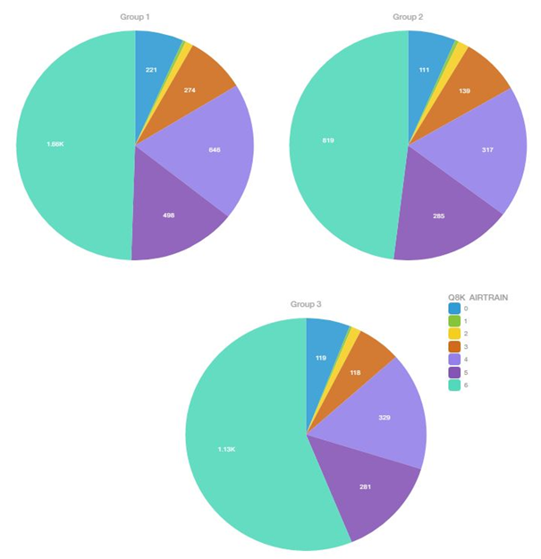
Airport Services Usage Analysis - AirTrain
More proportion of people from group 2 are using Airtrain
Satisfactory level from the AirTrain is equal in all group
About 60% to 70% of people have rated the service good.

Slide 21
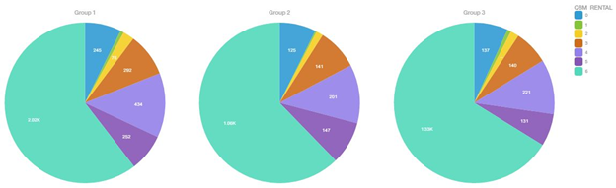
Airport Services Usage Analysis - Rental Car
Notes:
Helen:
aaaa sorry just saw this
you can still leave here and say there is no difference
if we write in the report, we should talk about it, even if it's just one sentense

Slide 22
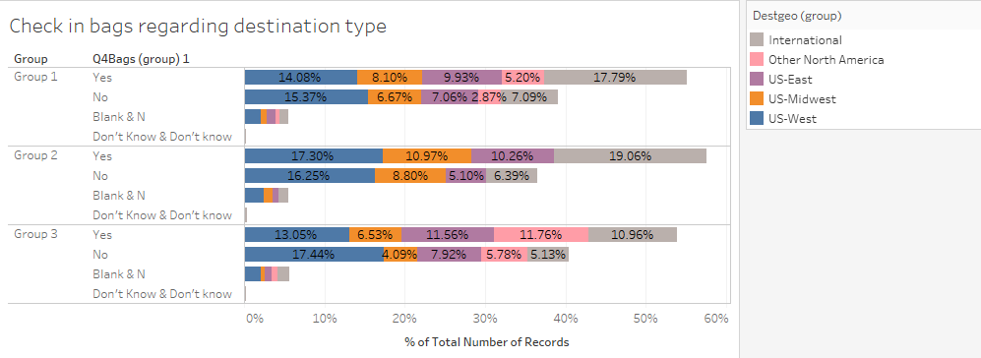
Airport Services Usage Analysis - Check Bags
Small differences exists
Group 3 - more US-west check bags
Group 2 - less US-midwest check bags

Slide 23
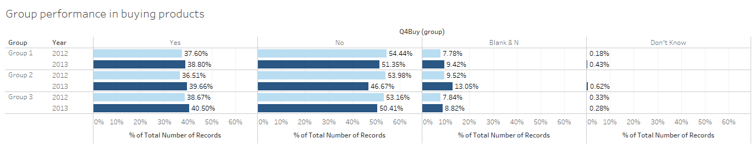
Airport Services Usage Analysis - Store Purchase
Slight increase in all groups from 2012 to 2013
Detail analysis shows vacation people are the largest store purchase group
Income has very limited impact

Slide 24
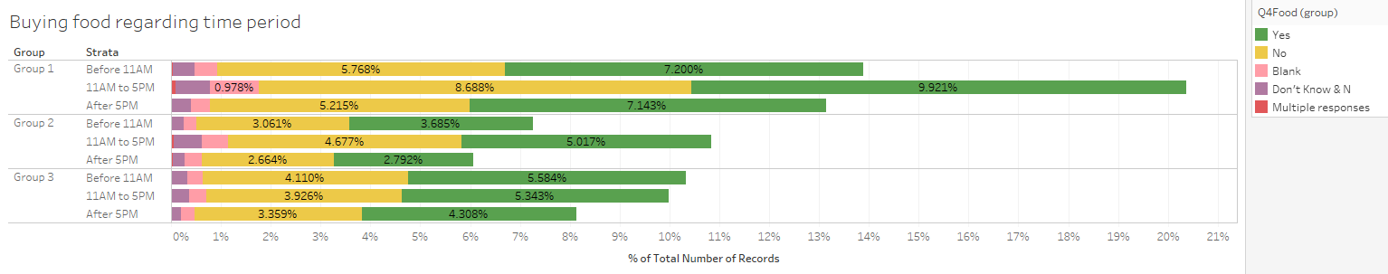
Airport Services Usage Analysis - Restaurant
Overall decrease from 2012 to 2013
Small difference exists
Still more people are buying food
Group 3 has similar food consumption rate in all times

Slide 25
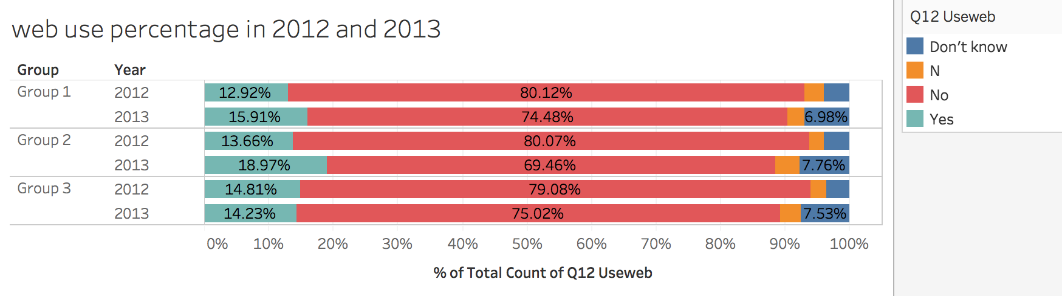
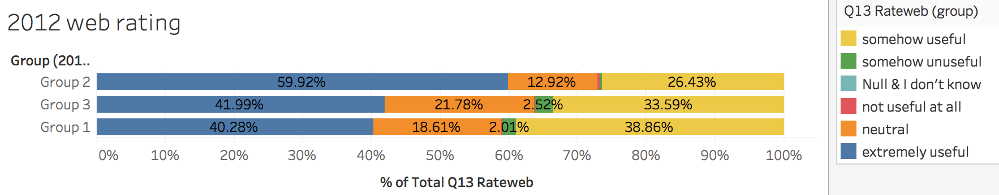
Website Usage Analysis - Website
Overall increase from 2012 to 2013
Overall positive attitude about website
Notes:
Changed the web rating to this page.

Slide 26
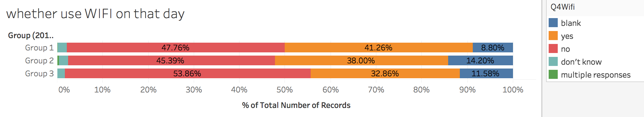
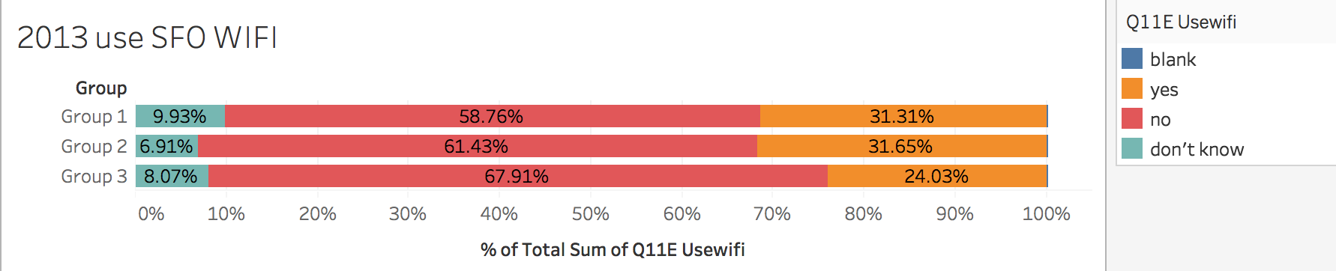
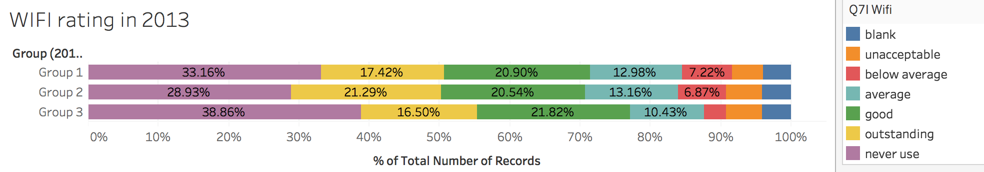
Website Usage Analysis - WIFI
One third of people use WIFI
Notes:
Added charts in this page.

Slide 27
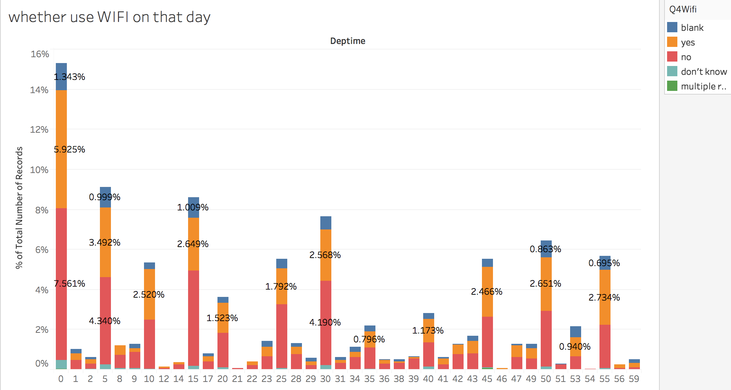
Website Usage Analysis - WIFI
Higher need around departure time.
Notes:
Added a chart about wifi usage

Slide 28
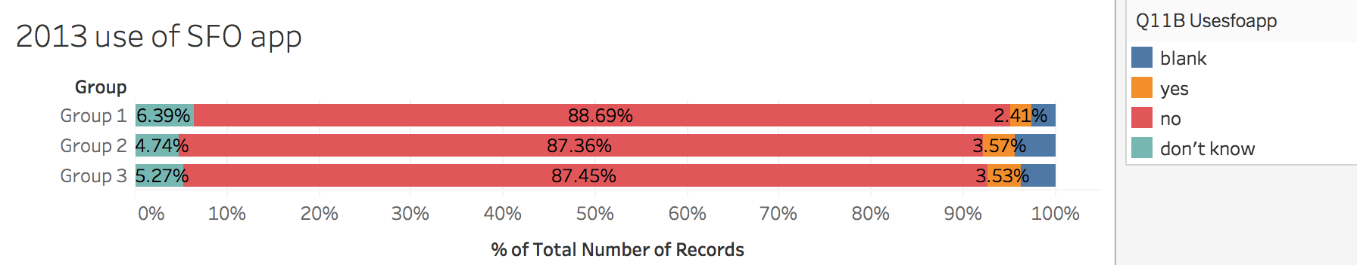
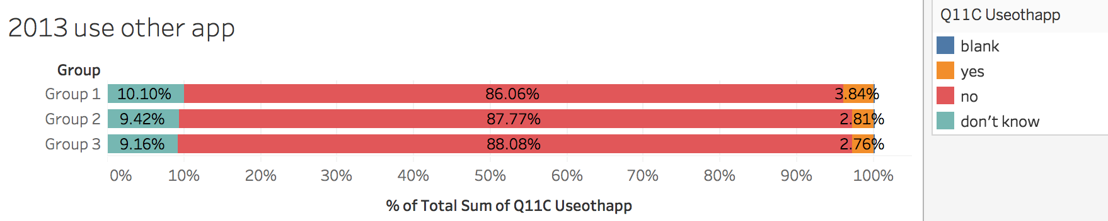
Website Usage Analysis - Apps
Similar percentage of app usage

Slide 29
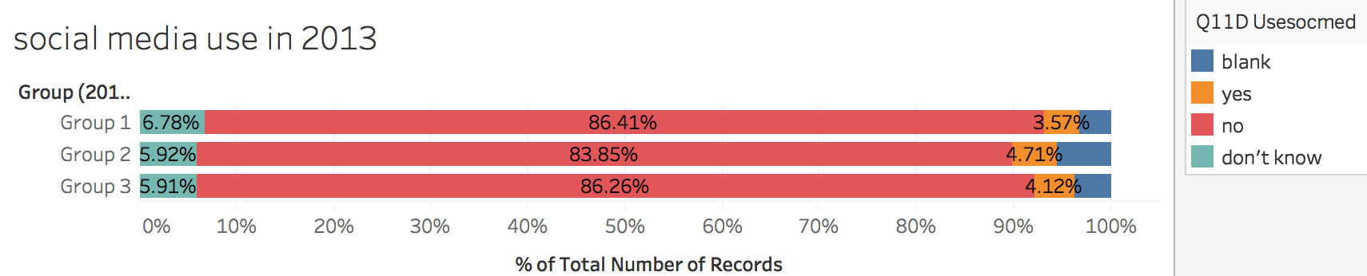
Website Usage Analysis - Social Media
Few people use SFO social media

Slide 30
Recommendations
Better for survey to have same questions and standards in different years for easier data pre-processing
Use advertisement board to educate the public on the advantage of BART so to increase usage
Keep and enhance marketing campaign in airport stores
To improve customers’ food buying, restaurant can launch promotion or special combo during peak hour, and launch online or offline survey about type of food they want to have in airport
SFO may collaborate with airline companies or booking systems to market website or application
SFO can improve the speed of WIFI around each boarding gate in order to improve people’s satisfaction about WIFI service more efficiently
Notes:
Need to add “ SFO can improve the speed of WIFI around each boarding gate in order to improve people’s satisfaction about WIFI service more efficiently. ”

Slide 31
Thank you!
Group 7

