Slide 1
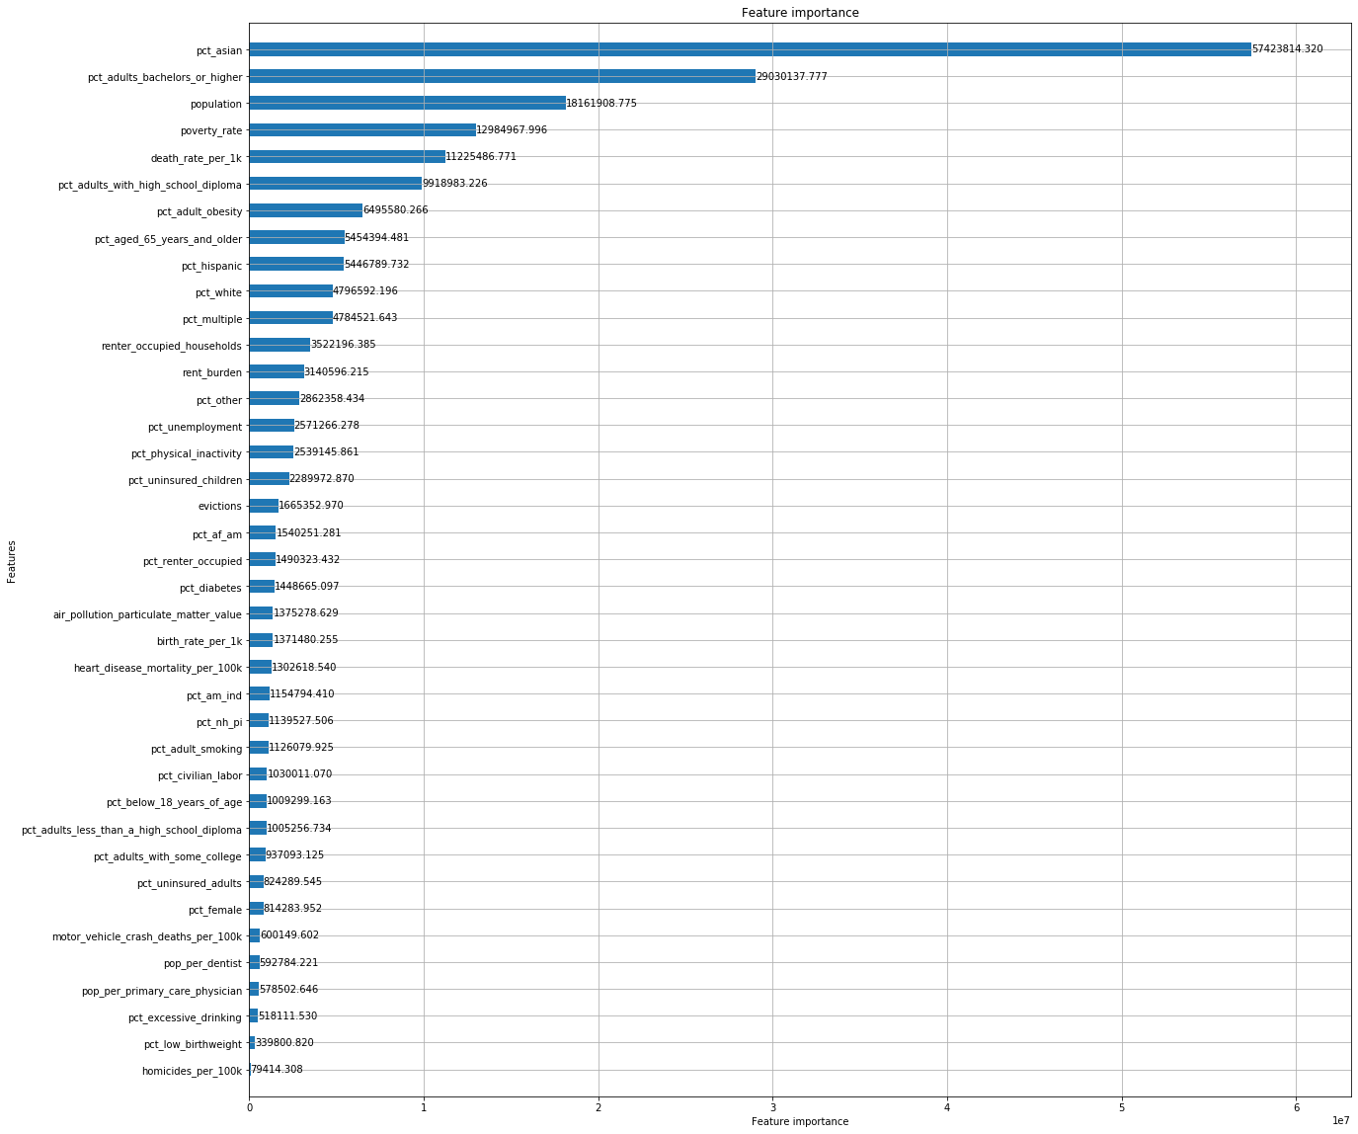
Light GBM

Slide 2
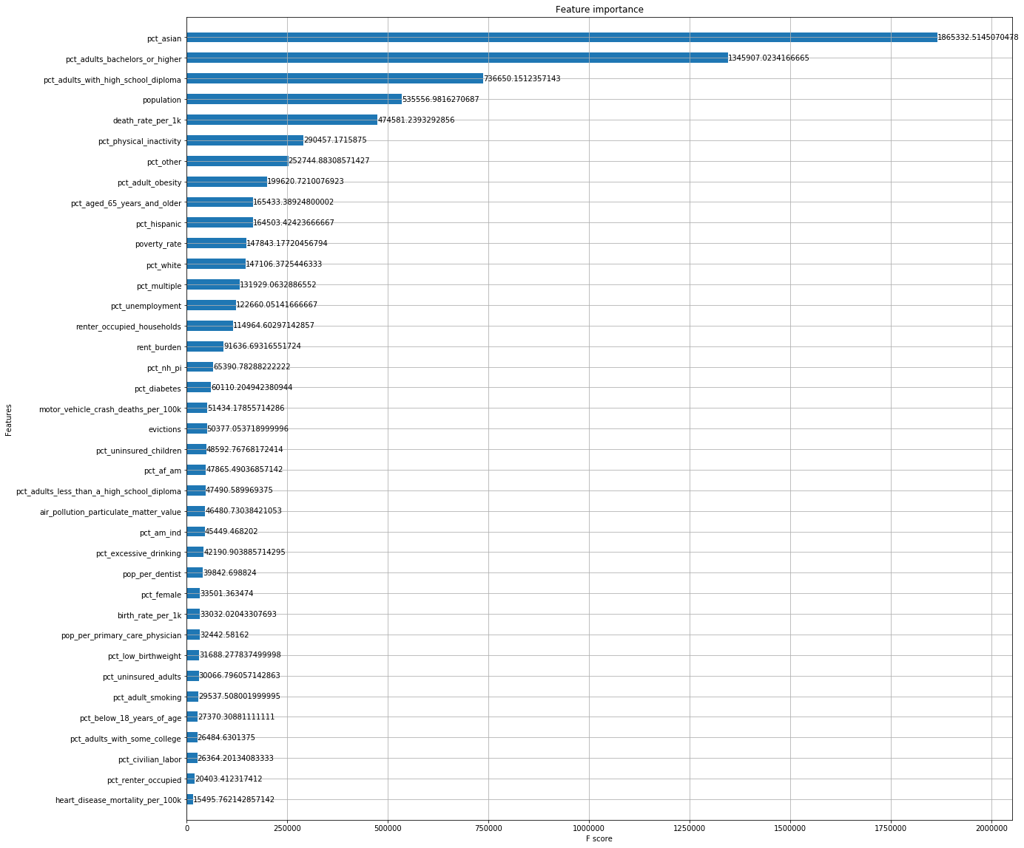
XG Boost

Slide 3
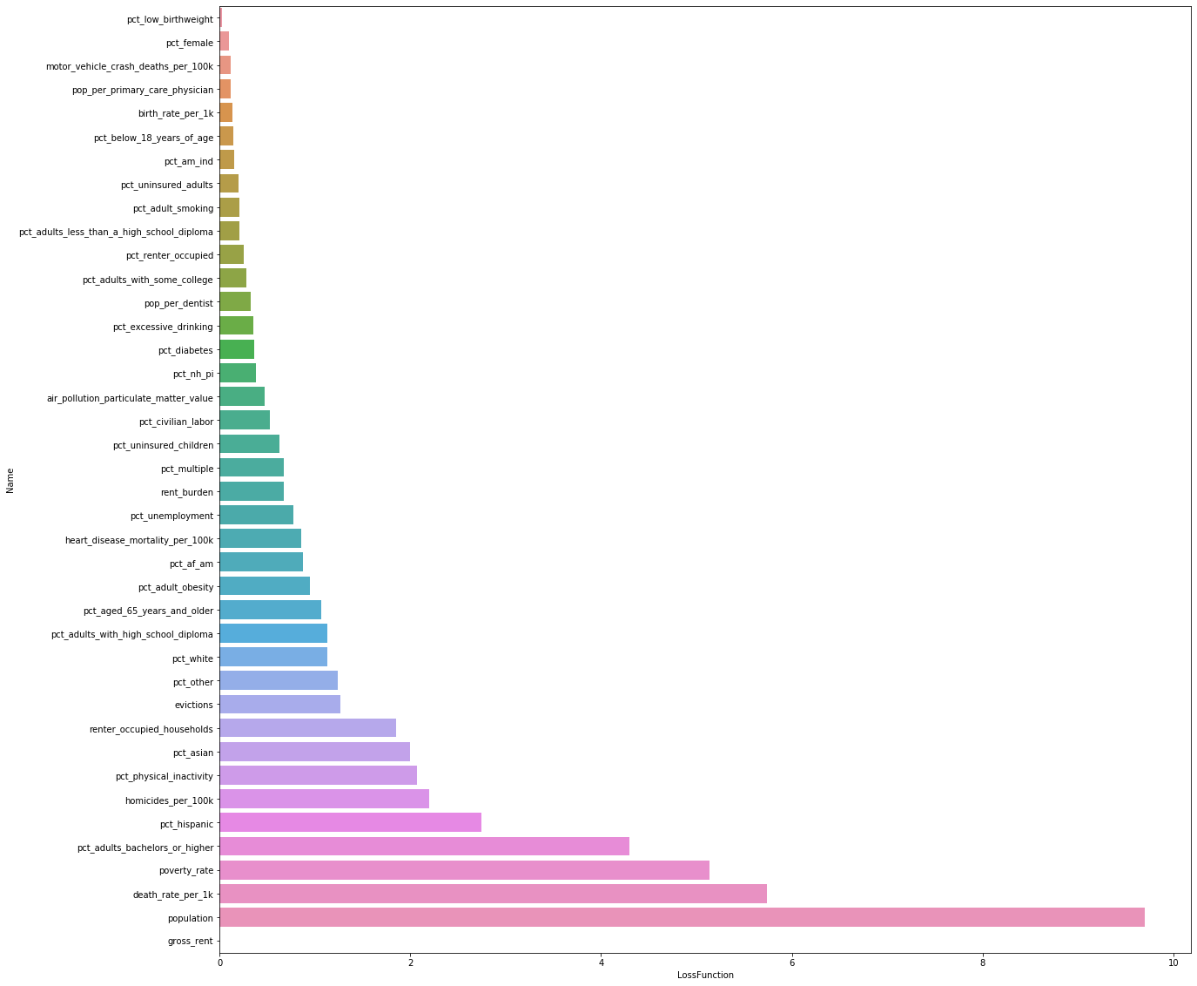
Cat Boost

Slide 4
Azure ML Studio
pct_adults_bachelors_or_higher
pct_adults_with_high_school_diploma
death_rate_per_1k
Population
pct_physical_inactivity
renter_occupied_households
pct_Asian

