Slide 1
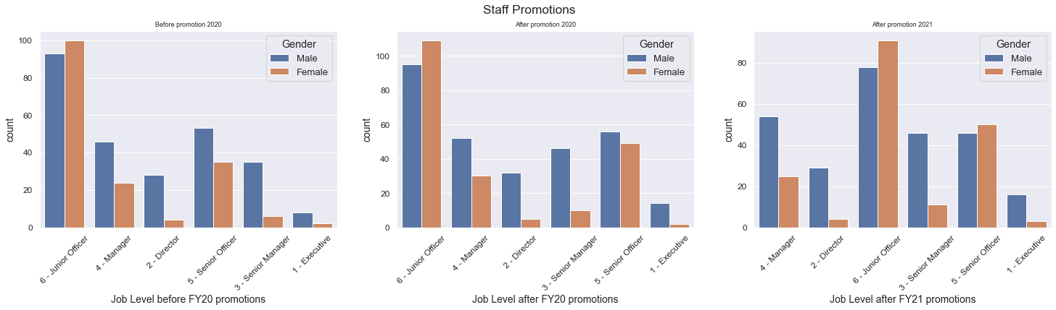
From Chart AbOVE:
RANKS 1 to 5 has glaring gender gap in promotions to higher level
Males still dominate leadership and managerial positions
GAP WAS closed for senior officer posts in fy2021
Missing information found for before FY2020 promotions and after 2021 promotions which need to be addressed for data completeness

Slide 2
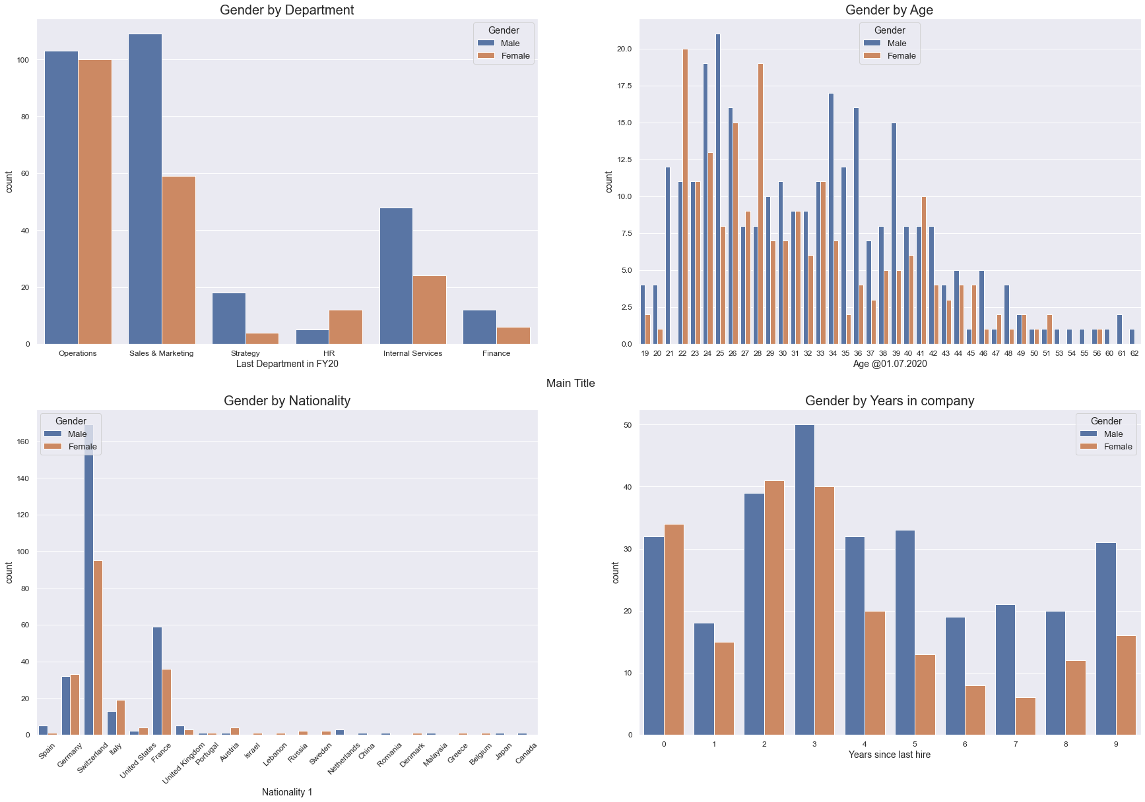
Strategy, HR and internal services dept exhibits gender gap
Age groups mainly 22-42
Majority are Swiss nationals,
mainly male
Employees worked in company 2 to 5 years range
Males tend to stay longer compared to females

