Slide 1

Data Analysis Report for Fond Rouge
Dennis Lam, SAP
June, 2021

Slide 2
Agenda
Background Information
Data Sources Used
Data Analysis Results for US region
Recommendation
Q&A Session

Slide 3
Background Information Suspected counterfeit products in US sales resulted in negative reviews online

Slide 4
Data Sources Used Fond Rouge’s Data in Excel - Sales data from 2019 – 2021 - Returns data with OrderID - Sentiment data from 2018 - 2021

Slide 5
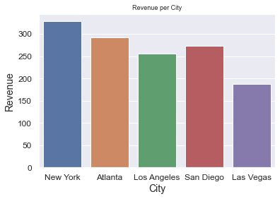
Data Analysis Results for US region

Slide 6
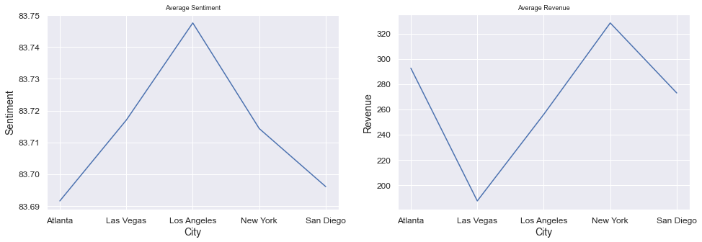
Sentiment and Revenue in US

Slide 7
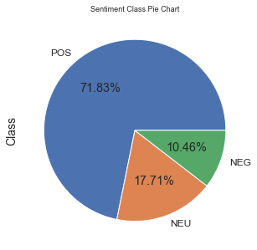
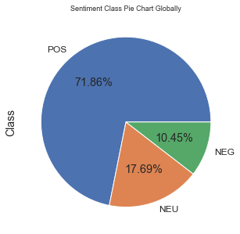
Sentiment Comparison

Slide 8
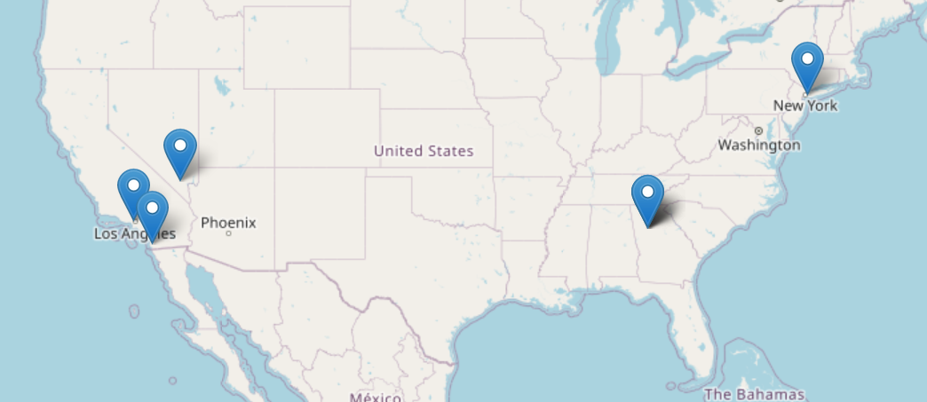
Geography Map of USA

Slide 9

Thank you.
Contact information:
Dennis Lam
Virtual Experience Participant
Malaysia

Slide 11
Data Analysis Report for Fond Rouge
Speaker’s Name, SAP
Month 00, 2021

Slide 12

Data Analysis Report for Fond Rouge
Speaker’s Name, SAP
Month 00, 2021

Slide 13

Data Analysis Report for Fond Rouge
Speaker’s Name, SAP
Month 00, 2021

Slide 14
Divider page

Slide 15
Divider page

Slide 16

Divider page

Slide 17
Insert page title (sentence case)

Slide 18
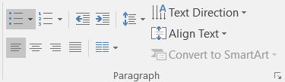
Insert page title (sentence case)
First level
Second level
Third level
NOTE: Delete the yellow stickers when finished.
The text placeholders have different, preformatted text levels. Each level has different formatting (font size, indent, bullet).
To jump between the preformatted text levels, use the Increase List Level and Decrease List Level buttons in the Paragraph toolbar.
Type your text in the placeholder.
Click the Increase List Level button in the Paragraph toolbar to go to the next level.
If you need a bullet list, choose level 2.
Avoid working with spaces, other bullets, or bullets in the wrong level. Only when you use the right levels it is possible to reset the slide layout.

Slide 19
Insert page title (sentence case)
First level
Second level
Third level

Slide 20
Insert page title (sentence case) Subheadline
First level
Second level
Third level

Slide 21
“Quote goes here and here and here.”
Source

Slide 22
“Quote goes here and here and here.”
Source

Slide 23
Insert page title (sentence case)
First level
Second level
First level
Second level
First level
Second level

Slide 24
Insert page title (sentence case)
First level
Second level
Third level

Slide 25
Insert page title (sentence case)
First level
Second level
Third level

Slide 26
Insert page title (sentence case)
First level
Second level
Third level
First level
Second level
Third level

Slide 27
Insert page title (sentence case)
First level
Second level
Third level
First level
Second level
Third level
First level
Second level
Third level

