Slide 1
Terraform-Sentinel 101
An introduction to HashiCorp’s Sentinel Framework
Dennis Lopes Silva

Slide 2
What is Sentinel?
A framework for implementing governance policies as code
It ensures that governance policies are really being checked instead of just being listed in a spreadsheet
Includes its own language and is embedded in HashiCorp enterprise products
Includes a CLI that allows you to test policies

Slide 3
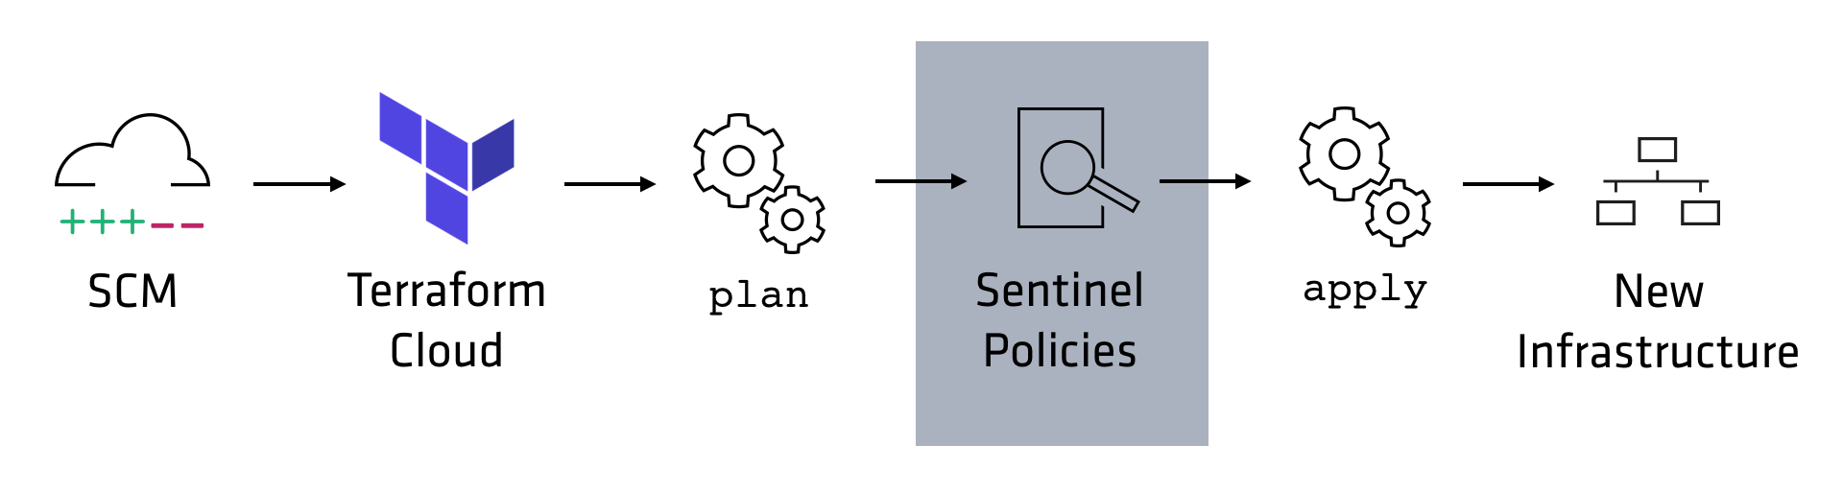
Where is Sentinel Used in Terraform?
Sentinel policies are checked between the standard plan and apply steps of Terraform runs.
Have different enforcement levels
Advisory
Soft Mandatory
Hard Mandatory
Notes:
Advisory
Only logs violations
Soft Mandatory
Can be overridden by authorized users:
Members of the owners team
Members of teams with the "Policies Override" permission
Hard Mandatory
Cannot be overridden by anyone
Customers often create new Sentinel policies as Advisory, then transition to Soft Mandatory, and eventually to Hard Mandatory.
This gives Terraform coders time to adapt and modify their code.

Slide 4
Where is Sentinel Used in Terraform?
Policy authors manage sentinel policies in TFE with a group of policies (policy sets) and organization owners control the scope of the policy
Sentinel policies can evaluate the attributes of existing and new resources based on the information of the plan, the configuration, the current state and other run data, including cost estimates
Notes:
Let's talk about where Sentinel is used in TFC and TFE.
It is run between the plan and the apply of a run.
If cost estimates are enabled for a workspace, the Sentinel policies are checked after the cost estimates are collected.
"Arguments" are the inputs to Terraform resources and data sources.
Each resource and data source also exports certain attributes that are computed during the apply. These are called "exported attributes".
But since the arguments or a resource are also exported, it is common to use "attributes" to refer to the union of a resource's arguments and exported attributes.

Slide 5
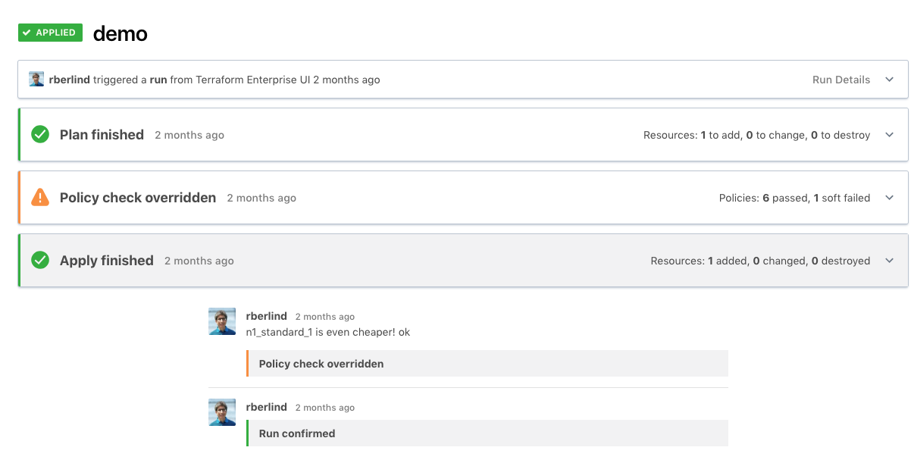
Soft Mandatory Policy Check Overridden
Notes:
Advisory
Only logs violations
Soft Mandatory
Can be overridden by authorized users:
Members of the owners team
Members of teams with the "Policies Override" permission
Hard Mandatory
Cannot be overridden by anyone

Slide 6
Sentinel typical usage
Enforce security standards
Avoid excessive costs
Enforce mandatory tags
Notes:
Require all S3 buckets use the private ACL and be encrypted by KMS.
Restrict which roles the AWS provider can assume.
Prohibit specific resources, data sources, providers, or provisioners
Limit the sizes of VMs and Kubernetes clusters in public clouds.
Limit the monthly spend of each Terraform workspace.

Slide 7
Types of Terraform Sentinel Policies
Essentially, we have four types of Terraform Sentinel policies corresponding to the 4 Terraform Sentinel imports:
tfplan/v2 to restrict specific attributes of specific resources and data sources in the currente Terraform plan
tfconfig/v2 to restrict the configuration of Terraform modules, variables, resources, data sources, providers, provisioners, and outputs
tfstate/v2 to check whether previously provisioned resources or data sources have attributes with values thar are no longer allowed
tfrun to check workspace and run metadata and whether cost estimates for planned resource are within limits
You can use more that one import in a policy
Notes:
The tfplan/v2 gives data generated from Terraform plans.
https://www.terraform.io/docs/cloud/sentinel/import/tfplan-v2.html
The tfconfig/v2 import gives data about the Terraform configuration.
https://www.terraform.io/docs/cloud/sentinel/import/tfconfig-v2.html
The tfstate/v2 import gives data about the current state of a workspace.
https://www.terraform.io/docs/cloud/sentinel/import/tfstate-v2.html
The tfrun import provides metadata for Terraform runs and their workspaces as well as cost estimate data. (There is no v2 version of it.)
https://www.terraform.io/docs/cloud/sentinel/import/tfrun.html
Let's talk about where Sentinel is used in TFC and TFE.
It is run between the plan and the apply of a run.
If cost estimates are enabled for a workspace, the Sentinel policies are checked after the cost estimates are collected.
"Arguments" are the inputs to Terraform resources and data sources.
Each resource and data source also exports certain attributes that are computed during the apply. These are called "exported attributes".
But since the arguments or a resource are also exported, it is common to use "attributes" to refer to the union of a resource's arguments and exported attributes.

Slide 8
Sentinel Mocks
Simulate data that is available to Sentinel import from Terraform plans
Can be generated from recent plans using TFE/TFC
Can be copied and edited to simulate different scenarios
Enable testing of Sentinel policies with the Sentinel CLI
Speed up development
Notes:
Require all S3 buckets use the private ACL and be encrypted by KMS.
Restrict which roles the AWS provider can assume.
Prohibit specific resources, data sources, providers, or provisioners
Limit the sizes of VMs and Kubernetes clusters in public clouds.
Limit the monthly spend of each Terraform workspace.

Slide 9
Key Sentinel Language Constructors
Boolean Expressions: true, false, undefined
Rules: Evaluate a single expression which could be the result of calling a single function
Main Rule: Every Sentinel policy must have a main rule (store the result of the policy)
Statements: Executes procedural logic
Functions: Execute various statements and return a value
Variables: Store values for use by rules and functions
Parameters: Accept inputs passed to policies
Notes:
Note that each rule can only contain a single expression. Rules cannot include statements, for loops, or if/else statements, but a rule could invoke a single function.
If you need to do complex processing that cannot be done with a single expression, define a function and call that function from your rule.
Rules that return a boolean value can use the "all" and "any" expressions since these are rendered as chained "and" and "or" logical operators.

Slide 10
Key Sentinel Language Constructors
Types: boolean, integer, float, string, list, map
Operators: Arithmetic, Logic, Comparison, Set, Matches, Else
Assignments
If/Else and Case Statements (Within a function)
For Loops: Frequently inside functions
Filter: returns a subset of a collection
Imports: Reusable libraries of Sentinel functions
Notes:
Note that each rule can only contain a single expression. Rules cannot include statements, for loops, or if/else statements, but a rule could invoke a single function.
If you need to do complex processing that cannot be done with a single expression, define a function and call that function from your rule.
Rules that return a boolean value can use the "all" and "any" expressions since these are rendered as chained "and" and "or" logical operators.

Slide 11
Standard Sentinel Imports
Beyond the imports already mentioned (tfplan, tfconfig, tfstate, tfrun)
base64
decimal
http
json
runtime
sockaddr
strings
time
types
units
version
See:
https://docs.hashicorp.com/sentinel/imports

Slide 12
Sentinel Modules
Functions and rules in a file that can be used by policies with a single import statement
Improve reusability of Sentinel functions
Repository includes 8 modules:
tfplan-functions, tfstate-functions, tfconfig-functions, tfrun-functions, aws-functions, azure-functions, gcp-functions, and registry-functions.
Notes:
Note that each rule can only contain a single expression. Rules cannot include statements, for loops, or if/else statements, but a rule could invoke a single function.
If you need to do complex processing that cannot be done with a single expression, define a function and call that function from your rule.
Rules that return a boolean value can use the "all" and "any" expressions since these are rendered as chained "and" and "or" logical operators.

Slide 13
Basic Methodology for development of policies
Create a Terraform configuration that creates the resource.
Create a workspace that uses your Terraform configuration.
Run a plan against the workspace.
Generate mocks against the plan in the TFC UI.
Write a new Sentinel policy.
Create test cases and test your policy with the Sentinel CLI.
Revise your policy and test cases until they all pass.
Deploy your policy to a TFC organization.
Notes:
Note that each rule can only contain a single expression. Rules cannot include statements, for loops, or if/else statements, but a rule could invoke a single function.
If you need to do complex processing that cannot be done with a single expression, define a function and call that function from your rule.
Rules that return a boolean value can use the "all" and "any" expressions since these are rendered as chained "and" and "or" logical operators.

Slide 14
A simple example (MIRA Provider)
Checking if the number of subnets provisioned by the MIRA for a specific network is greater than the limits allowed.
Example:
Subnet type | Max number of subnets
ainotebook-vpc-primary | 3
cloudsql-vpc-primary | 2
composer-master-primary | 5
composer-node-primary | 1

Slide 15
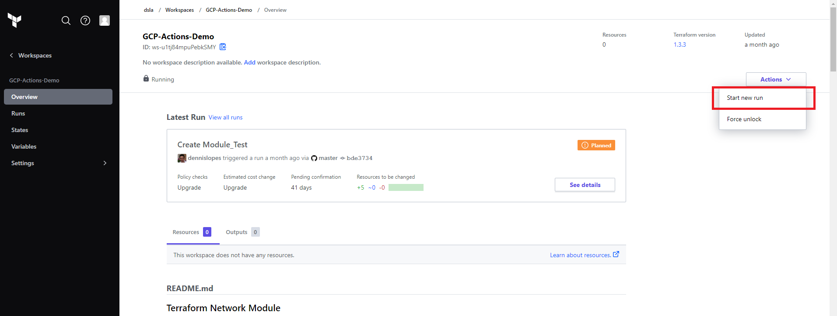
Create the mock

Slide 16
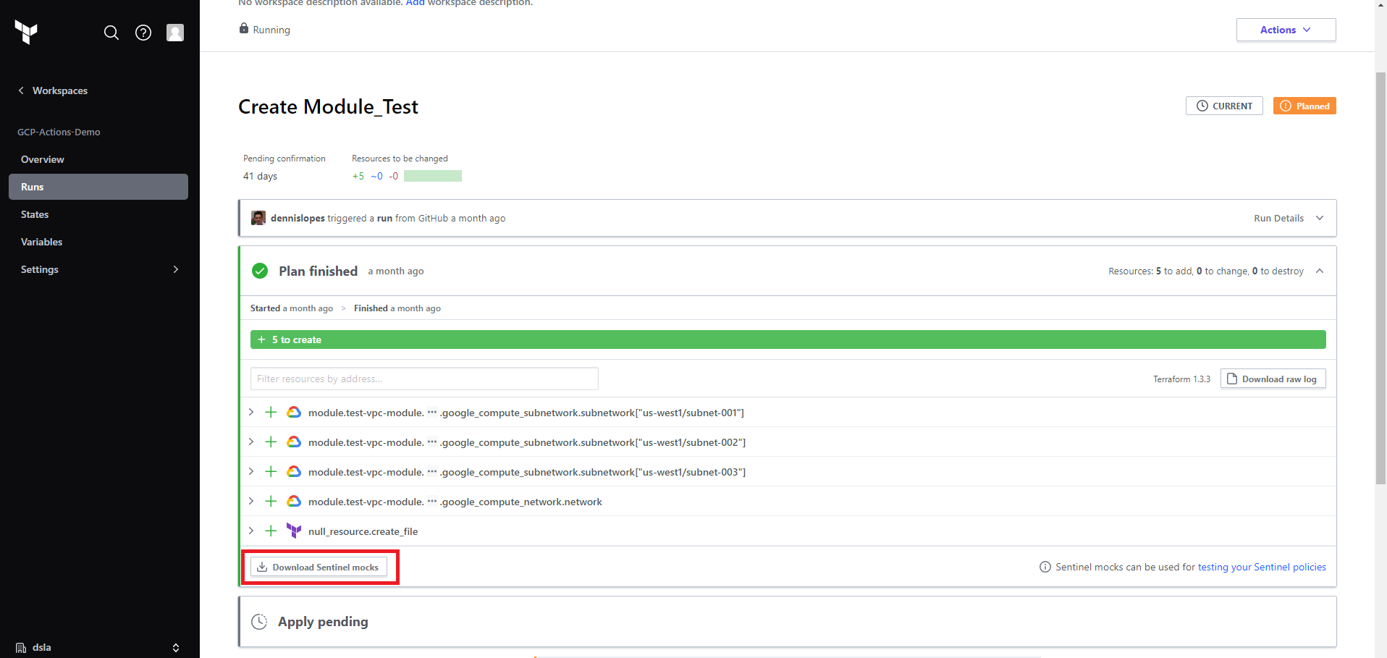
Download the mock

Slide 17
Prepare environment to test locally
Under the directory containing your policy, create a test directory.
Under the test directory, create a directory with the same name as your policy, but without the ".sentinel" extension.
Copy the mock-tfplan-v2.sentinel mock file that you downloaded and extracted from your workspace to this directory.
Change the name of the mock file to mock-tfplan-pass.sentinel.
Create a second copy of the file called mock-tfplan-fail.sentinel.
Create pass.hcl and fail.hcl files that have the text on the next
Edit the mock-tfplan-pass.sentinel mock file in order to make sentinel policy pass.
Edit the mock-tfplan-fail.sentinel mock file in order to make sentinel policy fail.
You should always have at least 1 fail and 1 pass test case.

Slide 18
pass.hcl
module "tfplan-functions" {
source = "../../../common-functions/tfplan-functions/tfplan-functions.sentinel"
}
mock "tfplan/v2" {
module {
source = "mock-tfplan-pass.sentinel"
}
}
test {
rules = {
main = true
}
}

Slide 19
fail.hcl
module "tfplan-functions" {
source = "../../../common-functions/tfplan-functions/tfplan-functions.sentinel"
}
mock "tfplan/v2" {
module {
source = "mock-tfplan-fail.sentinel"
}
}
test {
rules = {
main = false
}
}

Slide 20
Basic sentinel template for restrict attributes or resource on Terraform plan
# Import common-functions/tfplan-functions/tfplan-functions.sentinel
# with alias "plan"
import "tfplan-functions" as tfplan
result = #function that return true/false
main = rule {
result
}
Notes:
tfplan/v2 to restrict specific attributes of specific resources and data sources in the currente Terraform plan
Hashicorp recommendation is to use function to develop the logic and leverage the common-functions

Slide 21
Basic sentinel template for restrict attributes or resource on Terraform plan
# Import common-functions/tfplan-functions/tfplan-functions.sentinel
# with alias "plan"
import "tfplan-functions" as tfplan
resources = tfplan.find_resources("google_compute_subnetwork")
result = check_number_of_networks(resources, “composer-node-primary”, true)
main = rule {
result
}
Notes:
tfplan/v2 to restrict specific attributes of specific resources and data sources in the currente Terraform plan
Hashicorp recommendation is to use function to develop the logic and leverage the common-functions

Slide 22
Basic sentinel template for restrict attributes or resource on Terraform plan (The function)
### check_number_of_networks ###
# Restrict the number of planned networks based on the subnet_type
# author: dennis.silva@db.com
check_number_of_networks = func(resources, value, prtmsg) {
network_limits = {
"ainotebook-vpc-primary": 3, "cloudsql-vpc-primary": 2,
"composer-master-primary": 5, "composer-node-primary": 2, }
subnet_limit = network_limits[value]
violators = 0
messages = {}
for resources as address, rc {
v = tfplan.evaluate_attribute(rc, "network_type") else null
if v is null {
v = "null" }
if v is value {
violators += 1 }
}
if violators > subnet_limit {
message = "Number of " + tfplan.to_string(value) +
" subnets(" + tfplan.to_string(violators) +
") is greater than allowed for automatic provisioning(" +
tfplan.to_string(subnet_limit) + ")"
if prtmsg {
print(message)
}
return false
}
return true
}
Notes:
tfplan/v2 to restrict specific attributes of specific resources and data sources in the currente Terraform plan
Hashicorp recommendation is to use function to develop the logic and leverage the common-functions

Slide 23
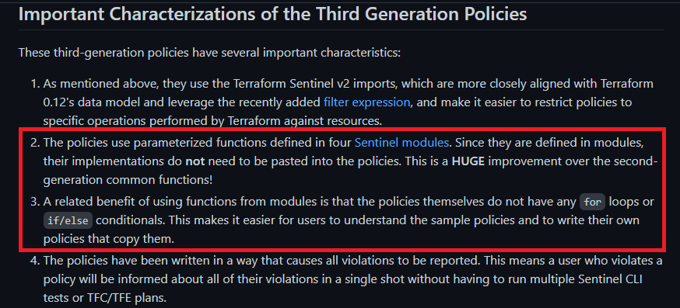
Common-functions
Third Generation Sentinel Policies for Terraform
Notes:
tfplan/v2 to restrict specific attributes of specific resources and data sources in the currente Terraform plan
Hashicorp recommendation is to use function to develop the logic and leverage the common-functions

Slide 24
Basic sentinel template for restrict attributes or resource on Terraform plan
To avoid a lot of code on the sentinel and to improve the reuse, create a common function code in which we can have all the methods that can be re-used on other sentinel policies.
In this code I should implement the required method:
check_number_of_networks = func(resources, value, prtmsg)
Notes:
tfplan/v2 to restrict specific attributes of specific resources and data sources in the currente Terraform plan
Hashicorp recommendation is to use function to develop the logic and leverage the common-functions

Slide 25
Basic sentinel template for restrict attributes or resource on Terraform plan
Then, we can import the function and the code is able to be re-used:
# Import common-functions/tfplan-functions/tfplan-functions.sentinel
# with alias "plan"
import "mira-functions" as mira
import "tfplan-functions" as tfplan
resources_by_google_provider = mira.find_resources("google_compute_subnetwork")
result = mira.check_number_of_networks (resources_by_google_provider, "composer-node-primary", true)
main = rule {
result
}
Notes:
tfplan/v2 to restrict specific attributes of specific resources and data sources in the currente Terraform plan
Hashicorp recommendation is to use function to develop the logic and leverage the common-functions

Slide 26
Add mira-functions to the fail.hcl and pass.hcl
module "tfplan-functions" {
source = "../../../common-functions/tfplan-functions/tfplan-functions.sentinel"
}
module "mira-functions" {
source = "../../../mira-functions/mira-functions.sentinel"
}
mock "tfplan/v2" {
module {
source = "mock-tfplan-pass.sentinel"
}
}
test {
rules = {
main = true
}
}

Slide 27
How to test?
1. Download Sentinel CLI
Downloads | Sentinel by HashiCorp
2. Add the binary to the PATH
3. Run the policy
sentinel test policy-name.sentinel
4. Check the results
5. Publish on TFE (Under investigation)

