Slide 1
Introduction to Data Mining
Objectives of today’s class
Understand the goal of data mining
Explore some applications of data mining
Identify ethical issues associated with data mining
Differentiate data mining from general machine learning
Explore potential research issues in data mining

Slide 2
Data Mining
Data Mining is the process of
Discovering structural patterns in data that capture the underlying relationships in the data
and
Using patterns in the data to make subsequent predictions about the values of one or more attributes

Slide 3
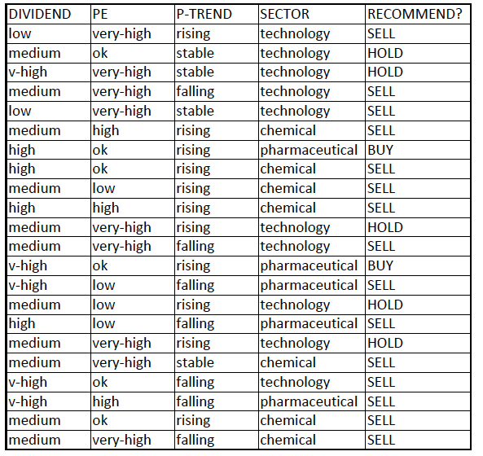
A Sample Dataset

Slide 4
Attributes
An attribute is a property or characteristic of an object.
The value for an attribute can be nominal in which case it has a finite discrete set of possible values
The value for an attribute can be numeric in which case it has an infinite set of values
In a classification problem, one attribute is called the target attribute or class attribute or dependent variable; this is the attribute that one is trying to predict.
The attributes used to make the prediction are called predictor attributes.

Slide 5
A Sample Dataset

Slide 6
Learned Model
The function that maps data about the values of predictor attributes to predictions about the value of the class attribute is called a learned model of the data.
A decision tree is one example of a learned model.
Given the values of the predictor attributes for an object, one obtains the prediction about the class value for the object by following the path from the root node to the class value at the bottom of the tree.

Slide 7
A Sample Dataset

Slide 8
Use Weka to illustrate a decision tree
What class value is predicted for the following?
DIVIDEND = high
PE = high
P-TREND = rising
SECTOR = pharmaceutical
What class value is predicted for the following?
DIVIDEND = medium
PE = ok
P-TREND = stable
SECTOR = technology

Slide 9
Data Mining
Data mining constructs such learned models.
The model is constructed from a set of training data.
The process must be automatic (or at least semi-automatic).
There must be a lot of data from which the patterns are derived, so that the patterns represent an inference about the world that is largely correct.
Evaluating the learned model
the performance of the resultant model can be evaluated on an independent set of test instances for which the correct outcome is known
but success is often also measured more subjectively, by evaluating the acceptability or intuitiveness of the learned model.

Slide 10
Data Mining
Why the growing interest in data mining?
The volume of data has grown tremendously
greater storage capacity
faster processors for analyzing data
The data encapsulates knowledge that can be productively and competitively utilized

Slide 11
Data Mining Tasks
Classification task: find a structural pattern that can be used to classify a new example
supervised: actual classification is given in the training instances
Numeric prediction task: a variant of the classification task in which the outcome is a numeric value instead of a category
supervised, but the class is numeric
Association task: find a structural pattern that can be used to predict one or more arbitrary attributes of an instance from other attributes --- ie., identify strong associations among attribute values
supervised --- attribute values are given as part of the training instances
Clustering task: group items together into apparent natural classes when there is no specified class in the dataset
unsupervised: no indication in the training set of which class (cluster) each instance belongs to

Slide 12
Real-world Applications
Diagnosis: soybean disease (classification task)
Data mining project
Plants evaluated along 35 attributes and labelled by an expert in plant pathology as normal or exhibiting one of 19 diseases
300 very different training examples were selected from the corpus
diagnosis system was trained on the 300 examples in the training set
resultant system was more successful at diagnosis than were hand-generated expert rules

Slide 13
Real-world Applications
Decision-making: loan approval (classification task)
clear accepts and rejects determined by statistical analysis; how to handle borderline cases (10% of applications)
Data mining project
loan dataset constructed using 20 attributes from borderline loan applications that were granted, along with indication of whether the borrower defaulted on the loan
prediction system trained on 1000 training examples of borderline cases
resultant system had a 67% success rate in predicting whether a borderline case should be given a loan
extra advantage: rules could be used to explain why a loan was denied

Slide 14
Real-world Applications
Market-basket analysis: (association task)
Example: supermarkets
Data mining project:
dataset consists of attributes from a single checkout: items purchased, amounts, day of week, month, near-holiday?, age, total-bill, location, etc.
association rules developed to identify structural patterns that associate sets of attribute values.
can be used for many purposes:
plan store displays so that the most profitable version of related items are featured together
generate coupons to entice a customer to try a new product
generate real-time coupons on new supermarket baskets to entice customers to purchase an item that they might not be considering
limit coupon discounts to only one item of a group that would regularly be purchased together

Slide 15
Real-world Applications
Target (change buying habits)
identify when a woman entered her second trimester of pregnancy and send her coupons for baby items
Data mining project
Data set consisted of store data (products purchased and when, credit cards used, etc.), public data (birth announcements) , and purchased data
Prediction system trained on a large set of examples of pregnant and non-pregnant women
Result: found that purchase of certain items (such as unscented lotions) suggested pregnancy
Coupons were sent to women hypothesized to be pregnant and buying habits changed.
But ethical issues arose

Slide 16
Ethical Considerations
Permission:
Is the individual aware of the information being collected?
Has the individual given permission for its collection?
Has the individual been informed of (and given permission regarding) how the information will be used?
Will the information be utilized for other purposes without obtaining permission from the individuals from whom it was collected?

Slide 17
Ethical Considerations
Discrimination:
certain attributes can substitute for racial, ethnic, religious, etc. characteristics.
But use of potentially discriminatory information is ethical in medical diagnosis, but not for deciding on loans
Privacy
Will use of the data result in an invasion of privacy?
Target department store example
Confidentiality
How will the collected information be protected?
Merely limiting to statistical use is insufficient
Changing Safeguards
Will individuals be made aware of changes in safeguards?

Slide 18
Data Mining vs. Machine Learning
Data Mining is a limited version or subcategory of machine learning.
Similarities:
Both data mining and general machine learning are performance-based:
the goal is to improve performance on a task with respect to some performance measurement P after training.
Both data mining and general machine-learning use training instances that are captured as sets of attribute-value pairs.
System performance is best if the training instances reflect the distribution of real-world occurrences.

Slide 19
Data Mining vs. Machine Learning
Differences:
Feedback
data mining uses direct feedback, in the form of instances and their correct classification or attribute associations
machine learning often must use indirect feedback.
credit-assignment problem
with indirect feedback, machine learning must determine how to assign credit or blame to aspects of the training situation

Slide 20
Data Mining Research
Scalability: handling huge data sets (gigabytes, terabytes, or petabytes of data)
out-of-core algorithms
sampling techniques
parallel algorithms
High dimensionality: data sets with a huge number of attributes
Gene expression data, temporal data, and spatial data often have thousands of attributes.
Techniques that reduce the number of dimensions that are considered.

Slide 21
Data Mining Research
Complex data
web pages with semi-structured text and hyperlinks
time-series measurements (temperature, pressure, humidity)
DNA data with sequential and 3-dimensional structure
Distributed data: data that is not stored in a single location
minimize the amount of required communication to remote sites
effective methods for integrating the data mining results from analyzing the data at different sites

