Slide 1
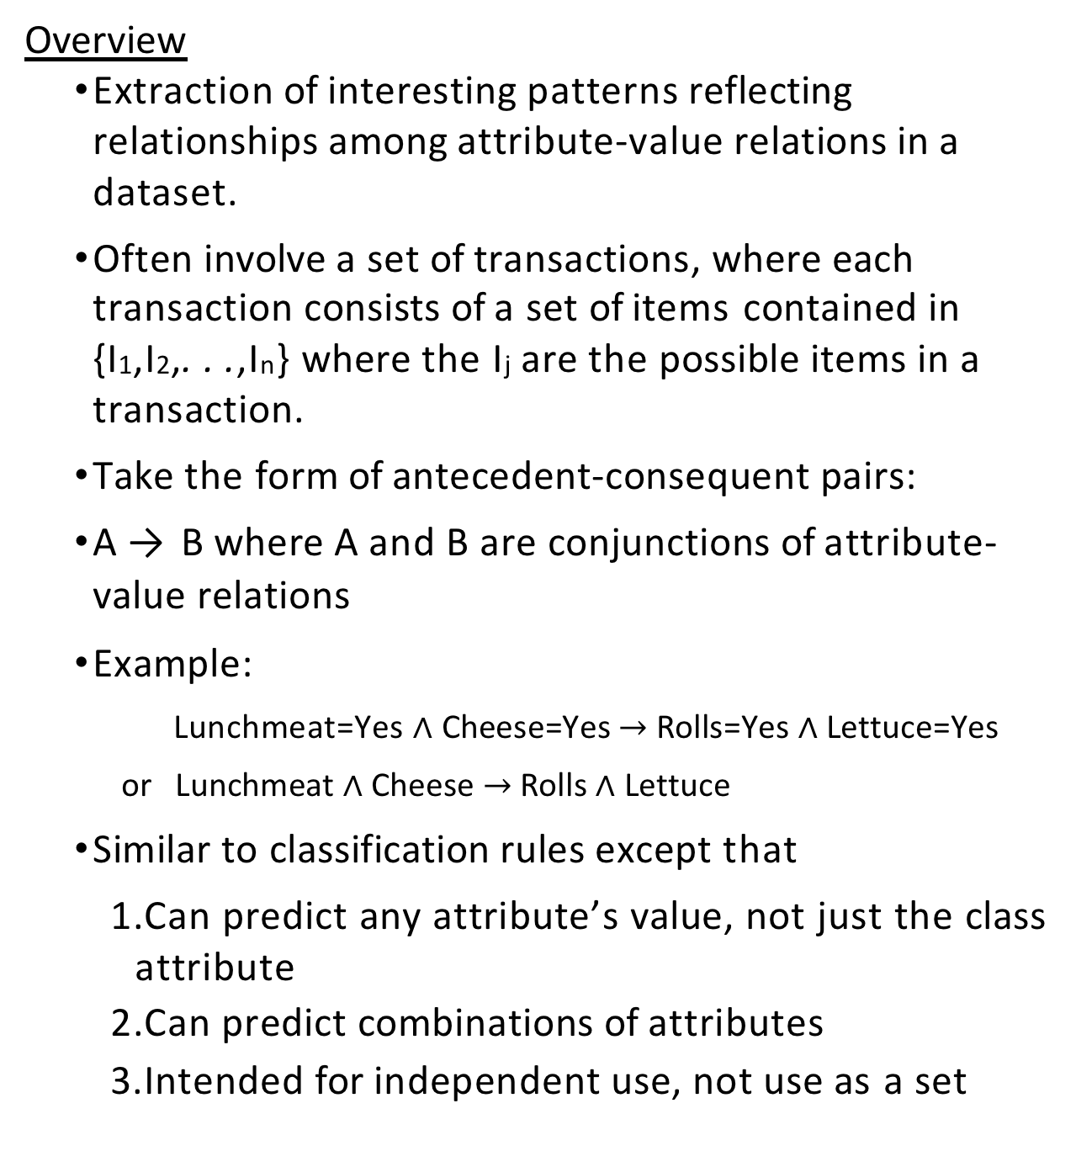
Association Mining
Overview
Extraction of interesting patterns reflecting relationships among attribute-value relations in a dataset.
Often involve a set of transactions, where each transaction consists of a set of items contained in
{I₁,I₂,. . .,I_{n}} where the I_{j} are the possible items in a transaction.
Take the form of antecedent-consequent pairs:
A → B where A and B are conjunctions of attribute-value relations
Example:
Lunchmeat=Yes $∧$ Cheese=Yes $→$ Rolls=Yes $∧$ Lettuce=Yes
or Lunchmeat $∧$ Cheese $→$ Rolls $∧$ Lettuce
Similar to classification rules except that
Can predict any attribute’s value, not just the class attribute
Can predict combinations of attributes
Intended for independent use, not use as a set

Slide 2
Association Mining
Motivation for Approach:
Coverage or Support for a rule is the number of instances in the dataset that contain all the attribute-value relations specified in the rule (both antecedent and consequent) — that is, the number of instances for which the predictions of an association rule hold.
We are only interested in those rules that have a minimum level of coverage — ie., they reflect many instances in the training set.
Accuracy or Confidence is the number of instances for which the rule is correct divided by the number of instances for which the rule antecedent holds.
Accuracy is the coverage of the rule divided by the coverage of the rule’s antecedent.
Also only interested in those rules that have at least some minimum accuracy

Slide 3
Association Mining
Terminology:
An itemset is a set of items.
An itemset that contains k items is a k-itemset.
A frequent itemset is an itemset that satisfies a minimum support threshold.
Apriori property: All nonempty subsets of a frequent itemset must also be frequent itemsets.
Corollary: IF S₁ and S₂ are two itemsets, THEN S=S₁ ∪ S₂ can be a frequent itemset only if both S₁ and S₂ are frequent itemsets.
Apriori property and Apriori algorithm get their name from taking advantage of prior knowledge about properties of frequent itemsets

Slide 4
Association Mining
Terminology:
Accuracy rule: (my terminology) If a rule with i elements in the antecedent and j elements in the consequent has the minimum coverage and minimum accuracy, then moving one of the consequents to the antecedent does not decrease the coverage and does not decrease the accuracy.
Corollary: If a rule with i+1 elements in the antecedent and j-1 elements in the consequent does not have the required accuracy, then moving one of the elements from the antecedent to the consequent cannot produce a rule with the desired accuracy.
Note that accuracy is coverage of rule divided by coverage of antecedent, and that denominator gets larger when an item is moved from the antecedent to the consequent but numerator stays the same.

Slide 5
Association Mining
Constructing Strong Association Rules:
Given: a dataset of attribute-value instances or a dataset of transactions, a minimum support threshold, and a minimum accuracy, rule construction involves two steps:
Construct all frequent itemsets
Generate strong association rules (ones with the minimum coverage and accuracy) from the frequent itemsets

Slide 6
Constructing frequent itemsets from dataset D
1. k=1
C₁ = set of all 1-itemsets from D with coverage of at least s
Repeat until C_{k}=∅
Let C_{k+1}=∅
Put the itemsets of C_{k} in lexicographic order
Construct candidate (k+1) itemsets: For each pair of itemsets X and Y in C_{k} for which the first (k-1) items in X and Y are identical, Do
construct (k+1)-itemset X ∪ Y
Itemsets are sorted into lexicographic order
Thus we need only consider pairs of k-itemsets from C_{k} where the first (k-1) items in the itemsets are identical. This is because the Apriori principle says that if a (k+1)-itemset is a frequent itemset, then each of its subsets must be frequent itemsets. Thus every k-itemset that is a subset must appear in C_{k}, and we can construct the (k+1)-itemset from the two k-itemsets that differ only in their last item.
(k+1)-itemsets that are not constructed in this fashion will not have the required minimum support due to the Apriori principle.
X ∪ Y may have the minimum support s, but we don’t know for sure.
Prune-1: If every k-element subset of X ∪ Y has minimum support s, then add X ∪ Y to ^{C}k+1
The Apriori principle says that if an itemset I has support s, then all of its subsets must also have support s.
Itemsets with their support counts are stored in a hash table for easy retrieval.
Prune-2: Scan the dataset to compute the coverage of each (k+1)-itemset in C_{k+1}. Remove any itemset that does not have the minimum support s.
Store frequent itemsets of C_{k+1} with their support in a hash table for easy retrieval of support. (f) k←−k+1

Slide 7
Example: minimum support is 2; minimum accuracy is 50%
Transaction-ID | Items
T100 | I1,I2,I5
T200 | I2,I4
T300 | I2,I3
T400 | I1,I2,I4
T500 | I1,I3
T600 | I2,I3
T700 | I1,I3
T800 | I1,I2,I3,I5
T900 | I1,I2,I3
Construct frequent 1-itemsets
Itemset | Support
{I1} | 6
{I2} | 7
{I3} | 6
{I4} | 2
{I5} | 2
All have at least the minimum required support
Construct frequent 2-itemsets
Construct candidate 2-itemsets by combining 1-itemsets whose first 0 items are identical
Remove any 2-itemsets that have a 1-item subset that is not a frequent 1-itemset
Scan the dataset to compute the actual support for each itemset
Itemset | Support
{I1,I2} | 4
{I1,I3} | 4
{I1,I4} | 1
{I1,I5} | 2
{I2,I3} | 4
{I2,I4} | 2
{I2,I5} | 2
{I3,I4} | 0
{I3,I5} | 1
{I4,I5} | 0
Remove those with less than the minimum level of support
Itemset
{I1,I2}
{I1,I3}
Support 4
4

Slide 8
{I1,I5} | 2
{I2,I3} | 4
{I2,I4} | 2
{I2,I5} | 2
Construct frequent 3-itemsets
Construct candidate 3-itemsets by combining 2-itemsets whose first 1 items are identical
Itemset
{I1,I2,I3}
{I1,I2,I5}
{I1,I3,I5}
{I2,I3,I4}
{I2,I3,I5}
{I2,I4,I5}
Remove any candidate 3-itemset that contains a 2-item subset that is not a frequent 2-itemset
Itemset
{I1,I2,I3}
{I1,I2,I5}
Scan the dataset to compute the actual support for each itemset
Itemset
{I1,I2,I3}
{I1,I2,I5}
Support 2
2
All have the minimum support
Construct frequent 4-itemsets
Construct candidaate 4-itemsets by combining 3-itemsets whose first 2 items are identical
Itemset
{I1,I2,I3,I5}
Remove any candidate 4-itemset that contains a 3-item subset that is not a frequent 3-itemset
{I2,I3,I5} is not a frequent 3-itemset so remove {I1,I2,I3,I5}. Nothing remains, so there are no frequent 4-itemsets
Now construct rules

Slide 9
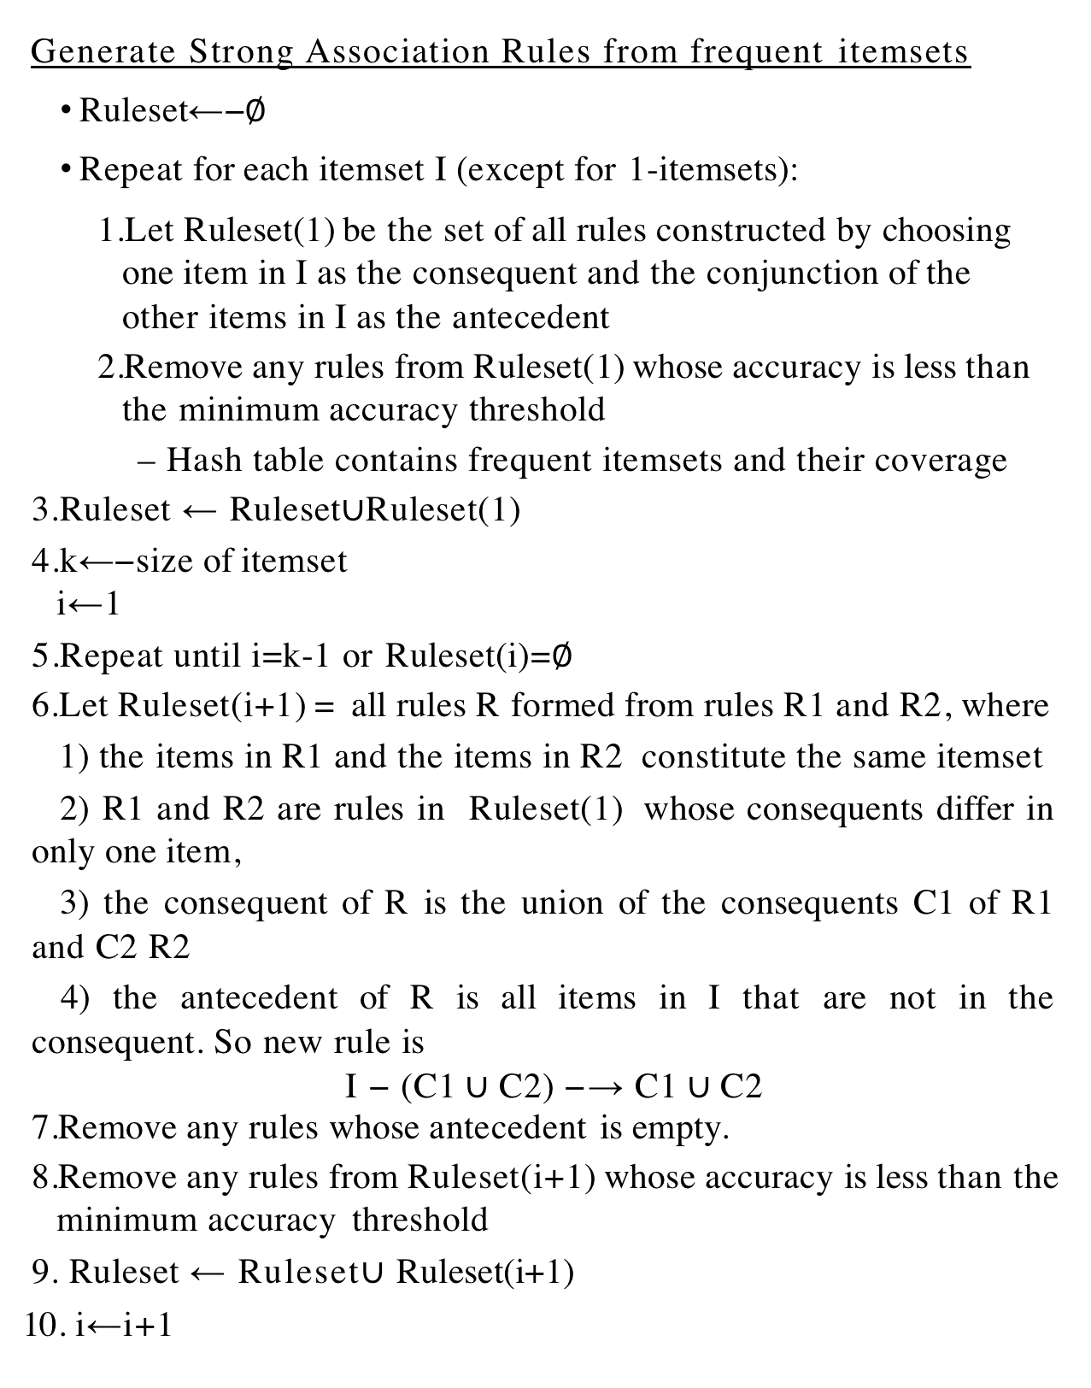
Generate Strong Association Rules from frequent itemsets
Ruleset←−∅
Repeat for each itemset I (except for 1-itemsets):
Let Ruleset(1) be the set of all rules constructed by choosing one item in I as the consequent and the conjunction of the other items in I as the antecedent
Remove any rules from Ruleset(1) whose accuracy is less than the minimum accuracy threshold
– Hash table contains frequent itemsets and their coverage
Ruleset ← Ruleset∪Ruleset(1)
k←−size of itemset i←1
Repeat until i=k-1 or Ruleset(i)=∅
Let Ruleset(i+1) = all rules R formed from rules R1 and R2, where
1) the items in R1 and the items in R2 constitute the same itemset
2) R1 and R2 are rules in Ruleset(1) whose consequents differ in only one item,
3) the consequent of R is the union of the consequents C1 of R1 and C2 R2
4) the antecedent of R is all items in I that are not in the consequent. So new rule is
I − (C1 ∪ C2) −→ C1 ∪ C2
Remove any rules whose antecedent is empty.
Remove any rules from Ruleset(i+1) whose accuracy is less than the minimum accuracy threshold
Ruleset ← Ruleset$∪$Ruleset(i+1)
10. i←i+1

Slide 10
From the frequent 2-itemsets, we get the following candidate rules Rule Accuracy
I1 | --> | I2 | 4/6
I2 | --> | I1 | 4/7
I1 | --> | I3 | 4/6
I3 | --> | I1 | 4/6
I1 | --> | I5 | 2/6
I5 | --> | I1 | 2/2
I2 | --> | I3 | 4/7
I3 | --> | I2 | 4/6
I2 | --> | I4 | 2/7
I4 | --> | I2 | 2/2
I2 | --> | I5 | 2/7
I5 | --> | I2 | 2/2
Remove those without minimum accuracy of 50%
Compute accuracy as coverage of itemset divided by coverage of antecedent
Rule |  | Accuracy
I1 --> | I2 | 4/6
I2 --> | I1 | 4/7
I1 --> | I3 | 4/6
I3 --> | I1 | 4/6
I5 --> | I1 | 2/2
I2 --> | I3 | 4/7
I3 --> | I2 | 4/6
I4 --> | I2 | 2/2
I5 --> | I2 | 2/2
From the frequent 3-itemsets, we get the following candidate rules with 1 item in the consequent
Rule
I1 AND I2 ---> I3 I1 AND I3 ---> I2 I2 AND I3 ---> I1
Accuracy 2/4
2/4
2/4
I1 AND I2 ---> I5 I1 AND I5 ---> I2 I2 AND I5 ---> I1
2/4
2/2
2/2
All have the required minimum accuracy of 50%
Now construct candidate rules with 2 items in the consequent. Combine only rules from above that are from the same itemset and differ by only 1 item in the consequent
Rule Accuracy

Slide 11
Rule
Accuracy
I1 ---> I3 AND I2 I2 ---> I3 AND I1 I3 ---> I2 AND I1
2/6
2/7
2/6
I1 ---> I5 AND I2 I2 ---> I5 AND I1 I5 ---> I2 AND I1
2/6
2/7
2/2
Remove rules that do not have the required minimum coverage
Rule
I5 ---> I2 AND I1
Accuracy 2/2

