Slide 1
Clustering
Overview
Clustering is the process of grouping objects together on the basis of similarity
A cluster is a group of objects that are similar to one another and dissimilar to objects in other clusters.
The objects being clustered do not have assigned classes a priori; instead the clustering process groups them — class labels can then be assigned to each cluster, if desired.
Thus clustering is unsupervised learning.
Advantages of clustering
Helps identify useful features that distinguish groups
Useful for outlier detection
– Example: detection of credit card fraud by recognizing unusual set of frequent, expensive transactions

Slide 2
K-means Clustering
1. Overview
Each cluster has a prototype (called its centroid) and a data item is assigned to the cluster whose prototype
it is closest to.
The prototype need not be an actual data item in the dataset.
Each data item is assigned to exactly one cluster.
Thus k-means partitions the dataset into distinct, non-overlapping clusters.

Slide 3
K-means Clustering
Algorithm
Specify a value for k, the number of clusters
Let C_{old}←∅
Randomly select k instances as cluster centers
Using a measure of similarity, assign each instance to the cluster whose center it is most similar to. Call this set of clusters C_{new}.
Repeat until C_{new}=C_{old} (or until at most 1% of the data items change clusters)
C_{old}←C_{new} and C_{new}←∅
Construct a new set of clusters C_{new}
For each cluster in C_{old}, compute the mean of the instances in the cluster, which is called the centroid, and make it the new center of a cluster in C_{new}.
Assign each instance in the dataset to the cluster in C_{new} whose centroid it is most similar to.

Slide 4
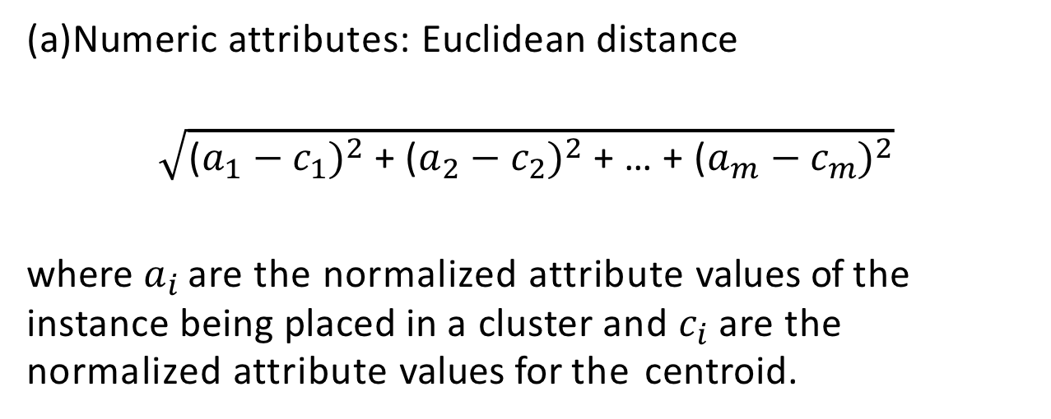
Objective function
The goal is to minimize some objective function that measures the goodness of the clustering
Typically, this is the sum of squared error of each data item from its centroid
Similarity measures (small values mean closer similarity)
Numeric attributes: Euclidean distance
$$\sqrt{{\text{(}a_{1}−c_{1})}^{2}\text{ + }{\text{(}a_{2}−c_{2})}^{2}\text{ + … + }{\text{(}a_{m}−c_{m})}^{2}}$$
where $a_{i}$ are the normalized attribute values of the instance being placed in a cluster and $c_{i}$are the normalized attribute values for the centroid.
Binary and categorical attributes:

Slide 5
Overall goal: Minimize the total squared error from each instance to its cluster’s centroid
But the minimization is local — there may be more globally optimum clusters
Final clusters are sensitive to initial selection of centers
Many approaches to selecting initial centers:
Thus run the clustering algorithm several times with a random seed used to select different initial cluster centers and choose the one that produces the smallest total squared error.

Slide 6
Selecting k
Start with k=1 and measure the total squared error
Increase k, compute the new clusters and the new total squared error
Determine the value of k that is best using elbow method or some variation
Advantages of K-means clustering
simple and efficient in both space and time
Typically works well
Limitations: due to SSE as objective function
Difficulty with clusters that are not globular
Difficulty with clusters that are close together and of different sizes
Difficulty with clusters that are close together and of different densities
Problems caused by outliers, which can produce wrong centroids

