Slide 1
Other Clustering Methods
Limitations of K-means Clustering
Cannot find “good” clusters when clusters have different sizes
Cannot find good clusters when clusters have different densities
Cannot find good clusters when clusters have non-spherical shapes.
K-means clustering’s “objective function is minimized by globular clusters of equal size and density or by clusters that are well separated”.

Slide 2
Other Clustering Methods
Density-based Clustering
Overview
Tries to cluster together points that are in a region that has a high density of points
Center-based approach (but there are many different approaches)
Counts the number of points within a specified radius of a point
Classifies points as one of the following
Core point: the number of points within the specified radius of the point reaches or exceeds some threshold — thus core points are dense points.
Border point: the point lies within the specified radius of a core point, but is not itself a core point
Noise points: a point that is neither a core point nor a border point

Slide 3
Other Clustering Methods
DBSCAN algorithm
Categorize each point as a core point, a border point, or a noise point.
Discard noise points
Put an edge between each pair of core points that are within the specified radius of one another.
Form clusters consisting of each set of connected core points. Thus dense regions that represent contiguous densities are merged, and will cause other points to enter the cluster.
Put border points in one of the clusters containing a core point that is within the specified radius of the border point. Thus border points are added to a cluster, but they do not cause additional points to be added.

Slide 4
Other Clustering Methods
DBSCAN algorithm
Selection of radius and threshold
Value of k is usually experimentally determined
k=4 has been found to be good for 2-dimensional data
Given k, hypothesize an appropriate radius
Method
For each data point, compute the distance to its k-th nearest neighbor.
Sort the data points in order according to the distance to its k-th nearest neighbor.
Plot the sorted values, where the y-axis is distance to k-th nearest neighbor and x-axis is number of data points
There will be a sharp rise at the value of distance that is an appropriate value for the radius.

Slide 5
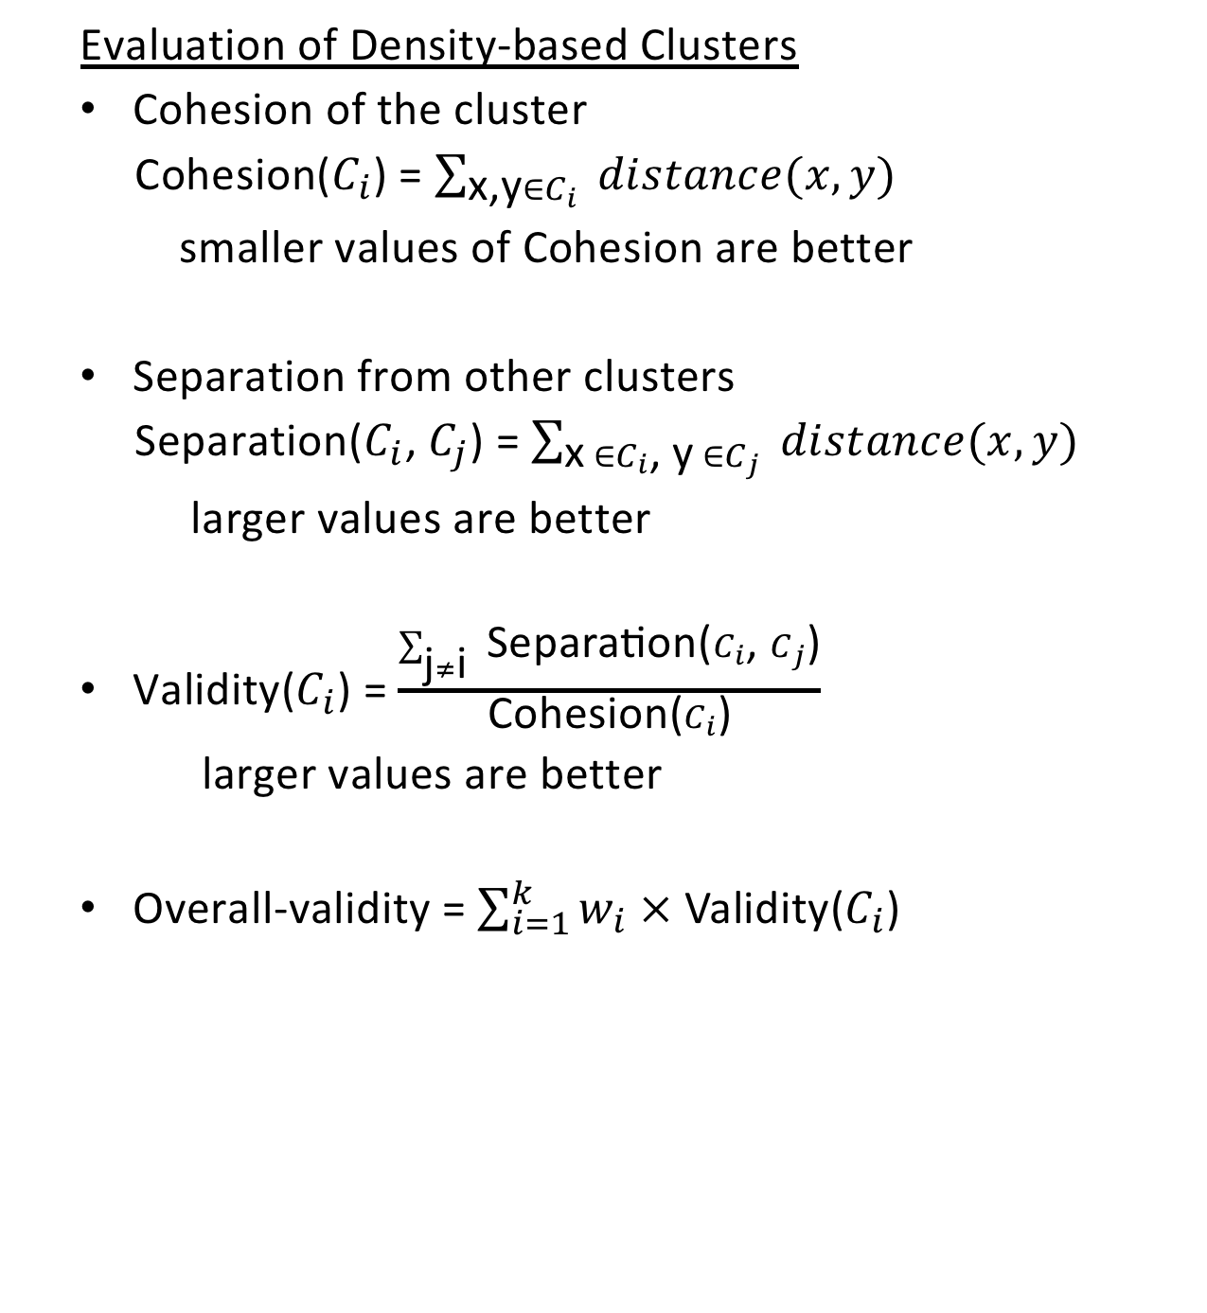
Other Clustering Methods
Evaluation of Density-based Clusters
Cohesion of the cluster
Cohesion($C_{i}$) = $\sum_{\text{x}\text{,}\text{y}∈C_{i} }{distance(x,y)}$
smaller values of Cohesion are better
Separation from other clusters
Separation($C_{i}$, $C_{j}$) = $\sum_{\text{x} ∈C_{i}\text{, }\text{y} ∈C_{j} }{distance(x,y)}$
larger values are better
Validity($C_{i}$) = $\frac{\sum_{\text{j}≠\text{i} }{\text{Separation}\text{(}C_{i}\text{,} C_{j}\text{)}}}{\text{Cohesion}\text{(}C_{i}\text{)}}$
larger values are better
Overall-validity = $\sum_{i=1}^{k}{w_{i} × \text{Validity}\text{(}C_{i}\text{) }}$

Slide 6
Selection of the radius and threshold
Value of k is usually experimentally determined; k=4 has been found to be good for 2 dimensional datasets
Given k, how do we hypothesize an appropriate radius?
Method
For each data point, compute the distance to its k-th nearest neighbor.
Sort the data points in order according to the distance to its k-th nearest neighbor.
Plot the sorted values, where the y-axis is distance to k-th nearest neighbor and x-axis is number of data points; thus x=500 and y=10 would mean that 500 data points had a distance of at most 10 to their k-th nearest neighbor.
There will be a sharp rise at the value of distance that is an appropriate value for the radius.

Slide 7
Advantages of density-based clustering
Density-based clustering can handle clusters of arbitrary shapes, not just globular clusters.
Density-based clustering is generally unhurt by noise.
Problems with DBSCAN
Can have difficulty with clusters that have widely varying density.
Has trouble with high-dimensional data since more difficult to define density.

