Slide 1
Statistical Clustering
Motivation
Rather than assigning an instance firmly to one cluster, develop a probability of the instance belonging to each cluster.
– The probability distributions for cluster C give the probability that an instance in cluster C would have a particular set of attribute values.
This removes the brittleness of methods that make hard and fast judgements

Slide 2
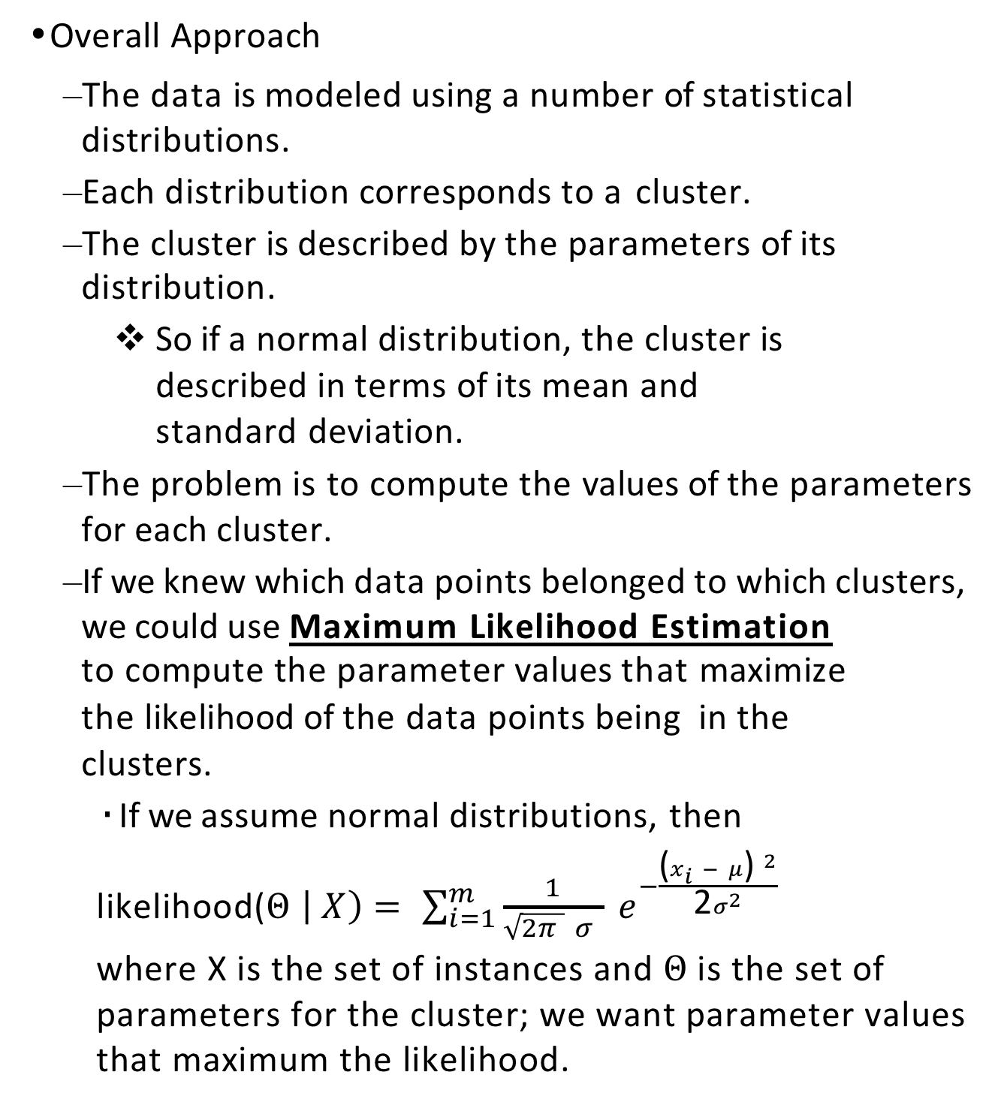
Statistical Clustering
Overall Approach
The data is modeled using a number of statistical distributions.
Each distribution corresponds to a cluster.
The cluster is described by the parameters of its distribution.
So if a normal distribution, the cluster is described in terms of its mean and standard deviation.
The problem is to compute the values of the parameters for each cluster.
If we knew which data points belonged to which clusters, we could use Maximum Likelihood Estimation
to compute the parameter values that maximize the likelihood of the data points being in the clusters.
If we assume normal distributions, then
likelihood($Θ \left| X\right)= \sum_{i=1}^{m}{\frac{1}{\sqrt{2π } σ } e^{−\frac{{\text{(}x_{i} − μ\text{) }}^{2}}{\text{2}σ^{2}} } }$
where X is the set of instances and $Θ$is the set of parameters for the cluster; we want parameter values that maximum the likelihood.

Slide 3
Statistical Clustering
Overall Methodology: Expectation-Maximization (EM) Algorithm
Expectation Step: For each instance, compute the probability that the instance is in each cluster.
Maximization Step: Compute the parameters that maximize this likelihood

Slide 4
Expectation-Maximization (EM) Algorithm:
1 numeric attribute**
Preliminaries
Each cluster has a probability distribution for its attribute — we’ll assume a normal distribution with a mean and standard deviation as its parameters.
The probability distribution of instances in cluster C_{j} gives the probability that an instance x_{i} with a particular attribute value would be in cluster C_{j} : P(C_{j} | x_{i})
There is also a cluster probability distribution reflecting the fact that some clusters are more likely than others

Slide 5
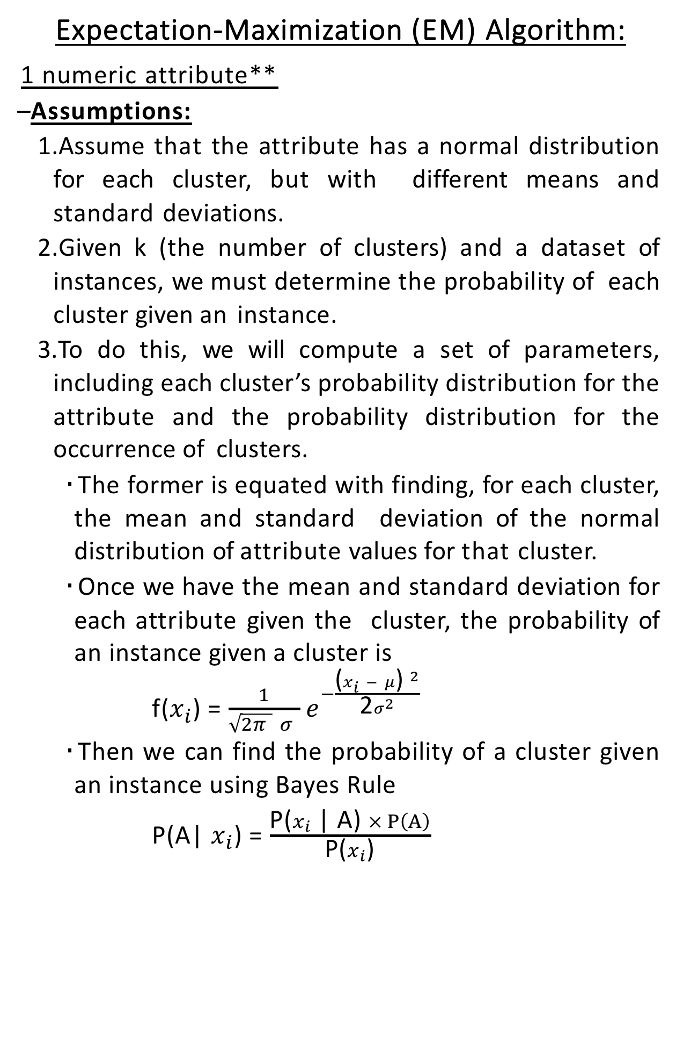
Expectation-Maximization (EM) Algorithm:
1 numeric attribute**
Assumptions:
Assume that the attribute has a normal distribution for each cluster, but with different means and standard deviations.
Given k (the number of clusters) and a dataset of instances, we must determine the probability of each cluster given an instance.
To do this, we will compute a set of parameters, including each cluster’s probability distribution for the attribute and the probability distribution for the occurrence of clusters.
The former is equated with finding, for each cluster, the mean and standard deviation of the normal distribution of attribute values for that cluster.
Once we have the mean and standard deviation for each attribute given the cluster, the probability of an instance given a cluster is
f($x_{i}$) = $\frac{1}{\sqrt{2π } σ }$ $e^{−\frac{{\text{(}x_{i} − μ\text{) }}^{2}}{\text{2}σ^{2}} }$
Then we can find the probability of a cluster given an instance using Bayes Rule
P(A| $x_{i}$) = $\frac{\text{P}\text{(}x_{i}\text{ | }\text{A}\text{) }× P\left(A\right)}{\text{P}\text{(}x_{i}\text{)}}$

Slide 6
Expectation-Maximization (EM) Algorithm:
1 numeric attribute**
Initialization
Suppose that we have two clusters (ie., k=2), referred to as A and B. Randomly distribute the instances in the dataset into A and B.
That is, Let p(x_{i} |A) = 1 if x_{i} was randomly assigned to cluster A and 0 otherwise. Do the same for cluster B.
Then guess the mean and standard deviation of each cluster by computing µ_{A}, σ_{A}, µ_{B} , σ_{B} for the instances assigned to each cluster.
Also guess the probability of each cluster by computing it as the proportion of instances in that cluster.

Slide 7
Expectation-Maximization (EM) Algorithm:
1 numeric attribute**
Expectation Step: Now for each instance, recompute the probability that the instance is in each cluster, given the current estimates for the parameters.
Compute the probability that each instance belongs to cluster A (P(A | x_{i})
Do the same for P(B | x_{i})
Do not need to compute the denominator P(x_{i}). Just compute the numerators for both clusters A and B, and then normalize by dividing by the sum of their numerators. (Recall that the sum of (P(A | x_{i}) and P(B | x_{i}) must equal 1.)
(Note that you do this for every instance, since each instance now has at least a small probability of being in each cluster.)
Maximization Step:
Recompute the estimates of the parameters (means and standard deviations) so that they maximize the likelihood of the distributions given the data. That is, use the probabilities of each instance being in each of the clusters to compute the means and standard deviations of the single attribute for each cluster and the probability of each cluster.
Recompute the probability of each cluster

Slide 8
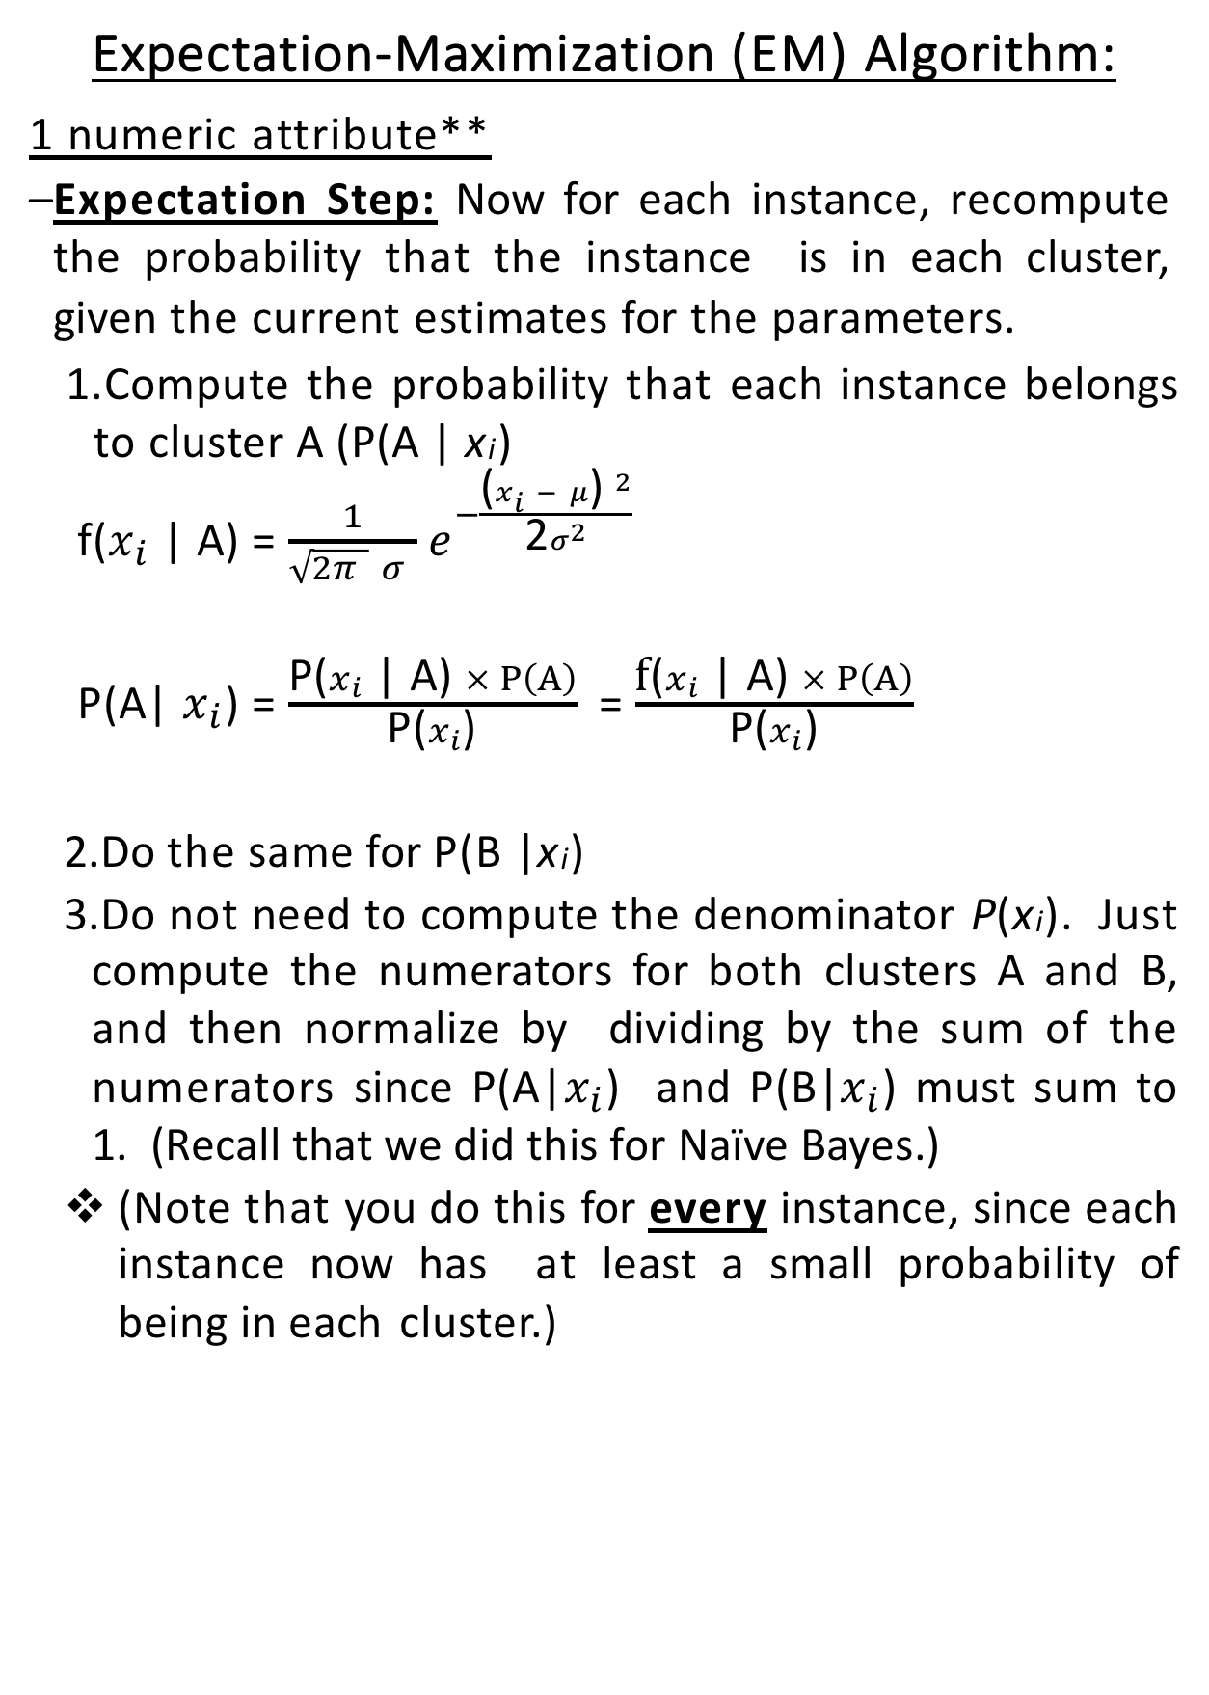
Expectation-Maximization (EM) Algorithm:
1 numeric attribute**
Expectation Step: Now for each instance, recompute the probability that the instance is in each cluster, given the current estimates for the parameters.
Compute the probability that each instance belongs to cluster A (P(A | x_{i})
f($x_{i}$ | A) = $\frac{1}{\sqrt{2π } σ }$ $e^{−\frac{{\text{(}x_{i} − μ\text{) }}^{2}}{\text{2}σ^{2}} }$
P(A| $x_{i}$) = $\frac{\text{P}\text{(}x_{i}\text{ | }\text{A}\text{) }× P\left(A\right)}{\text{P}\text{(}x_{i}\text{)}}$ = $\frac{\text{f}\text{(}x_{i}\text{ | }\text{A}\text{) }× P\left(A\right)}{\text{P}\text{(}x_{i}\text{)}}$
Do the same for P(B | x_{i})
Do not need to compute the denominator P(x_{i}). Just compute the numerators for both clusters A and B, and then normalize by dividing by the sum of the numerators since P(A|$x_{i}$) and P(B|$x_{i}$) must sum to 1. (Recall that we did this for Naïve Bayes.)
(Note that you do this for every instance, since each instance now has at least a small probability of being in each cluster.)

Slide 9
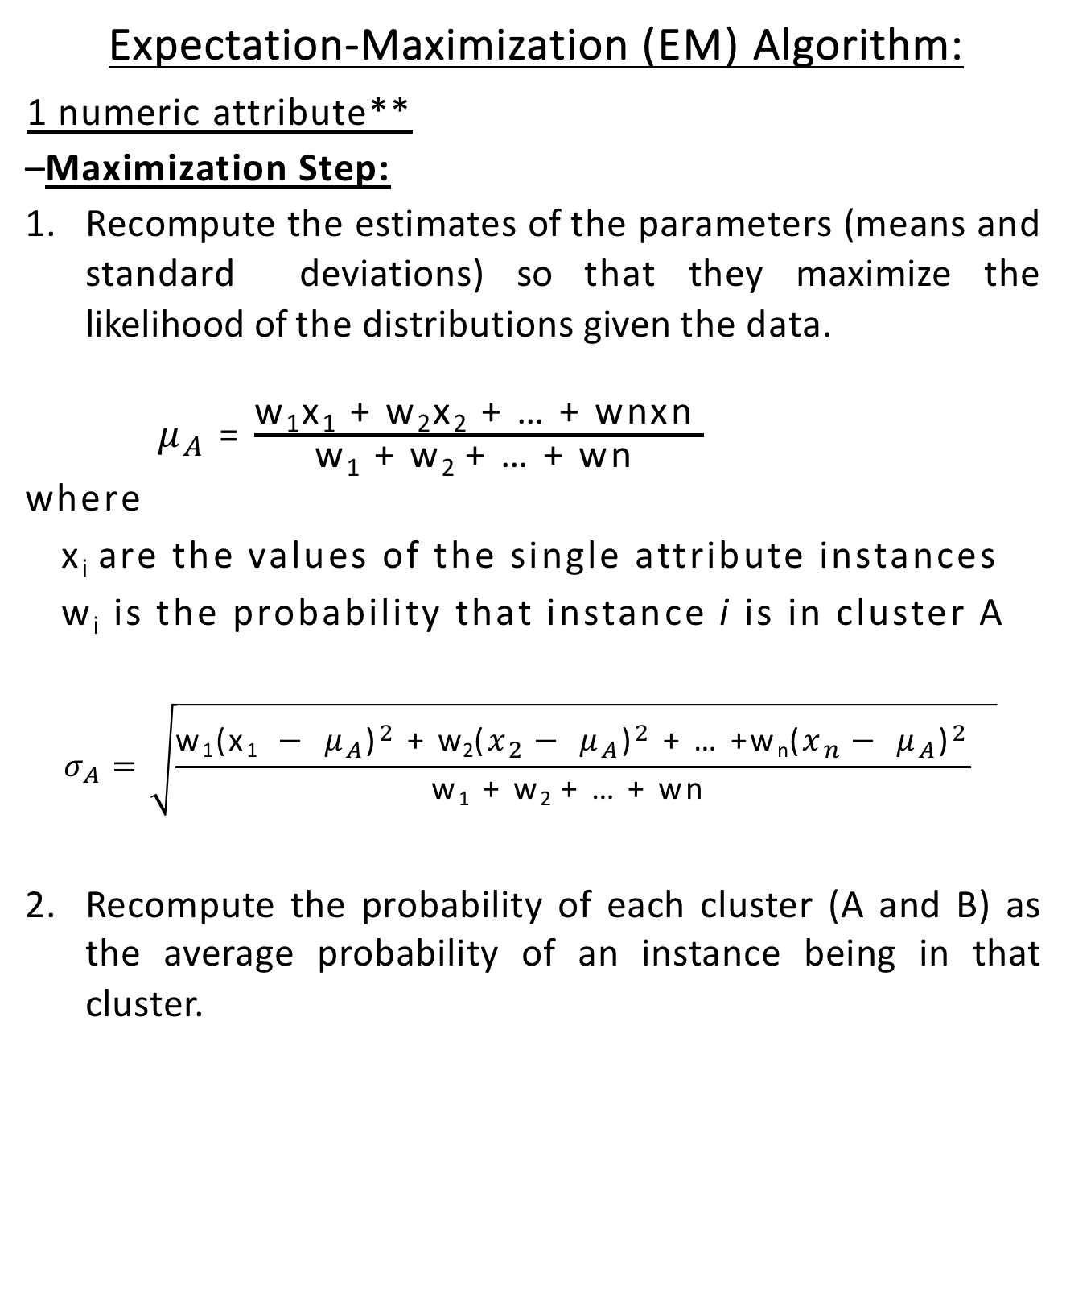
Expectation-Maximization (EM) Algorithm:
1 numeric attribute**
Maximization Step:
Recompute the estimates of the parameters (means and standard deviations) so that they maximize the likelihood of the distributions given the data.
$μ_{A}$ = $\frac{\text{w}\text{1}\text{x}\text{1}\text{ + }\text{w}\text{2}\text{x}\text{2}\text{ + … + }\text{wnxn} }{\text{w}\text{1}\text{ + }\text{w}\text{2 }\text{+ … + }\text{wn} }$
where
x_{i} are the values of the single attribute instances
w_{i} is the probability that instance i is in cluster A
$$σ_{A}=\sqrt{\frac{\text{w}\text{1}{\text{(}\text{x}\text{1} − μ_{A}\text{)}}^{2}\text{ + }{\text{w}\text{2}\text{(}x_{2}− μ_{A}\text{)}}^{2}\text{ + … +}\text{w}\text{n}{\text{(}x_{n}− μ_{A}\text{)}}^{2}}{\text{w}\text{1}\text{ + }\text{w}\text{2 }\text{+ … + }\text{wn} } }$$
Recompute the probability of each cluster (A and B) as the average probability of an instance being in that cluster.

Slide 10
Expectation-Maximization (EM) Algorithm:
1 numeric attribute**
Expanding to k clusters:
Initialization
Randomly assign the instances in the dataset to the k clusters.
Compute the mean and standard deviation of the single attribute for each cluster.
Estimate the probability of each cluster as the proportion of instances in that cluster.
Expectation Step: For each instance, compute the probability that it belongs to each of the clusters.
Maximization Step:
Compute the weighted mean and weighted standard deviation of the single attribute for each cluster.
Compute the probability of each cluster as the average probability of the instances being in that cluster.

Slide 11
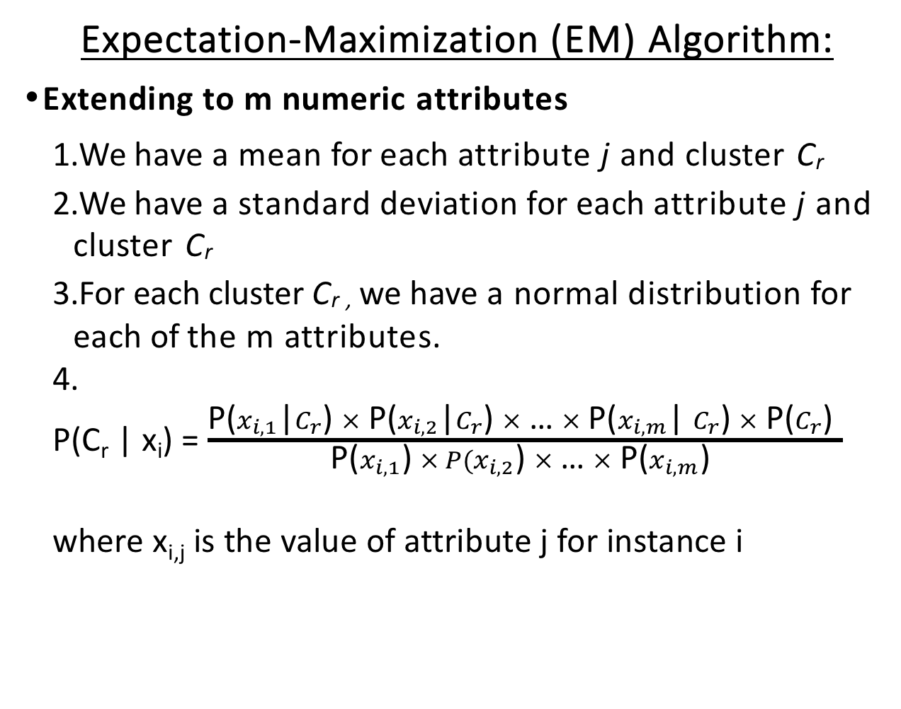
Expectation-Maximization (EM) Algorithm:
Extending to m numeric attributes
We have a mean for each attribute j and cluster C_{r}
We have a standard deviation for each attribute j and cluster C_{r}
For each cluster C_{r ,} we have a normal distribution for each of the m attributes.
4.
P(C_{r} | x_{i}) = $\frac{\text{P}\text{(}x_{i,1}\text{|}C_{r}\text{) }× \text{P}\text{(}x_{i,2}\text{|}C_{r}\text{) }×\text{ … }× \text{P}\text{(}x_{i,m}\text{| }C_{r}\text{) }× \text{P}\text{(}C_{r}\text{) }}{\text{P}\text{(}x_{i,1}\text{) }× P(x_{i,2}\text{) }×\text{ … }× \text{P}\text{(}x_{i,m}\text{) }}$
where x_{i,j} is the value of attribute j for instance i

Slide 12
Expectation-Maximization (EM) Algorithm:
Extending to nominal attributes
If a nominal attribute has v values, then instead of a normal distribution, we have v numbers representing the probability of each of the v nominal attribute values. (very similar to Naive Bayes)
Start by randomly dividing the instances between clusters and use the proportion of occurrences of each attribute value to get an initial estimate of the probability of each attribute value for each cluster.
Compute the probability of each cluster as the percentage of the instances initially assigned to that cluster.
Compute P(C_{r} | x_{i}) for each cluster C_{r} and instance x_{i}
Now when iterating, we will need to recompute P(x_{i,j} | C_{r})
For each possible value of attribute j, sum the probabilities for belonging to cluster C_{r} for the instances in the dataset that have that value of attribute j.
Divide the above value by the sum of the probabilities for belonging to cluster C_{r} for all of the instances in the dataset

Slide 13
Example:
2 clusters: C1 and C2
just 2 values for the nominal attribute, tall and short
Atrribute value tall: .4, .3, .2 for probability of being in cluster C1 Attribute value short: .8, .7 for probability of being in cluster C1

Slide 14
Statistical Clustering
Summary
Rather than assigning an instance firmly to one cluster, develop a probability of the instance belonging to each cluster.
– The probability distributions for cluster C give the probability that an instance in cluster C would have a particular set of attribute values.
This removes the brittleness of methods that make hard and fast judgements
Uses Expectation-Maximization
Can be adapted to other distributions besides a normal distribution
Other such clustering methods exist

