Slide 1
Comparing Classifiers
Suppose we want to compare two learning methods on the same problem to see which is better?
Procedure with unlimited data
Select k different datasets of the same size and perform cross-validation on each model M1 and M2, getting k success rates for each model
This produces k independent success rates for each model
Compute the mean success rate for each model: call these X_{M1} and X_{M2}
Now we want to determine whether, at some level of confidence c, we can say that the two means are different — ie., that X_{M1} − X_{M2} is not 0.
Let u be the true value of the mean of the success rates on the independent samples. Since the variance (and thus the standard deviation) is not exact but is instead estimated, the standardized distribution (one with mean 0 and standard deviation 1) has a Student’s distribution with (k-1) degrees of freedom (called a Student’s t-test), where k is the number of different datasets on which the models were evaluated.

Slide 2
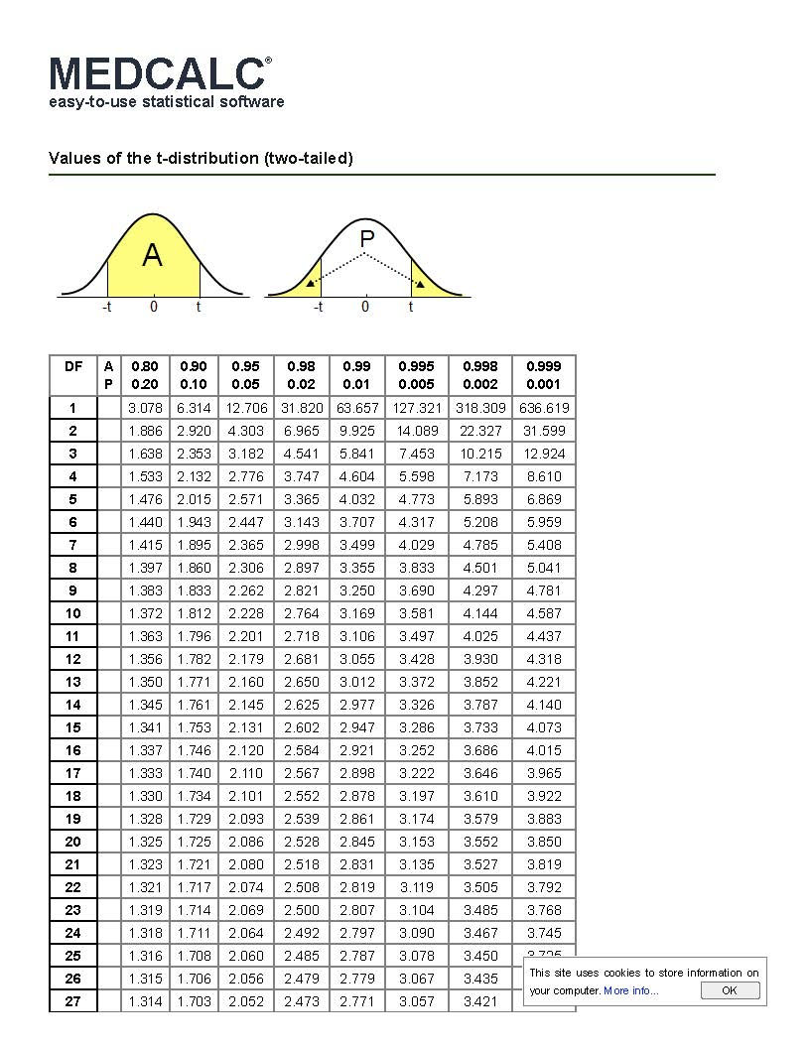

Slide 3
Comparing Classifiers
Procedure:
Let us assume that we have unlimited data and can divide the data into k equal-size test sets. We will test the two models M1 and M2 on each of the test sets, using 10-fold cross validation, thereby getting k success rates for each model (one for each of the k test sets).
We will do a pairwise comparison of the models M1 and M2 on the k test sets.
. Let d_{i} = x_{M1} - x_{M2} where x_{M1} and x_{M2} are the success rates of models M1 and M2 respectively on the i-th test set
Now we want to examine d* = (X_{M1} − X_{M2)*} which is the mean difference between the two

Slide 4
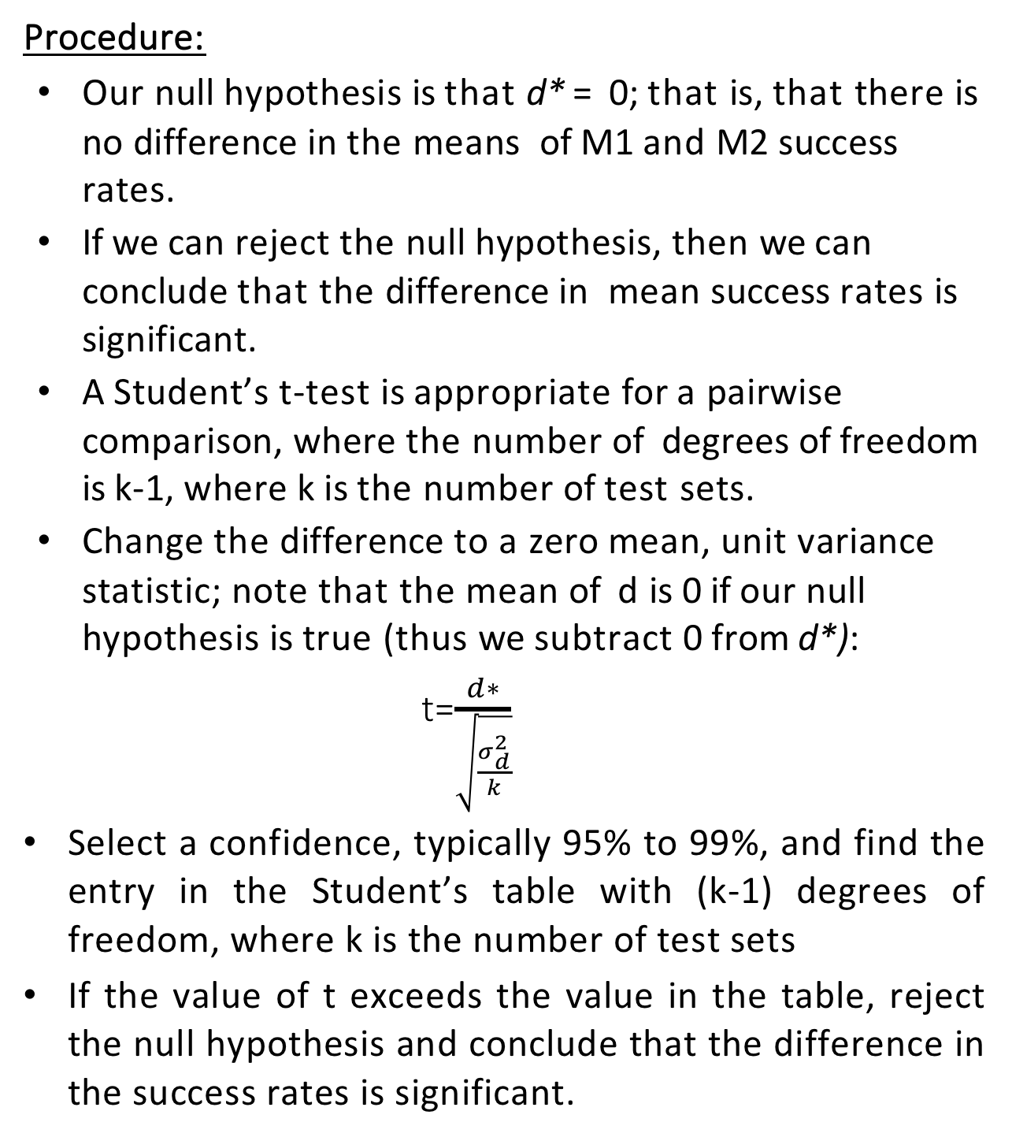
Comparing Classifiers
Procedure:
Our null hypothesis is that d* = 0; that is, that there is no difference in the means of M1 and M2 success rates.
If we can reject the null hypothesis, then we can conclude that the difference in mean success rates is significant.
A Student’s t-test is appropriate for a pairwise comparison, where the number of degrees of freedom is k-1, where k is the number of test sets.
Change the difference to a zero mean, unit variance statistic; note that the mean of d is 0 if our null hypothesis is true (thus we subtract 0 from d*):
t=$\frac{d∗}{\sqrt{\frac{σ_{d}^{2}}{k}}}$
Select a confidence, typically 95% to 99%, and find the entry in the Student’s table with (k-1) degrees of freedom, where k is the number of test sets
If the value of t exceeds the value in the table, reject the null hypothesis and conclude that the difference in the success rates is significant.

Slide 5
Example:
Suppose that we have done 10-fold cross validation 10 times and have obtained the following success rates for models M1 and M2:
M1: 70 73 78 72 73 76 75 76. 73 77
M2: 74 66 77 70 71 69 77 70 71 69
Let our desired confidence level be 95%

Slide 7
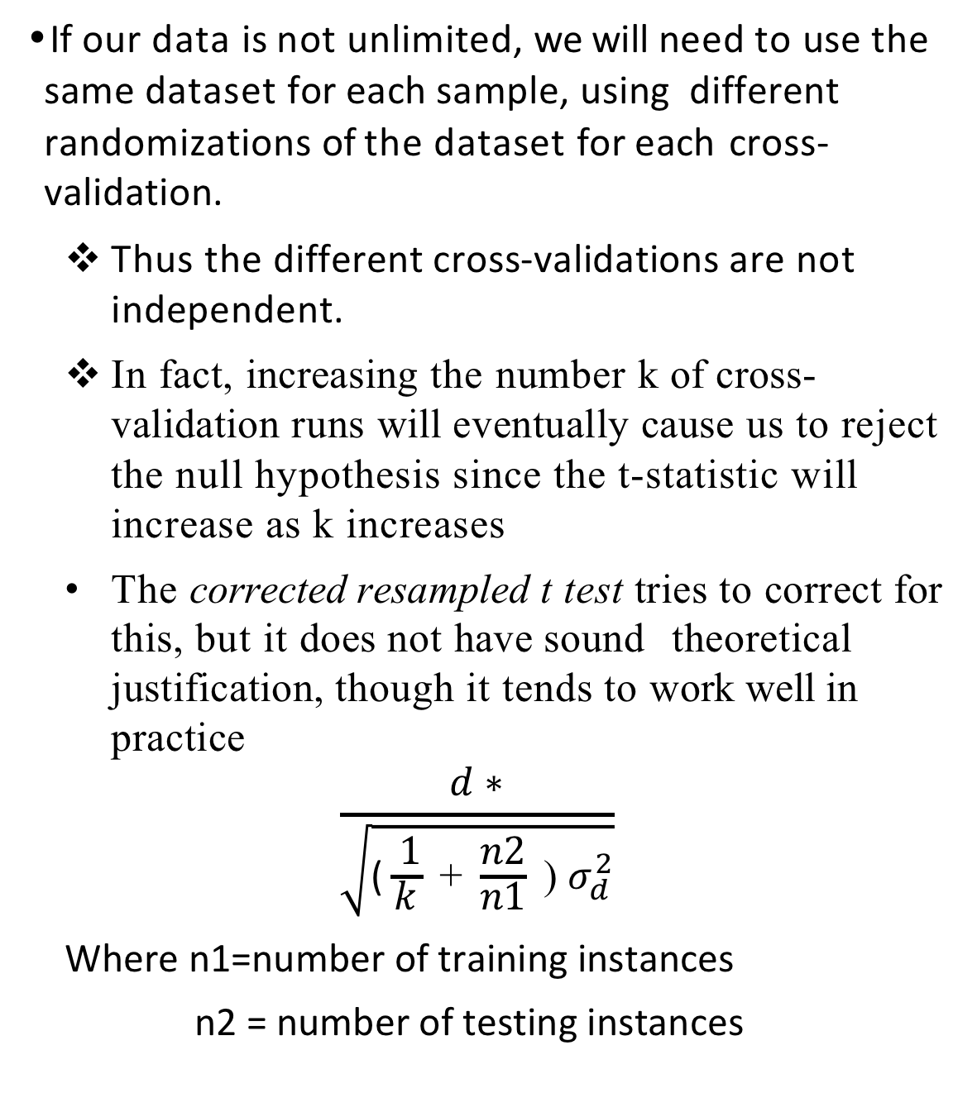
If our data is not unlimited, we will need to use the same dataset for each sample, using different randomizations of the dataset for each cross-validation.
Thus the different cross-validations are not independent.
In fact, increasing the number k of cross-validation runs will eventually cause us to reject the null hypothesis since the t-statistic will increase as k increases
The corrected resampled t test tries to correct for this, but it does not have sound theoretical justification, though it tends to work well in practice
$$\frac{d∗}{\sqrt{\text{(}\frac{ 1}{k}\text{ + }\frac{n2}{n1}\text{ ) }σ_{d}^{2}}}$$
Where n1=number of training instances
n2 = number of testing instances

Slide 8
Example:
Suppose that we have done 10-fold cross validation 10 times and have obtained the following success rates for models M1 and M2:
M1: 70 73 78 72 73 76 75 76. 73 77
M2: 74 66 77 70 71 69 77 70 71 69
Let our desired confidence level be 95%
And we have 1000 instances in the data set

