Slide 1
Pruning Decision Trees
Overfitting occurs when the learning method relies too heavily on replicating the examples in the training data and thus does not sufficiently generalize from them.
Methods for addressing overfitting
Prepruning: stop the construction of the decision tree at the point where overfitting would occur
Use a threshold on purity to decide when to stop splitting
Advantage: avoids the work of building subtrees that are later removed.
Disadvantage: difficult to determine what that threshold should be

Slide 2
Pruning Decision Trees
Postpruning: build the complete tree and then simplify it in some manner
Subtree replacement: Some subtrees are replaced with leaves
For each non-leaf node X whose children are all leaf nodes, analyze X to decide whether to replace the subtree rooted at X with a leaf node.
If the replacement is made, then we may have a new non-leaf node all of whose children are leaf nodes. If so, consider replacing it with a leaf.

Slide 3
Pruning Decision Trees
Subtree raising: Some subtrees are raised up and replace the parent of the subtree as the test condition
The root of each subtree in the decision tree represents a test condition
If decide to raise a subtree, then the test at the root of the subtree replaces the test in the parent of the subtree
All instances that were distributed on other branches of the parent of the subtree will need to be reclassified.

Slide 4
Pruning Decision Trees
How do you decide when to prune?
Reduced error pruning
Use a separate pruning set of data
Compute the error rate without pruning
Compute the error rate on the pruning set without pruning the subtree
Compute the error rate with pruning
Determine the class value for the root of the subtree if its leaves are pruned
Compute the error rate on the pruning set for the pruned tree
If the error rate is no greater with pruning than without pruning, then prune
Advantage: simplicity
Disadvantage: keeping a separate pruning set will reduce the amount of data available for training.

Slide 5
Pruning Decision Trees
Reduced Error Pruning Example:
Pruning set:
P-E=low branch: Buy: 3 Sell: 3 Hold: 1
P-E=medium branch: Buy: 4 Sell: 2 Hold: 2
P-E=high branch: Buy: 2 Sell: 2 Hold: 1
SECTOR
Pharmaceutical
Tech
Chemical
rising
P-trend
stable
falling
low
P-E
medium
high
Buy: 12
Sell: 15
Hold: 9

Slide 6
Pruning Decision Trees
How do you decide when to prune?
Pessimistic Error Pruning
Try to estimate the error of the pruned and unpruned trees via the training data
Find a confidence interval for the true error rate on the pruned and unpruned trees, based on the observed error rate on the training data
But only use the upper bounds on the confidence intervals, since the error rate on a separate pruning set would likely be higher than the error rate on the training data
Compare the pessimistic error rate for the pruned tree with the pessimistic error rate for the unpruned tree; if the error rate on the pruned tree is no greater than the error rate on the unpruned tree, then prune

Slide 7
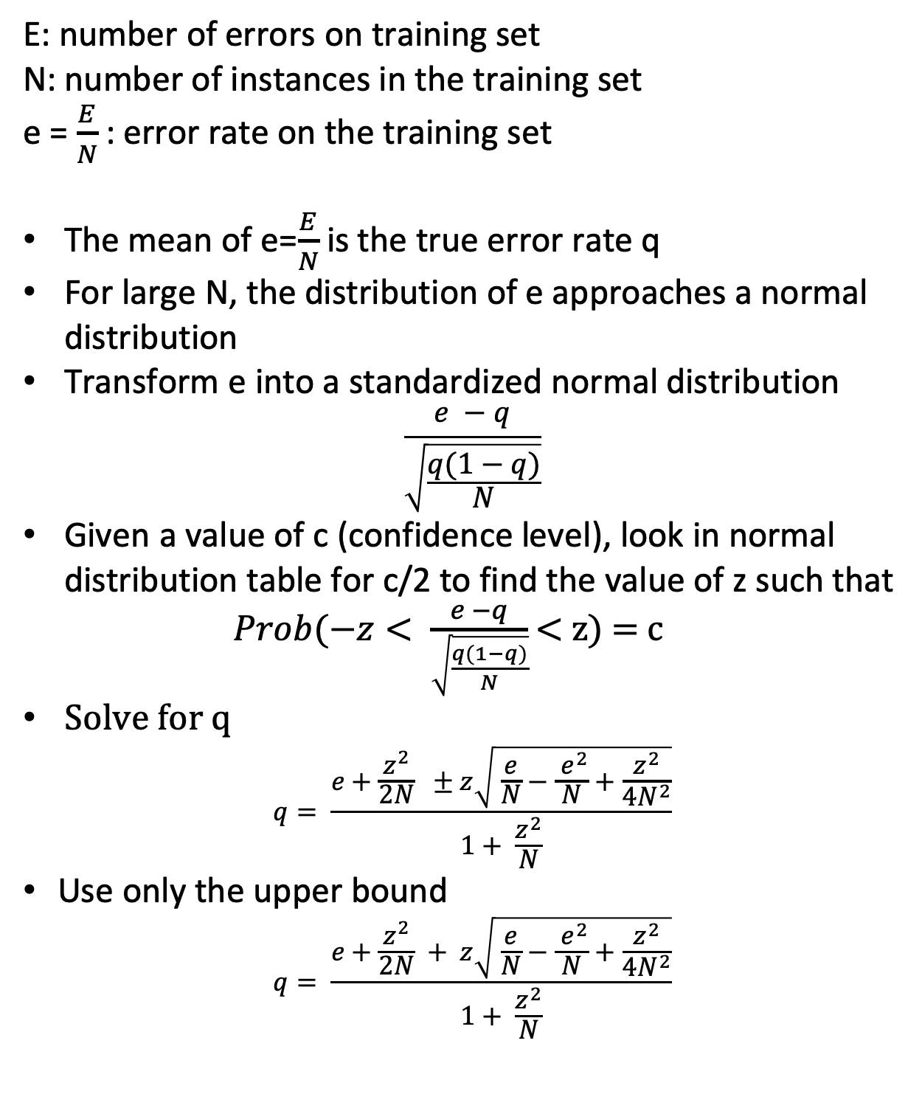
Pruning Decision Trees
E: number of errors on training set
N: number of instances in the training set
e = $\frac{E}{N}$ : error rate on the training set
The mean of e=$\frac{E}{N}$ is the true error rate q
For large N, the distribution of e approaches a normal distribution
Transform e into a standardized normal distribution
$$\frac{e −q}{\sqrt{\frac{q(1−q)}{N}}}$$
Given a value of c (confidence level), look in normal distribution table for c/2 to find the value of z such that
$Prob(−z< \frac{e −q}{\sqrt{\frac{q(1−q)}{N}}}$ < z) = c
Solve for q
$$q= \frac{e+\frac{z^{2}}{2N} ±z\sqrt{ \frac{e}{N}−\frac{{ e}^{2}}{N}+\frac{z^{2}}{4N^{2}}}}{1+ \frac{z^{2}}{N}}$$
Use only the upper bound
$$q= \frac{e+\frac{z^{2}}{2N} + z\sqrt{ \frac{e}{N}−\frac{{ e}^{2}}{N}+\frac{z^{2}}{4N^{2}}}}{1+ \frac{z^{2}}{N}}$$

Slide 8
Pruning Decision Trees
To apply this to the decision about whether to prune a subtree in subtree replacement:
Compute the pessimistic error rate without pruning
Estimate the pessimistic error rate for each leaf
Combine these into a weighted average, where the weighting is done by the proportion of instances that went to each leaf, to get a pessimistic error rate for the subtree without pruning
Compute the pessimistic error rate with pruning
Determine the class value for the root of the subtree if the leaves are pruned --- ie., if there is no test at the root of the subtree
Compute the pessimistic error rate for the root of the subtree if the leaves are pruned.
If the pessimistic error rate with pruning is less than or equal to the pessimistic error rate without pruning, then prune — it indicates that the test at the root (and thus adding the leaves) hurt the tree.

Slide 9
Pruning Decision Trees
Pessimistic Error Pruning:
Example (from Witten, pp. 195)
HPC: Health Plan Contributions
Compute pessimistic error rate for the unpruned HPC subtree with a confidence of 50%
Z value for .5/2 is .68
Leftmost leaf error rate is 2/6 = .33 and its pessimistic error rate from the equation is .47
Middle leaf error rate is .50 and its pessimistic error rate from the equation is .72
Right leaf error rate is 2/6 and its pessimistic error rate is .47
Weighting these, we get a pessimistic error rate for the unpruned tree of
(6/14)*.47 + (2/14)*.72 + (6/14)*.47 = .5057
Compute pessimistic error rate for the pruned subtree with a confidence of 50%
Z value for .5/2 is .68
Error rate for the pruned tree is 5/14 = .357 and its pessimistic error rate from the equation is .447
Since the error rate with pruning is not larger than the error rate without pruning, prune the tree --- ie., eliminate the HPC test
HPC
4 correct
2 wrong
1 correct
1 wrong
4 correct
2 wrong

