Slide 1
Dataset (predicting computer purchases)
AGE | INCOME | STUDENT | CREDIT-RATING | BUYS-COMPUTER
youth | high | no | fair | no-buy
youth | high | no | excellent | no-buy
middle-aged | high | no | fair | buy
senior | medium | no | fair | buy
senior | low | yes | fair | buy
senior | low | yes | excellent | no-buy
middle-aged | low | yes | excellent | buy
youth | medium | no | fair | no-buy
youth | low | yes | fair | buy
senior | medium | yes | fair | buy
youth | medium | yes | excellent | buy
middle-aged | medium | no | excellent | buy
middle-aged | high | yes | fair | buy
senior | medium | no | excellent | no-buy
Each line in the table captures an instance in the world
What are the attributes in this dataset?
Which attributes are predictor attributes?
What is the class attribute?
What are the values of the class attribute?
1

Slide 2
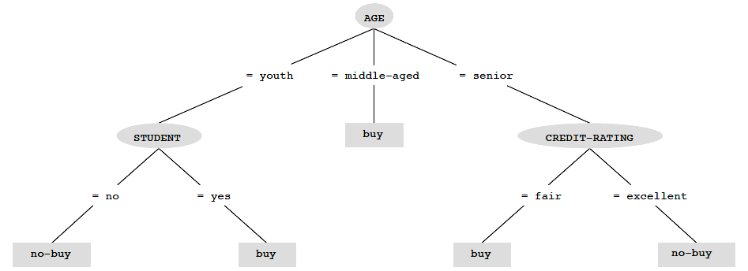
DECISION TREE
* Each internal node represents a test on the value of an
attribute
* Each branch from an internal node is labelled with a
possible value of the node’s attribute
* Leaf nodes specify the class value for data instances that
follow that path in the tree
* To classify a new instance, follow the path in the decision
tree that corresponds to the values of its attributes
AGE: senior
INCOME: medium
STUDENT: no
CREDIT-RATING: fair
AGE: youth
INCOME: low
STUDENT: no
CREDIT-RATING: fair

Slide 3
Constructing a Decision Tree
Must there be a different path for each value of a test attribute or can several attribute values follow the same path?
Must there be a branch for every possible value of a test attribute?
Must the sequence of tested attributes be identical for all paths?
Can an attribute be tested more than once on a given path or can an attribute only be used once on a given path?
How should the class value in a leaf node be determined?
How should the test attribute be determined at each node in the tree?
Exponentially many trees that could be constructed from a given set of data
There may be several different trees that fit the data
Typically, algorithms for constructing a decision tree take a greedy, divide-and-conquer approach

Slide 4
Constructing a Decision Tree
Want a decision tree that agrees on classifying the examples as much as possible and is the simplest possible
Intractable to get smallest decision tree
Can use heuristics to get a smallish one — test most significant attribute first
most significant attribute is the attribute that makes the most difference in the classification of the examples
The criteria for selecting the attribute to test and the labels on the branches is called the split criteria
The attribute that is selected for testing is called the split attribute

Slide 5
Constructing a Decision Tree
At an internal node of the tree (one which has instances with different classifications and for which the instances do not all have the same attribute values):
use the splitting criteria to select the best of the remaining attributes as the test or split attribute, along with the split point(s) or split subsets
insert a branch for each split point or split subset of the attribute’s values
distribute the node’s instances along the branches according to their value for the test attribute.

Slide 6
Constructing a Decision Tree
For each leaf node (one that is not an internal node):
if all of the data instances at that node have the same class value, then assign that class value as the answer to be returned
if a mixture of class values at the node and not all of the data instances have the same attribute values, then select a new split attribute and split further
If a mixture of class values at the node and all of the data instances have the same attribute values, then use majority vote to determine the class value to be returned
If no instances of data reach that node, then return the default answer computed from the majority class value at the parent node

Slide 7
Constructing a Decision Tree
Issues
Determine how to split the nodes (called the split criteria)
Determine when to stop splitting nodes

Slide 8
Split criteria
Split criteria refers to the criteria for selecting the best attribute for splitting a node
What is a good attribute?
* Need a measure of node purity/impurity

Slide 9
Information Gain approach
Overview of Entropy
Entropy measures the homogeneity of the examples
For 2 classes, pos and neg,
Entropy(S) = -Pr(pos)log₂Pr(pos) - Pr(neg) log₂Pr(neg)
Note that log₂(x) = the k such that 2^{k}=x
log₂1=0 log₂2=1 log₂4=2 log₂8=3 log₂16=4 log₂32=5
log₂(1/2)=-1 log₂(/4)=-2 log₂(1/8)=-3 log₂(1/32)=-5

Slide 10
Information Gain approach
Overview of Entropy
For 2 classes, pos and neg,
Entropy(S) = -Pr(pos)log₂Pr(pos) - Pr(neg) log₂Pr(neg)
Note that log₂(x) = the k such that 2^{k}=x
Example-1: | 8 | positive and 0 negative instances Entropy =
Example-2: | 4 | positive and 4 negative instances Entropy =
Example-3: | 1 | positive and 7 negative instances Entropy =

Slide 11
Information Gain approach
Overview of Entropy
For 2 classes, pos and neg,
Entropy(S) = -Pr(pos)log₂Pr(pos) - Pr(neg) log₂Pr(neg)
Note that log₂(x) = the k such that 2^{k}=x
Example-1: | 8 | positive and 0 negative instances
Entropy(S) | = = = | -(8/8)log(8/8) - (0)log(0) -(1)log(1) - 0 0
Example-2: | 4 | positive and 4 negative instances
Entropy(S) | = = = | -(4/8)log(4/8) - (4/8) log(4/8) -1/2 log(1/2) - (1/2) log(1/2) -(1/2)(-1) - (1/2)(-1)
= 1
Example-3: | 1 | positive and 7 negative instances
Entropy(S) | = | -(1/8)log(1/8) - (7/8)log(7/8)
 | = | -(1/8)(-3) - (7/8)(-.19)
 | = | .541

Slide 12
In general,
Entropy(S)=sum[-Pr(S_{i}) * log₂(S_{i})]
where S_{i} is S divided into n subsets S₁,S₂,. . .,S_{n}
High entropy equates with being from a uniform distribution — ie., with being from a distribution that provides little information about the value of an element.
Low entropy equates with being from a lopsided distribution — ie., with being from a distribution where one can better predict a randomly sampled element’s value
Possible values of entropy
Range of possible values of entropy for binary attribute is 0 to 1.
Range of possible values of entropy for k-valued attribute is 0 to log₂(k)
Thus for 20-valued attribute, possible values of entropy are 0 to 4.3

Slide 13

Weighted Entropy
To select the best attribute to split a node, one must consider the weighted entropy of the resulting child nodes
where parent node S is split into n subsets, one subset $S_{v}$ for each of the values v of attribute A.

Slide 14
Example
S has 6 positive and 6 negative instances
Class values are + and –
Attribute A1 has 3 values: X,Y,and Z
X:(0+, 2-) Y:(4+, 0-) Z:(2+, 4-)
Weighted-Entropy(S, A1) =
Attribute A2 has 4 values: R,S,T,and U
R:(1+,1-) S:(1+,1-) T:(2+,2-) U:(2+,2-)
Weighted-Entropy(S, A2) =

Slide 15
Example
S has 6 positive and 6 negative instances
Class values are + and –
Attribute A1 has 3 values: X,Y,and Z
X:(0+, 2-) Y:(4+, 0-) Z:(2+, 4-)
Weighted-Entropy(S, A1) =
(2/12)(0) + (4/12)(0) + (6/12)Entropy(2+,4-)
= (1/2)[(-2/6)log(2/6) - (4/6)log(4/6)]
= (1/2)[(-1/3)(-1.58) - (2/3)(-.58)]
= .454
Attribute A2 has 4 values: R,S,T,and U
R:(1+,1-) S:(1+,1-) T:(2+,2-) U:(2+,2-)
Weighted-Entropy(S, A2) =
[(2/12)(1) + (2/12)(1) + (4/12)(1) + (4/12)(1)]
= 1
So attribute A1 is better for splitting than attribute A2 since splitting on A1 produces a smaller weighted entropy.

Slide 16
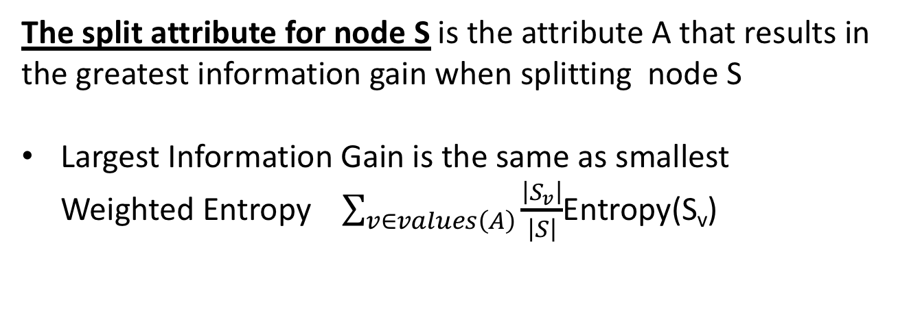
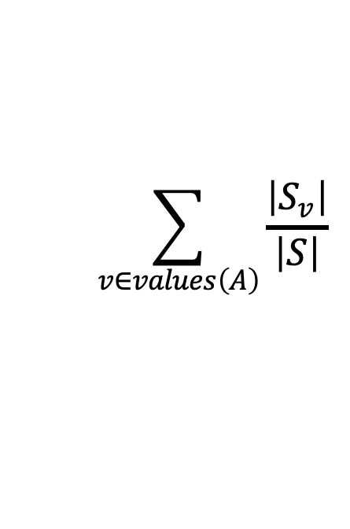
Information Gain
Information Gain measures the expected reduction in entropy resulting from partitioning the data instances according to the values of an attribute
$$\sum_{v∈values\left(A\right)}{\frac{\left|S_{v}\right|}{\left|S\right|}}$$
Entropy(S_{v})
Information Gain(S,A) = Entropy(S) -
where parent node S is split into n subsets, one subset S_{v} for each of the values v of attribute A.
The split attribute for node S is the attribute A that results in the greatest information gain when splitting node S
Largest Information Gain is the same as smallest Weighted Entropy $\sum_{v∈values\left(A\right)}{\frac{\left|S_{v}\right|}{\left|S\right|}}$Entropy(S_{v})
* The k values of attribute A are used to split node S into k subnodes
* Allows multiway splits (multiple branches from a node)

Slide 17
Example
S has 6 positive and 6 negative instances
Class values are + and –
Attribute A1 has 3 values: X,Y,and Z
X:(0+, 2-) Y:(4+, 0-) Z:(2+, 4-)
InfoGain(S, A1) =
Attribute A2 has 4 values: R,S,T,and U
R:(1+,1-) S:(1+,1-) T:(2+,2-) U:(2+,2-)
InfoGain(S, A2) =

Slide 18
Example
S has 6 positive and 6 negative instances
Class values are + and –
Attribute A1 has 3 values: X,Y,and Z
X:(0+, 2-) Y:(4+, 0-) Z:(2+, 4-)
InfoGain(S, A1) =
1 - (2/12)(0) - (4/12)(0) - (6/12)Entropy(2+,4-)
= 1 - (1/2)[(-2/6)log(2/6) - (4/6)log(4/6)]
= 1 - (1/2)[(-1/3)(-1.58) - (2/3)(-.58)]
= .546
Attribute A2 has 4 values: R,S,T,and U
R:(1+,1-) S:(1+,1-) T:(2+,2-) U:(2+,2-)
InfoGain(S, A2) =
1 - [(2/12)(1) - (2/12)(1) -(4/12)(1) -(4/12)(1)]
= 1 - 1
= 0
So attribute A1 is better for splitting than attribute A2 since splitting on A1 produces a larger information gain.

Slide 19
Example from Buy-Computer Dataset
Entropy(S) =
Entropy(Age=youth) =
Entropy(Age=middle-aged) =
Entropy(Age=senior) =
Weighted-Entropy(split on Age) =
InfoGain(S,Age) =
InfoGain(S,income) = .029
InfoGain(S,student) = .151
InfoGain(S,credit-rating) = .048
So choose Age as the split attribute

Slide 20
Example from Buy-Computer Dataset
Entropy(S) = -(9/14)log(9/14) - (5/14)log(5/14)
= -(9/14)(-.637) -(5/14)(-1.485)
= .4095 + .530
=.9395 or approximately .94
Entropy(Age=youth) = -(2/5)log(2/5) - (3/5)log(3/5)
= -(2/5)(-1.322) -(3/5)(-.737)
= .5288 + .4422
= .971
Entropy(Age=middle-aged) = -(4/4)log(4/4) -(0/4)log(0/4)
= 0 + 0
=0
Entropy(Age=senior) = -(3/5)log(3/5) -(2/5)log(2/5)
=.971
InfoGain(S,Age) = .94 - [(5/14)(.971) + (4/14)(0) + (5/14)(.971)
= .94 - .694
= .246
InfoGain(S,income) = .029
InfoGain(S,student) = .151
InfoGain(S,credit-rating) = .048
So choose Age as the split attribute

