Slide 1
Discretizing Numeric Attributes
Decision trees rely on nominal attributes; so must discretize numeric-valued attributes into nominal classes (in this case, intervals)

Slide 2
Approaches to Discretization
Supervised versus unsupervised discretization
Supervised discretization uses the class values during the discretization.
Unsupervised discretization does not consider the class values.
Top-down versus bottom-up discretization
Top-down discretization starts with one large interval and then recursively breaks intervals into smaller intervals
Bottom-up discretization starts with the individual numeric values in the training set and builds up intervals by grouping them together.
Local versus global discretization
Global discretization occurs when we discretize the numeric attributes before learning begins, and then use this same discretization throughout learning.
Local discretization occurs when we discretize as necessary during the learning process
the division of values depends on the situation at the time the discretization is needed; for a decision-tree, the discretization would depend on the instances residing in the node that is to be split.

Slide 3
Methods
Equal-interval Binning
Divide the overall set of numeric values into k equal intervals.
Example: Buy-Computer dataset
attribute values for AGE:
13 14 16 19 20 21 29 35 44 55 58 62 64 68
N Y N N Y Y Y Y Y N Y Y N Y
Advantage: very easy to implement
Disadvantages:
likely to choose poor boundaries between bins — ie., instances at the end of one bin may be the same class as instances at the beginning of the adjacent bin.
may have intervals with few or no instances from the training set

Slide 4
Methods
Equal-frequency Binning
Divide the instances into k bins, with the same number of instances from the training set falling into each bin.
Example: Buy-Computer dataset
attribute values for AGE:
13 14 16 19 20 21 29 35 44 55 58 62 64 68
N Y N N Y Y Y Y Y N Y Y N Y
Advantage: overcomes the problem of bins having very different numbers of instances from the training set
In practice, often produces very good results when the number of bins is based on the available data — set number of bins to the square root of the number of instances in the training data.
Disadvantage: can still have adjacent bins with instances at the end of one bin having the same class as instances at the beginning of the next bin.

Slide 5
Methods
Global Entropy-based discretization
Procedure
Compute the weighted entropy for each possible split point between attribute values in the training set
Select the division that produces the largest decrease in entropy — ie.,the biggest difference in entropy between the interval’s entropy and the weighted entropy of the split interval.
Place the threshold as midway between the values on either side of the split point in the dataset
Recurse until a stopping criteria is satisfied.
Decrease in entropy for all possible splits points is less than some threshold
Number of intervals exceeds a threshold
Minimum Distance Length (MDL) principle

Slide 6
Example of Global Entropy-based Discretization
Example: Buy-Computer dataset
attribute values for AGE:
13 14 16 19 20 21 29 35 44 55 58 62 64 68
N Y N N Y Y Y Y Y N Y Y N Y

Slide 7
Methods
Global Entropy-based discretization
Advantages
Uses class information, so likely to provide a discretization that will be useful during learning
Entropy-based discretization, especially with the MDL stopping criteria, is one of the best supervised discretization techniques
Disadvantages
More time-consuming to do
but can be done off-line before learning
however, must make sure to use the same discretized intervals during testing as were constructed for training.

Slide 8
Methods
Local Entropy-Based Discretization for Decision Trees
Procedure
Use reduction in entropy to determine the best binary split point for each numerical attribute where all of the values less than or equal to V_{k} are in one partition and all values greater than V_{k} are in the other partition
Select the attribute with the maximum reduction in impurity as the split attribute — if that attribute is numerical, then use its split point to construct the two branches

Slide 9
Methods
Local Entropy-Based Discretization for Decision Trees
Procedure
Use reduction in entropy to determine the best binary split point for each numerical attribute where all of the values less than or equal to V_{k} are in one partition and all values greater than V_{k} are in the other partition
Select the attribute with the maximum reduction in impurity as the split attribute — if that attribute is numerical, then use its split point to construct the two branches
Whereas only test once on a nominal attribute when using information gain or gain ratio, can test multiple times on a numeric attribute since have not exhausted its information contribution with a binary split
Could allow multiway test on a numeric attribute, but this gets harder to implement

Slide 10
Methods
Chi-squared based discretization
Start with n-intervals, where n is the number of instances in the training data
Compute the Chi-square test for each pair of adjacent intervals.
Merge the intervals for which the Chi-square value is smallest and does not exceed a critical value
Repeat until some stopping criteria
One stopping criteria is that no pair of adjacent intervals has a Chi-square value that is lower than some threshold

Slide 11
Chi-Square Test
For our purposes, the Chi-square test determines whether the intervals differentiate the attributes class values — ie., whether presence in one interval suggests a different class value than presence in the other interval. If not, then the intervals can be considered for merging.
Our null hypothesis is that the intervals do not differentiate the attributes class values.

Slide 12
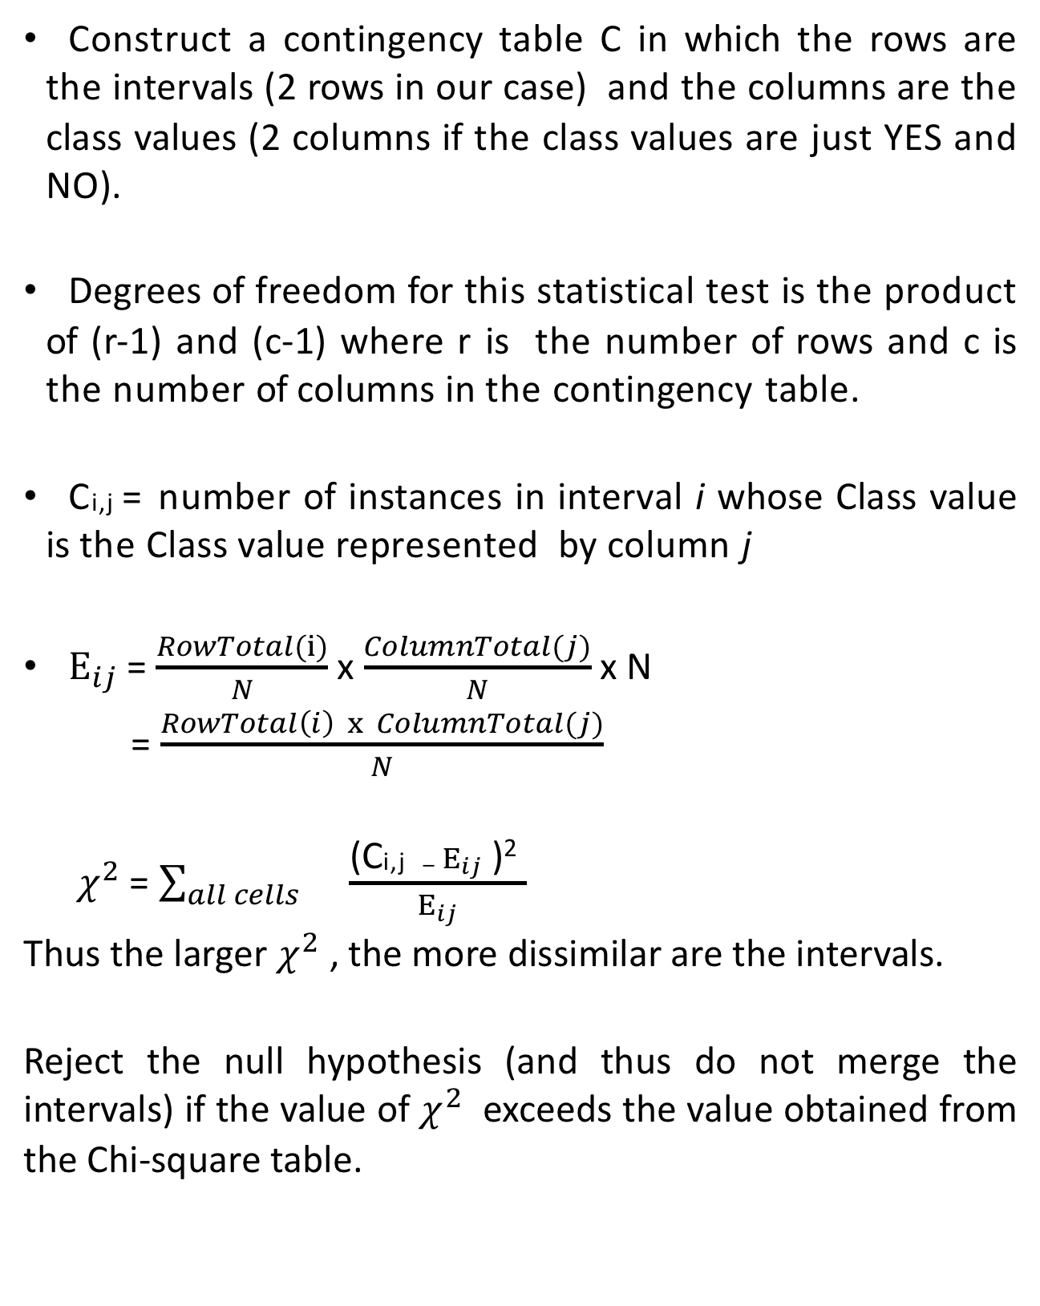
Chi-Square Test
Construct a contingency table C in which the rows are the intervals (2 rows in our case) and the columns are the class values (2 columns if the class values are just YES and NO).
Degrees of freedom for this statistical test is the product of (r-1) and (c-1) where r is the number of rows and c is the number of columns in the contingency table.
C_{i,j} = number of instances in interval i whose Class value is the Class value represented by column j
$E_{ij}$ = $\frac{RowTotal(i)}{N}$ x $\frac{ColumnTotal(j)}{N}$ x N
= $\frac{RowTotal\left(i\right) x ColumnTotal(j)}{N}$
$χ^{2}$ = $\sum_{all cells}{}\frac{\text{(}\text{C}\text{i}\text{,}\text{j} − E_{ij}\text{ )}\text{2} }{E_{ij}}$
Thus the larger $χ^{2}$ , the more dissimilar are the intervals.
Reject the null hypothesis (and thus do not merge the intervals) if the value of $χ^{2}$ exceeds the value obtained from the Chi-square table.

Slide 13
Methods
Chi-squared based discretization
Start with n-intervals, where n is the number of instances in the training data
Compute the Chi-square test for each pair of adjacent intervals.
Merge the intervals for which the Chi-square value is smallest and does not exceed a critical value
Repeat until some stopping criteria
One stopping criteria is that no pair of adjacent intervals has a Chi-square value that is lower than some threshold

