Slide 1
Evaluation
Terms
Def. A true positive (TP) for a given class is an instance that is correctly classified by a model as being in that class.
Def. A false positive (FP) for a given class is an instance that is incorrectly classified by a model as being in that class.
Def. A true negative (TN) for a given class is an instance that is correctly classified by a model as not being part of the class.
Def. A false negative (FN) for a given class is an instance that a model incorrectly classifies as not being part of that class.
Def. The true positive rate for a given class is the number of true positives (TP) divided by the total number of instances that are in that class (TP+FN).
Def. The false positive rate for a given class is the number of false positives (FP) divided by the total number of instances that are not in that class (TN+FP).
Weka reports true positive rate and False positive rate by class value.

Slide 2
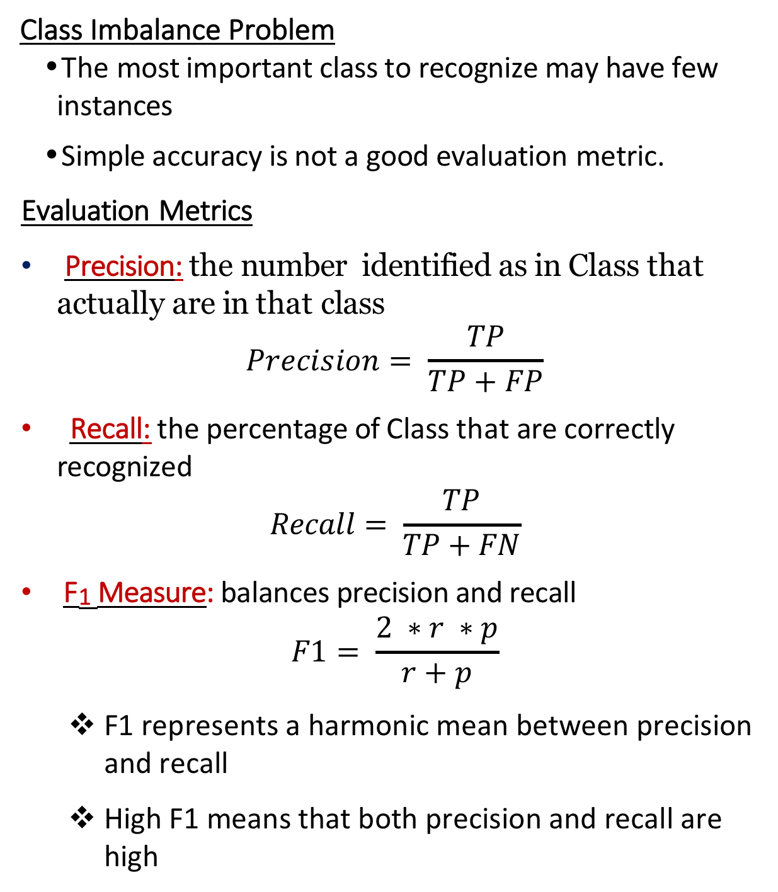
Evaluation
Class Imbalance Problem
The most important class to recognize may have few instances
Simple accuracy is not a good evaluation metric.
Evaluation Metrics
Precision: the number identified as in Class that actually are in that class
$$Precision= \frac{TP}{TP+FP}$$
Recall: the percentage of Class that are correctly recognized
$$Recall= \frac{TP}{TP+FN}$$
F₁ Measure: balances precision and recall
$$F1= \frac{2 ∗r ∗p}{r+p}$$
F1 represents a harmonic mean between precision and recall
High F1 means that both precision and recall are high

Slide 3
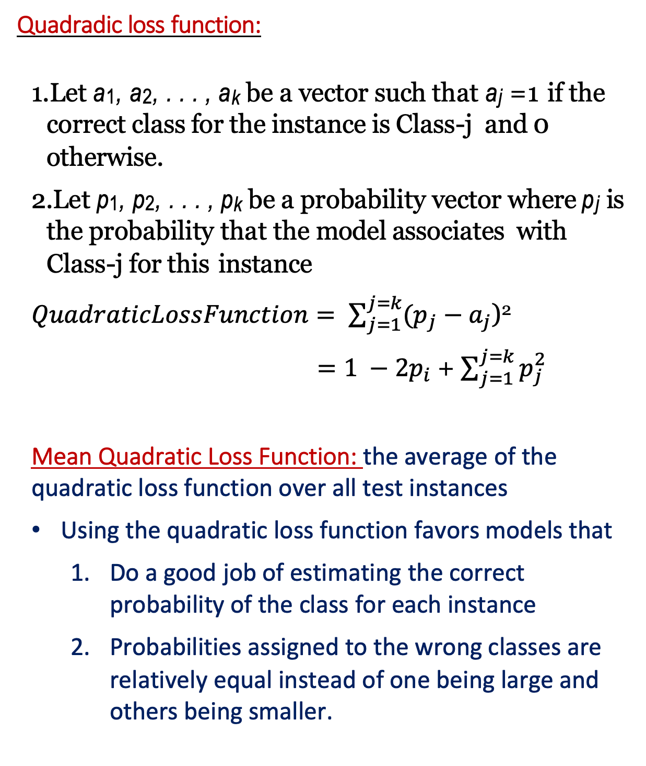
Evaluation of Models that Predict Probabilities
Quadradic loss function:
Let a₁, a₂, . . . , a_{k} be a vector such that a_{j} =1 if the correct class for the instance is Class-j and 0 otherwise.
Let p₁, p₂, . . . , p_{k} be a probability vector where p_{j} is the probability that the model associates with Class-j for this instance
$QuadraticLossFunction= \sum_{j=1}^{j=k}{(p_{j}}−a_{j}$)²
$=1 −2p_{i}$ + $\sum_{j=1}^{j=k}{p_{j}^{2}}$
Mean Quadratic Loss Function: the average of the quadratic loss function over all test instances
Using the quadratic loss function favors models that
Do a good job of estimating the correct probability of the class for each instance
Probabilities assigned to the wrong classes are relatively equal instead of one being large and others being smaller.

Slide 4
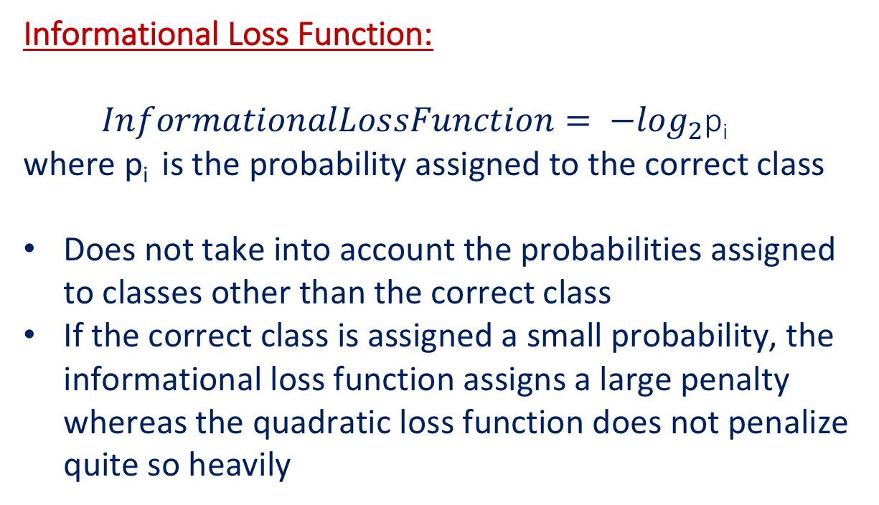
Evaluation of Models that Predict Probabilitiea
Informational Loss Function:
$InformationalLossFunction= {−log}_{2}$p_{i}
where p_{i} is the probability assigned to the correct class
Does not take into account the probabilities assigned to classes other than the correct class
If the correct class is assigned a small probability, the informational loss function assigns a large penalty whereas the quadratic loss function does not penalize quite so heavily

Slide 5
Evaluation of Models that Predict Probabilities
ROC Curve: (receiver operating characteristic curve):
A graph that depicts the tradeoff between the true positive rate (sensitivity) and the false positive rate for a class
structure of ROC curve
x-axis is false positive rate
y-axis is true positive rate
Order test instances by probability of the class
For each test instance, note whether or not it is actually in the class
Starting at the top of the list, draw a line after each test instance and plot the x,y coordinates at this point under the assumption that the model has classified all test instances above the line as in the class

Slide 6
Evaluation of Models that Predict Probabilities
ROC Curve:
Diagonal line from (0,0) to (1,1) represents the situation where the model does not improve over a random selection
A model that is good at estimating probabilities will have a curve that is substantially above the diagonal
The closer the ROC curve is to the diagonal, the less accurate is the model
AUC: (Area Under Curve) gives a rough estimation of the quality of the model
The closer AUC is to .5, the weaker the model

Slide 7
Example: 20 test instances, 12 are in the class
Test-instance | Probability | In-Class ?
X | .99 | YES
K | .98 | YES
A | .98 | NO
R | .96 | YES
B | .96 | YES
Y | .96 | YES
Z | .95 | NO
E | .93 | NO
G | .90 | YES
1.0
__
TP
__
.8
__
__
.6
__
__
.4
__
__
.2
__
.2
.4
.6
.8
1.0
FP

Slide 8
Cost-sensitive Evaluation
A cost matrix C is a square matrix where the entries are the costs associated with each misclassification
Entry C_{ij} represents the cost of misclassifying a Class-I instance as Class-j
Entries on the diagonal are 0
To evaluate a model, compute the model’s cost as the average cost of the classifications for each of the instances in the test set
The model with the lowest average cost is the best
Example:
Cost Matrix Confusion Matrix
A B C A B C
0 3 2 A 40 10 0 A
5 0 3 B 20 5 0 B
2 1 0 C 10 0 15 C
Cost = ?

Slide 9
Cost-sensitive Model Construction
Instead of selecting the prediction with the greatest probability, compute the expected cost for each prediction and choose the prediction that results in the lowest expected cost.
Example:
Given an instance for which the model, such as Naive Bayes, would predict the following probabilities for each class value: Class-1: prob = .45 Class-2: prob = .35 Class-3: prob = .2
Cost matrix:
Actual Class Predicted Class
Class-1 Class-2 Class-3
Class-1 0 3 3
Class-2 5 0 3
Class-3 2 1 0
What is the cost of each prediction?
Cost Class-1
Cost Class-2
Cost Class-3

Slide 10
Using the Model to Maximize Return
If the model associates a probability with each prediction, the the model can be used to select entities that will be the most productive according to some cost criteria.
Construct a classification model that assigns a probability to the likelihood that an instance will be a positive one.
Given a new set of instances, use the model to classify them and sort the instances according to the probability that they will be positive instances, from most likely to least likely.
To identify a set of size n such that the set has the greatest proportion of positive instances, select the top n instances in the sorted list.
To get the largest sample with an accuracy of at least Y, move down the ordered list selecting elements until the accuracy equals Y on the test set — then select the same proportion of instances from the new set.
The lift factor is the degree to which the model is estimated to improve the proportion of positive instances. It is computed on the test set as the proportion of the selected subset that is positive instances divided by the proportion of the whole test set that is positive instances.

Slide 11
Example:
Test set has 100,000 instances
Response rate to telephone solicitation is 1%
Model assigns probability of purchase to instances in the test set and the top 5000 are selected.
150 of these test instances purchased the product.
What is the lift factor?

Slide 12
Using the Model to Maximize Return
Lift Chart: is a graphical depiction of the lift provided by a model for different sizes of the selected subset.
x-axis represents the subset size as a percent of the total test set
y-axis represents the number of positive instances in the subset, from 0 to the number of positive instances in the full test set
Plot points for each subset size by counting the number of positive instances in the subset.
Diagonal line (not necessarily at 45 degree angle) estimates the number of positive instances if a sample of size X where randomly selected from the test set
Thus want to be far above the diagonal
Also prefer to be to the left side of the chart

Slide 13
Using the Model to Maximize Return
Example of Lift Chart:
Number sent Number of responses
100 40
200 70
300 80
400 93
500 96
600 98
700 99
800 100
900 100
1000 100
# of positive instances
% of test set

Slide 14
Using the Model to Maximize Returns
If one knew the costs of a mailout with no response (ie., the cost of mailing) and the profit from a response, then would could compute the cost/profit for mailouts of increasing size and identify the most profitable
Example:
Profit from a sale = $5
Cost of a mailing (with no response) = $2
CUSTOMER PROBABILITY OF RESPONSE
A .98
B .90
C .83
D .83
E .80
When should one stop mailouts?

