Slide 1
Instance-based Representation and Mining
Motivation
Suppose instead of developing a generalized model from a set of instances, we store the instances themselves and use them to classify a new instance.
Thus the “work” is done when the new instance is presented for classification, instead of when the training instances are encountered
Called a lazy learner since it postpones the work as long as possible, as opposed to eager learners that develop a generalized model as soon as the training data is encountered.

Slide 2
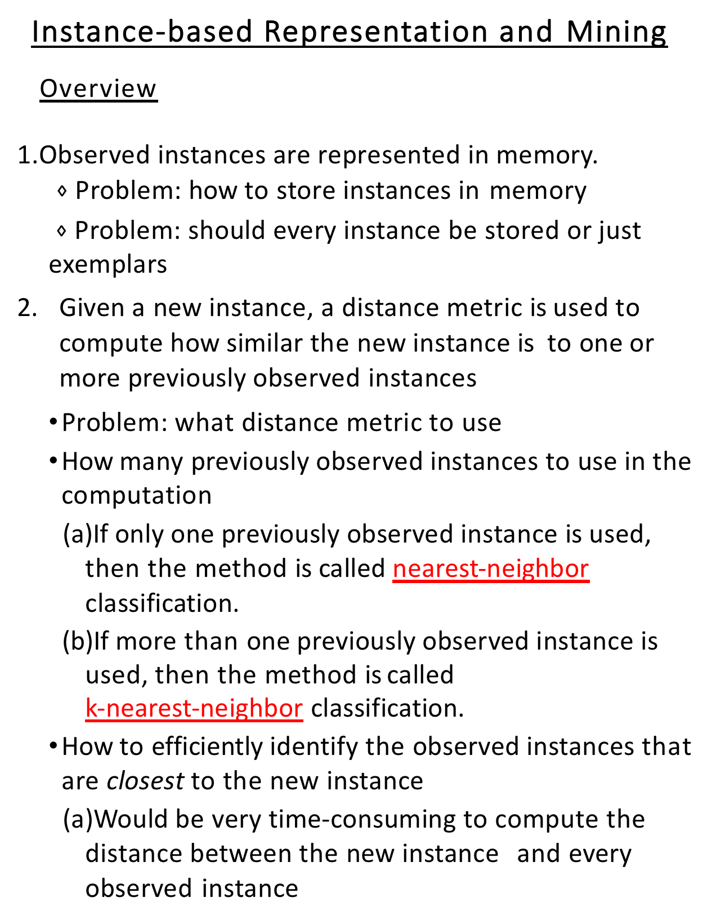
Instance-based Representation and Mining
Overview
Observed instances are represented in memory.
$⋄$ Problem: how to store instances in memory
$⋄$Problem: should every instance be stored or just exemplars
Given a new instance, a distance metric is used to compute how similar the new instance is to one or more previously observed instances
Problem: what distance metric to use
How many previously observed instances to use in the computation
If only one previously observed instance is used, then the method is called nearest-neighbor classification.
If more than one previously observed instance is used, then the method is called
k-nearest-neighbor classification.
How to efficiently identify the observed instances that are closest to the new instance
Would be very time-consuming to compute the distance between the new instance and every observed instance

Slide 3
Instance-based Representation and Mining
Overview
Use the similar previously observed instances to hypothesize the class of the new instance
Problem: how to hypothesize the class of the new instance from the classes of the observed instances that are viewed as similar to the new instance
If nearest-neighbor, then use its class
If k-nearest-neighbor,
1) Nominal class attributes
use the majority class — but this treats all instances the same, without distinguishing between ones that are close to the new instance and ones that are far away from it.
weight the votes by the inverse of their distance from the new instance
2)Numeric class attribute
use the inverse-distance-weighted average of the predictions

Slide 4
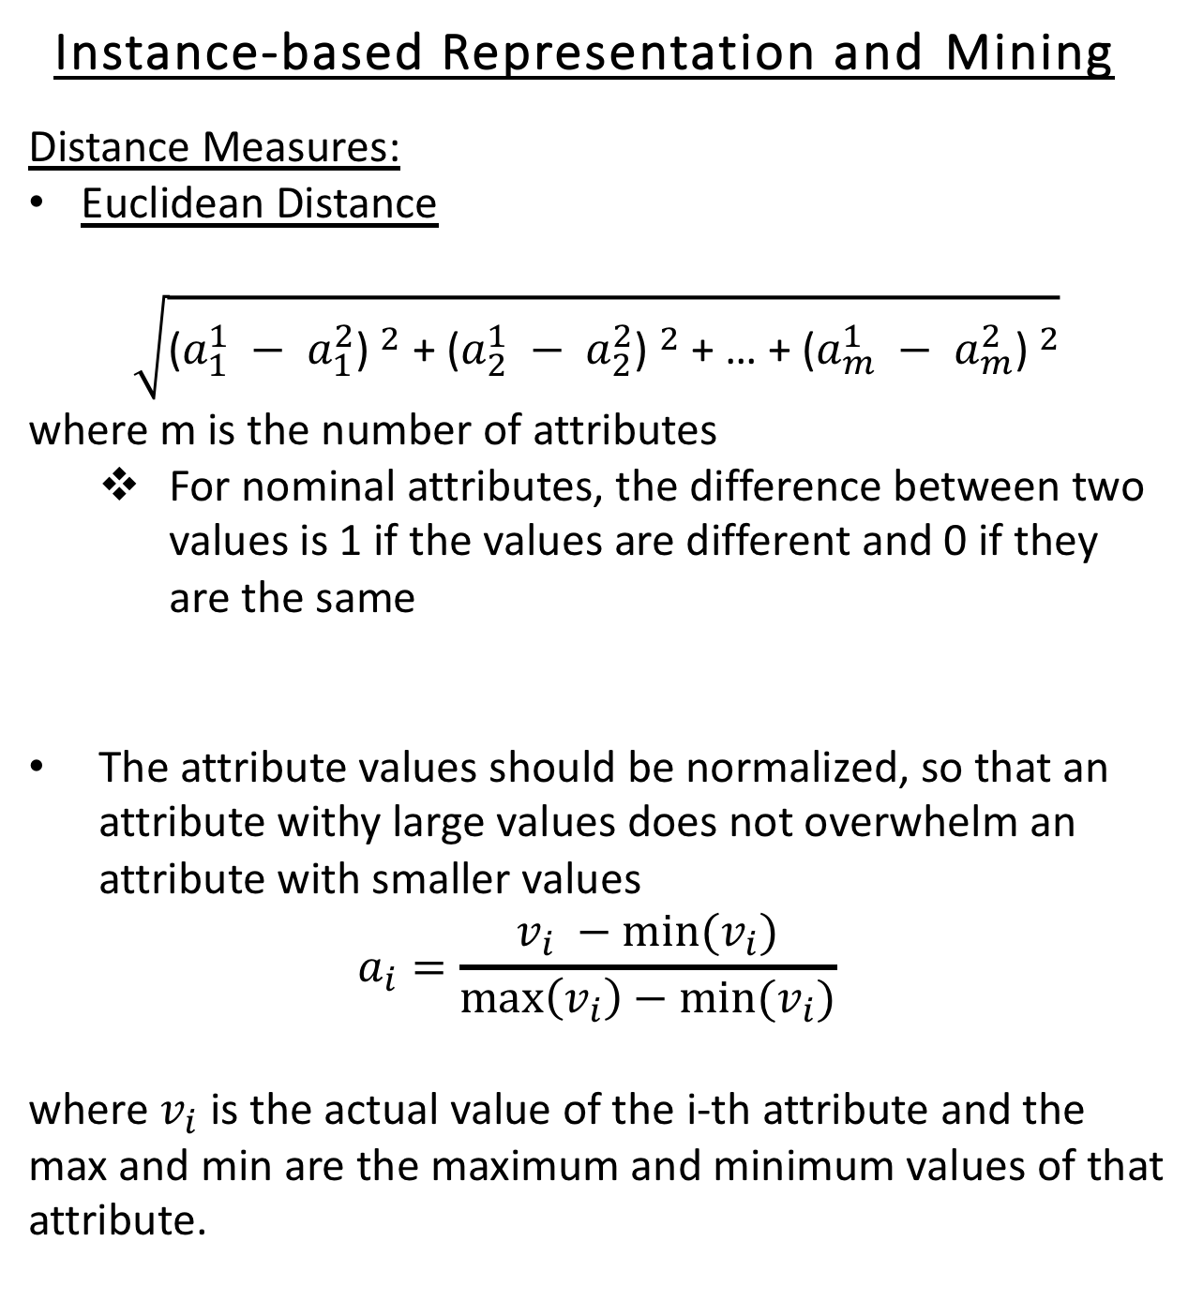
Instance-based Representation and Mining
Distance Measures:
Euclidean Distance
$$\sqrt{{\text{(}a_{1}^{1} − a_{1}^{2}\text{) }}^{2}\text{ + }{\text{(}a_{2}^{1} − a_{2}^{2}\text{) }}^{2}\text{ + … + }{\text{(}a_{m}^{1} − a_{m}^{2}\text{) }}^{2}}$$
where m is the number of attributes
For nominal attributes, the difference between two values is 1 if the values are different and 0 if they are the same
The attribute values should be normalized, so that an attribute withy large values does not overwhelm an attribute with smaller values
$$a_{i}=\frac{v_{i} −min⁡(v_{i})}{\max\left(v_{i}\right)−min⁡(v_{i})}$$
where $v_{i}$ is the actual value of the i-th attribute and the max and min are the maximum and minimum values of that attribute.

Slide 5
Instance-based Representation and Mining
Missing Attribute Values:
If nominal, treat the difference as 1 if either the observed value or the new instance is missing a value for the attribute
If numeric,
if both attributes are missing the value, then the difference is treated as 1
if only one is missing the attribute value, then the difference is often computed as either the normalized value of the other attribute or 1 minus the normalized value, whichever is larger

Slide 6
Instance-based Representation and Mining
Other Issues:
Noisy exemplars hurt the performance of nearest-neighbor methods since they cause new instances to be misclassified
more likely to be a problem with small values of k
can monitor the performance of each exemplar and discard the ones that repeatedly misclassify
Overfitting can result if k is very small
Use a validation set to select the best value of k

Slide 7
Instance-based Representation and Mining
Summary:
Called a lazy method since no general model is constructed; instead, most of the work is postponed until a new instance needs to be classified
Has the benefit that new exemplars can be added to the dataset and used for classification.

Slide 8
kD-trees
kD-trees provide an efficient way of identifying the observed instances that need to be considered by a nearest-neighbor algorithm
Structure:
binary tree
space of training set is divided with a hyperplane that is parallel to one of the m axes (where m is the number of attributes)
not all branches of the tree need to go to the same depth
every node in the tree corresponds to an observed instance, with as many as half of them being leaf nodes

Slide 9
Building a kD-tree
Compute the variance of the observed instances along each of the k-axes, where k is the number of attributes
Select the axis with the greatest variance
Since each split will select the axis with the greatest remaining variance, it is likely that different axes will be selected for each split; thus we will avoid long skinny regions.
Create a splitting hyperplane perpendicular to that axis
Locate the mean value along the axis to which the hyperplane will be perpendicularThis makes the split perpendicular to the direction of greatest spread
This tends to produce a relatively well-balanced tree
Select the instance whose attribute value is closest to the mean
Place the selected instance as the root of the tree or subtree and label the branches as <= or > the selected instance’s value on that axis
Pass observed instances down the branches of the tree and repeat the process

Slide 10
Building a kD-tree: Example
Observed instances in 2-dimensional space are:
(3,8) (6,7) (7,4) (2,2)
compute the variance along each axis
select the axis with the largest variance
compute the mean of the attribute values along this axis
select the observed instance whose value along this axis is closest to the mean value
place the selected instance as the root of the tree or subtree
pass observed instances down the branches

Slide 11
(3,8)
(6,7)
(7,4)
(2,2)
0,0
This gives us the following tree structure:
(7,4) y−split
(2,2)
rest of instances

Slide 12
(3,8) | (6,7)
(7,4) (2,2)

Slide 13
kD-trees
Finding the nearest neighbor in a kD-tree
Given a new instance, move down the branches of the tree, looking for the subspace in the tree where this new instance would be placed
Note that this subspace need not contain the observed instance that is closest to the new instance.
But it gives us a place to start, and any better observed instance must be closer than the instance in this subspace
Compute the distance between the observed instance in this subspace and the new instance — note that the observed instance is the instance associated with this node in the tree.
Set this observed instance as best-candidate.
This defines a k-dimensional sphere within which the closest observed instance must lie. The center of the sphere is the new instance and the radius of the sphere is the distance between the new instance and the observed instance in this space — call this distance d.

Slide 14
kD-trees
4. Recursively move up to parent nodes, investigating their other child.
If a better observed instance can lie within the space defined by the other child, then that child must be investigated by looking at any of its children whose space may contain a better observed instance.
How do we know whether a space can contain a better observed instance?
Does the sphere with radius d intersect the space defined by the node in the tree?
Can decide this by looking at the min and max values for each attribute in that subspace and finding the value that is closest to the new instance’s value, putting that into the distance computation, and determining whether it is smaller than d.
If yes, then that space could contain a better observed instance.
if no, then that space cannot contain a better observed instance.
Whenever we move to a new node, we check its instance to see if it is closer to the new instance than the current best-candidate — if so, we have a new best-candidate and d becomes the distance between it and the new instance.

Slide 15
(3.5,8) |  | (6,7) (7.5,4.3)
(2.5,2) | _{(4,1)} (9,1.9)
The kD-tree is shown below:
(3,4)
split on y
y<4 (4,1)
y>4 (6,7)
split on x
split on x
(2.5,2)
y<4 x<4
9,1.8)
y<4 x>4
(3.5,8)
y>4 x<6
(7.5,4.3)
y>4 x>6
The new instance is (8.2,3.5)

Slide 16
(3.5,8) |  | (6,7) (7.5,4.3)
(2.5,2) | _{(4,1)} (9,1.9)
The kD-tree is shown below:
(3,4)
split on y
y<4 (4,1)
y>4 (6,7)
split on x
split on x
(2.5,2)
y<4 x<4
9,1.8)
y<4 x>4
(3.5,8)
y>4 x<6
(7.5,4.3)
y>4 x>6
The new instance is (8.2,3.5)

Slide 17
(3.5,8) |  | (6,7) (7.5,4.3)
(2.5,2) | X (8.2,3. _{(4,1)} (9,1.9)
5)

Slide 18
kD-trees
Adding new nodes to the kD-tree
An advantage of instance-based learning is that instances can be added to the dataset at any time.
To retain this advantage for kD-trees, we must have a means of incrementally adding new nodes to the tree.
We just take the new instance and take the path in the tree for this new node until we reach a leaf node.
If the leaf node is empty, place the new node there
If it is not empty, split along the longest dimension of that subspace in order to preserve squarishness, moving the new instance into one of the branches
This approach does not guarantee that the tree will retain balance and squarishness of its subspaces, so will need to reconstruct the tree offline every so often.

Slide 19
Add
(3.5,8) |  | (6,7) (7.5,4.3)
(2.5,2) | _{(4,1)} (9,1.9)
The kD-tree is shown below:
(3,4)
split on y
y<4 (4,1)
y>4 (6,7)
split on x
split on x
(2.5,2)
y<4 x<4
9,1.8)
y<4 x>4
(3.5,8)
y>4 x<6
(7.5,4.3)
y>4 x>6
Add (8.2, 3.5)

Slide 20
Add
(3.5,8) |  | (6,7) (7.5,4.3)
(2.5,2) | _{(4,1)} (9,1.9)
The kD-tree is shown below:
(3,4)
split on y
y<4 (4,1)
9
y<4 x>4
y>4 (6,7)
split on x
split on x
(2.5,2)
y<4 x<4
(3.5,8)
y>4 x<6
(7.5,4.3)
y>4 x>6
(9,1.8)
y>1.8
(8.2, 3.5)
Add (6, 1)

Slide 21
Instance-Based Learning
A lazy method in that a general model is NOT constructed
Most of the work is postponed until a new instance needs to be classified
Has the benefit that new exemplars can be added to the dataset
When combined with pruning of noisy exemplars, attribute weighting, and mechanisms such as Kd-trees, instance-based methods do well in comparison with other methods.

