Slide 1
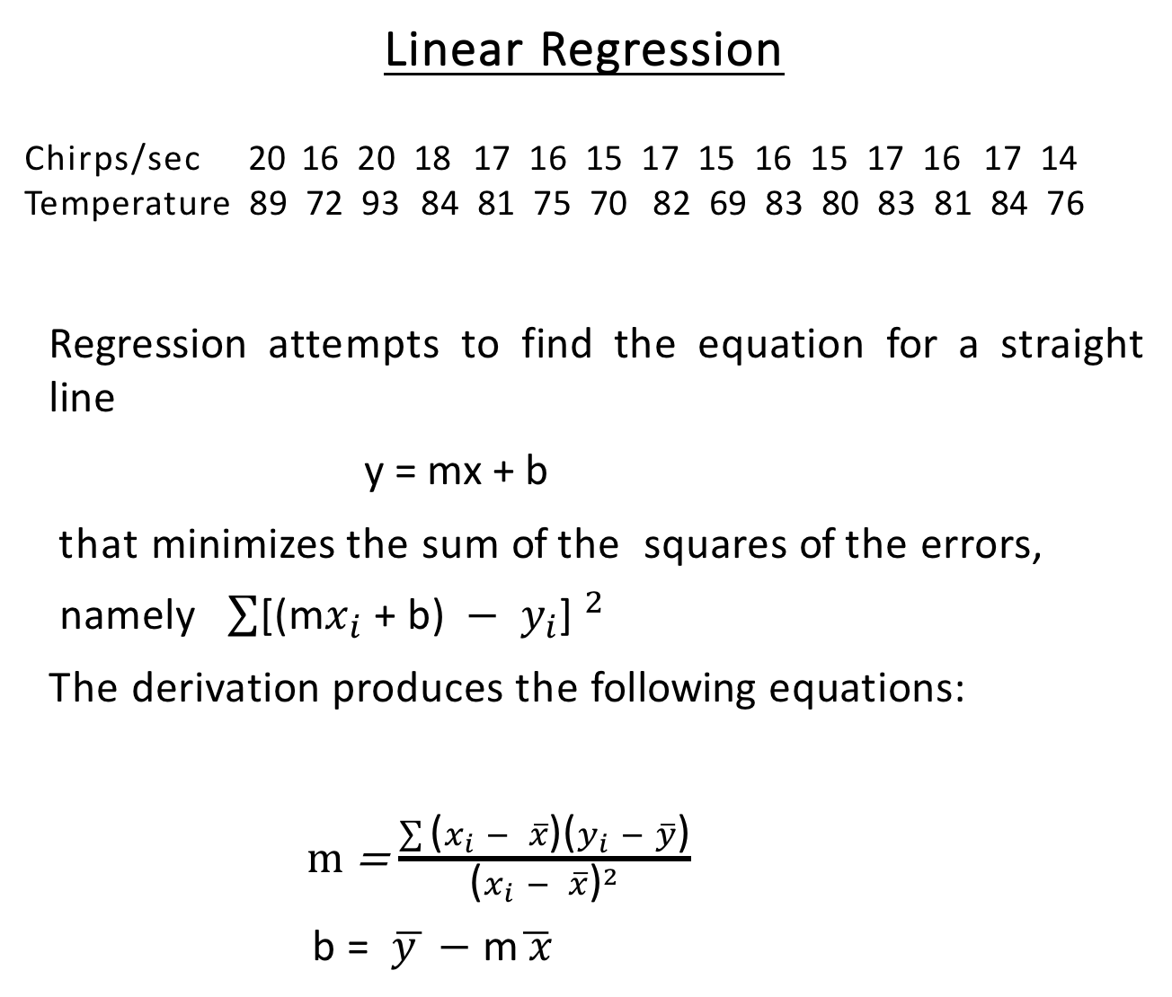
Linear Regression
Chirps/sec 20 16 20 18 17 16 15 17 15 16 15 17 16 17 14
Temperature 89 72 93 84 81 75 70 82 69 83 80 83 81 84 76
Regression attempts to find the equation for a straight line
y = mx + b
that minimizes the sum of the squares of the errors,
namely $\sum{{\text{[(}\text{m}x_{i}\text{ + }\text{b}\text{) }− y_{i}\text{] }}^{2}}$
The derivation produces the following equations:
m = $\frac{\sum{\text{(}x_{i} − \overline{x}\text{)(}y_{i} − \overline{y}\text{)}}}{{\text{(}x_{i} − \overline{x}\text{)}}^{2}}$
b = $\overline{y }$ $−$ m$\overline{ x}$

Slide 2
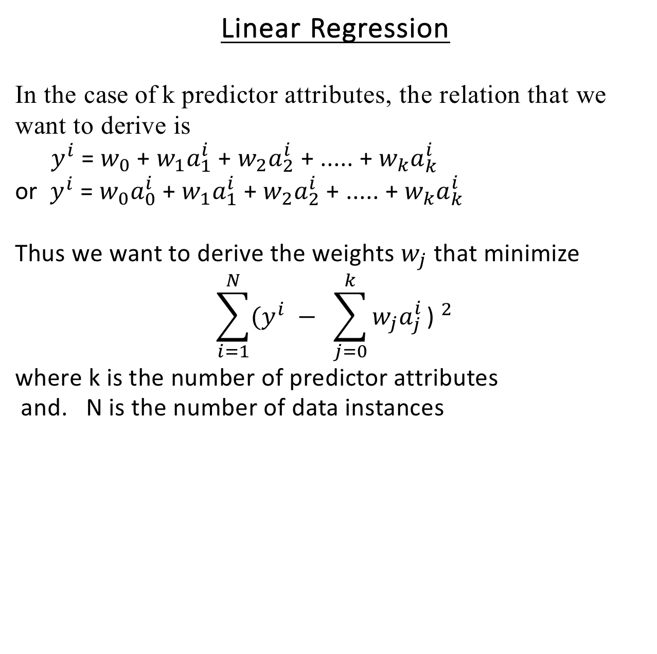
Linear Regression
In the case of k predictor attributes, the relation that we want to derive is
$y^{i}$ = $w_{0}$ + $w_{1}a_{1}^{i}$ + $w_{2}a_{2}^{i}$ + ..... + $w_{k}a_{k}^{i}$
or $y^{i}$ = $w_{0}a_{0}^{i}$ + $w_{1}a_{1}^{i}$ + $w_{2}a_{2}^{i}$ + ..... + $w_{k}a_{k}^{i}$
Thus we want to derive the weights $w_{j}$ that minimize
$$\sum_{i=1}^{N}{{{(y}^{i} − \sum_{j=0}^{k}{w_{j}a_{j}^{i}}\text{) }}^{2}}$$
where k is the number of predictor attributes
and. N is the number of data instances

Slide 3
Linear Regression
Advantages of Linear Regression:
Simple method for prediction when the predictor attributes are numeric and the response variable is continuous-valued
Works well in many cases
Disadvantages of Linear Regression:
Data may really represent a non-linear dependency that is not captured by linear regression
Many assumptions underlie linear regression
The values of the predictor attributes are exact
The noise in the value of the response variable is normally distributed
The data points are independent
The response variable is not comprised of the predictor variable
And more

Slide 4
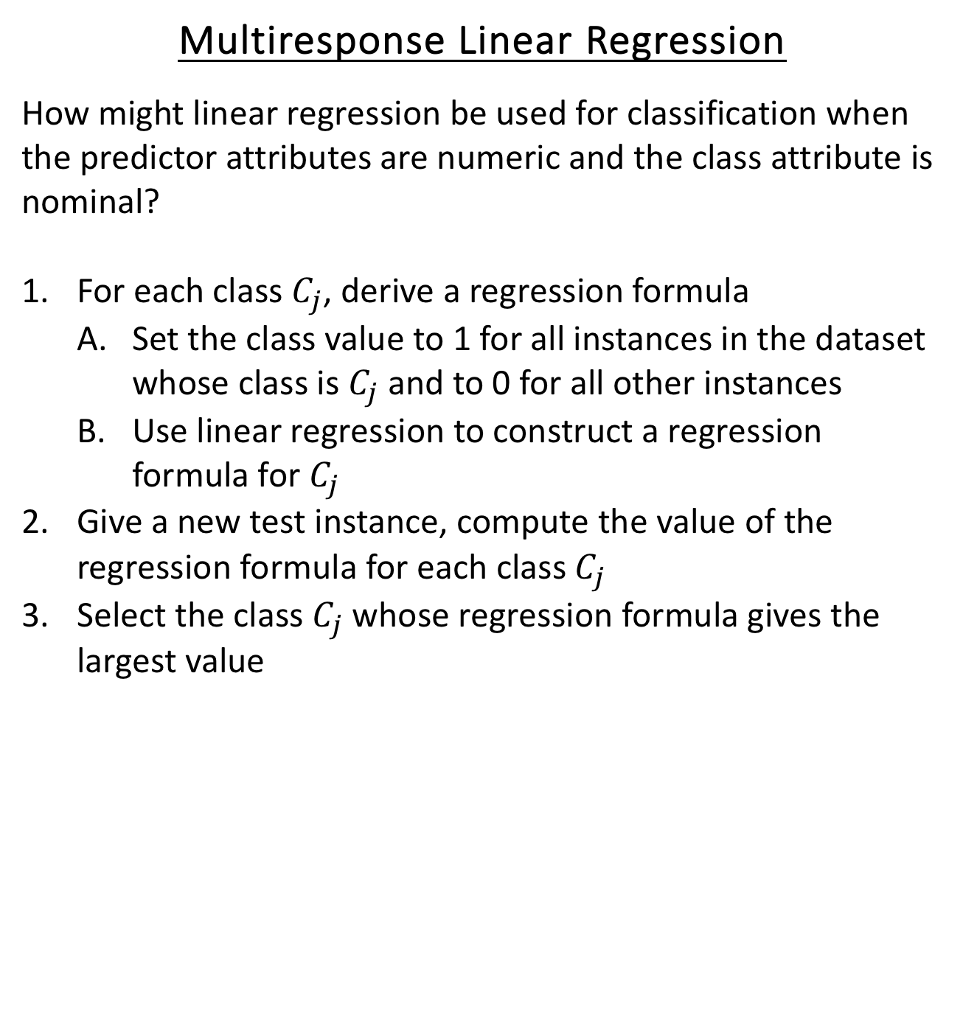
Multiresponse Linear Regression
How might linear regression be used for classification when the predictor attributes are numeric and the class attribute is nominal?
For each class $C_{j}$, derive a regression formula
Set the class value to 1 for all instances in the dataset whose class is $C_{j}$ and to 0 for all other instances
Use linear regression to construct a regression formula for $C_{j}$
Give a new test instance, compute the value of the regression formula for each class $C_{j}$
Select the class $C_{j}$ whose regression formula gives the largest value

Slide 5
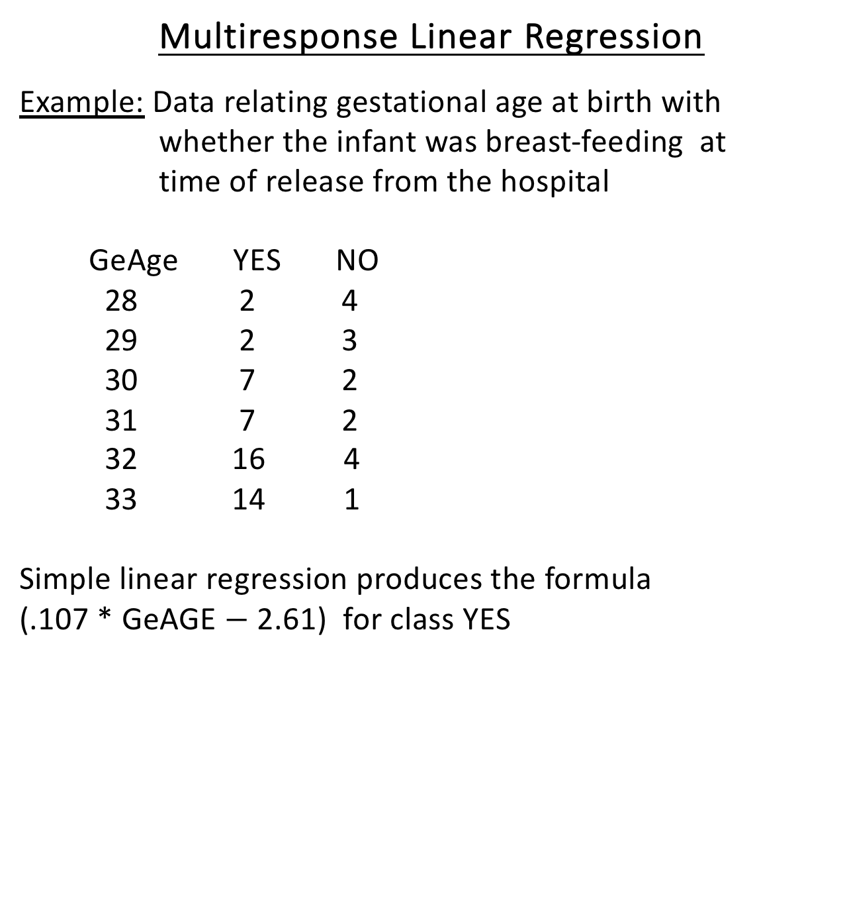
Multiresponse Linear Regression
Example: Data relating gestational age at birth with
whether the infant was breast-feeding at
time of release from the hospital
GeAge YES NO
28 2 4
29 2 3
30 7 2
31 7 2
32 16 4
33 14 1
Simple linear regression produces the formula
(.107 * GeAGE $−$ 2.61) for class YES

Slide 6
Multiresponse Linear Regression
Although this approach often gives good results, it many
Problems:
The values produced by the regression formulae should not exceed 1 or be smaller than 0
So the idea that we are predicting a 0 or a 1 has problems
Violates some of the assumptions of linear regression
Variance of response variable is constant --- i.e., does not depend on the predictor variable
Errors are not statistically independent and normally distributed --- cannot hold for classification problems since only two class values (0 and 1)

Slide 7
Logistic Regression
Appropriate when predictor attributes are numeric and class value is nominal
Produces an S-curve that is constrained to give values between 0 and 1
The values produced for the class can be viewed as probabilities

