Slide 1
Logistic Regression
Appropriate when predictor attributes are numeric and class value is nominal
Produces an S-curve that is constrained to give values between 0 and 1
The values produced for the class can be viewed as probabilities

Slide 2
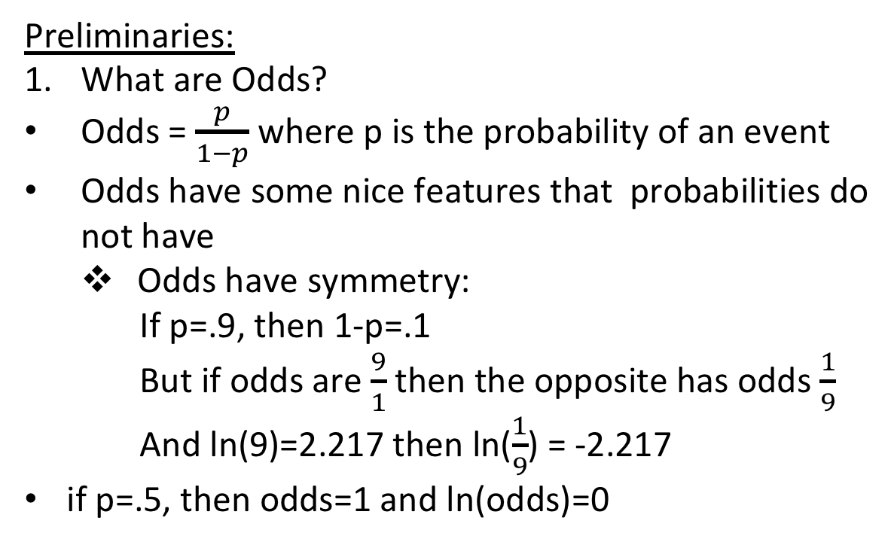
Logistic Regression
Preliminaries:
What are Odds?
Odds = $\frac{p}{1−p}$ where p is the probability of an event
Odds have some nice features that probabilities do not have
Odds have symmetry:
If p=.9, then 1-p=.1
But if odds are $\frac{9}{1}$ then the opposite has odds $\frac{1}{9}$
And ln(9)=2.217 then ln($\frac{1}{9}$) = -2.217
if p=.5, then odds=1 and ln(odds)=0

Slide 3
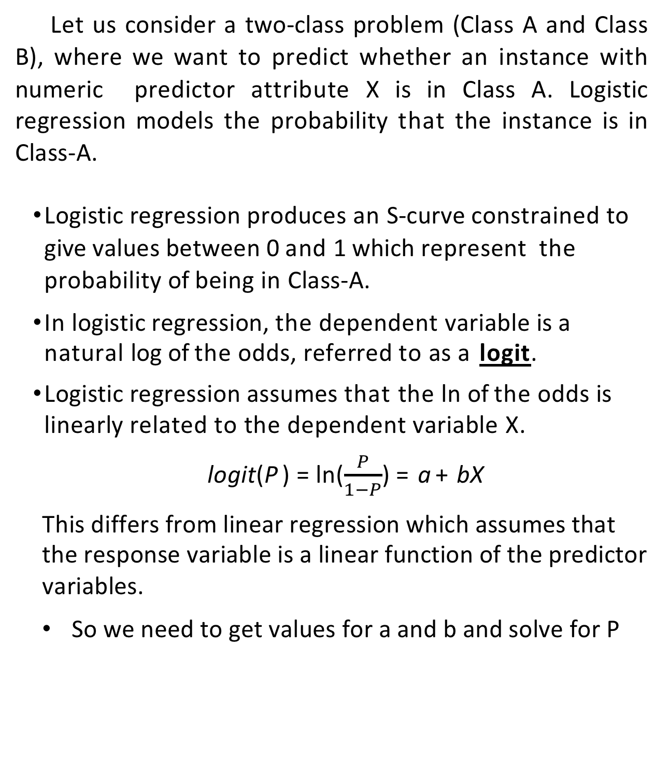
Logistic Regression
Let us consider a two-class problem (Class A and Class B), where we want to predict whether an instance with numeric predictor attribute X is in Class A. Logistic regression models the probability that the instance is in Class-A.
Logistic regression produces an S-curve constrained to give values between 0 and 1 which represent the probability of being in Class-A.
In logistic regression, the dependent variable is a natural log of the odds, referred to as a logit.
Logistic regression assumes that the ln of the odds is linearly related to the dependent variable X.
logit(P ) = ln($\frac{P}{1−P}$) = a + bX
This differs from linear regression which assumes that the response variable is a linear function of the predictor variables.
So we need to get values for a and b and solve for P

Slide 4
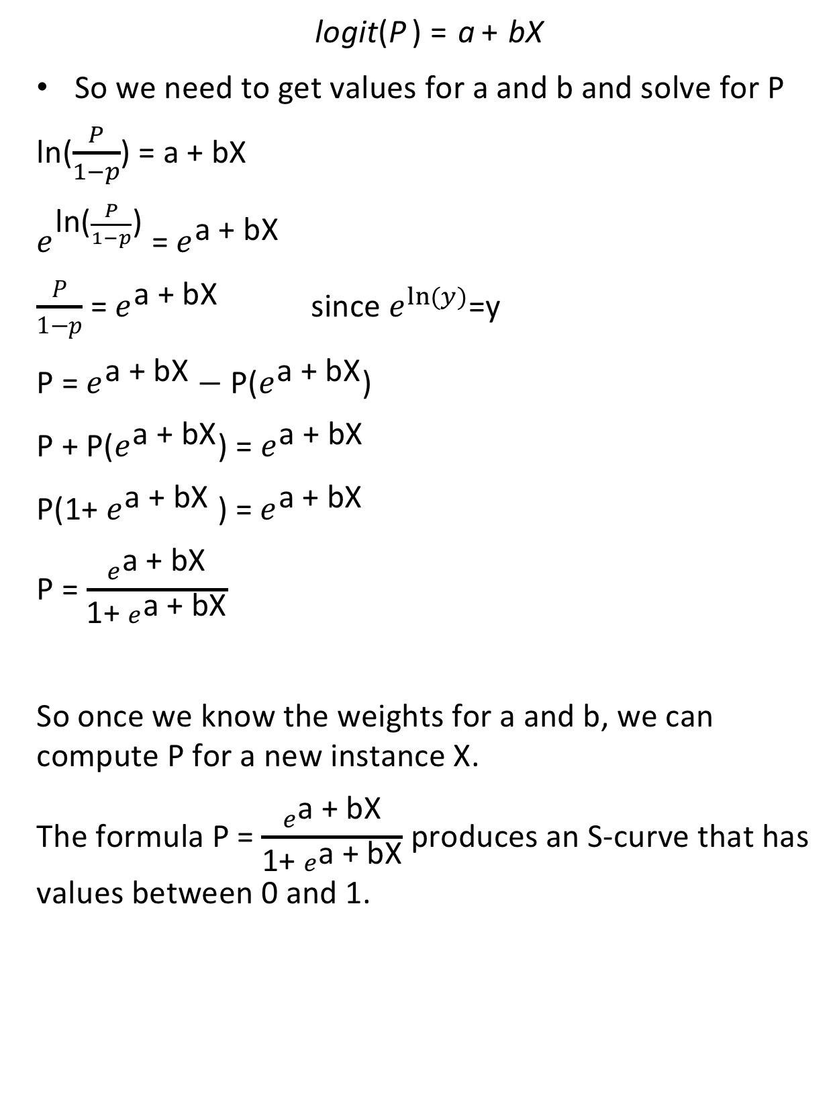
Logistic Regression
logit(P ) = a + bX
So we need to get values for a and b and solve for P
ln($\frac{P}{1−p}$) = a + bX
$e^{\text{ln}\text{(}\frac{P}{1−p}\text{)}}$ = $e^{\text{a}\text{ + }\text{bX}}$
$\frac{P}{1−p}$ = $e^{\text{a}\text{ + }\text{bX}}$ since $e^{ln⁡(y)}$=y
P = $e^{\text{a}\text{ + }\text{bX}}$ $−$ P($e^{\text{a}\text{ + }\text{bX}}$)
P + P($e^{\text{a}\text{ + }\text{bX}}$) = $e^{\text{a}\text{ + }\text{bX}}$
P(1+ $e^{\text{a}\text{ + }\text{bX}}$ ) = $e^{\text{a}\text{ + }\text{bX}}$
P = $\frac{e^{\text{a}\text{ + }\text{bX}}}{\text{1+ }e^{\text{a}\text{ + }\text{bX}}}$
So once we know the weights for a and b, we can compute P for a new instance X.
The formula P = $\frac{e^{\text{a}\text{ + }\text{bX}}}{\text{1+ }e^{\text{a}\text{ + }\text{bX}}}$ produces an S-curve that has values between 0 and 1.

Slide 5
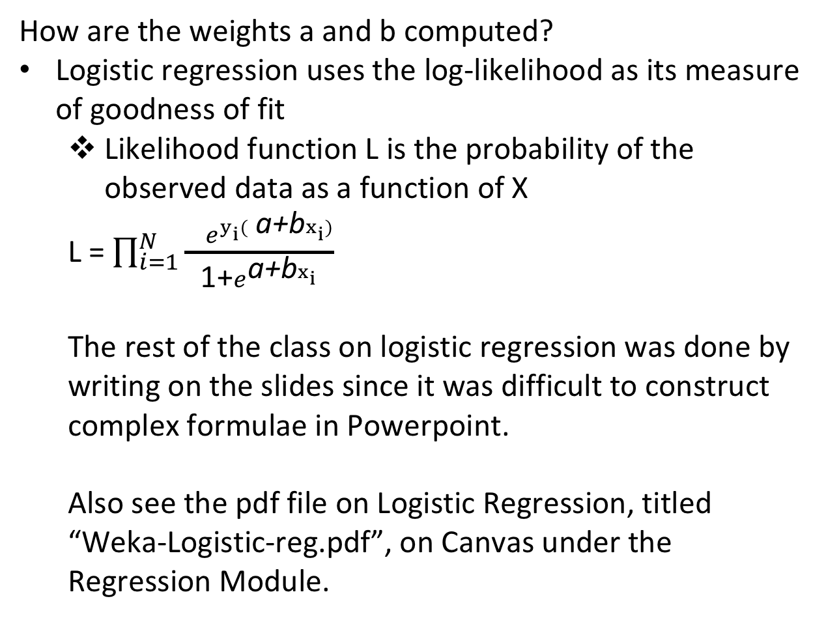
Logistic Regression
How are the weights a and b computed?
Logistic regression uses the log-likelihood as its measure of goodness of fit
Likelihood function L is the probability of the observed data as a function of X
L = $\prod_{i=1}^{N}{\frac{{ e}^{y_{i}( \text{a}\text{+}\text{b}x_{i})}}{\text{1+}e^{\text{a}\text{+}\text{b}x_{i}}}}$
The rest of the class on logistic regression was done by writing on the slides since it was difficult to construct complex formulae in Powerpoint.
Also see the pdf file on Logistic Regression, titled
“Weka-Logistic-reg.pdf”, on Canvas under the Regression Module.

