Slide 1
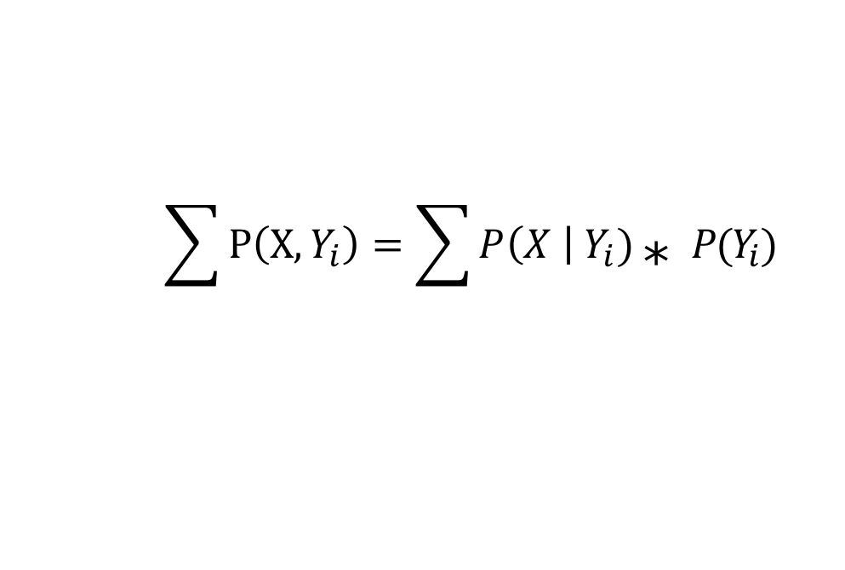
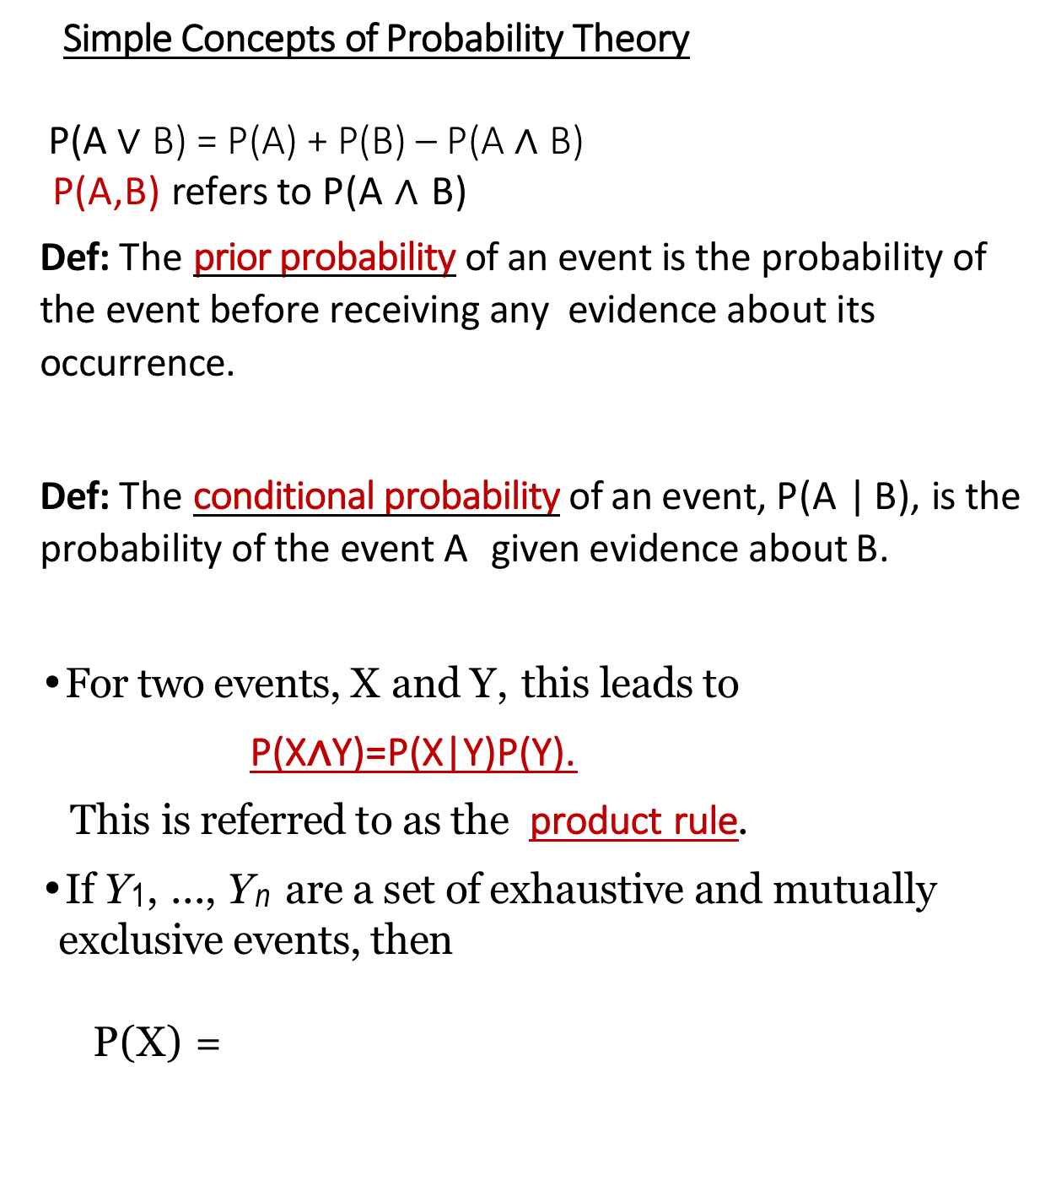
Probability Theory (short review)
Simple Concepts of Probability Theory
P(A $∨$ B) = P(A) + P(B) – P(A $∧$ B)
P(A,B) refers to P(A $∧$ B)
Def: The prior probability of an event is the probability of the event before receiving any evidence about its occurrence.
Def: The conditional probability of an event, P(A | B), is the probability of the event A given evidence about B.
For two events, X and Y, this leads to
P(X∧Y)=P(X|Y)P(Y).
This is referred to as the product rule.
If Y₁, ..., Y_{n} are a set of exhaustive and mutually exclusive events, then
P(X) =
$$\sum{P\left(X,Y_{i}\right)}=\sum{P\left(X \right| Y_{i}) \text{∗} P(Y_{i})}$$

Slide 2
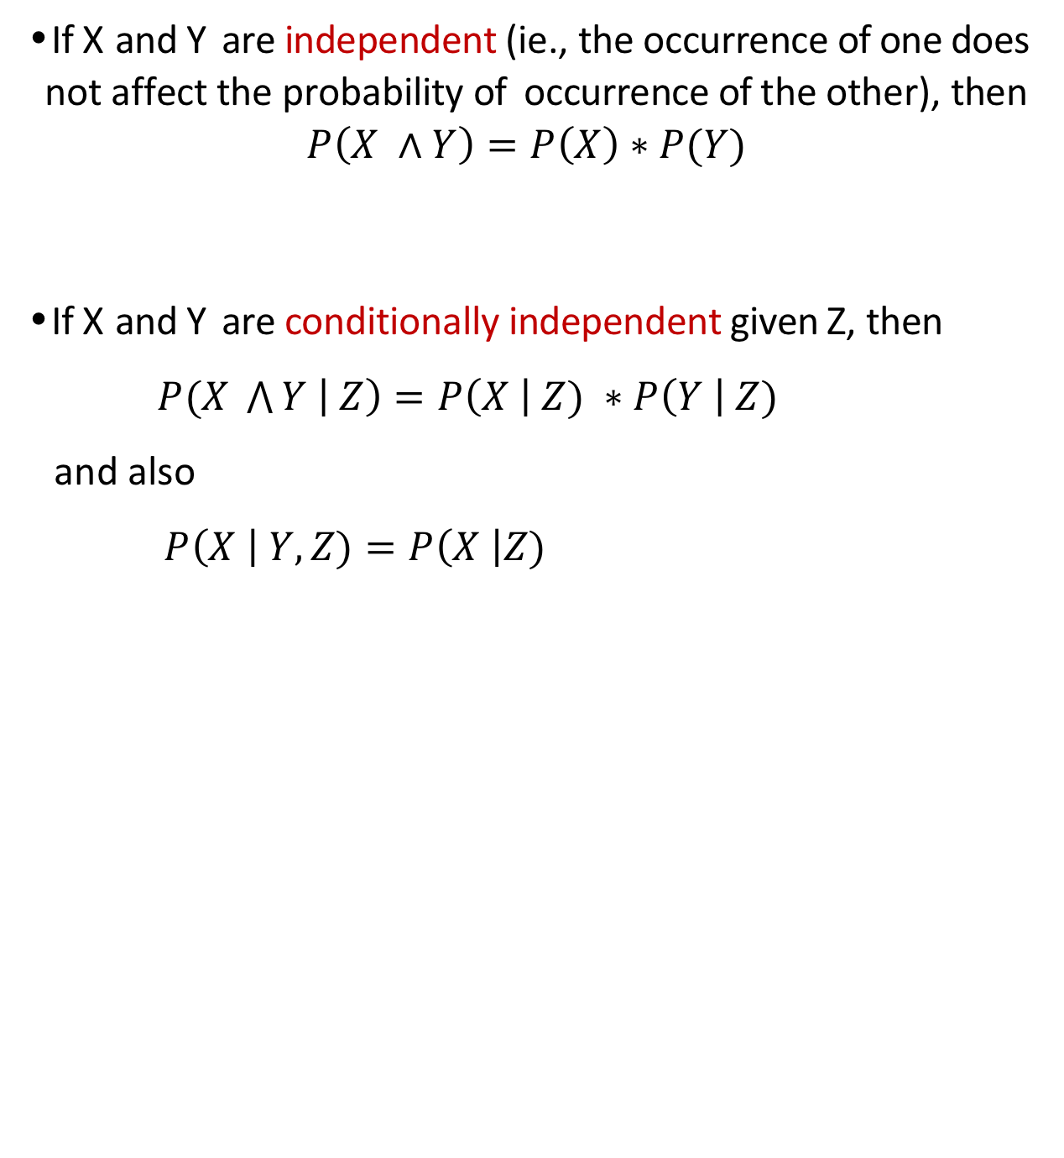
Probability Theory (short review)
If X and Y are independent (ie., the occurrence of one does not affect the probability of occurrence of the other), then
$$P\left(X ∧Y\right)=P\left(X\right)∗P(Y)$$
If X and Y are conditionally independent given Z, then
$P(X \bigwedge{Y \left| Z\right)=P\left(X \right| Z) ∗P\left(Y \right| Z)}$
and also
$P\left(X \right| Y,Z)=P\left(X \right|Z)$

Slide 3
Example:
Strep Throat
Fever
Sore Throat
Truck Accident
Slow Traffic
Police

Slide 4
Example:
Covid-19
Fever
Cough
Loss-of-taste

Slide 5
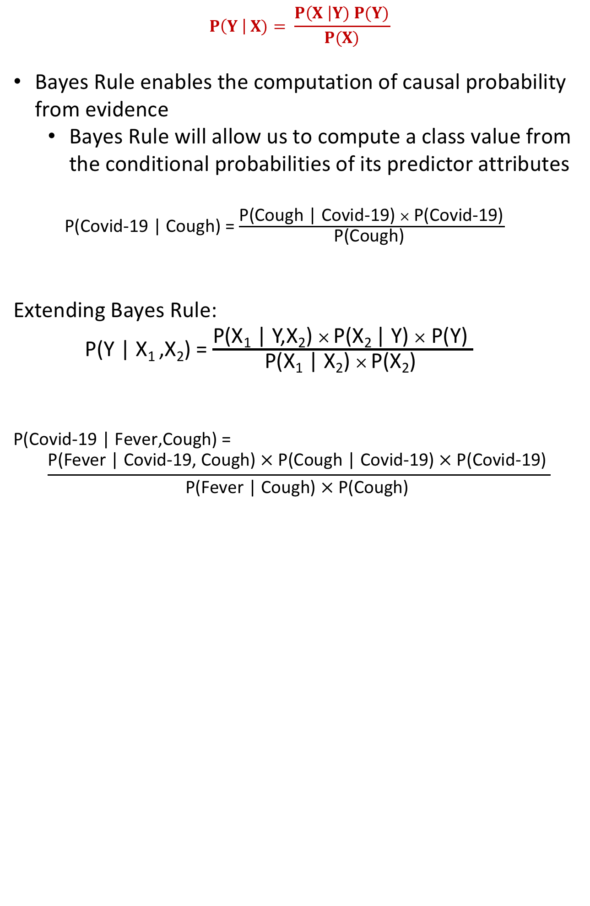
Bayes Rule
$$P\left(Y \right| X)= \frac{P\left(X \right|Y) P(Y)}{P(X)}$$
Bayes Rule enables the computation of causal probability from evidence
Bayes Rule will allow us to compute a class value from the conditional probabilities of its predictor attributes
P(Covid-19 | Cough) = $\frac{\text{P}\text{(}\text{Cough}\text{ |} \text{Covid}\text{−19) }× \text{P}\text{(}\text{Covid}\text{−19)}}{\text{P}\text{(}\text{Cough}\text{) }}$
Extending Bayes Rule:
P(Y | X₁ ,X₂) = $\frac{\text{P}\text{(}\text{X}\text{1}\text{ | }\text{Y}\text{,}\text{X}\text{2}\text{) }× \text{P}\text{(}\text{X}\text{2 }\text{| }\text{Y}\text{) }× \text{P}\text{(}\text{Y}\text{) }}{\text{P}\text{(}\text{X}\text{1}\text{ | }\text{X}\text{2}\text{) }× \text{P}\text{(}\text{X}\text{2}\text{) }}$
P(Covid-19 | Fever,Cough) =
$$\frac{\text{P}\text{(}\text{Fever}\text{ | }\text{Covid}\text{−19, }\text{Cough}\text{) }× \text{P}\text{(}\text{Cough}\text{ | }\text{Covid}\text{−19) }× \text{P}\text{(}\text{Covid}\text{−19) }}{\text{P}\text{(}\text{Fever}\text{ | }\text{Cough}\text{) }× \text{P}\text{(}\text{Cough}\text{) }}$$

Slide 6
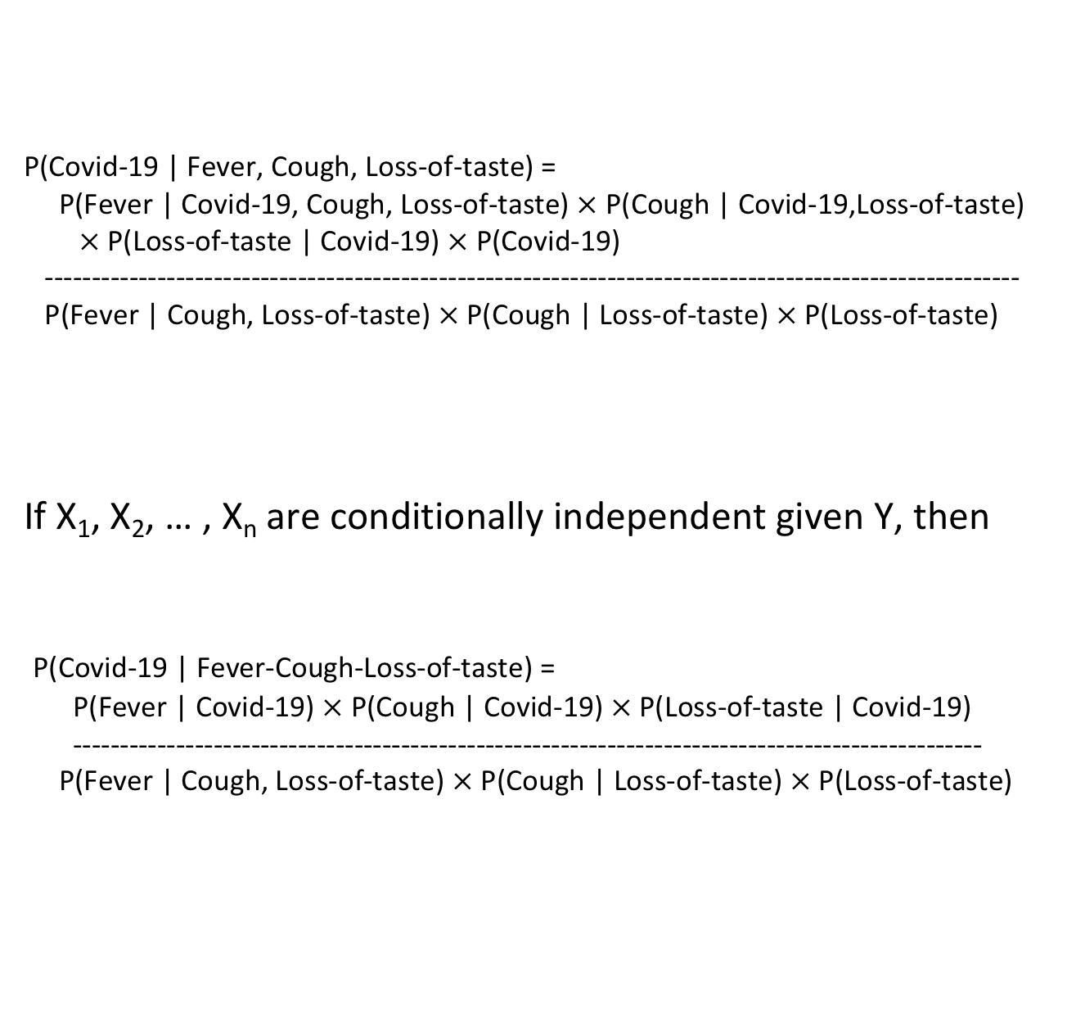
Bayes Rule (generalized)
P(Covid-19 | Fever, Cough, Loss-of-taste) =
P(Fever | Covid-19, Cough, Loss-of-taste) $×$ P(Cough | Covid-19,Loss-of-taste)
$×$ P(Loss-of-taste | Covid-19) $×$ P(Covid-19)
--------------------------------------------------------------------------------------------------------
P(Fever | Cough, Loss-of-taste) $×$ P(Cough | Loss-of-taste) $×$ P(Loss-of-taste)
If X₁, X₂, … , X_{n} are conditionally independent given Y, then
P(Covid-19 | Fever-Cough-Loss-of-taste) =
P(Fever | Covid-19) $×$ P(Cough | Covid-19) $×$ P(Loss-of-taste | Covid-19)
-------------------------------------------------------------------------------------------------
P(Fever | Cough, Loss-of-taste) $×$ P(Cough | Loss-of-taste) $×$ P(Loss-of-taste)

Slide 7
Naïve Bayes Method
Assumptions:
all of the attributes are equally important in making the decision
the attributes are conditionally independent of one another, given the value of the class attribute
AGE | INCOME | STUDENT | CREDIT-RATING | BUYS-COMPUTER
youth | high | no | fair | no-buy
youth | high | no | excellent | no-buy
middle-aged | high | no | fair | buy
senior | medium | no | fair | buy
senior | low | yes | fair | buy
senior | low | yes | excellent | no-buy
middle-aged | low | yes | excellent | buy
youth | medium | no | fair | no-buy
youth | low | yes | fair | buy
senior | medium | yes | fair | buy
youth | medium | yes | excellent | buy
middle-aged | medium | no | excellent | buy
middle-aged | high | yes | fair | buy
senior | medium | no | excellent | no-buy

Slide 8
Naive Bayes Method
2. Details:
Given a new instance X₁, . . . , X_{n}, predict its class value using the generalized version of Bayes Rule.
If there are k possible values for the class attribute Y, then we want to compute P(Y | X₁, . . . , X_{n}) for each of the k possible values of Y and select the value for Y that yields the greatest probability.
From the training set, compute for each predictor attribute value X_{i}, P(X_{i} | Y) for each value of the response variable Y. This enables us to compute the numerator in Bayes Rule
Do not need to compute the denominator since it is the same for all k formulas.
To get the actual probabilities, normalize the results of the k formulae by dividing each of them by their sum — this is because they must sum to 1.

Slide 9
Naïve Bayes Method (example)
AGE | INCOME | STUDENT | CREDIT-RATING | BUYS-COMPUTER
youth | high | no | fair | no-buy
youth | high | no | excellent | no-buy
middle-aged | high | no | fair | buy
senior | medium | no | fair | buy
senior | low | yes | fair | buy
senior | low | yes | excellent | no-buy
middle-aged | low | yes | excellent | buy
youth | medium | no | fair | no-buy
youth | low | yes | fair | buy
senior | medium | yes | fair | buy
youth | medium | yes | excellent | buy
middle-aged | medium | no | excellent | buy
middle-aged | high | yes | fair | buy
senior | medium | no | excellent | no-buy

Slide 10
Naïve Bayes Method
Problem of zero occurrences
• If a predictor attribute does not assume each of its possible values for each value of the class attribute, then we can encounter situations where P(X_{i} | Y)=0.
• Such zero values overwhelm everything else
• Solution:
Adjust the attribute counts by adding 1 to each
if a given attribute has k possible values, the count for each class value Y when computing P(Att=X_{i} | Class=Y) increases by k.
When computing P(Class=Y), add 1 to the count of each class value
This technique is referred to as the LaPlace estimator.

Slide 11
Naïve Bayes Method
Numeric attribute values
Assume that the values for each numeric attribute assume a normal (Gaussian) distribution.
For each numeric predictor attribute, compute the mean and standard deviation for each of the predictor attributes given the class value.
Given a new instance to classify, use the formula for the normal distribution to compute the probability of the numeric attribute value given a value of the class attribute; use this value in Bayes rule.

Slide 12
Naïve Bayes Method
Missing predictor attribute values
If some training instances are missing the value for a predictor attribute, then those instances are not counted when computing the conditional probability of the predictor attribute’s values in the numerator of Bayes formula.
Suppose that a new test instance is given for classification, but the instance is missing the value for one of the predictor attributes. That just means that there are fewer terms when computing the numerator in Bayes formula.

