Slide 1
Regression and Model Trees
Motivation
Problems with regression:
Linear regression: linear models often do not fit the data well
Nonlinear regression: even more complicated than linear regression
Why not combine the advantages of trees with regression?
Use the decision tree concept of dividing and conquering to break into groups to which a linear model is more appropriate
At the leaf nodes, we have a linear model that predicts the value for the instance
regression tree: the value at the leaf is the average of the values for the instances in the training set that reach that leaf node
model tree: each leaf node contains a linear regression equation that predicts the value for new instances

Slide 2
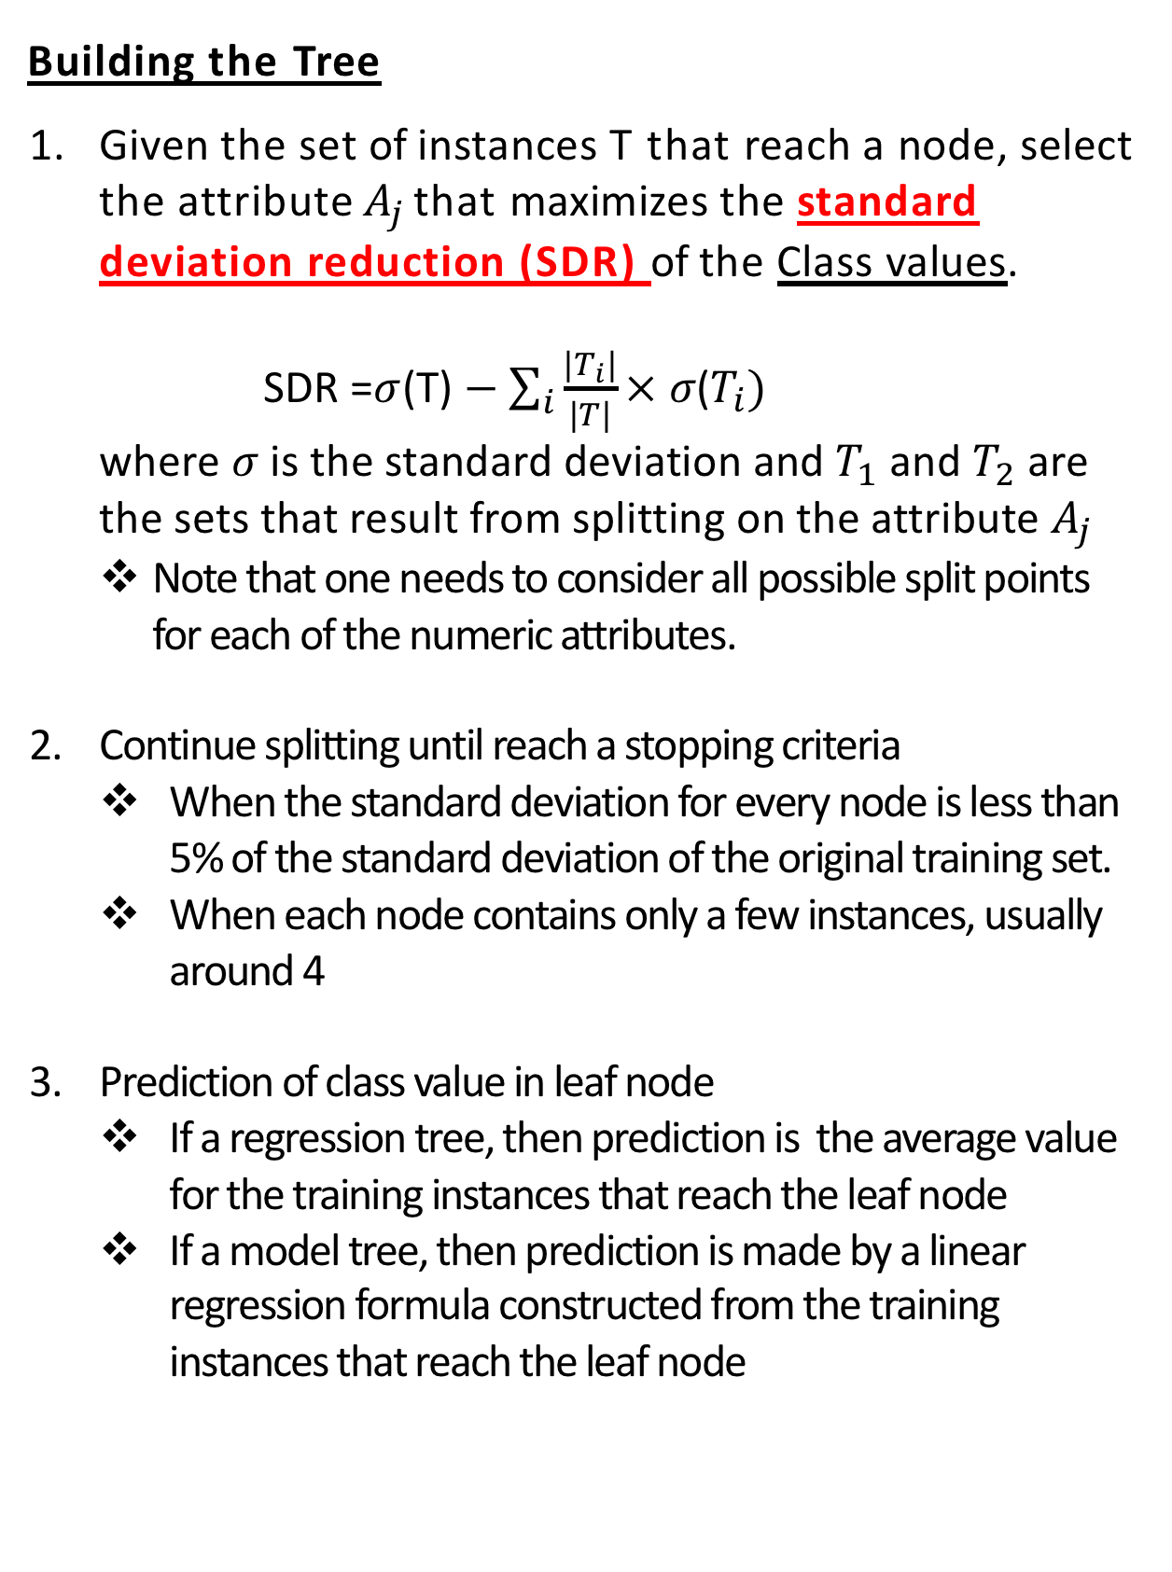
Regression and Model Trees
Building the Tree
Given the set of instances T that reach a node, select the attribute $A_{j}$ that maximizes the standard deviation reduction (SDR) of the Class values.
SDR =$σ$(T) $−$ $\sum_{i}{\frac{|T_{i}|}{|T|}× σ\text{(}T_{i}) }$
where $σ$ is the standard deviation and $T_{1}$ and $T_{2}$ are the sets that result from splitting on the attribute $A_{j}$
Note that one needs to consider all possible split points for each of the numeric attributes.
Continue splitting until reach a stopping criteria
When the standard deviation for every node is less than 5% of the standard deviation of the original training set.
When each node contains only a few instances, usually around 4
Prediction of class value in leaf node
If a regression tree, then prediction is the average value for the training instances that reach the leaf node
If a model tree, then prediction is made by a linear regression formula constructed from the training instances that reach the leaf node
i
i
i

Slide 3
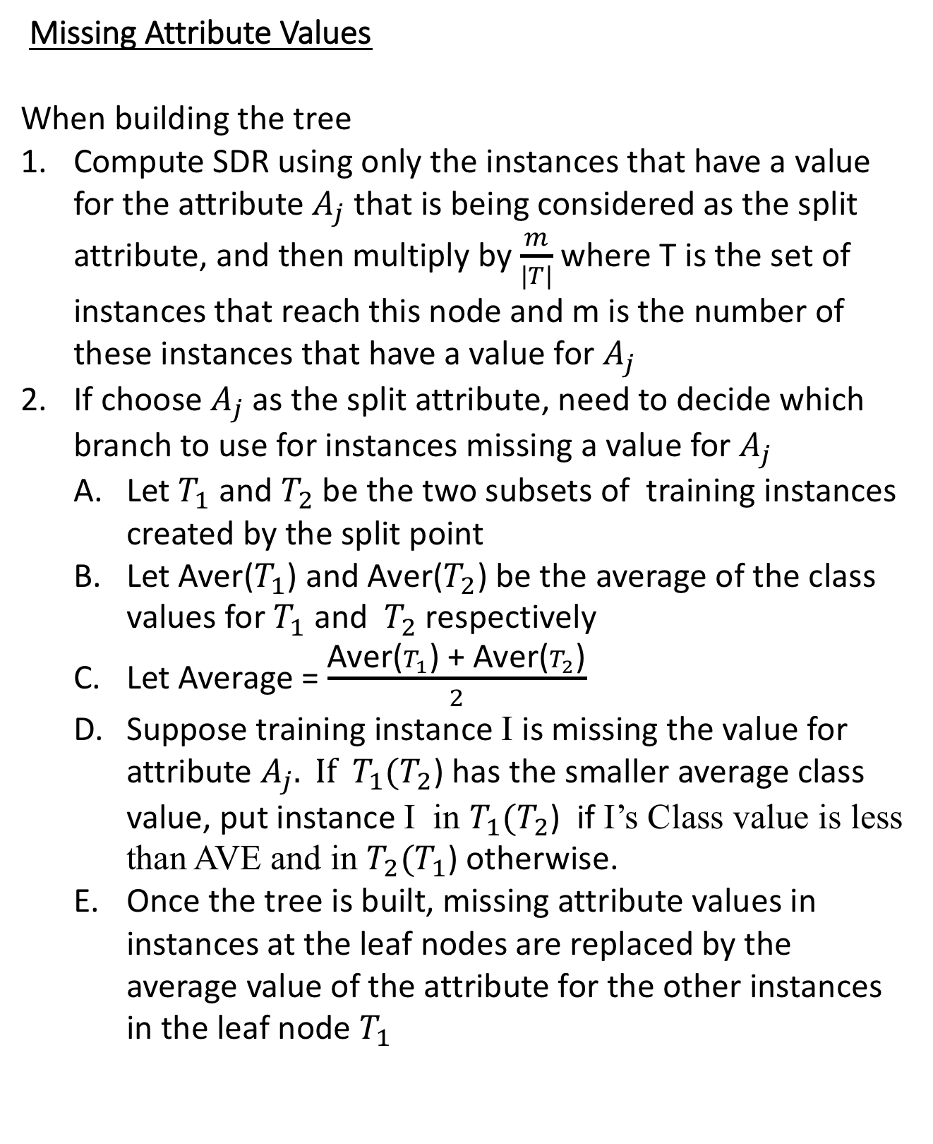
Regression and Model Trees
Missing Attribute Values
When building the tree
Compute SDR using only the instances that have a value for the attribute $A_{j}$ that is being considered as the split attribute, and then multiply by $\frac{m}{|T|}$ where T is the set of instances that reach this node and m is the number of these instances that have a value for $A_{j}$
If choose $A_{j}$ as the split attribute, need to decide which branch to use for instances missing a value for $A_{j}$
Let $T_{1}$ and $T_{2}$ be the two subsets of training instances created by the split point
Let Aver($T_{1}$) and Aver($T_{2}$) be the average of the class values for $T_{1}$ and $T_{2}$ respectively
Let Average = $\frac{\text{Aver}\text{(}T_{1}\text{) }\text{+} \text{Aver}\text{(}T_{2}\text{)}}{2}$
Suppose training instance I is missing the value for attribute $A_{j}. If T_{1}(T_{2}$) has the smaller average class value, put instance I in $T_{1}(T_{2}$) if I’s Class value is less than AVE and in $T_{2}(T_{1}$) otherwise.
Once the tree is built, missing attribute values in instances at the leaf nodes are replaced by the average value of the attribute for the other instances in the leaf node $T_{1}$
i
i
i

Slide 4
Regression and Model Trees
Missing Attribute Values
When classifying a new test instance
If the test instance is missing a value for the split attribute for a node, assume that the missing attribute value is the average of the attribute’s value for all of the training instances that reached this node
At the leaf node of a model tree, replace any missing attribute values with the average value for that attribute for all of the training instances that reached the leaf node.
i
i
i

Slide 5
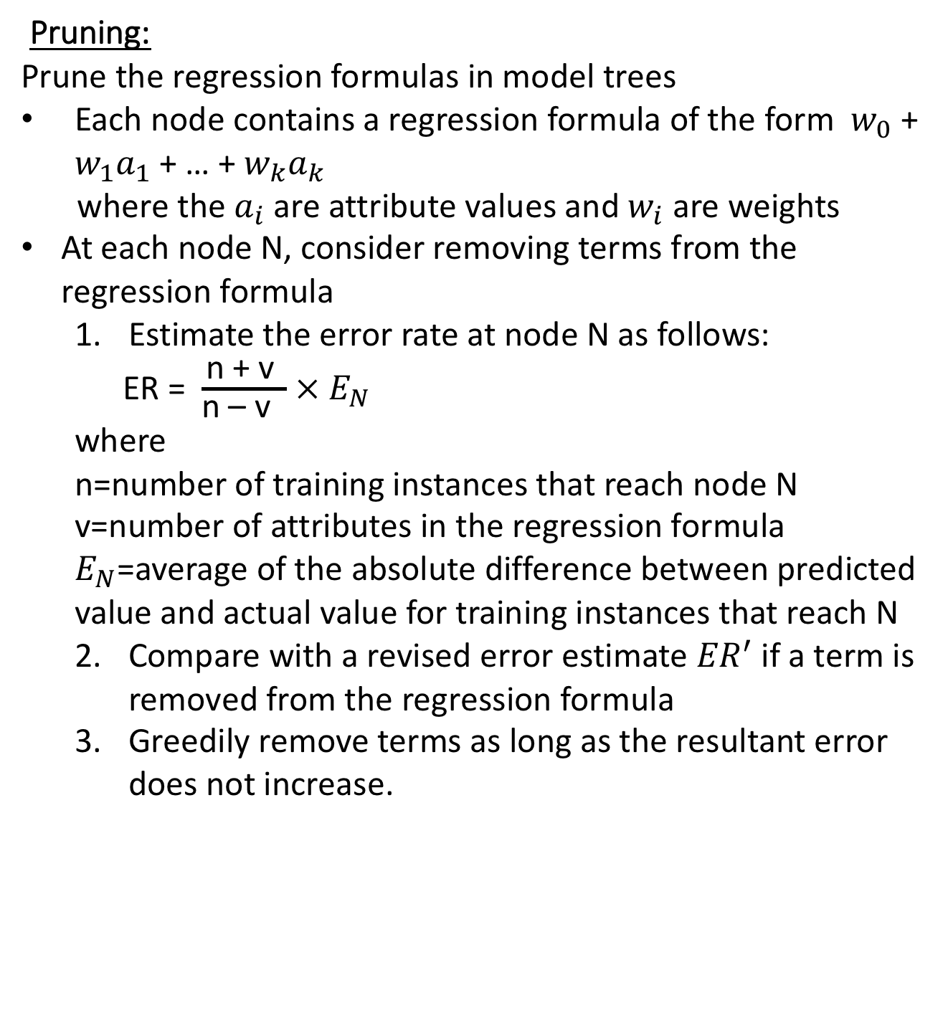
Regression and Model Trees
Pruning:
Prune the regression formulas in model trees
Each node contains a regression formula of the form $w_{0}$ + $w_{1}a_{1}$ + … + $w_{k}a_{k}$
where the $a_{i}$are attribute values and $w_{i}$ are weights
At each node N, consider removing terms from the regression formula
Estimate the error rate at node N as follows:
ER = $\frac{\text{n}\text{ + }\text{v} }{\text{n}\text{ – }\text{v} }$ $×$ $E_{N}$
where
n=number of training instances that reach node N
v=number of attributes in the regression formula $E_{N}$=average of the absolute difference between predicted value and actual value for training instances that reach N
Compare with a revised error estimate ${ER}^{′}$ if a term is removed from the regression formula
Greedily remove terms as long as the resultant error does not increase.
i
i
i

Slide 6
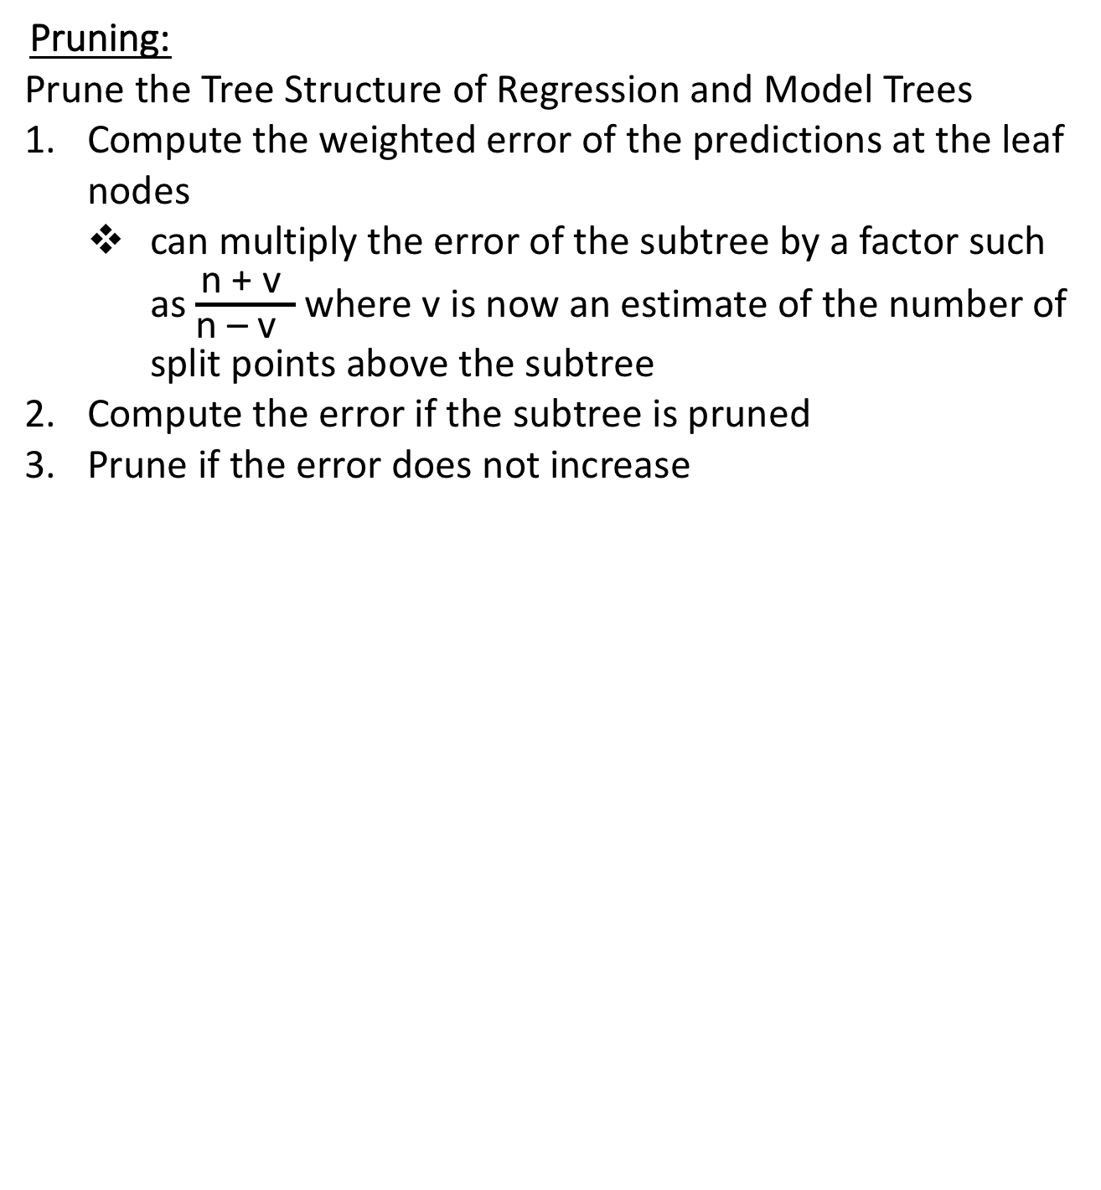
Regression and Model Trees
Pruning:
Prune the Tree Structure of Regression and Model Trees
Compute the weighted error of the predictions at the leaf nodes
can multiply the error of the subtree by a factor such as $\frac{\text{n}\text{ + }\text{v} }{\text{n}\text{ – }\text{v} }$ where v is now an estimate of the number of split points above the subtree
Compute the error if the subtree is pruned
Prune if the error does not increase
i
i
i

Slide 7
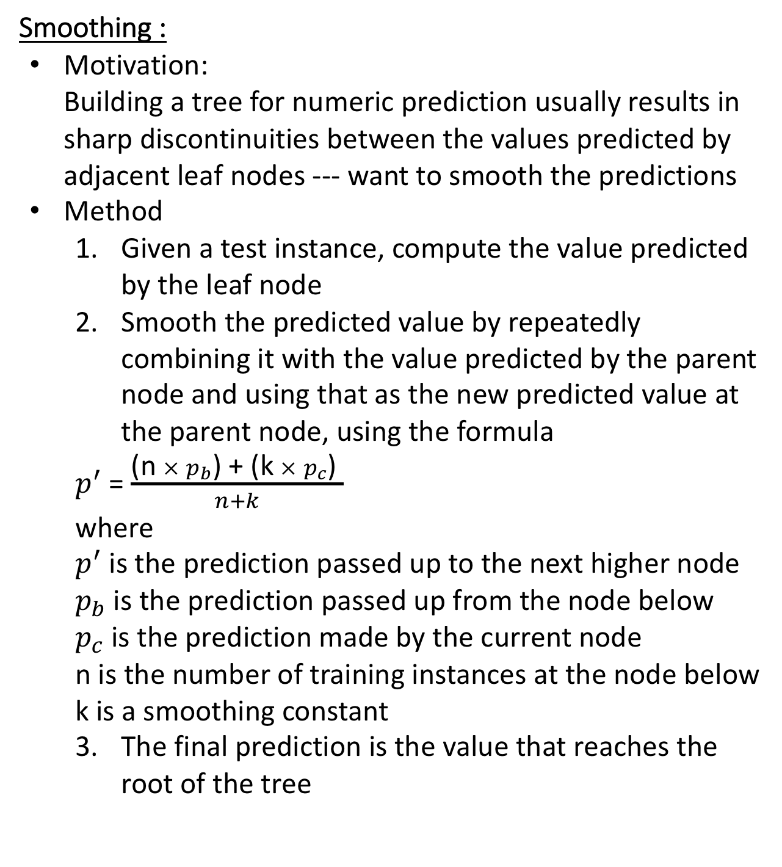
Regression and Model Trees
Smoothing :
Motivation:
Building a tree for numeric prediction usually results in
sharp discontinuities between the values predicted by
adjacent leaf nodes --- want to smooth the predictions
Method
Given a test instance, compute the value predicted by the leaf node
Smooth the predicted value by repeatedly combining it with the value predicted by the parent node and using that as the new predicted value at the parent node, using the formula
$p^{′}$ = $\frac{\text{(}\text{n} × p_{b}\text{) + (}\text{k} × p_{c}\text{) }}{n+k}$
where
$p^{′}$ is the prediction passed up to the next higher node
$p_{b}$ is the prediction passed up from the node below
$p_{c}$ is the prediction made by the current node
n is the number of training instances at the node below
k is a smoothing constant
The final prediction is the value that reaches the root of the tree
i
i
i

Slide 8
Regression and Model Trees
Weks MSP (under trees) provides choices:
whether a regression or a model tree
minimum number of training instances per node
whether pruned or not
whether predictions are smoothed or not
i
i
i

