Slide 1
Classification Rules
Rules take the form of antecedent-consequent pairs, where usually the antecedent is a conjunction of attribute-value tests and the consequent is the class value.
Rules can be much more compact than trees.
Can be a decision list in which the rules are ordered and the class value is determined by the first rule that applies.
If not a decision list, then each rule represents an independent “nugget of knowledge”.
What if encounter a new instance for which the ruleset does not provide a classification?
Can choose the most frequently occurring class as a default
Rule generation algorithms generally construct a decision list when doing multi-class classification, thus requiring that the rules be executed in order and thereby destroying the modularity of the rules.

Slide 2
Classification Rules
Generating Rules from a Dataset
Typically start with the smallest class and generate rules for it
The smallest class has fewer positive instances so want to get them out of the way before look at larger classes
The small classes represent more specialized cases
Sequential Covering Algorithms
Most popular method of generating sets of classification rules
Called sequential because rules are generated sequentially, with potentially several rules per class
Called covering since the algorithm attempts to “cover” or “account for” instances in the class that it is focused on

Slide 3
Classification Rules
Sequential Covering Algorithm:
Repeat the following for each class C and construct the union of the learned rulesets:
Let ruleset_{C} = ∅
Let D = the instances in the training data
Repeat the following until ruleset_{C} is an acceptable set of rules for instances in Class C
Let RULE = ( ) → C
Repeat the following until a stopping criteria is met
Select the attribute-value test that most improves RULE and add it as a conjunct to the antecedent of RULE
Remove the instances that are covered by RULE
Note that we are removing both positive and negative instances that are covered by the rule
Note that the current rule will already classify the negative instances that it covers as part of the class, so it doesn’t matter what the next rule does with them
(d) Add RULE to ruleset_{C}

Slide 4
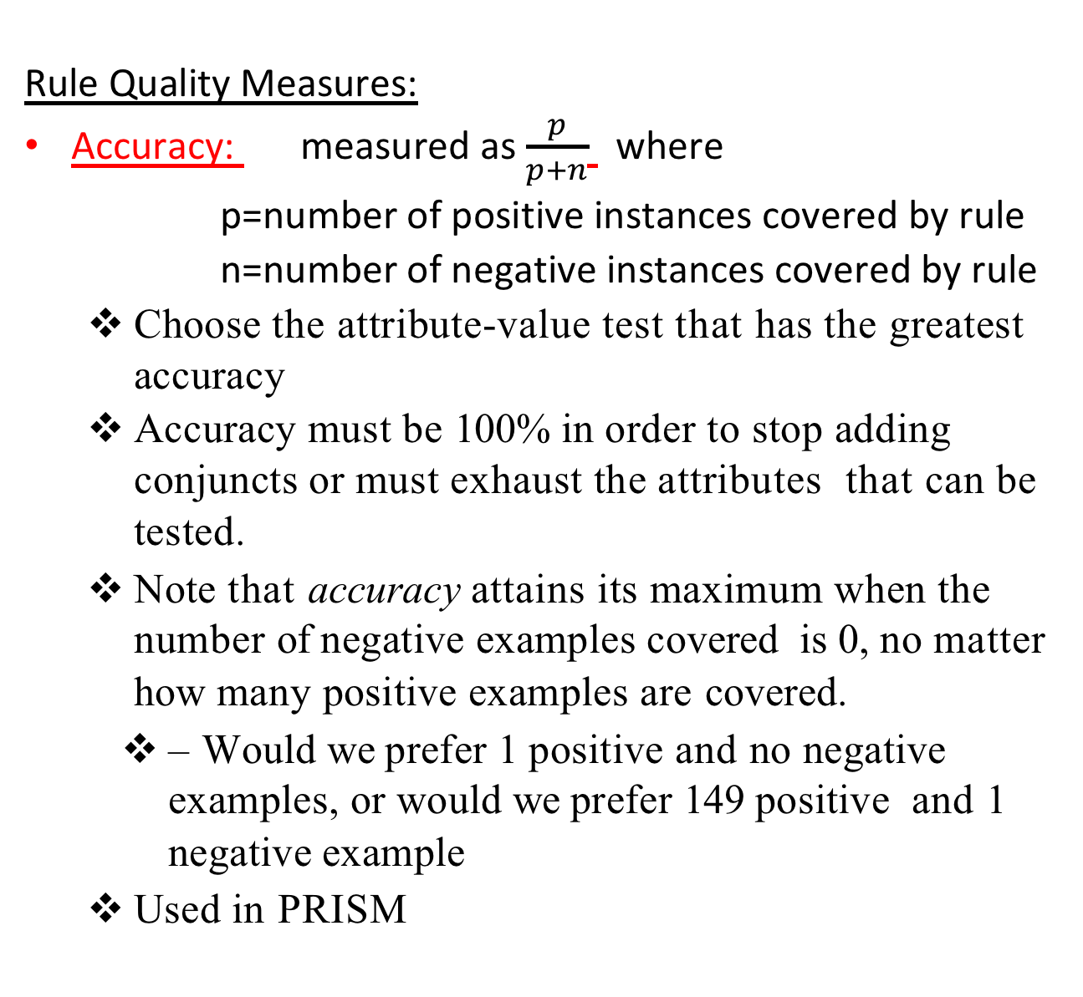
Classification Rules
Rule Quality Measures:
Accuracy: measured as $\frac{p}{p+n}$ where
p=number of positive instances covered by rule
n=number of negative instances covered by rule
Choose the attribute-value test that has the greatest accuracy
Accuracy must be 100% in order to stop adding conjuncts or must exhaust the attributes that can be tested.
Note that accuracy attains its maximum when the number of negative examples covered is 0, no matter how many positive examples are covered.
– Would we prefer 1 positive and no negative examples, or would we prefer 149 positive and 1 negative example
Used in PRISM

Slide 5
AGE SPECTACLE ASTIGMATISM TEAR-PRODUCTION LENS
------ ----------------- ------------------ ------------------------- --------
child nearsighted no reduced NONE
child nearsighted no normal SOFT
child nearsighted yes reduced NONE
child nearsighted yes normal HARD
child farsighted no reduced NONE
child farsighted no normal SOFT
child farsighted yes reduced NONE
child farsighted yes normal HARD
young-adult nearsighted no reduced NONE
young-adult nearsighted no normal SOFT
young-adult nearsighted yes reduced NONE
young-adult nearsighted yes normal HARD
young-adult farsighted no reduced NONE
young-adult farsighted no normal SOFT
young-adult farsighted yes reduced NONE
young-adult farsighted yes normal NONE
senior nearsighted no reduced NONE
senior nearsighted no normal NONE
senior nearsighted yes reduced NONE
senior nearsighted yes normal HARD
senior farsighted no reduced NONE
senior farsighted no normal SOFT
senior farsighted yes reduced NONE
senior farsighted yes normal NONE

Slide 6
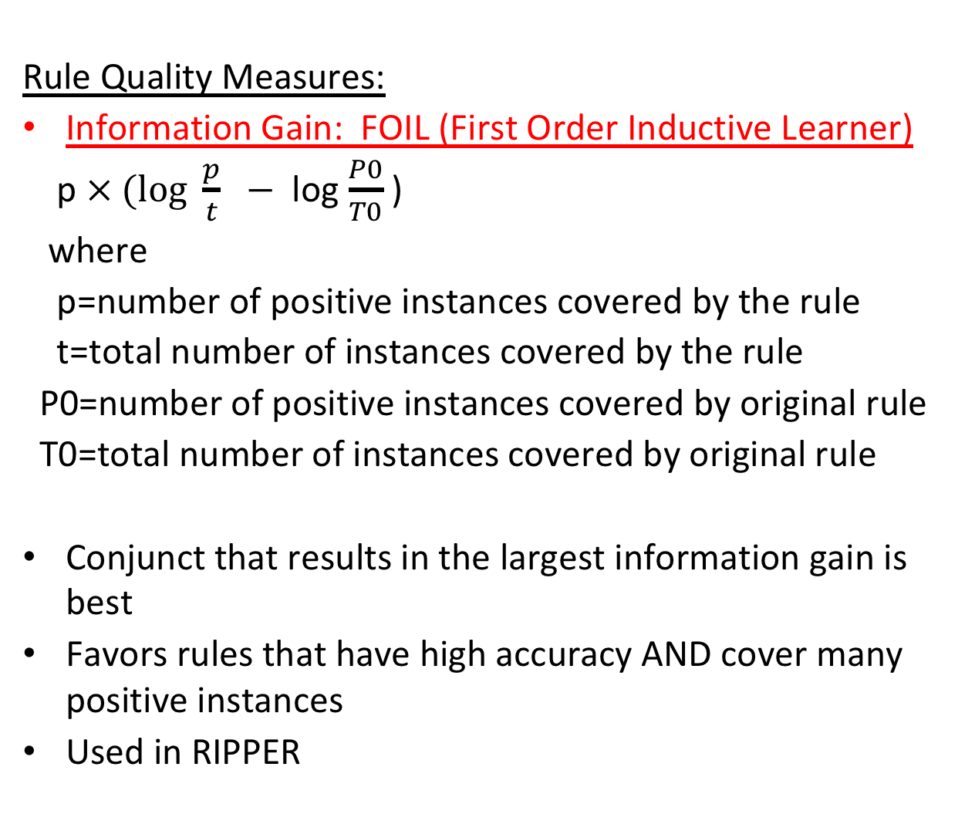
Classification Rules
Rule Quality Measures:
Information Gain: FOIL (First Order Inductive Learner)
p $× (log \frac{p}{t}$ $−$log $\frac{P0}{T0}$ )
where
p=number of positive instances covered by the rule
t=total number of instances covered by the rule
P0=number of positive instances covered by original rule
T0=total number of instances covered by original rule
Conjunct that results in the largest information gain is best
Favors rules that have high accuracy AND cover many positive instances
Used in RIPPER

Slide 7
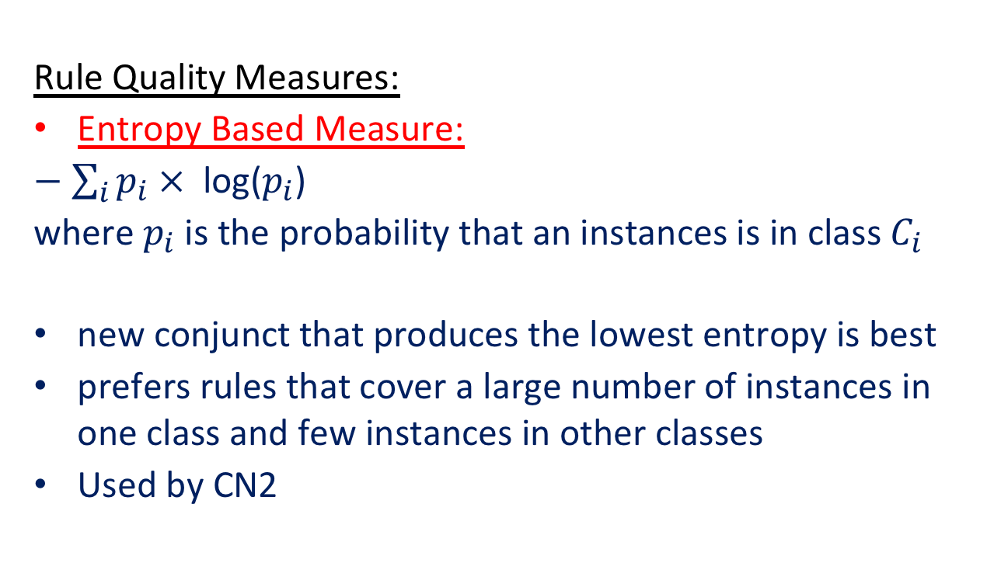
Classification Rules
Rule Quality Measures:
Entropy Based Measure:
$−$ $\sum_{i}{p_{i} × \text{log}\text{(}p_{i}\text{) }}$
where $p_{i}$is the probability that an instances is in class $C_{i}$
new conjunct that produces the lowest entropy is best
prefers rules that cover a large number of instances in one class and few instances in other classes
Used by CN2

Slide 8
Classification Rules
Criteria for an Acceptable Rule:
when rule quality measure does not improve a rule
could have a threshold on rule quality for stopping
but might miss some attribute-value conjuncts that significantly improve the rule
Pruning Rules:
can use a pruning set
often use a different rule

Slide 9
Classification Rules
Handling Missing Attribute Values:
During model construction:
Treat a missing attribute value as not satisfying any test on that attribute
During testing:
Treat a missing attribute value as not satisfying any test on that attribute
Handling Numeric Predictor Attributes:
Can do local or global discretization as was done for decision trees

Slide 10
Decision Tree Induction versus Covering Algorithms
Both are greedy, selecting a test that looks best and sticking with it
decision trees are divide-and-conquer since choose an attribute to split on that divides the problem into subproblems; classification rules are separate-and-conquer since they choose an attribute-value test that covers many of the instances in the class (and excludes many that are not in the class), separates out the positive instances that are covered, and continues the process on the instances that remain.
Covering algorithms generally focus on one class at a time, whereas decision tree induction considers all classes and tries to maximize the purity of the split.
Splits are multiway for methods based on information gain, and binary for methods based on Gini index, but in both cases they are considering all classes.
Decision trees may be much larger than a set of rules

