Slide 1

Final Project Report – Ethics Review
ISYE 6748
Piper Gradient
Dennis Morozov
7/18/2021

Slide 2
“AI systems should be designed to augment, complement and empower human cognitive, social and cultural skills.”
- IEEE Australia’s AI Ethics Principles

Slide 3
Index
1. Introduction
2. Stakeholders
3. Data Review
4. Model Review
4. Q&A

Slide 4
Introduction
AI Ethics Overarching Principles
AI ethics is a dynamic filed, a wild west for ethics, where every organization is become aware of the ethical implication of ML technologies. There are few areas of agreement on AI and ML ethics:
Consider the human element and all stakeholders, protect their rights and privacy.
Minimize bias, strive for fairness.
Build systems that are transparent, flexible for improvements, and explainable.
Allow room for debate and conversations but keep a clear channel of ownership and accountability.

Slide 5
“It’s not whether AI systems alone produce questionable ethical outcomes, it’s whether the AI systems are less biased than the current human systems and their known biases.”
- Australia’s AI Ethics Principles

Slide 6
Stakeholders
^{Twitter:}
Twitter the company: Twitter has specific policies that govern how developers use twitter data:
https://developer.twitter.com/en/developer-terms/agreement-and-policy
Twitter users: per twitter policy, twitter users may request to delete their history at any time, and developers are responsible for regularly updating their dataset.
^{Data Science Practitioners:}
Student developing the model: In this case, I am responsible for the groundwork of this model. The methods and approaches in developing the model should be transparent, reproducible, clear and flexible to updates.
Piper Gradient Instructors: the piper team acting as instructors have had a “commentary” session on the project and had influence in the direction of the project, delivered a datasets for model development, communication, and ultimately will own a copy of the project to serve their purpose.
Piper Gradient Data Scientist that may implement the model in future tools
Decision Makers and Product Implementation
^{Piper Gradient Team}
^{Piper Gradient System}
^{Regulators:}
^{Twitter Legal Team}
GT Ethics and Guidelines for AI
US Government Privacy Protection Laws

Slide 7
Data Reivew
Twitter
The data was collected using the twitter API by the Piper team and it was filtered around the topic of American Jobs or the Infrastructure Bill. Twitter data was not updated through the course of the project.
3 datasets are available for this project
Small – 47 k rows, used for developing and testing
Medium – 923 k rows, used to test and validate algorithms
Large – 93 million rows, used to perform final analysis
Kaggle Datasets with Emotional Labels:
Text with Emotional Categories:
Kaggle name: Emotions dataset for NLP
Kaggle usability score: 10
Vocabulary with Emotional Categories – Kaggle usability score of 8.2
Kaggle name: Emotions Sensor Data Set
Kaggle usability score: 8.2
Both Kaggle datasets have additional documentation for data generation, traceability and lifecycle.
The datasets were used to train CNN models to classify tweets with emotional labels

Slide 8
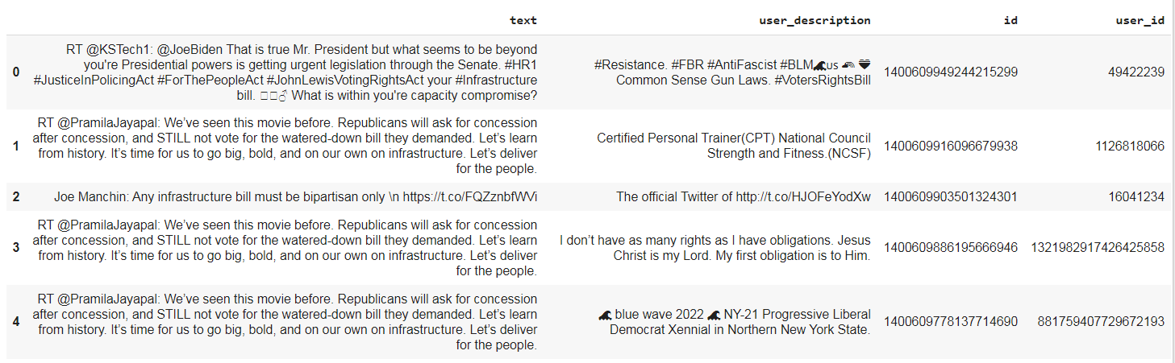
Data Review
Twitter Data Sample
Features
The data include twitter ids, user ids, response to twitter ids, actual text of the twitter, user profile descriptions and more.
Full list of columns: created_at', 'id', 'reply_to_id', 'screen_name', 'coordinates', 'place', 'retweet_count', 'favorite_count', 'lang', 'source', 'is_quote_status', 'user_id', 'user_loc', 'user_description', 'verified', 'followers_count', 'friends_count', 'favourites_count', 'statuses_count', 'listed_count', 'user_created_at', 'text'

Slide 9
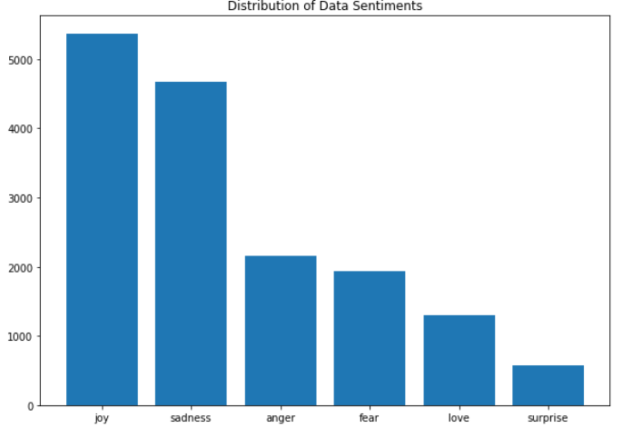
Data Review – Kaggle Emotions from Text
Text with Emotional Categories
The training dataset sentimental distribution was not even, sentiments like joy and sadness are the most prevalent, while “surprise” the most under-represented.
During model development, several attempts at minimizing the bias were undertaken, with similar model performance.
Sample with replacements.
Shrink data to the most under-represented fields.
The CNN model trains well with big datasets, thus any strategies at reducing data made model performance significantly worse.
https://www.kaggle.com/praveengovi/emotions-dataset-for-nlp?select=train.txt

Slide 10
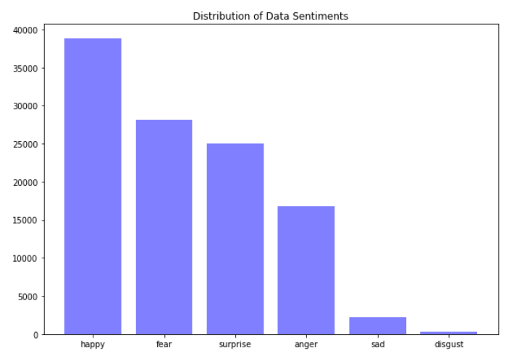
Data Review – Kaggle Emotions from Vocabulary
Vocab with Emotional Categories
This dataset was mostly used as a benchmark and may be inconsequential to model results. It must be pointed out however that the dataset is also not evenly distributed, uneven distribution is highly biased against “sad” and “disgust”.
During model development, several attempts at minimizing the bias were undertaken, with similar model performance.
Sample with replacements.
Shrink data to the most under-represented fields.
https://www.kaggle.com/iwilldoit/emotions-sensor-data-set

Slide 11
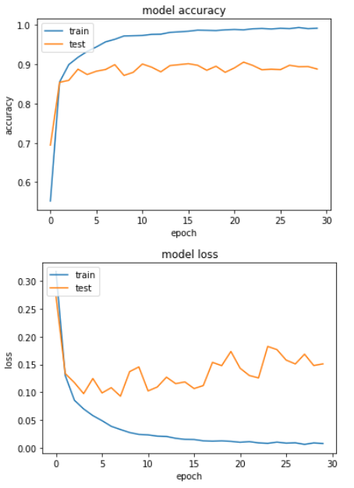
Model Review – best performing CNN
Best performing model:
At the first glance the model seems to train and validate very well. A closer look revealed high bias.

Slide 12
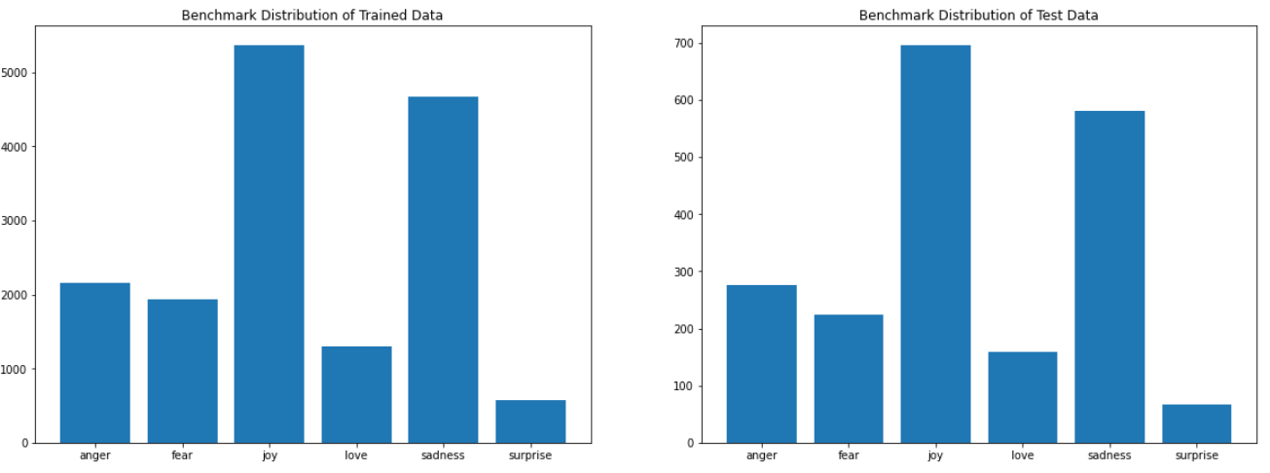
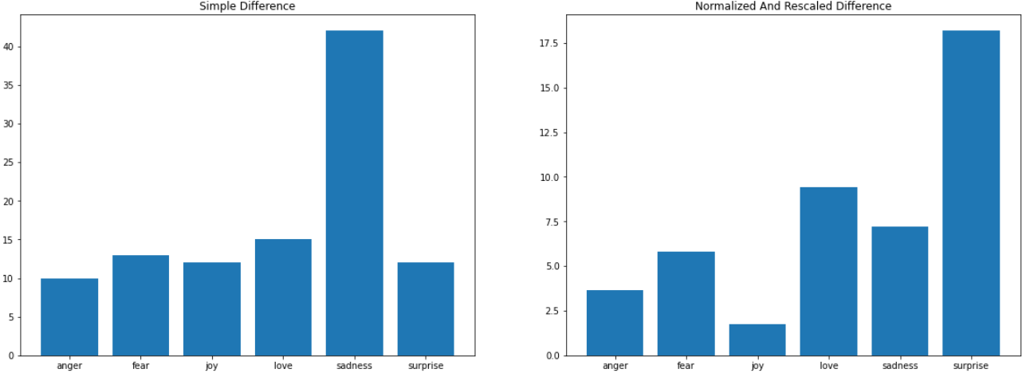
Model Review - Convolutional Neural Net (CNN)
Benchmark:
Distribution of sentiment frequency for the training and testing dataset.
Model Results:
Distribution of how many sentiments were miss-categorized.

Slide 13
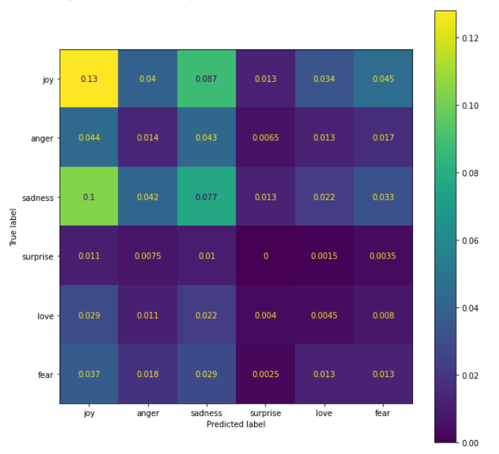
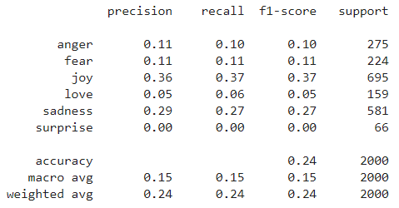
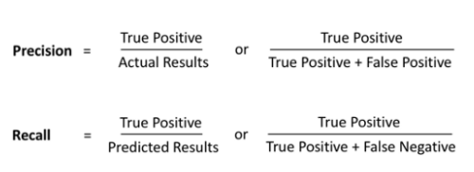
Model Review - Convolutional Neural Net (CNN)
Configuration B Performance a deeper look:
How many selected
items are relevant
From the relevant items,
How many were selected

Slide 14
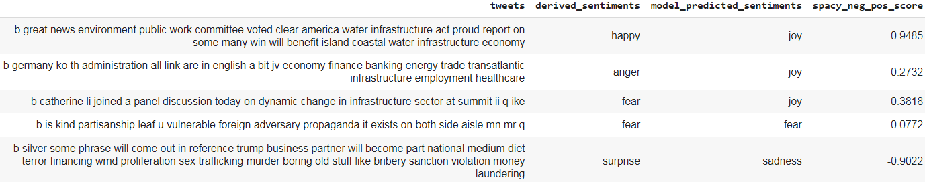
Model Review- Heuristic Comparison: Results to Benchmarks
Dataset Challenges
Derived sentiments used a vector distance calculation between each tweet vector and a predefined vocabulary with sentimental labels. Tweet vector distance was then used to assign a label to each tweet as another benchmark measure.
Spacy sentiment prediction can be interpreted as -1 negative 0 neutral and 1 as positive.
CNN model predicted labels can then be compared to both Spacy, vector derived sentiments, and heuristically to the actual text.

Slide 15
Q & A
What data biases have you discovered?
Data is highly skewed in distribution which results in model prediction bias. The bias is so strong that the model never predict the sentiment “surprise” .
What are the appropriate metrics to assess the capability's output? What would be tolerable in the actual operation of the Gradient system?
Sentimental analysis is a tricky thing no nail down. The best metrics are heuristic, or whether a human agrees with model predictions. Pre-labeled datasets are a powerful tool to test the model also because it can identify bias and skew in predictions.
How may introducing an accountable human to the Gradient CONOPS produce cognitive biases and/or confirmation bias?
Since at least part of the model performance evaluation is heuristic, a single practitioner may have significant sway in whether the model perform as “expected”. To minimize human judgement bias, multiple people can validate model classification.
How should undesired bias and potential impacts of the bias be communicated to a Gradient user and administrator who interact with the technology and output data?
At the user interface level, a bias index (or “sureness” index) can be simulated with color transparency. If a result is heavily biased, the transparency of the visual object can be increased.

Slide 16
Q & A
If analyses rely on third-party technology, software, or data product, what additional risks may be associated with that third party's assumptions, motives, or methodologies?
Indeed, much of the analysis is heavily reliant on datasets that were labeled by third parties. Even the benchmarks use third party libraries. The main concern is the lack of transparency and clear documentation of methods. I found several NLTK lemmantizers and stemmers that yield slightly different results. The subtle differences in different NLTK packages were not heavily studied for this model, but the differences were evident.
Given the purpose of the AI, what level of explain-ability or interpretability should be required for how the AI made its determination? For third-party dependencies, how can you ensure a level of explain-ability or interpretability?
Neural Network models are notoriously hard to explain, however they can perform well in natural language processing. TensorFlow library made it very easy to access all model weights and parameters for each layer. An embedding layer was also added to the model to improve performance, however it degrade explain-ability.
What processes need to be in-place during operation for discovering undesired bias and drawing conclusions?
The most important process is a flexible and iterative system where it’s easy to test and improve the model with new data. The main challenge at the moment is data availability. Neural networks models perform well with large amount of data, thus this model must contently be updated and retrained with new data.

