Slide 1
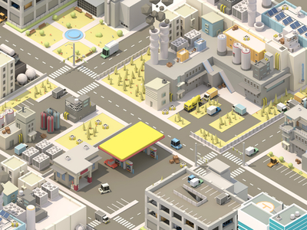
Survivors Idle
A horde has been spotted outside your settlement!
0
of
10
Scavenging
2
10
Exploring
2
10
Security
2
10
Recruiting
2
10
Builders
2
10

