Slide 1
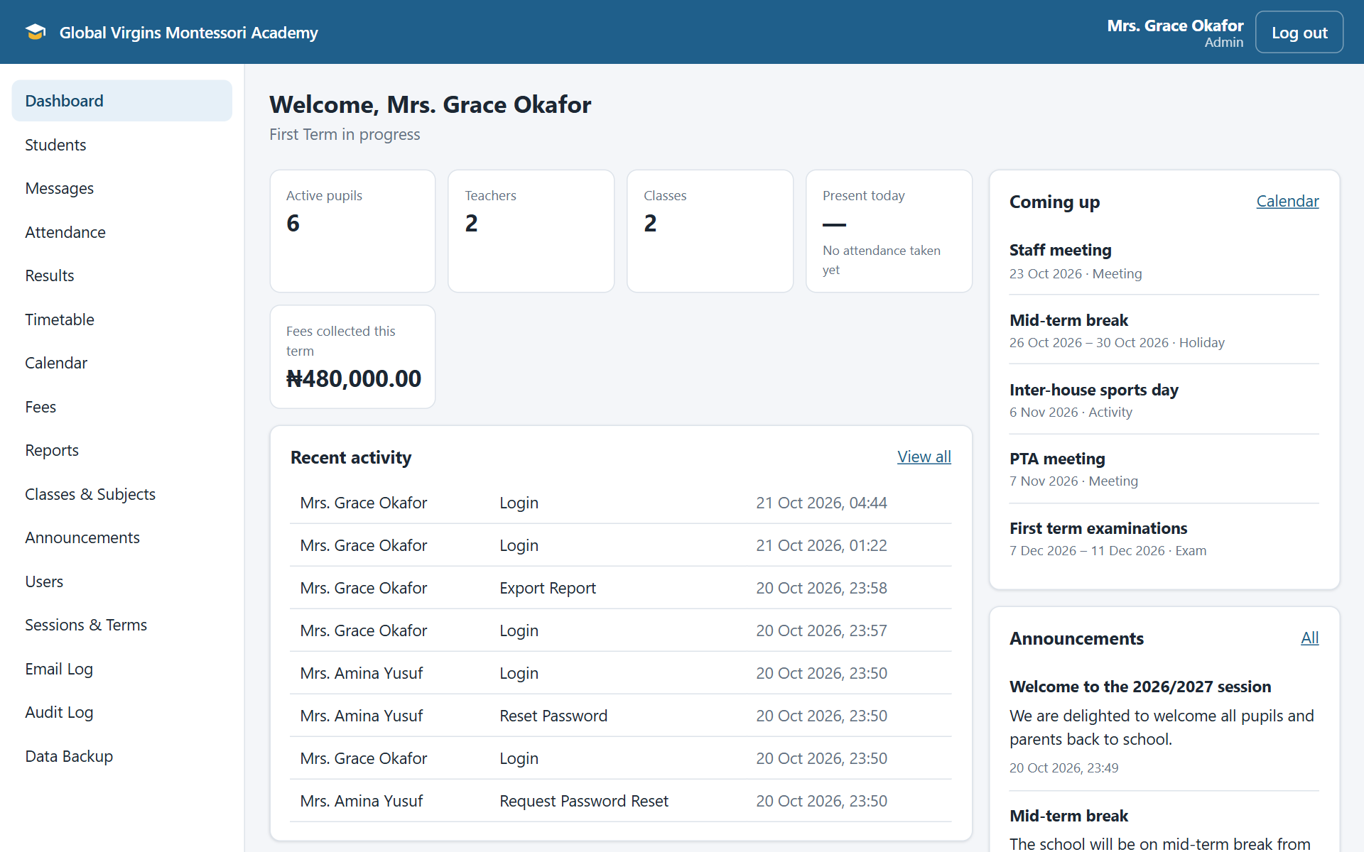
School Management System
for Global Virgins Montessori Academy
Samuel Batu · Fred Wosornu · Seth Mensah Quaye · [Your name]
[Course code] · Supervisor: [Name] · October 2026
Notes:
Introduce the group and the project: a web-based school management system built for Global Virgins Montessori Academy, from our Software Requirements Specification. The picture on the right is the real administrator dashboard.

Slide 2
The problem today
1
Paper and spreadsheets
2
Results worked out by hand
Records are duplicated, hard to search and easy to lose.
Totals, grades and positions take days each term, with errors.
3
Fees hard to track
4
Parents kept in the dark
Balances, receipts and follow-up take a lot of office time.
Little visibility of attendance, results or fees; no backup either.
Notes:
Explain the current situation described in our SRS: paper registers and spreadsheets, hand-calculated results, hard-to-track fees, and little information for parents. Every one of these costs staff time and risks errors or lost records.

Slide 3
Aim and objectives
1
Specify the requirements (SRS)
AIM
2
Design one central database
A secure, easy-to-use web system that makes the school's academic and administrative work faster, more accurate and more transparent.
3
Build every module: records, attendance, results, fees, timetable, communication, reports
4
Role-based access for admin, teachers, bursar and parents
5
Automate grades, report cards, receipts and reports
6
Test against the requirements, in a production-like setting
7
Develop together on GitHub with traceable contributions
Notes:
Read the aim, then summarise the seven objectives. Point out that each objective is checked off in Chapter 5 of the report.

Slide 4
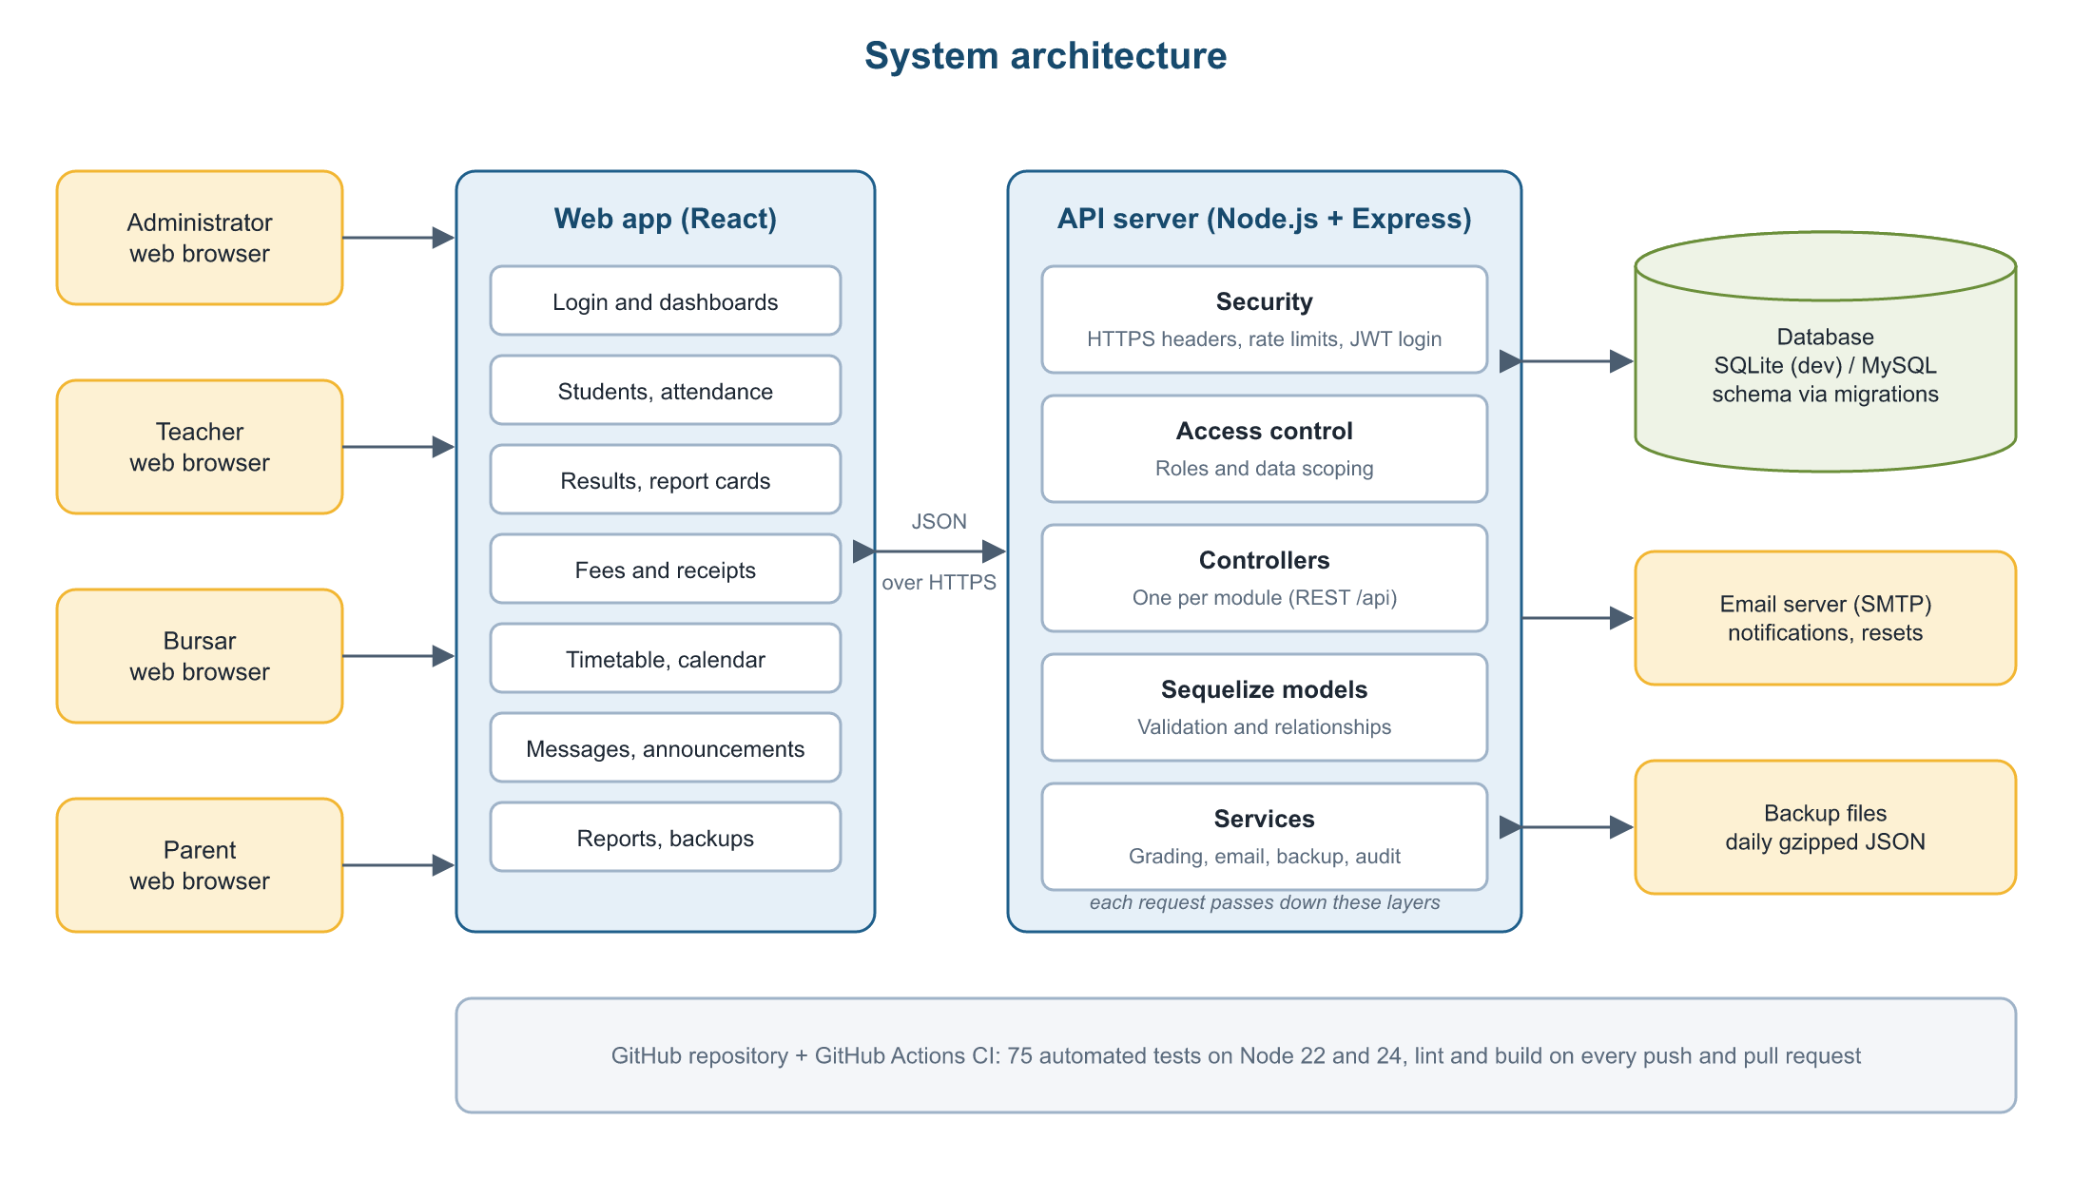
How it works
Three tiers: React web app → Node.js + Express API → SQLite / MySQL database
Notes:
Walk through the architecture from left to right: each role uses the React web app in a browser; it talks to the Node.js and Express API over HTTPS; every request passes the security layers before reaching the database. The server also sends emails and keeps daily backups. GitHub runs our 75 tests on every change.

Slide 5
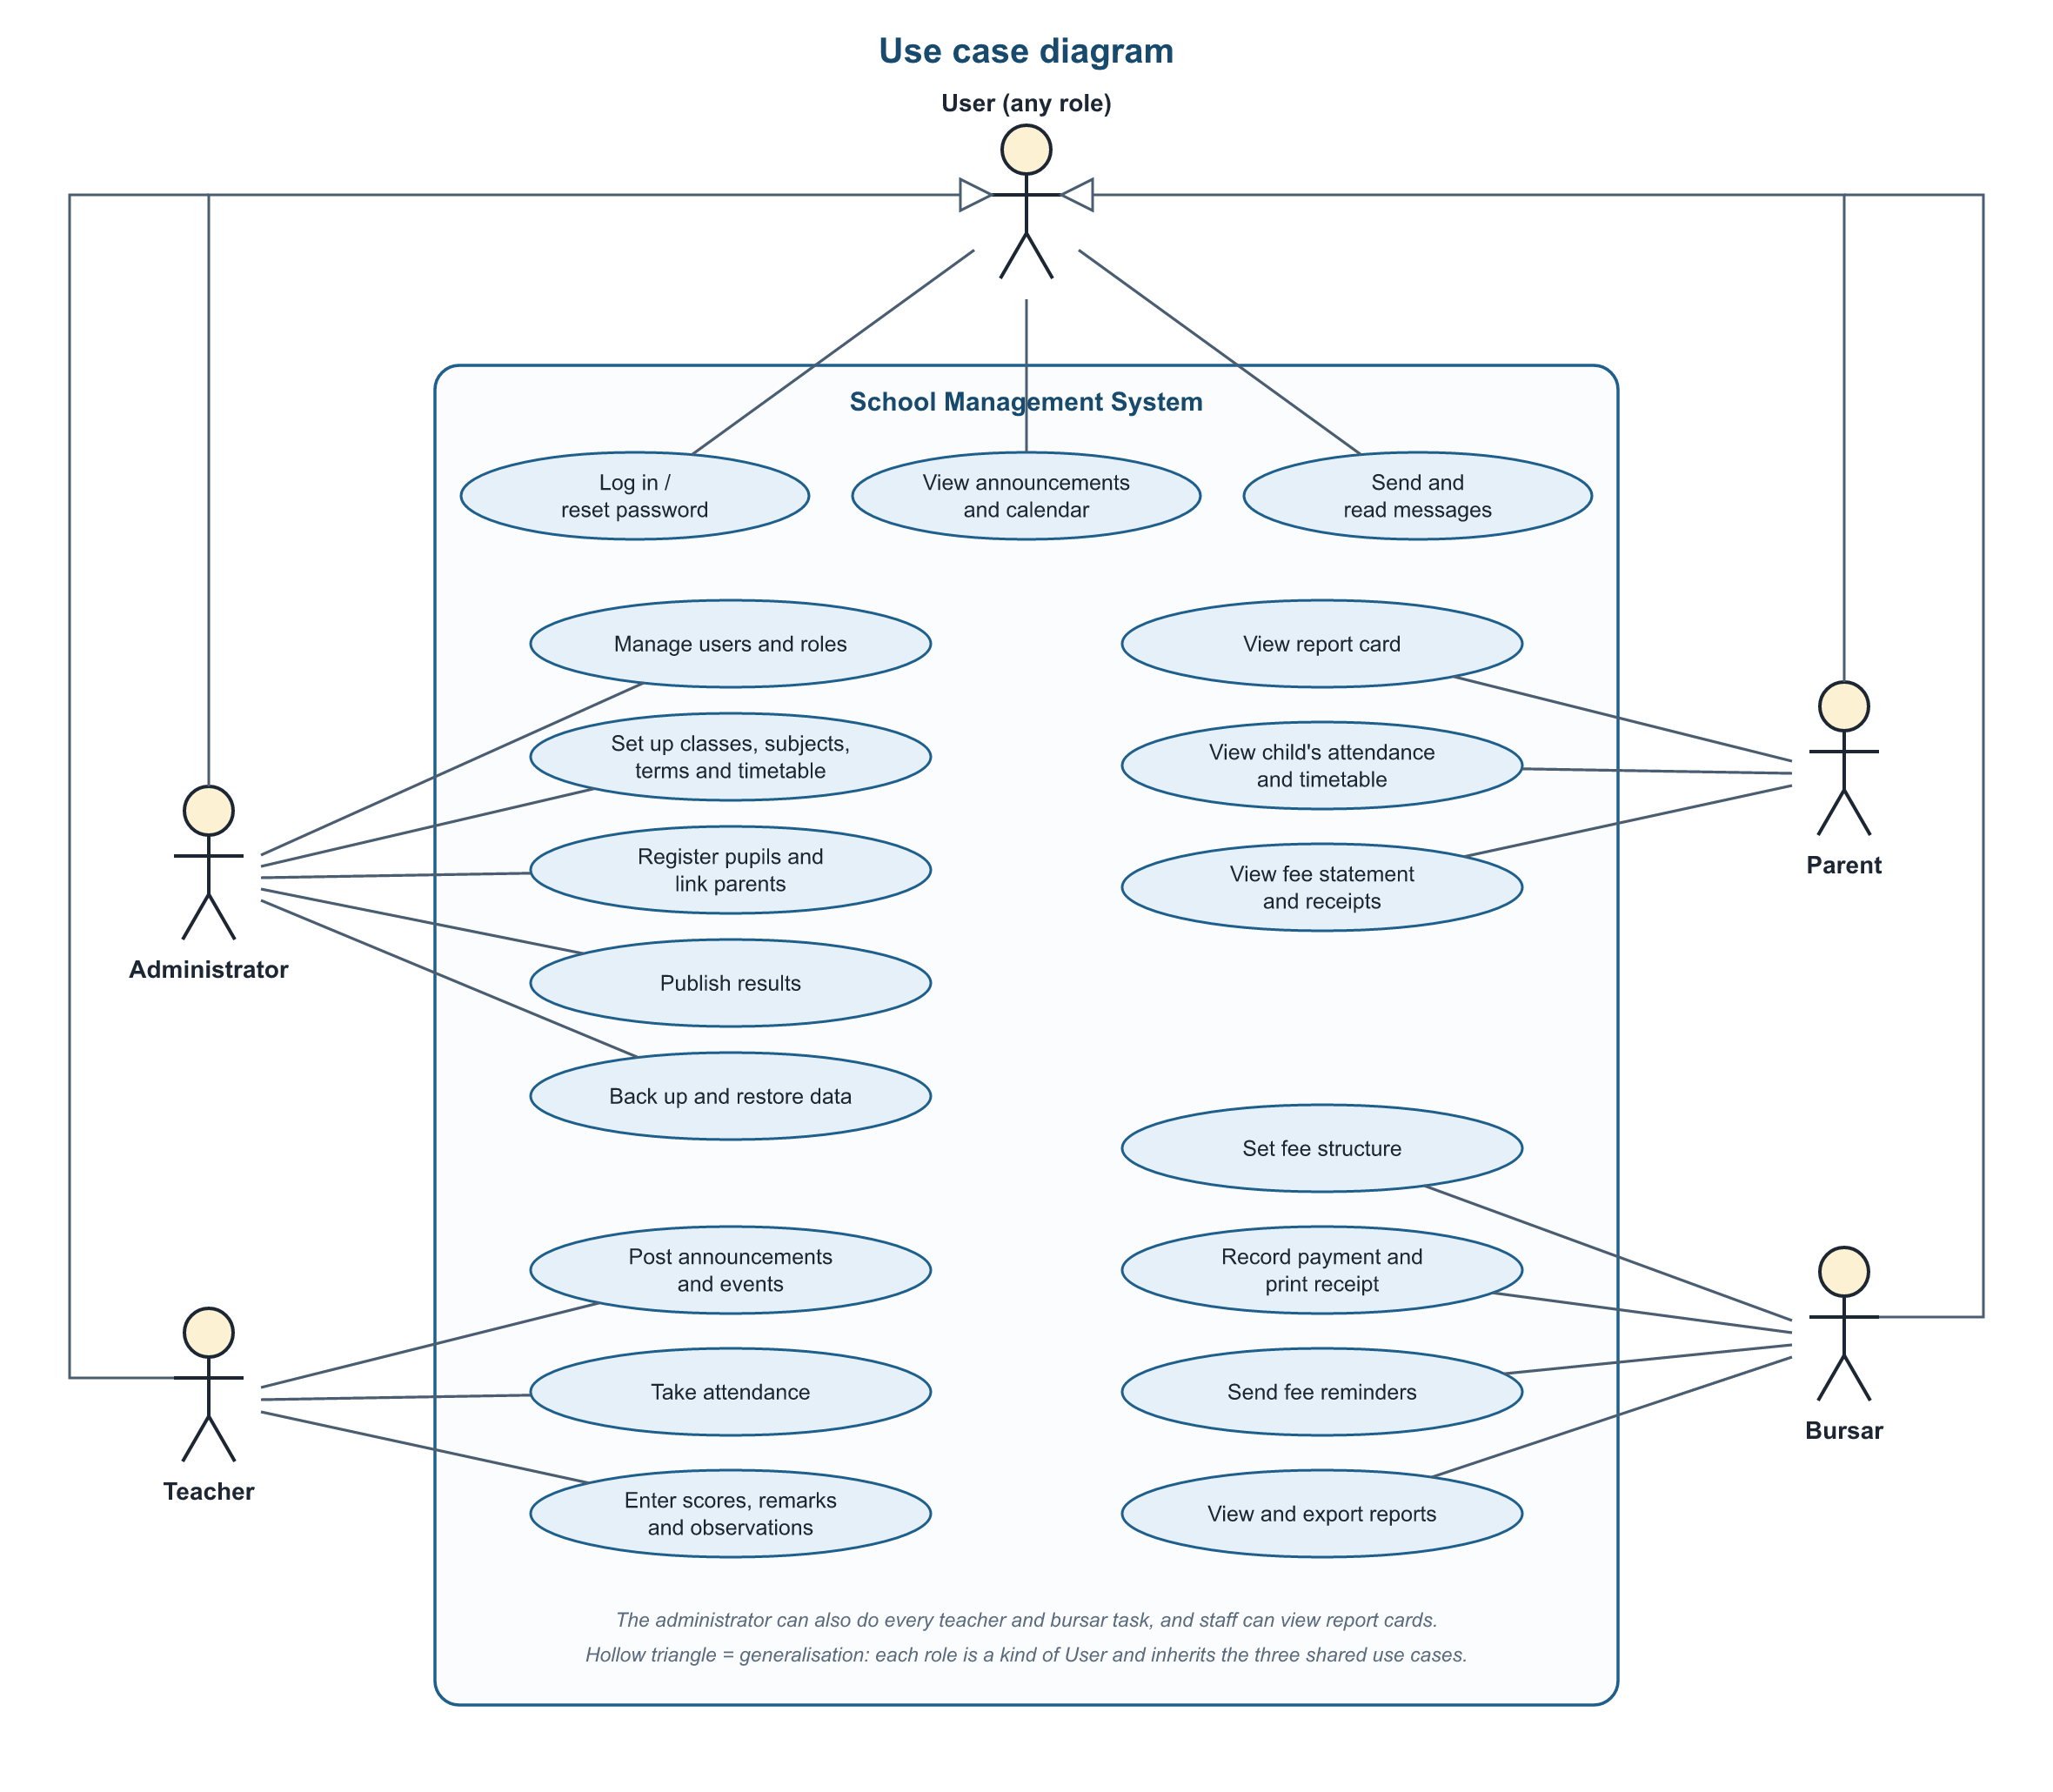
Four roles, one system
Administrator
Users, classes, terms, timetable, publishing results, reports, backups
Teacher
Attendance, scores and remarks, Montessori observations, messages
Bursar
Fee structure, payments and receipts, reminders, fee reports
Parent
Their own children: attendance, report cards, fees, messages
Notes:
Every user signs in to the same system, but sees only what their role allows. Explain each role briefly using the use case diagram. Stress that access is checked on the server for every request, so a parent can only ever see their own children.

Slide 6
What the system does
1
2
3
4
Pupil records
Attendance
Results
Fees
Admission, classes, parents
Daily register in a few clicks
Auto grades, positions, report cards
Statements, receipts, debtors
5
6
7
8
Timetable
Communication
Reports
Data backup
Clash-free periods, school calendar
Messages, notices, email alerts
Print or export to Excel
Daily, with safe restore
Notes:
Give a one-line tour of the eight modules. All requirements from the SRS are covered, including the Montessori developmental observations on report cards.

Slide 7
Everything at a glance
1
Live numbers
Pupils, staff, attendance and fees
2
What is coming up
Events and announcements
3
Who did what
Every key action is logged
Notes:
Show the administrator dashboard: live counts, today's attendance, fees collected this term, upcoming events and the audit trail of recent activity. Teachers and parents get their own dashboards. If possible, switch to the live demo here.

Slide 8
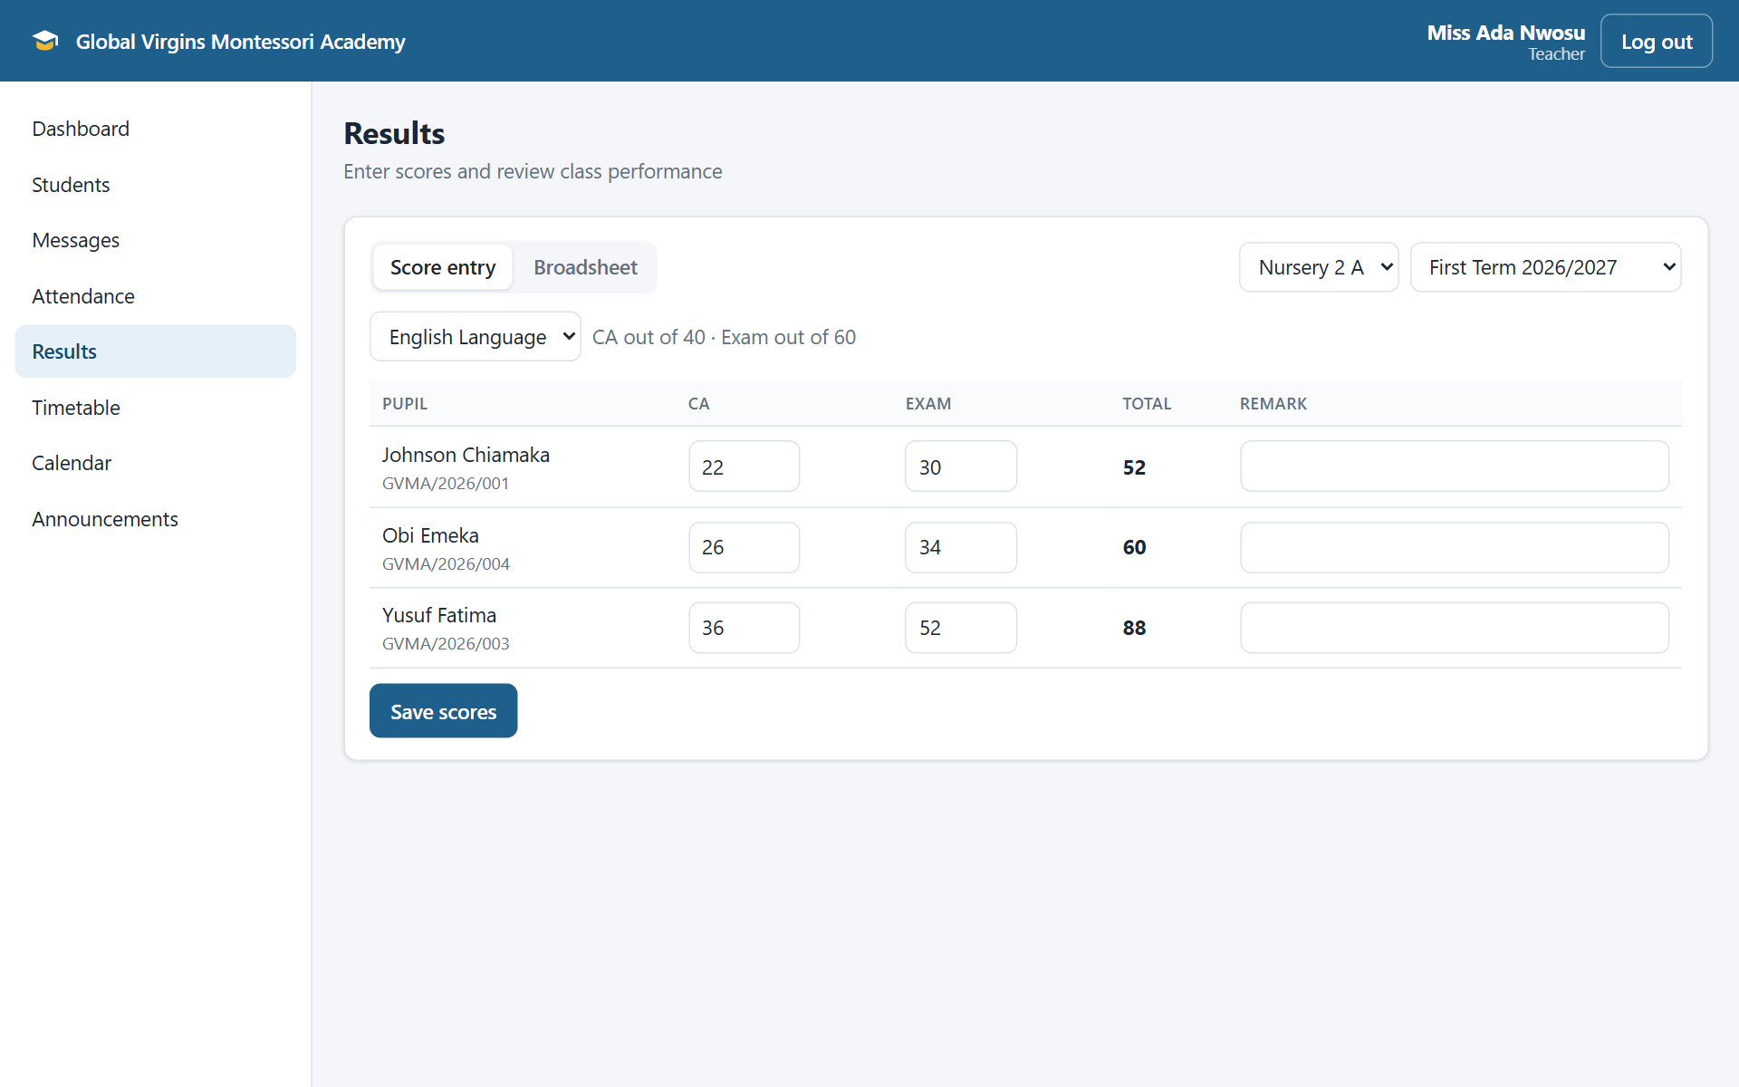
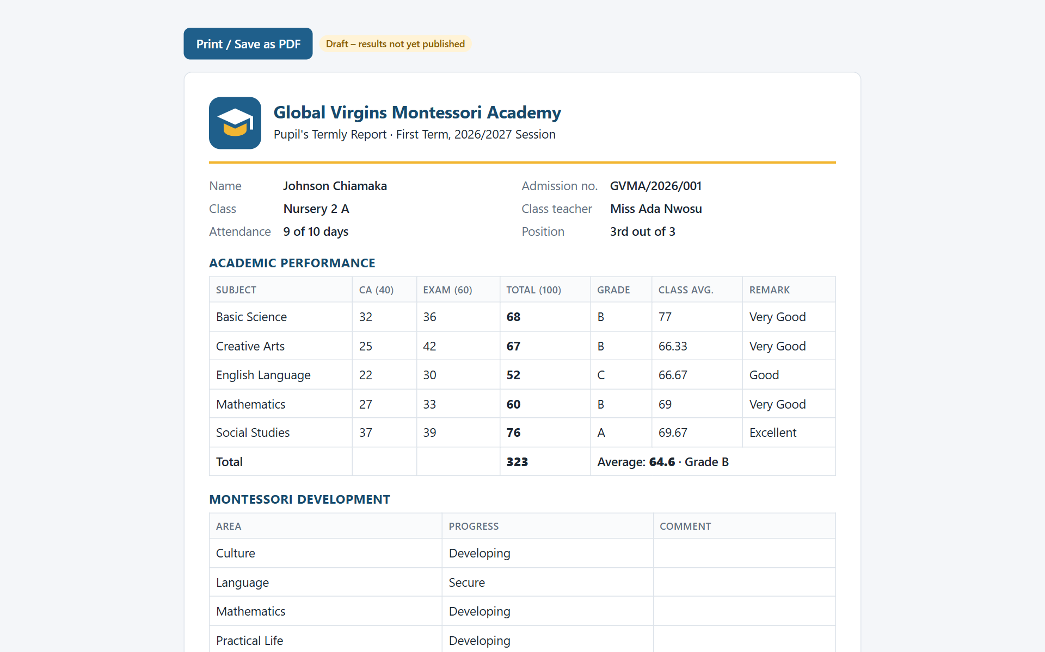
Results without the arithmetic
Teacher enters CA and exam scores
Printable report card with grades and position
Totals, grades, averages and class positions are calculated automatically.
Notes:
Teachers type CA (out of 40) and exam (out of 60) scores; the system checks the range and calculates totals, grades, averages and class positions. The report card also shows attendance, Montessori observations and remarks. Parents only see it after the administrator publishes results, and they get an email when that happens.

Slide 9
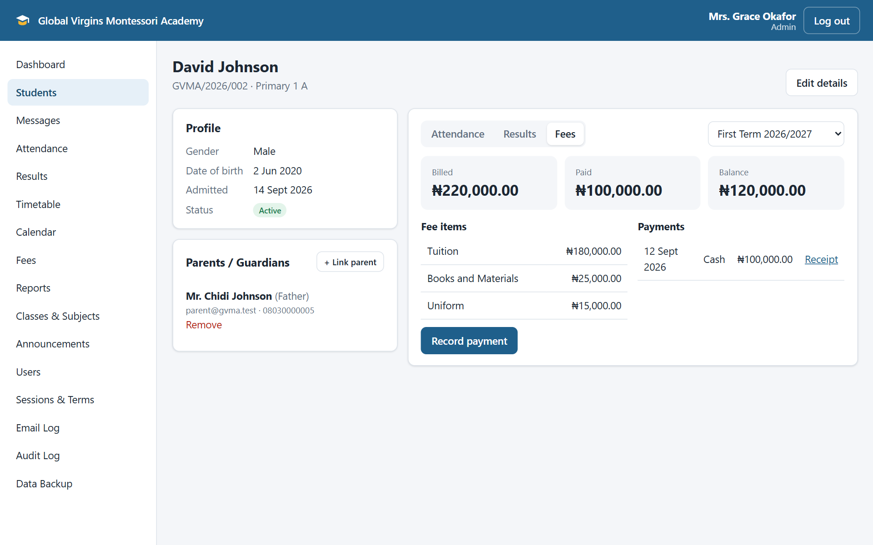
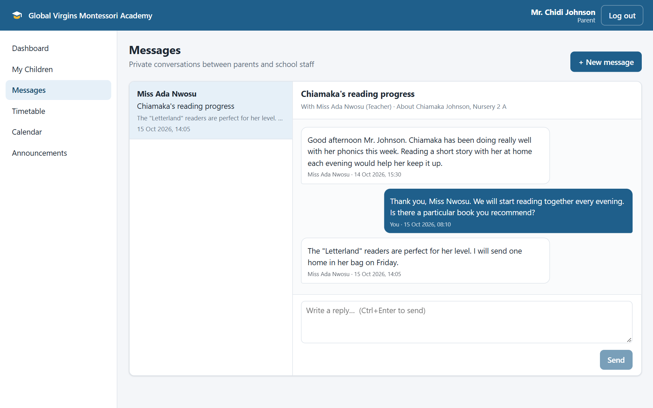
Fees and communication
Fee statement with the balance owed
Private parent–teacher messaging
Receipts, reminders, results and messages can all be sent by email.
Notes:
On the left, a pupil's fee statement: billed, paid and balance, with numbered receipts. On the right, a private conversation between a parent and the class teacher. Every new message, receipt and published result can also be emailed.

Slide 10
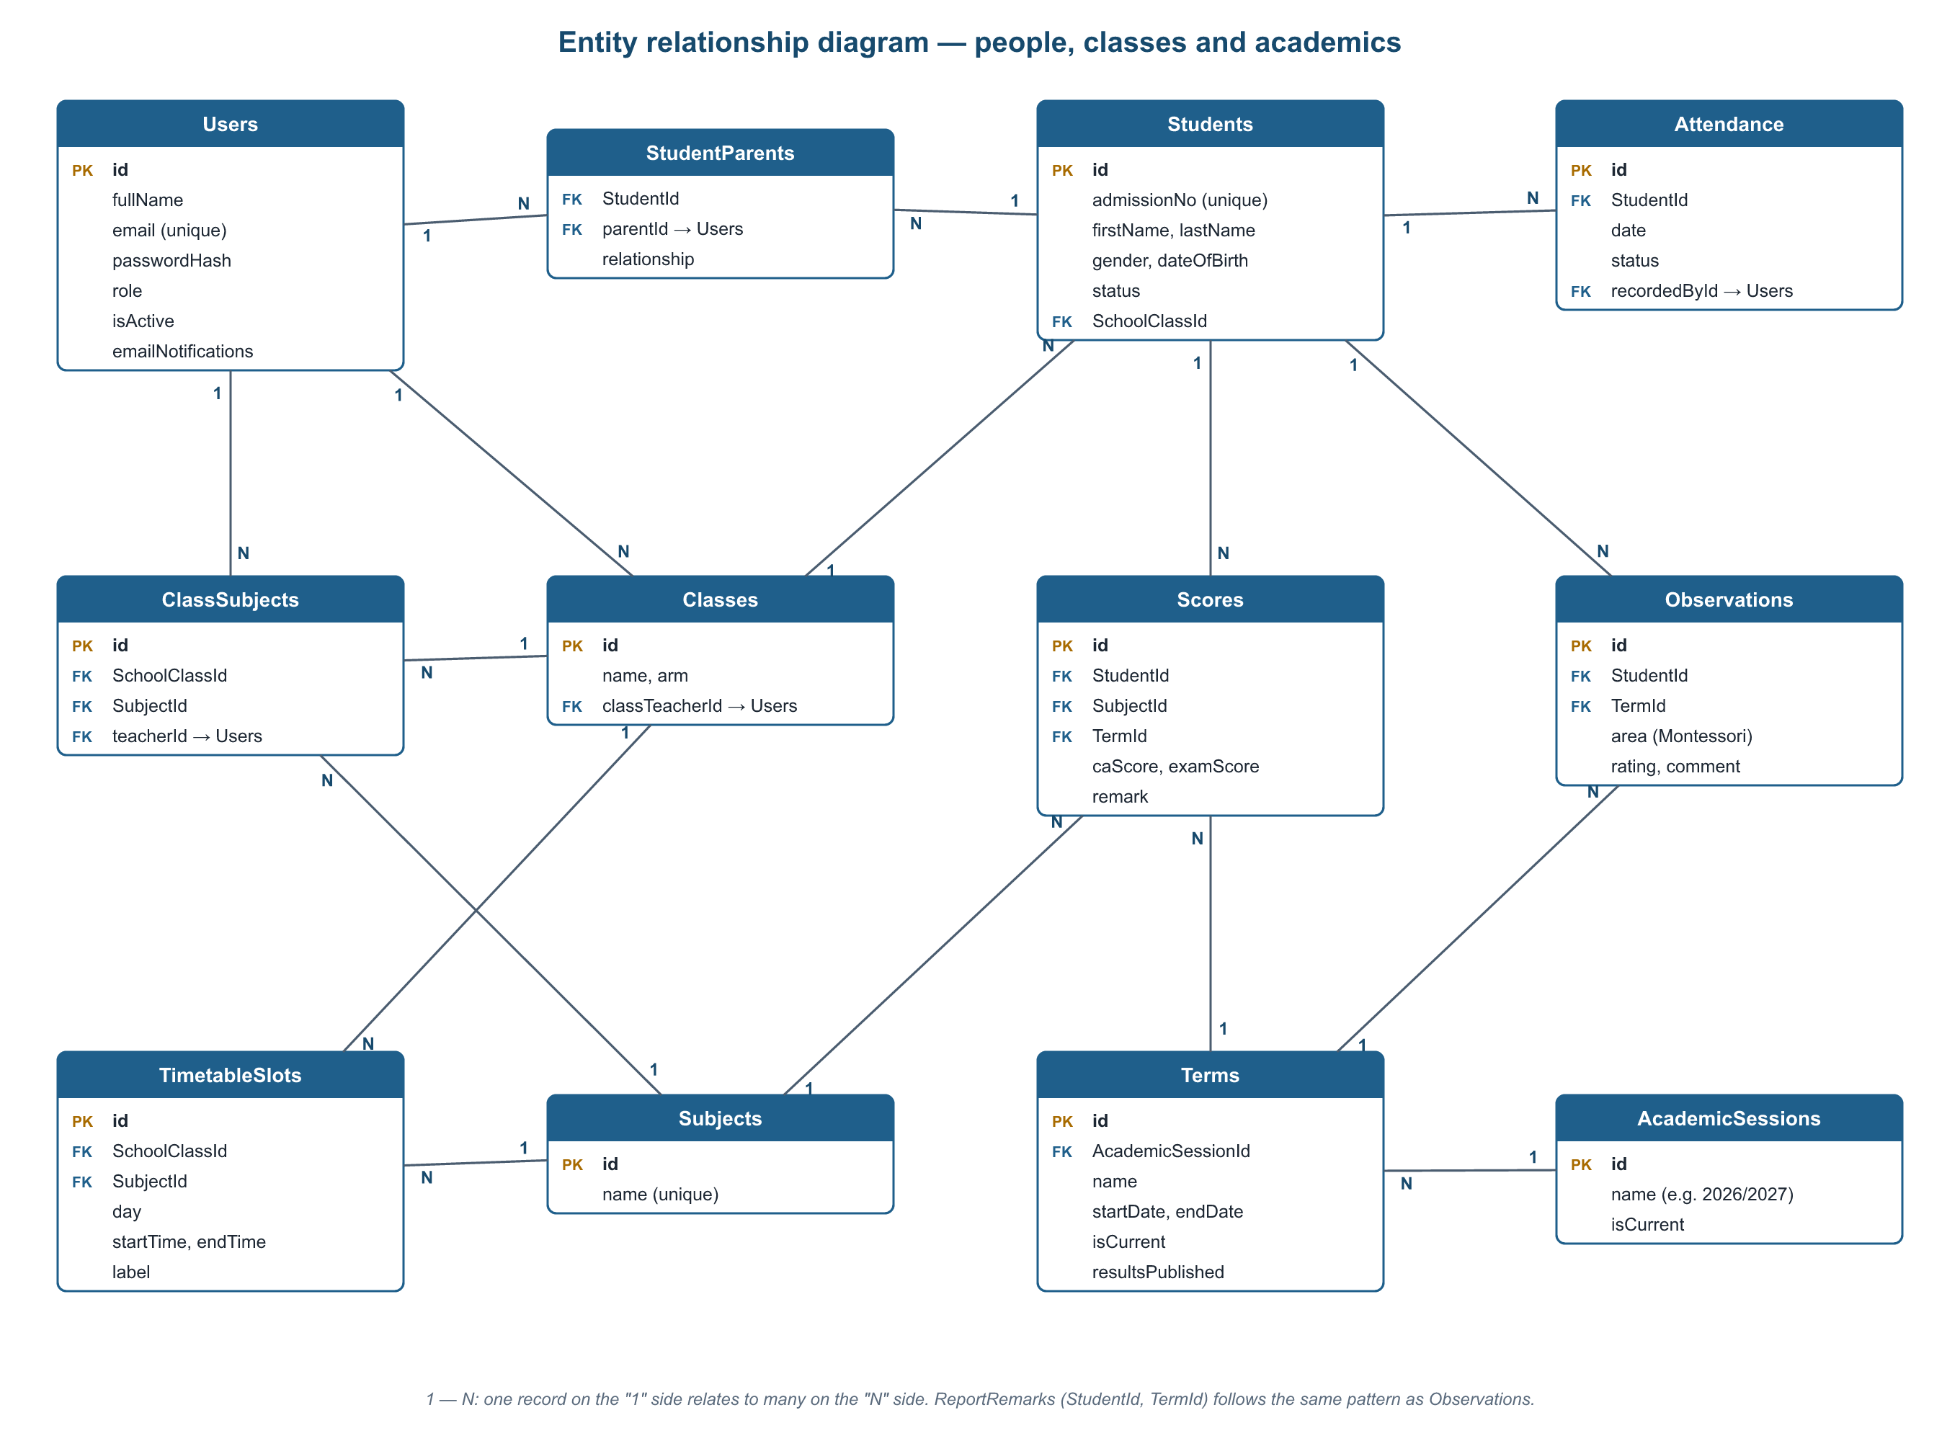
Database design
22
related tables
Foreign keys link every record
Unique rules block duplicates
Migrations update it without losing data
Notes:
The database has 22 related tables; this diagram shows the academic half. Foreign keys and unique rules stop bad data, for example two attendance records for the same pupil on the same day. Changes to the structure go through migrations, so the school never loses data when the system is updated.

Slide 11
Security built in
Hashed passwords
Role checks on every request
✓
✓
bcrypt; never stored in plain text
Parents only ever see their own children
Sign-in limits
Sessions time out
✓
✓
10 failed attempts → 15-minute block
Signed out after 30 idle minutes
One-time reset links
Safe settings
✓
✓
Expire after an hour; used once
Won't start in production without a strong key
Notes:
The system holds children's data, so security was designed in from the start, following the OWASP Top 10. Go through the six measures. Mention that in production the server refuses to start without a strong secret key.

Slide 12
Tested on every change
75
automated tests, all passing
2
Node.js versions tested on every push
3
real bugs caught and fixed before release
Notes:
We wrote 75 automated tests, grouped as shown in the chart. GitHub runs all of them on two Node.js versions every time anyone pushes code. The tests caught real bugs before release, for example a parent being able to open another family's child, which we fixed.

Slide 13
How we built it
Core system
PR #1
Messaging
PR #3
Password reset
PR #5
Automatic testing
PR #7
Production ready
PR #9
1
2
3
4
5
6
7
8
9
Timetable & calendar
PR #2
Data backup
PR #4
Reports & export
PR #6
Migrations
PR #8
One branch and pull request per increment · tests with every feature
Notes:
We followed an iterative, incremental process. Each of the nine increments was built on its own branch, tested, and submitted as a GitHub pull request, so every member's contribution is visible in the history.

Slide 14
Conclusion and next steps
What we achieved
Next steps
All SRS requirements built and tested
Replaces paper registers and hand-worked results
Parents get secure, timely information
Ready to deploy: one server, HTTPS, daily backups
Pilot with real records, one term at a time
Online fee payment
SMS alerts for parents
Installable mobile app
Import existing records from Excel
Notes:
Conclude: every SRS requirement is built and tested, and the system is ready to deploy for the school. Then list the recommended next steps and future features.

Slide 15
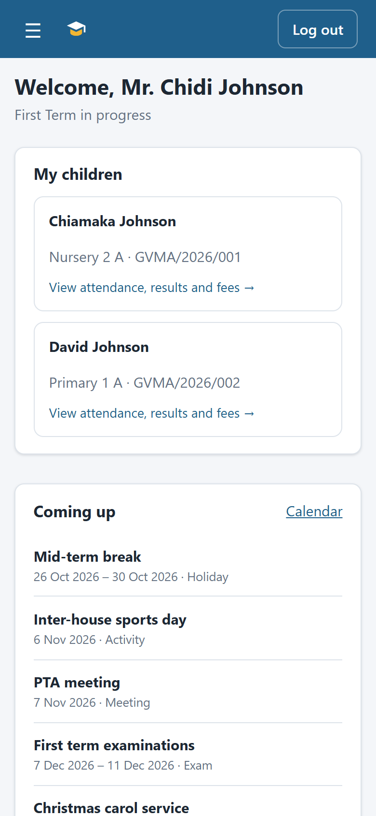
Thank you
Questions and live demo
Demo sign-in: admin@gvma.test · Password123
Code: github.com/dennisnomo89/Myproject
Notes:
Thank the audience and invite questions. If time allows, sign in live as the administrator, a teacher and a parent to show how each role sees different information. The phone screenshot shows that parents can use it on their phones.

