Slide 1
...didn’t find a name yet :,)
Dennis Orlando, Fabio Giovanazzi, Filippo Degrandi, Alessio Zeni

Slide 2

Challenge

Slide 3


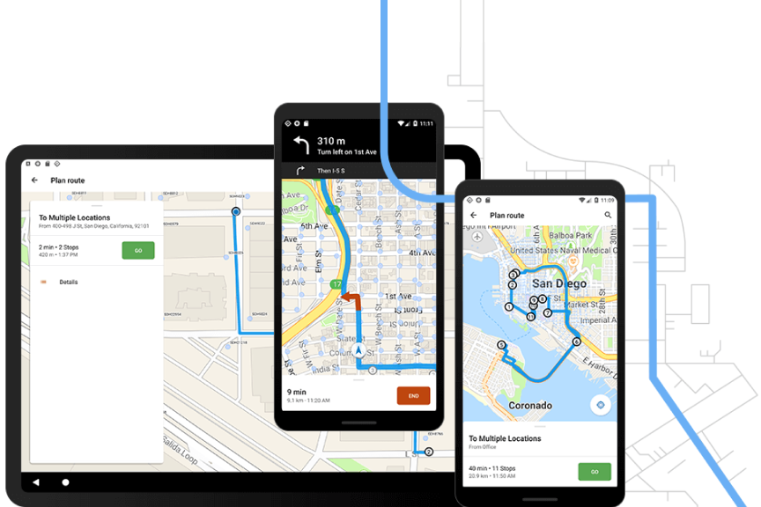
Tech Stack
- Blazingly Fast Rust
- Jetpack Compose Multiplatform ( for now)
- OSM integrations & co
https://www.esri.com/content/dam/esrisites/en-us/arcgis/products/navigator/assets/navigator-overview-banner-illustration-routes.png

Slide 4
Our focus
Usability / Simplicity
Customizability

