Slide 1

EVPlanner.rs
Dennis Orlando, Alessio Zeni,
Fabio Giovanazzi, Filippo De Grandi

Slide 2
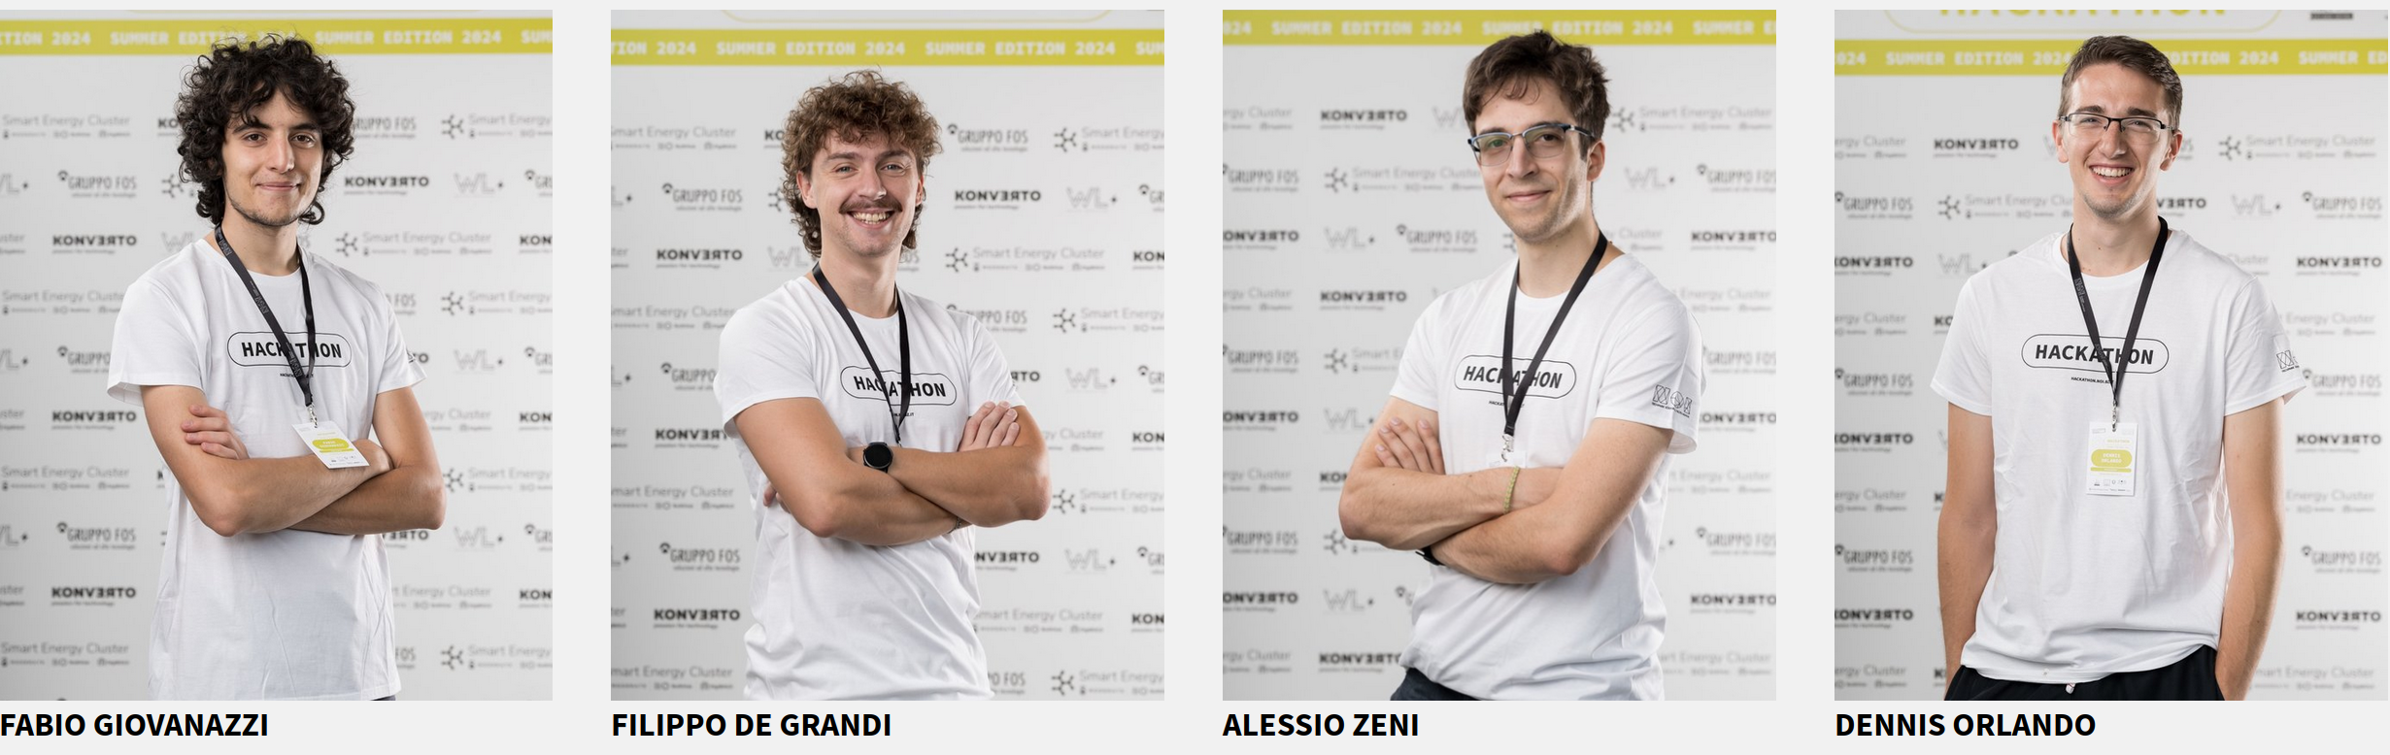
Our team (grazie Marco per le foto <3)

Slide 3

EVPlanner.rs
Dennis Orlando, Alessio Zeni,
Fabio Giovanazzi, Filippo Degrandi

Slide 4
<here is where we show the app>

Slide 5

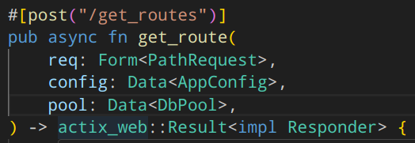
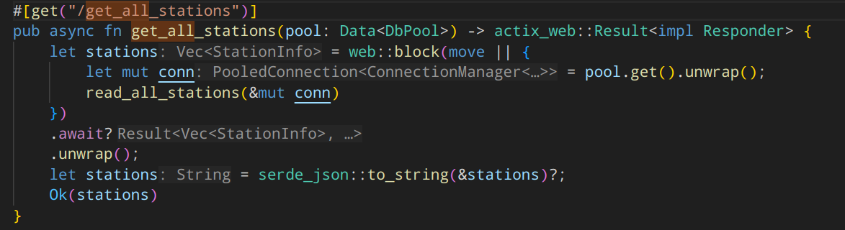
Backend endpoints

Slide 6
<here is where we get back to the app>

Slide 7
Tech Stack
Flutter (Android, Linux, Smart Fridge)
OSRM, Nominatim
Rust (actix-web & lots of crates)
Docker Compose

Slide 8

Tech Stack
Flutter (Android, Linux, Smart Fridge)
OSRM, Nominatim
Rust (actix-web & lots of crates)
  ...(blazingly fast )
Docker Compose (docker compose up
and you’re good to go)

Slide 9
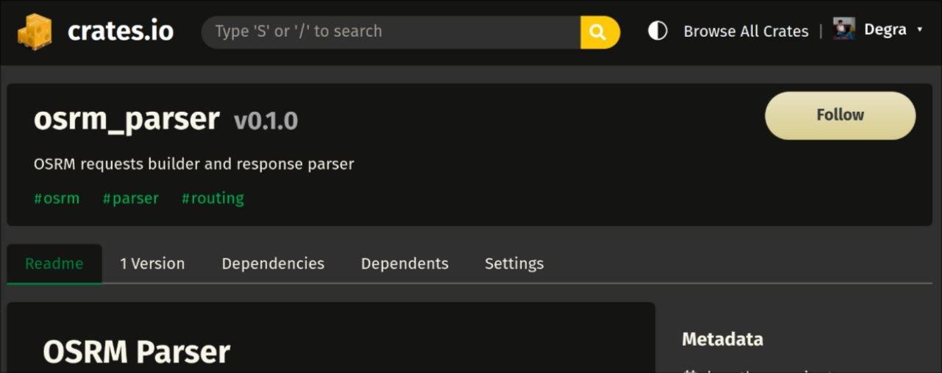
Tech Stack

Slide 10

Future Work
Cost-optimizing algorithm
Multiple appointments
Minor bugs (i.e. politely arguing
with OSM APIs)

Slide 11
Thank you! :)
...and thanks to JetBrains for this gorgeous Slide backgrounds <3

