Slide 1
Di Candilo · Steel City ERP
Platform Overview — All Screens
23 screens across 8 modules

Slide 2
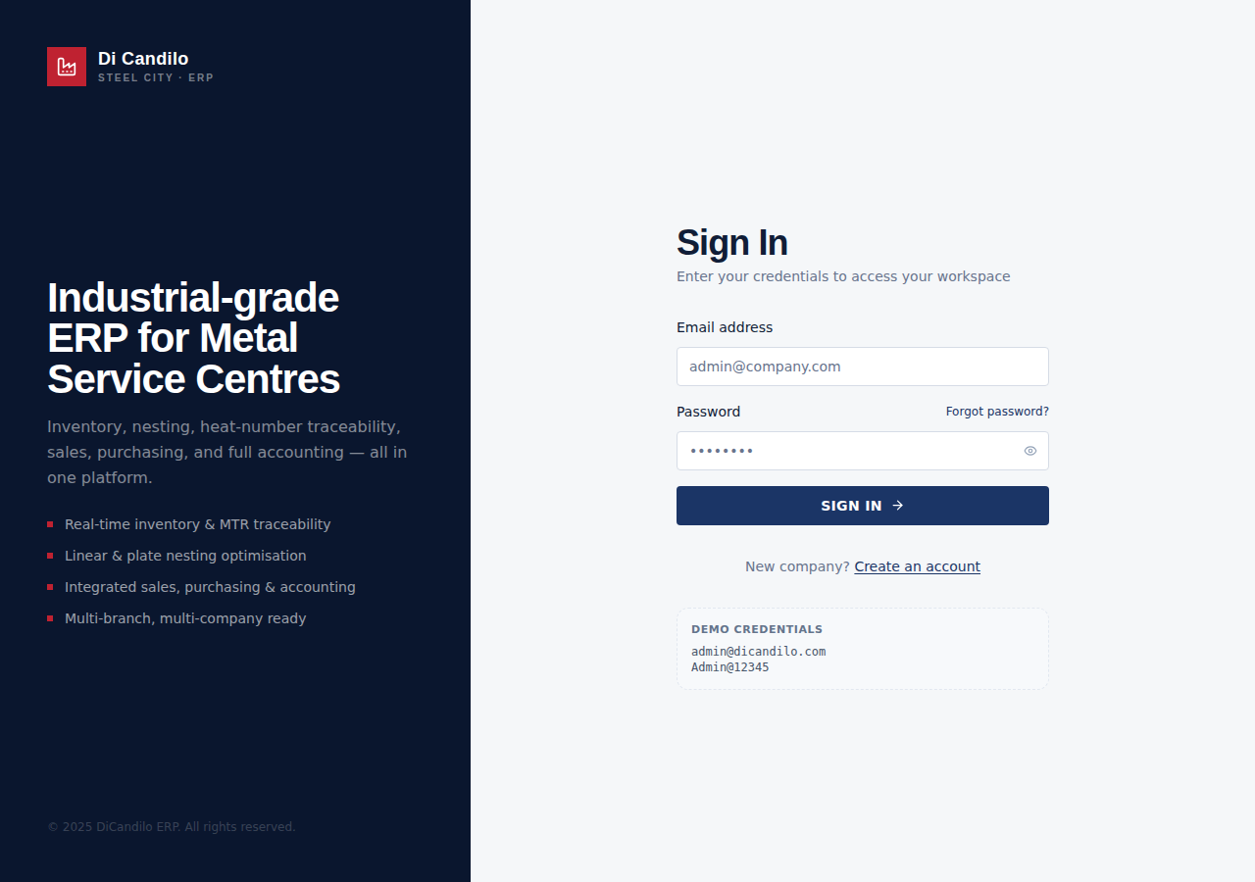
AUTHENTICATION
Login

Slide 3
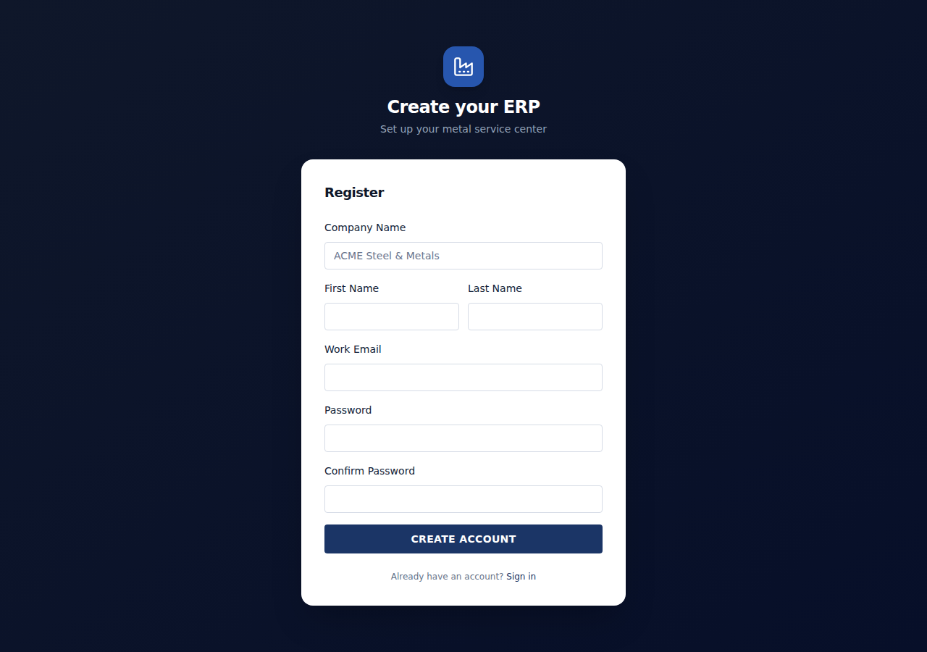
AUTHENTICATION
Register

Slide 4
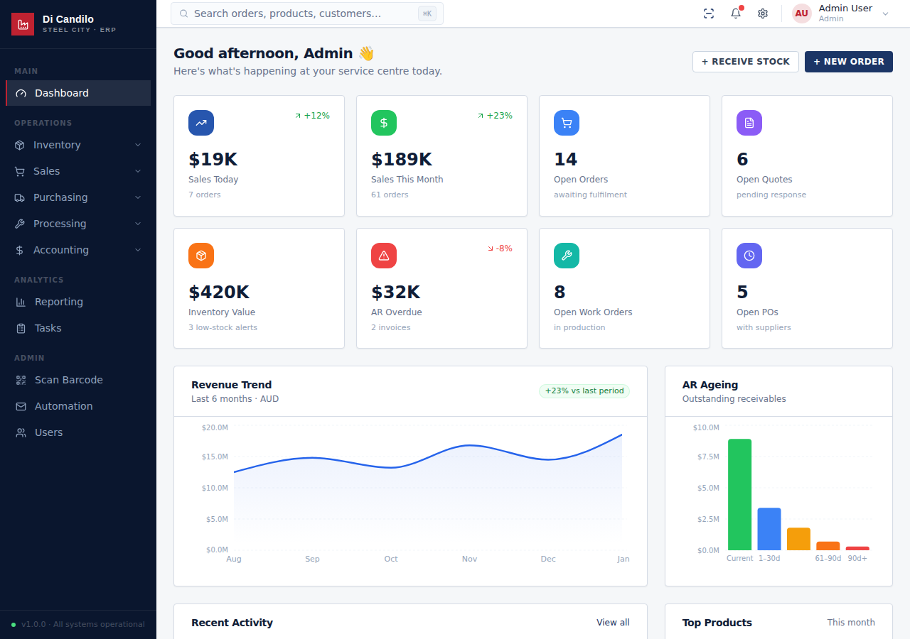
MAIN
Dashboard

Slide 5
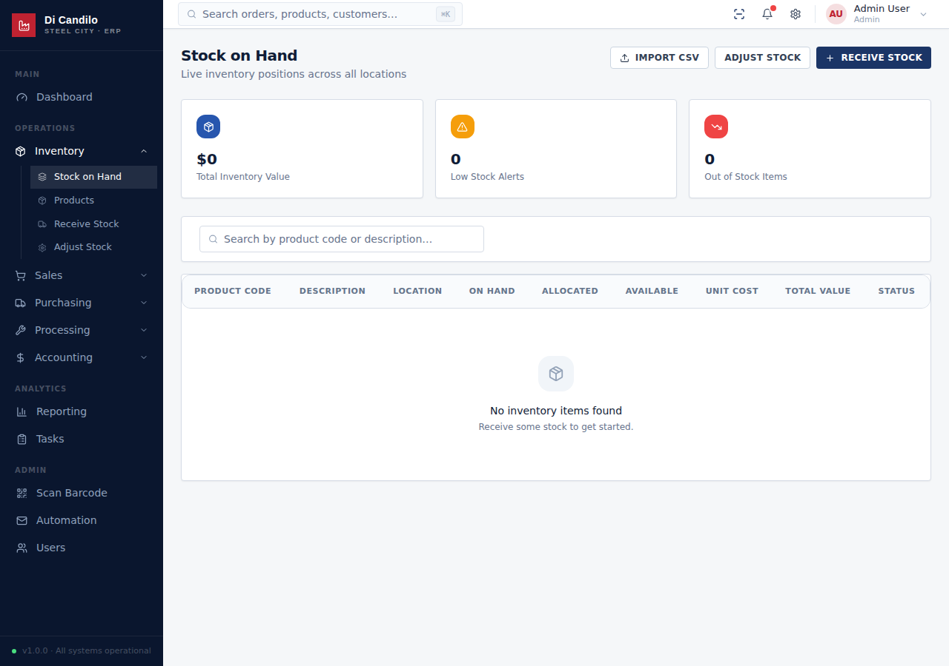
INVENTORY
Stock on Hand

Slide 6
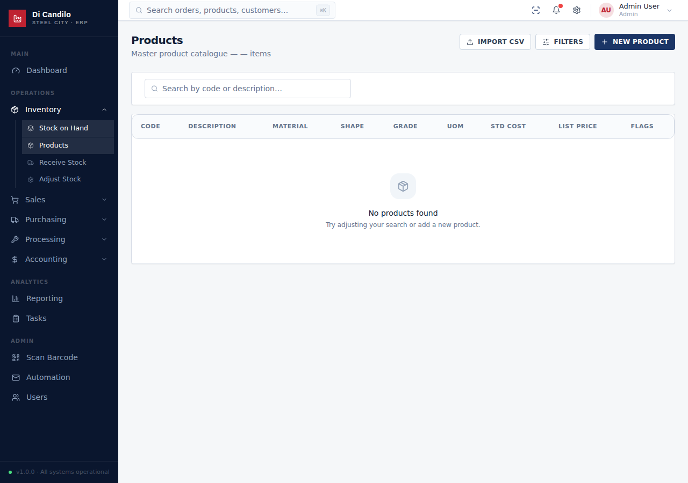
INVENTORY
Products

Slide 7
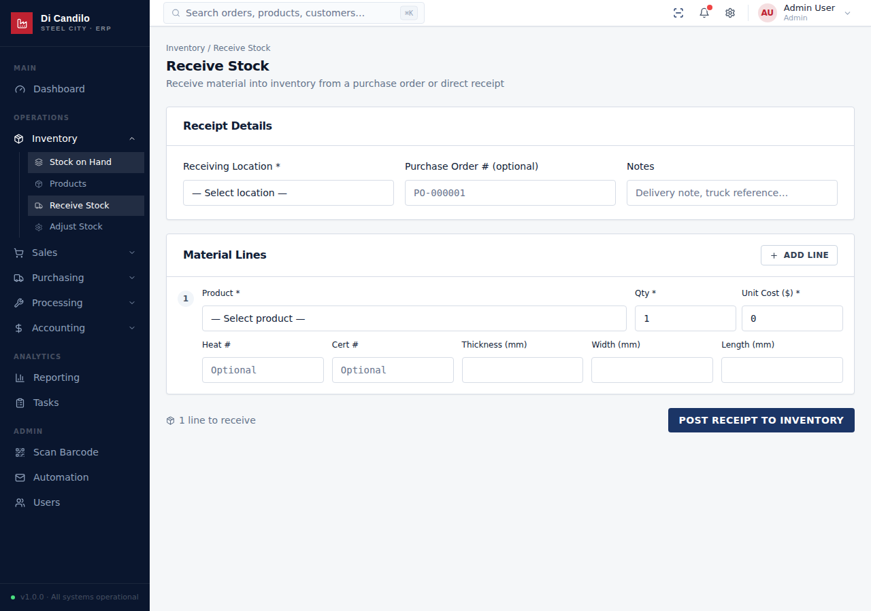
INVENTORY
Receive Stock

Slide 8
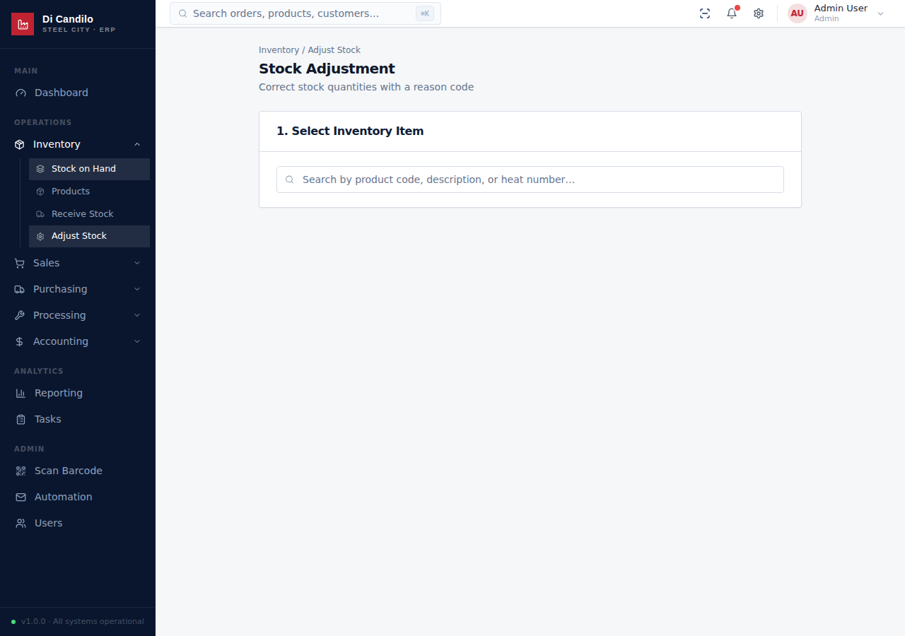
INVENTORY
Adjust Stock

Slide 9
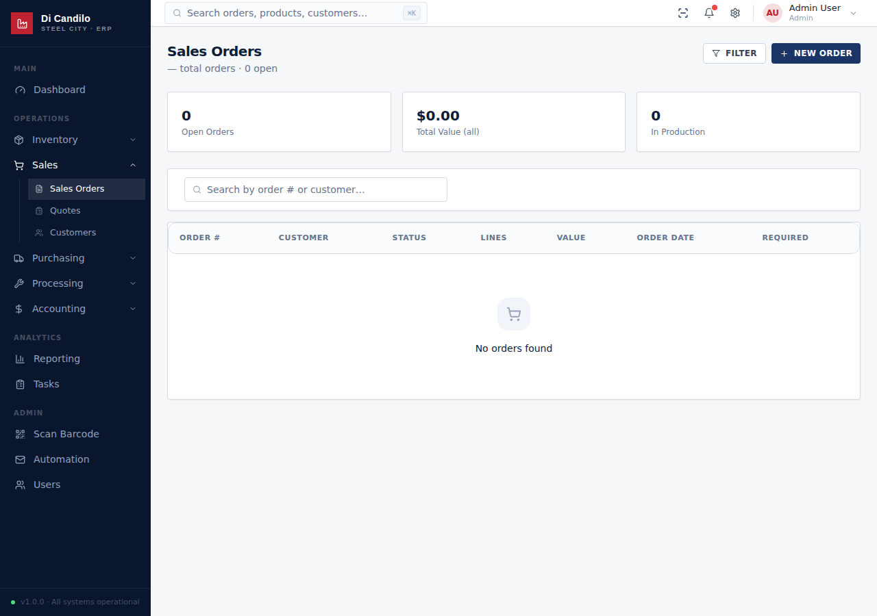
SALES
Sales Orders

Slide 10
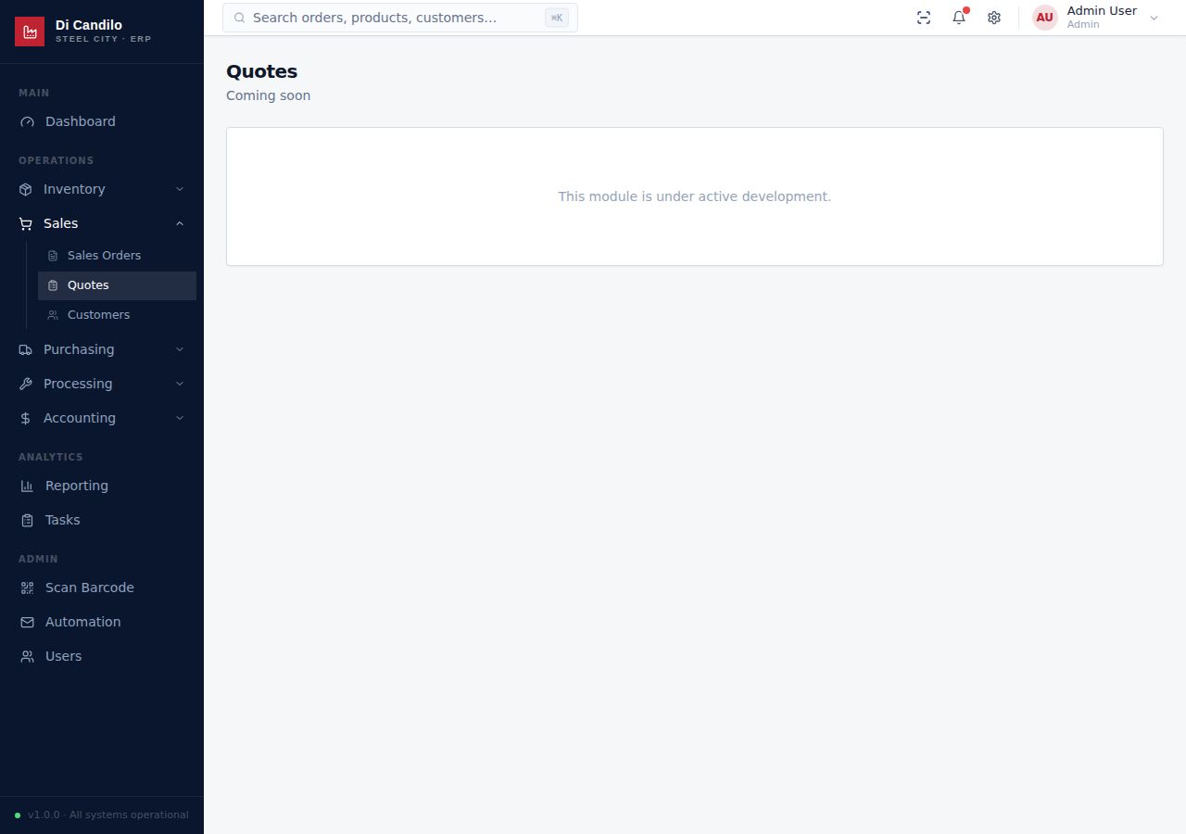
SALES
Quotes

Slide 11
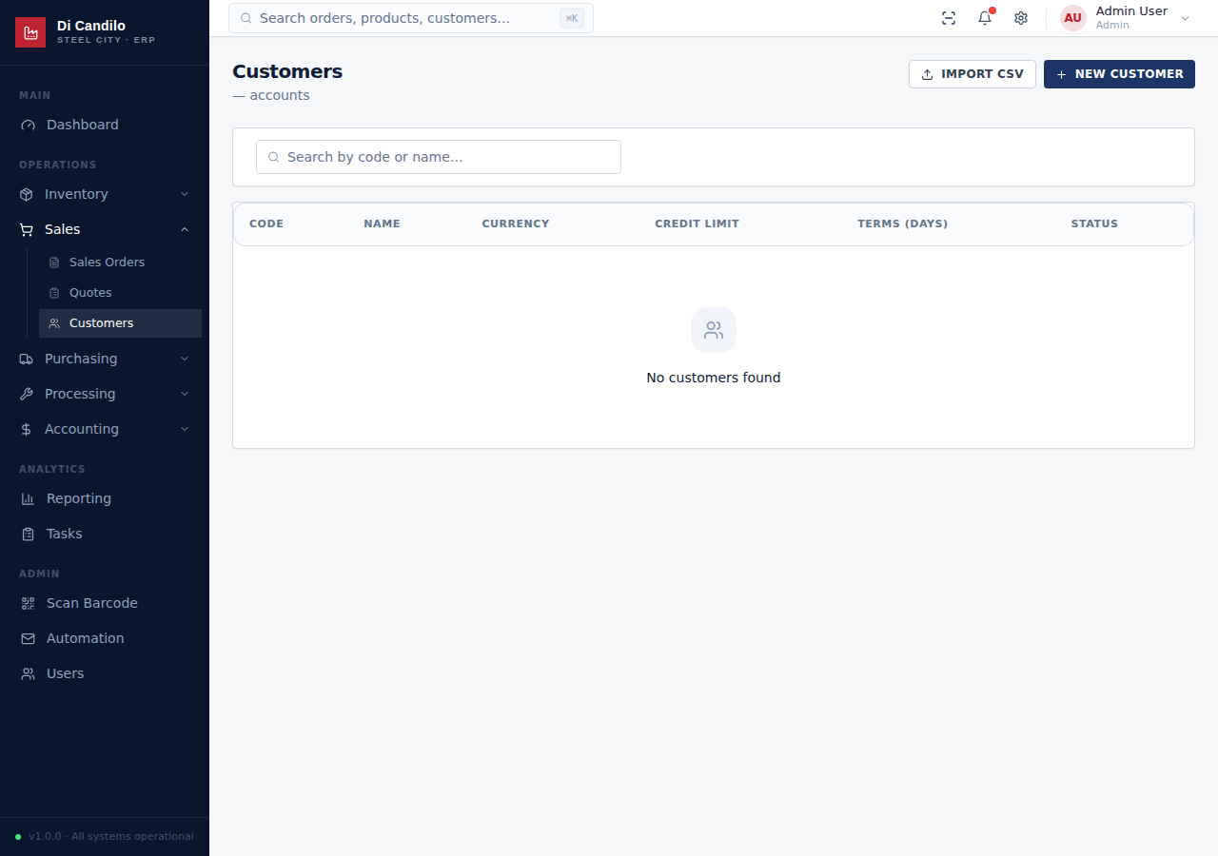
SALES
Customers

Slide 12
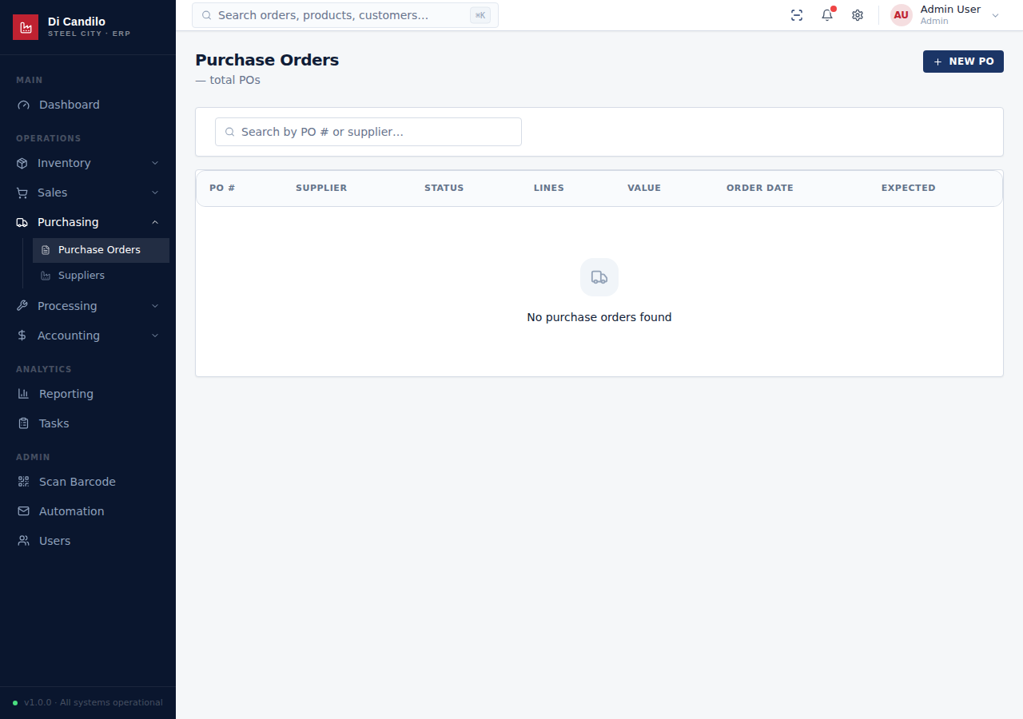
PURCHASING
Purchase Orders

Slide 13
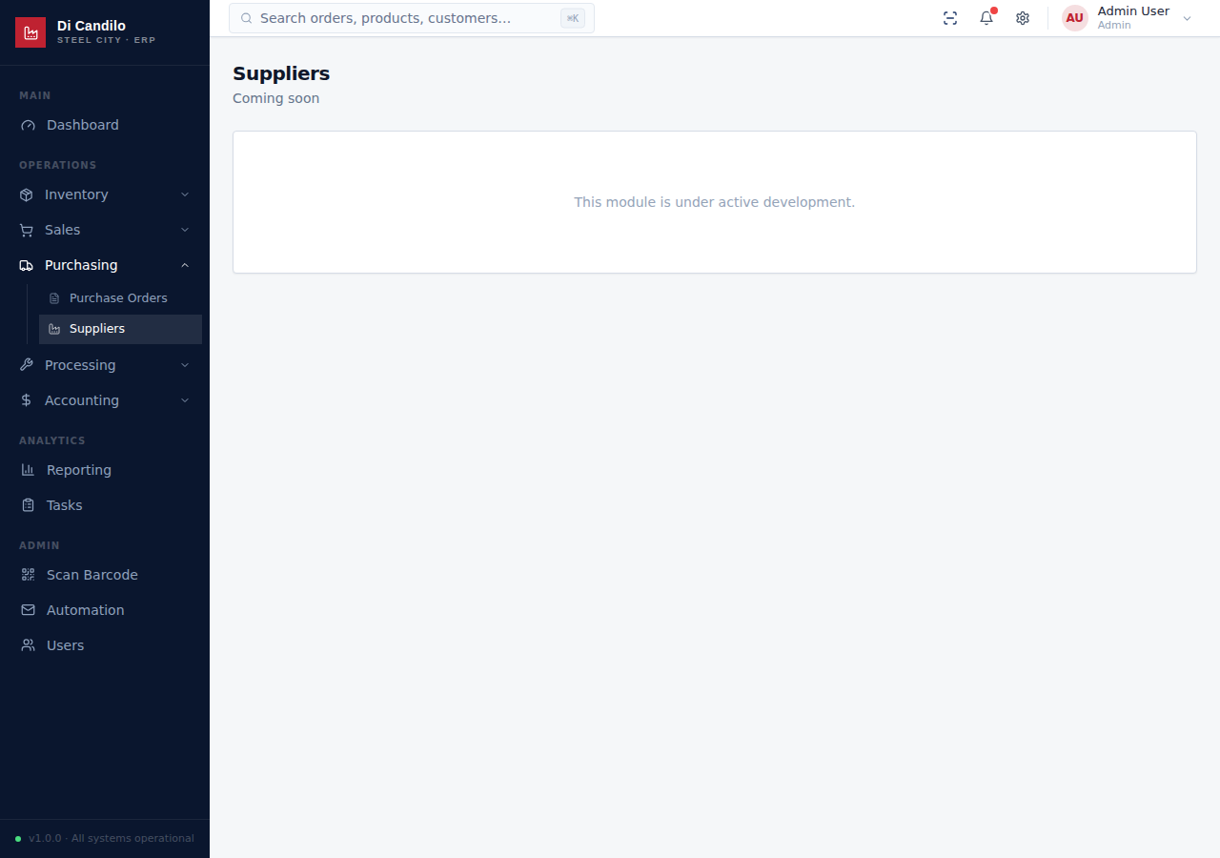
PURCHASING
Suppliers

Slide 14
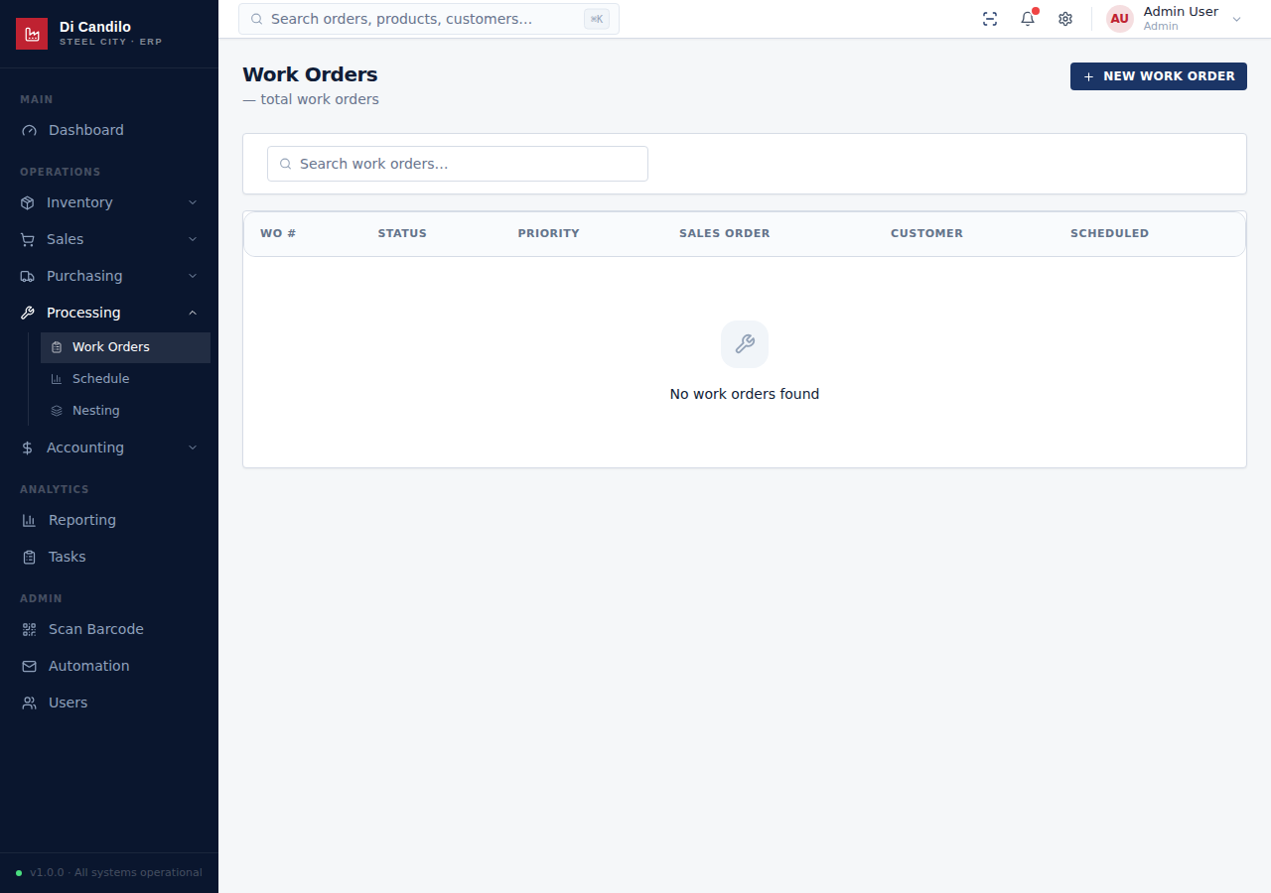
PROCESSING
Work Orders

Slide 15
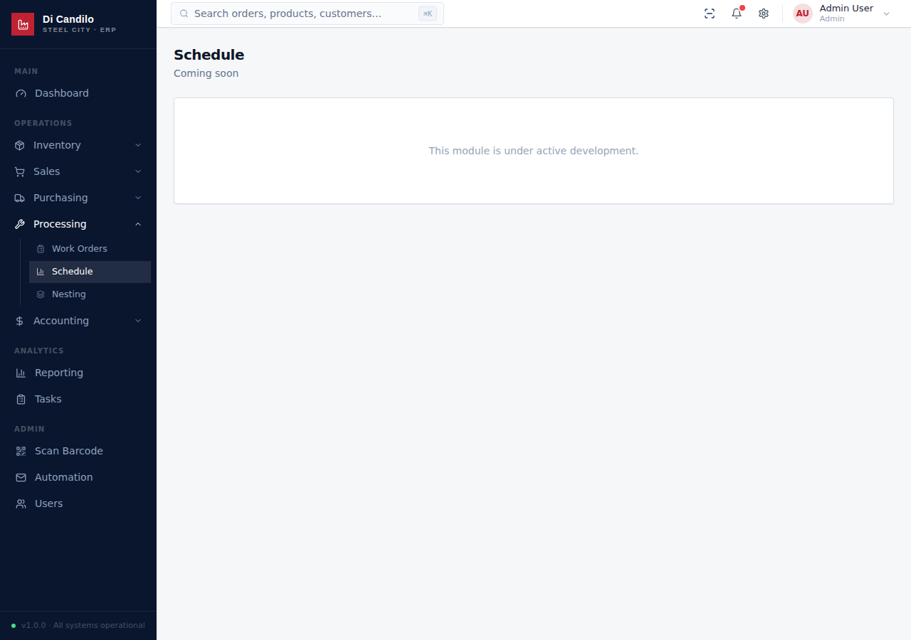
PROCESSING
Production Schedule

Slide 16
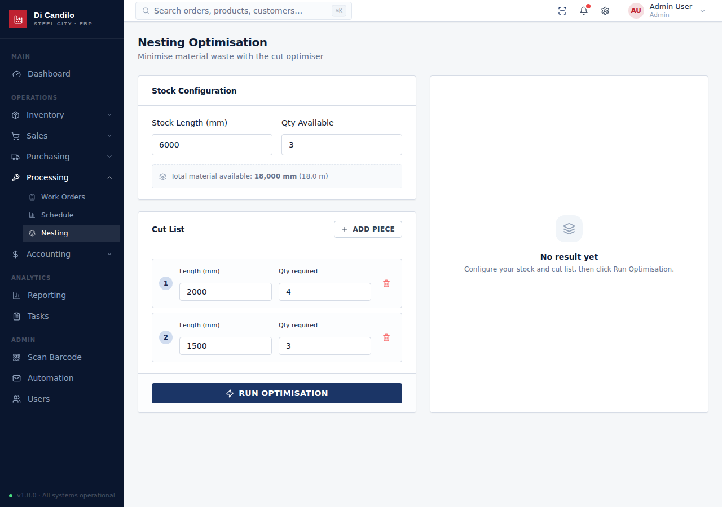
PROCESSING
Nesting Optimiser

Slide 17
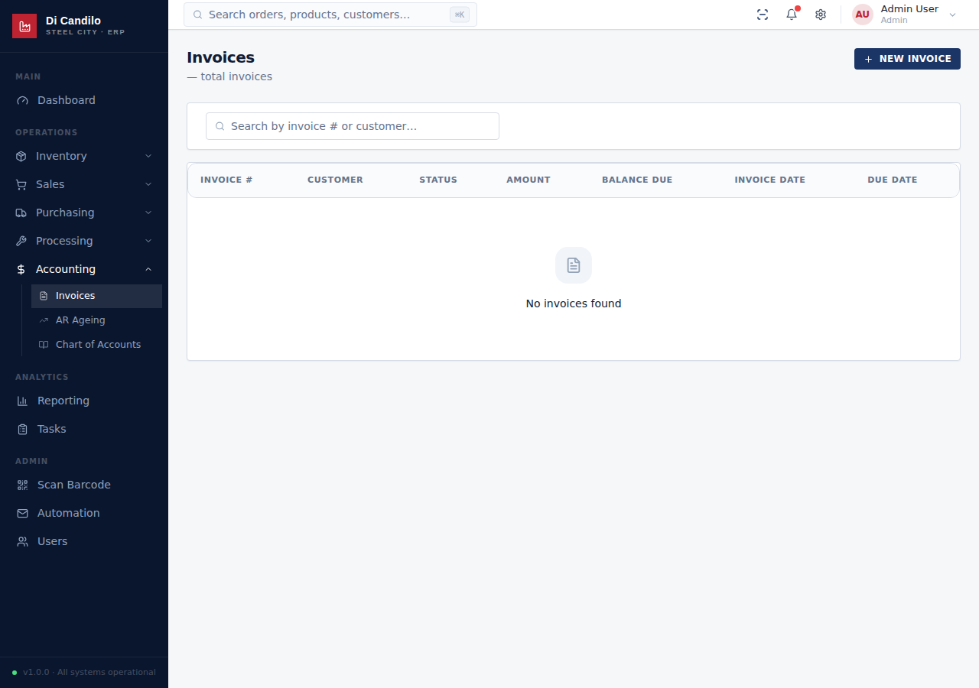
ACCOUNTING
Invoices

Slide 18
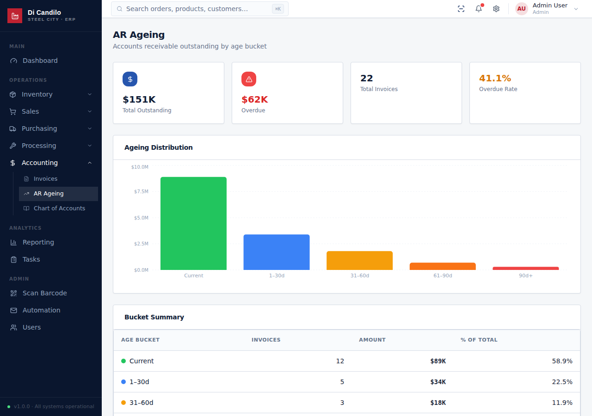
ACCOUNTING
AR Ageing

Slide 19
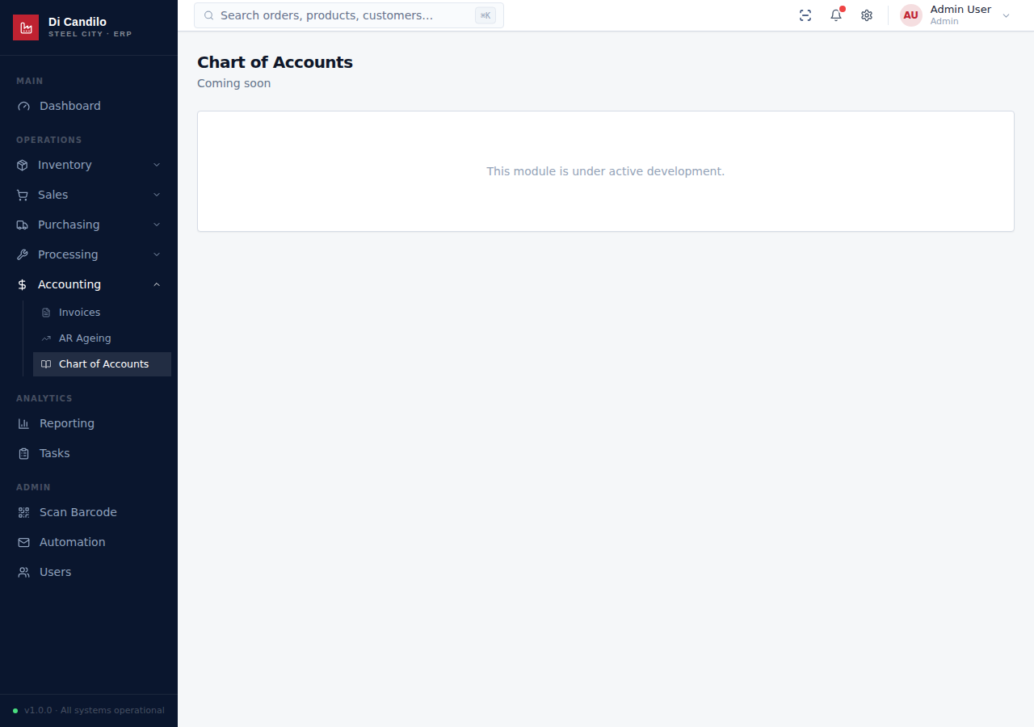
ACCOUNTING
Chart of Accounts

Slide 20
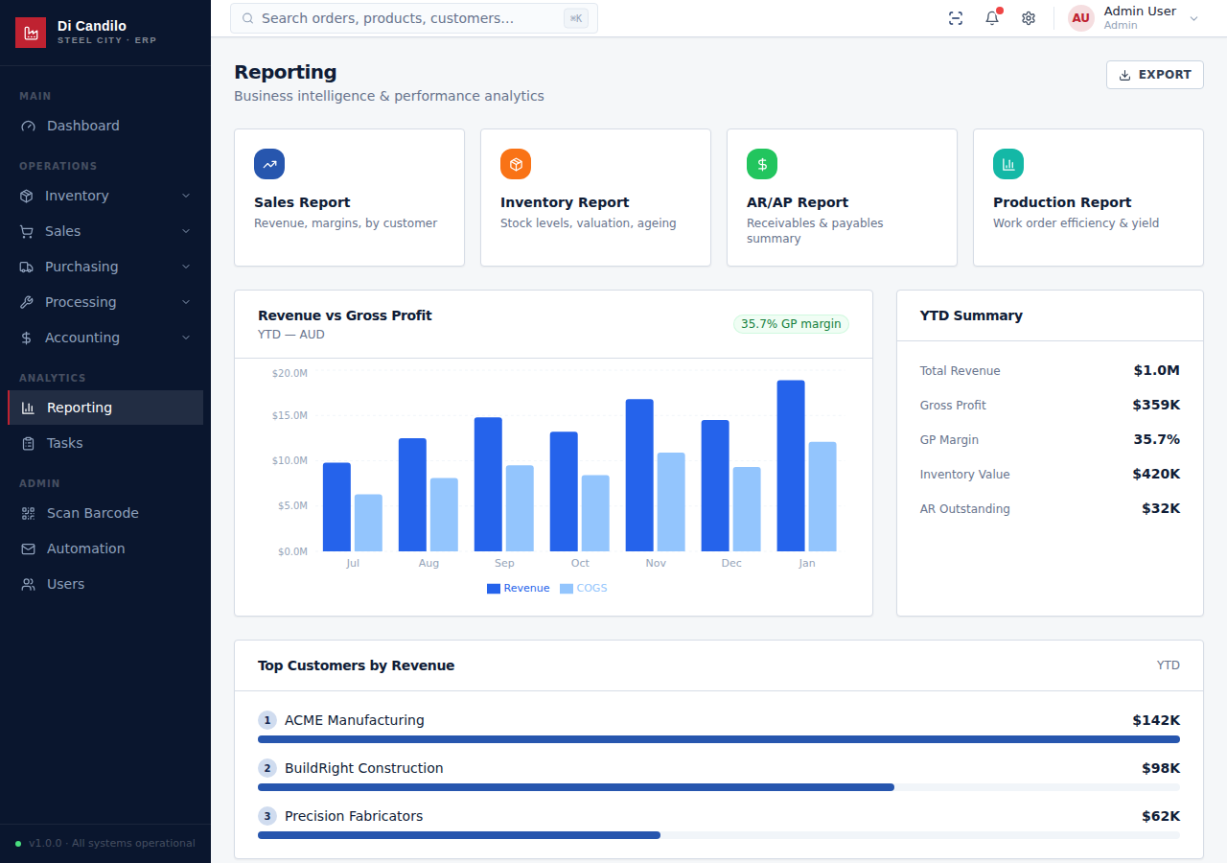
ANALYTICS
Reporting

Slide 21
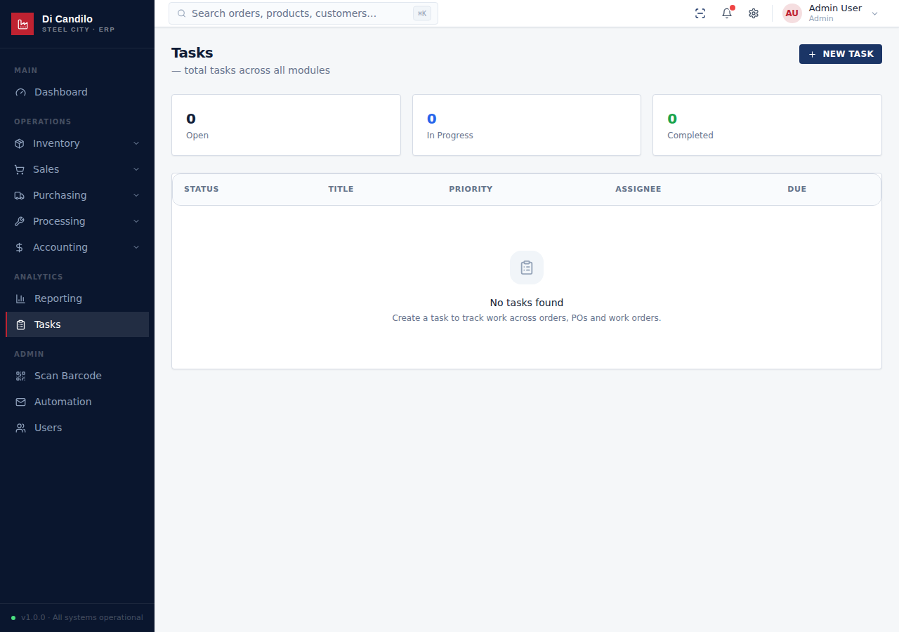
ANALYTICS
Tasks

Slide 22
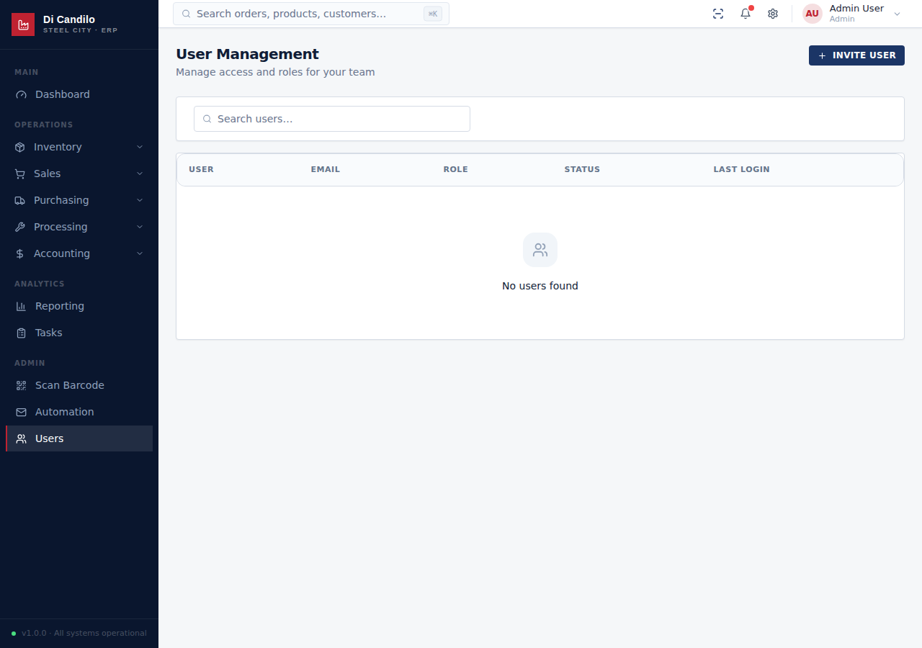
ADMIN
User Management

Slide 23
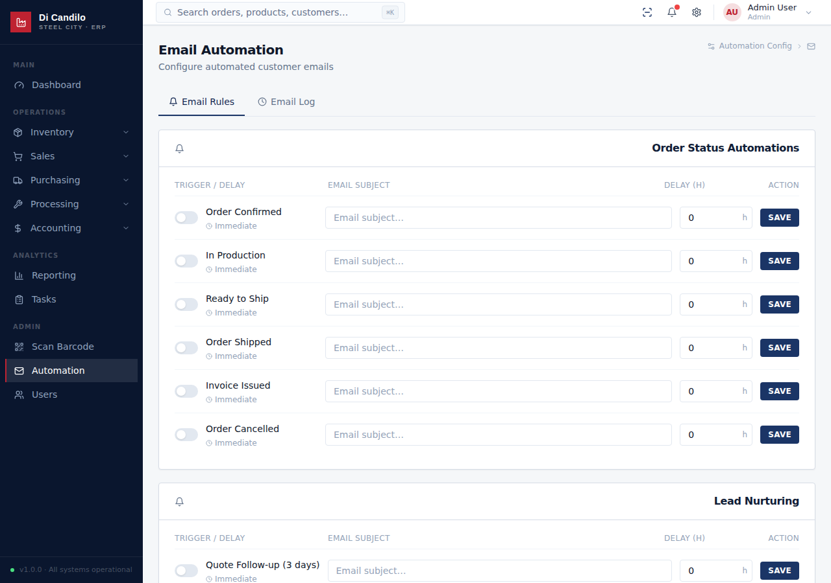
ADMIN
Automation Rules

Slide 24

ADMIN
Barcode Scanner

