Slide 1
All-In-One Budgeting App
UTA-VIRT-FSF-PT-01-2020-U-LOL Project #2
FELIPE / ASHLEY / CATHERINE / IAN / AMIT

Slide 2
Summary
FACIA™ is an app that is an all in one financial aid. It can have various features such as: An expense tracker that can dynamically analyze future expense needs and costs. Some sub-features would include a tip calculator, a tax calculator, and more.
CORE FEATURE
Budgeting & Expenses
SECONDARY FEATURES
Tip Calculator
Tax Calculator
Stocks

Slide 3
Building Process
FRONT END
Catherine & Ashley
Page layout
CSS styling
General design
BACK END
Ian & Felipe
Database setup and functionality
API setup and functionality

Slide 4
Technology
FACIA™ Web App Utilizes:
Node and Express Web Server
MySQL Database with a Sequelize ORM
GET and POST routes for retrieving and adding new data
Heroku (with data, for deployment)
Travis CI and ESLint
Incorporates at least one new library, package, or technology that we haven’t discussed (currency converter npm package)
Polygon Stock API
https://polygon.io/
--- Tax API
HTML, Bootstrap, CSS, JS

Slide 5
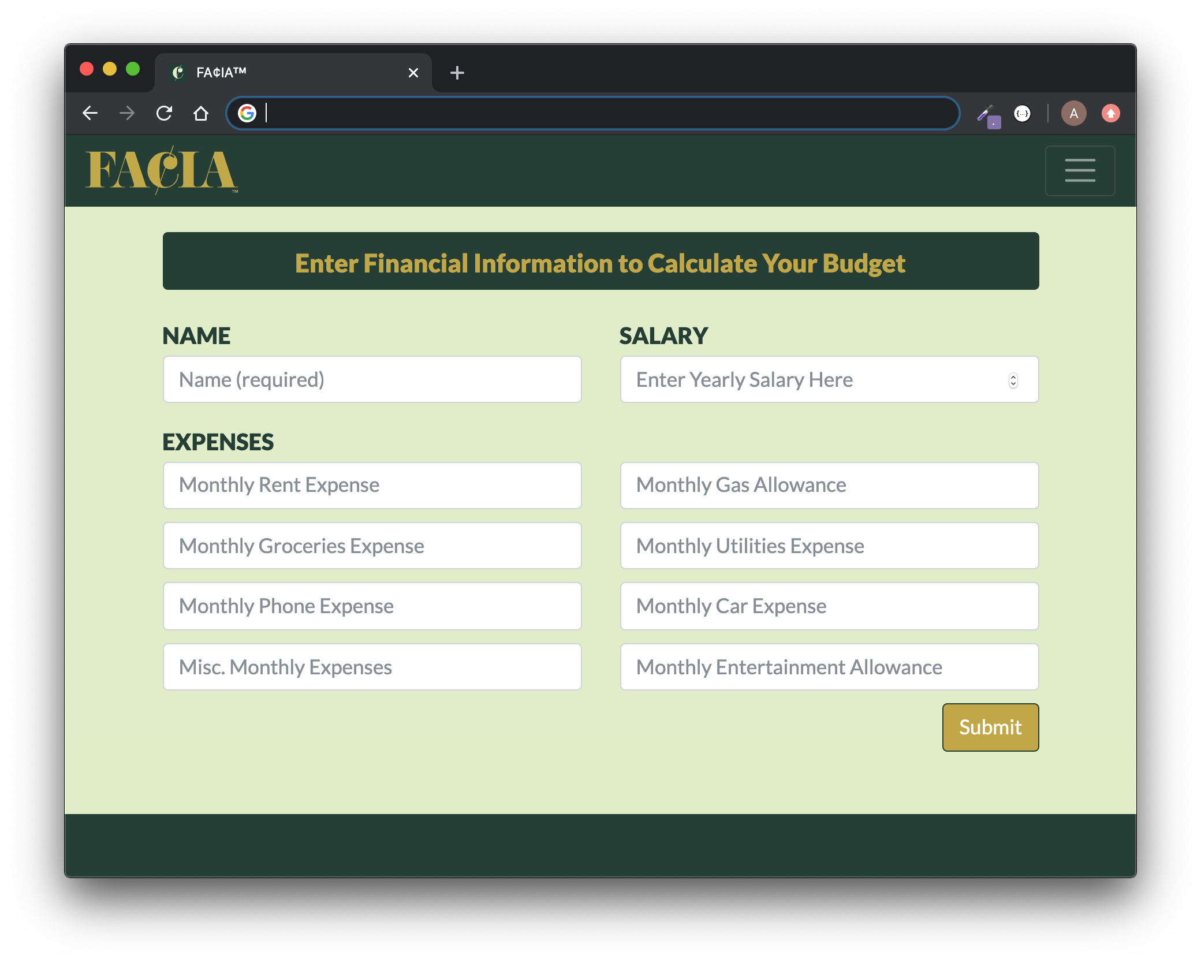
App Demonstration

Slide 6
Challenges
Navigating confusing documentation
Wanting to contribute but not wanting to step on anyone’s toes or mess up anyone’s code
Working off of starter code as opposed to writing code from scratch
Getting all of the files to work together cohesively
The process of pushing/pulling to GitHub in a collaboration

Slide 7
Directions for Future Development
Additional Features to Add
Currency Converter
Built-In Investment Portfolio
Expense Tracker & Graphs

