Slide 1
All-In-One Budgeting App
UTA-VIRT-FSF-PT-01-2020-U-LOL Project #2
FELIPE / ASHLEY / CATHERINE / IAN / AMIT

Slide 2
Summary
FACIA™ is all-in-one financial aid app. It provides a personal budgeting snapshot into one’s expenses and features handy calculators and a currency converter.
CORE FEATURE
Budgeting & Expenses
SECONDARY FEATURES
Tip Calculator
Tax Calculator
Currency Converter
Financial News Results

Slide 3
Building Process
FRONT END
Catherine & Ashley
Page layout
CSS styling
General design
Currency Converter
Presentation
BACK END
Ian & Felipe
Database setup and functionality
API setup and functionality

Slide 4
Technology
FACIA™ Web App Utilizes:
Node and Express Web Server
MySQL Database with a Sequelize ORM
GET and POST routes for retrieving and adding new data
Heroku (with data, for deployment) and JAWSdb
Travis CI and ESLint
A currency converter widget from https://currencyrate.today
Polygon Stock API from https://polygon.io/
HTML, Bootstrap, CSS, JS

Slide 5
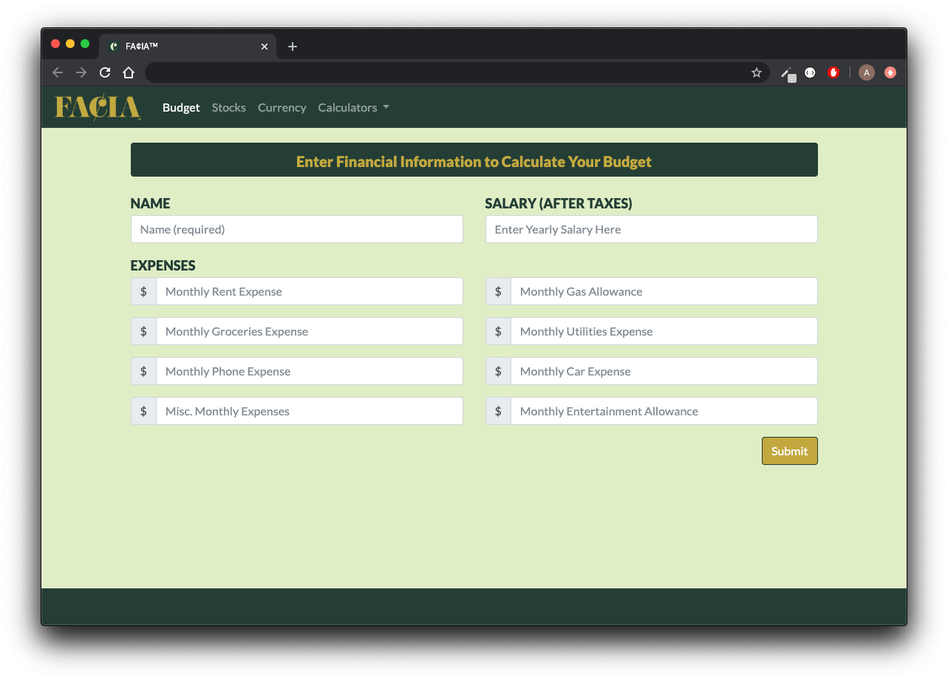
App Demonstration

Slide 6
Challenges
Navigating confusing documentation
Wanting to contribute but not wanting to step on anyone’s toes or mess up anyone’s code
Working off of starter code as opposed to writing code from scratch
Getting all of the files to work together cohesively
The process of pushing/pulling to GitHub in a collaboration

Slide 7
Directions for Future Development
Additional Features to Add
Built-In Investment Portfolio
Expense Tracker & Graphs

