Slide 1
All-In-One Budgeting App
UTA-VIRT-FSF-PT-01-2020-U-LOL Project #2
FELIPE / ASHLEY / CATHERINE / IAN / AMIT

Slide 2
Summary
FACIA is an app that is an all in one financial aid. It can have various features such as: An Expense tracker that can dynamically analyze future expense needs and costs. Some sub features would include a tip calculator, a tax calculator, and more.
CORE FEATURE
Budgeting & Expenses
SECONDARY FEATURES
Tip Calculator
Currency Converter
Stocks

Slide 3
Building Process
FRONT END
Catherine & Ashley
Page layout
CSS styling
General design
BACK END
Ian & Felipe
Database setup and functionality
API setup and functionality

Slide 4
Technology
FACIA Web App Utilizes:
Node and Express Web Server
MySQL Database with a Sequelize ORM
GET and POST routes for retrieving and adding new data
Heroku (with data, for deployment)
Travis CI and ESLint
Incorporates at least one new library, package, or technology that we haven’t discussed
APIs
HTML, Bootstrap, CSS, JS

Slide 5
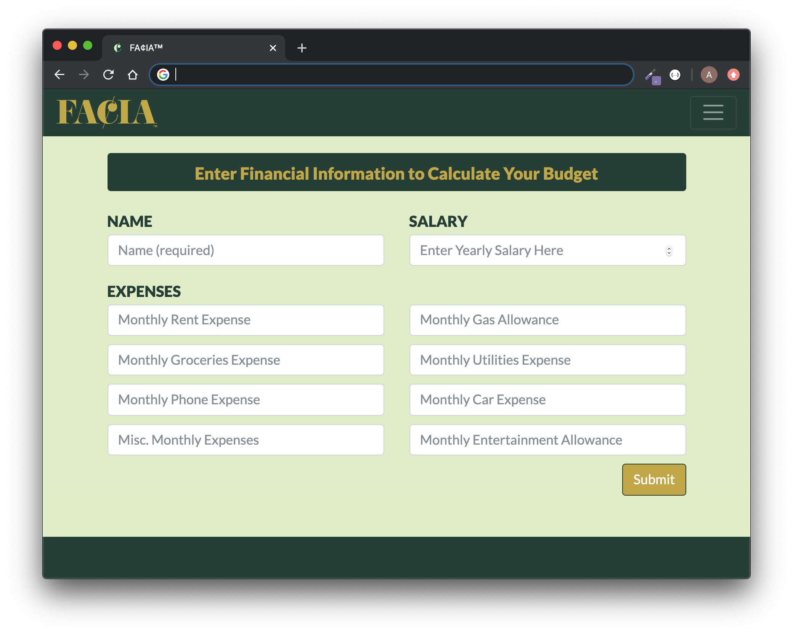
App Demonstration

Slide 6
Challenges
Navigating confusing documentation
Issues getting Rapid API to work, so went straight to the source
Wanting to contribute but not wanting to step on anyone’s toes or mess up anyone’s code
We all prefer working alone so adjusting to working in a group, especially virtually, was a new but welcomed challenge
Getting used to the process of pushing/pulling to GitHub in a collaboration

Slide 7
Directions for Future Development
Additional Features to Add
Recreating restaurant foods
1-5 Star Ratings
Food Trivia
Food Jokes
Wine Pairings

