Slide 1
v

Slide 2
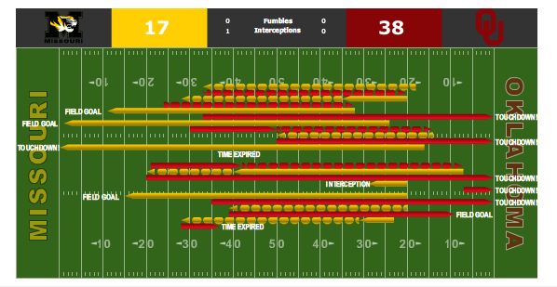
Model Evaluation (10-Fold CV)
Classifier | Accuracy | Balanced Accuracy | Precision | Average Precision | Recall | F1 | AUC
Logistic Regression | 0.6513 (+/- 0.0142) | 0.6535 (+/- 0.0161) | 0.5561 (+/- 0.0143) | 0.5894 (+/- 0.0274) | 0.6649 (+/- 0.0312) | 0.6056 (+/- 0.0198) | 0.7031 (+/- 0.0228)
K-Nearest Neighbors | 0.6371 (+/- 0.0154) | 0.6038 (+/- 0.0156) | 0.5645 (+/- 0.0256) | 0.5364 (+/- 0.0205) | 0.4329 (+/- 0.0209) | 0.4899 (+/- 0.0212) | 0.6621 (+/- 0.0155)
Decision Tree | 0.6709 (+/- 0.0144) | 0.6506 (+/- 0.0153) | 0.6006 (+/- 0.0231) | 0.6060 (+/- 0.0274) | 0.5463 (+/- 0.0382) | 0.5719 (+/- 0.0229) | 0.7194 (+/- 0.0205)
Random Forest | 0.6911 (+/- 0.0163) | 0.6688 (+/- 0.0166) | 0.6331 (+/- 0.0248) | 0.6502 (+/- 0.0255) | 0.5542 (+/- 0.0243) | 0.5909 (+/- 0.0216) | 0.7490 (+/- 0.0195)
Gradient Boosted Trees | 0.6735 (+/- 0.0160) | 0.6443 (+/- 0.0163) | 0.6184 (+/- 0.0266) | 0.6144 (+/- 0.0244) | 0.4942 (+/- 0.0227) | 0.5493 (+/- 0.0219) | 0.7213 (+/- 0.0215)
Adaboost | 0.6630 (+/- 0.0071) | 0.6430 (+/- 0.0081) | 0.5891 (+/- 0.0107) | 0.6082 (+/- 0.0158) | 0.5399 (+/- 0.0241) | 0.5633 (+/- 0.0134) | 0.7086 (+/- 0.0111)
XGBoost | 0.6976 (+/- 0.0114) | 0.6786 (+/- 0.0117) | 0.6367 (+/- 0.0173) | 0.6605 (+/- 0.0238) | 0.5806 (+/- 0.0209) | 0.6073 (+/- 0.0154) | 0.7566 (+/- 0.0187)
LightGBM | 0.6782 (+/- 0.0174) | 0.6479 (+/- 0.0178) | 0.6284 (+/- 0.0299) | 0.6300 (+/- 0.0256) | 0.4922 (+/- 0.0264) | 0.5520 (+/- 0.0245) | 0.7299 (+/- 0.0215)
CatBoost | 0.6958 (+/- 0.0155) | 0.6755 (+/- 0.0159) | 0.6362 (+/- 0.0228) | 0.6594 (+/- 0.0264) | 0.5714 (+/- 0.0250) | 0.6020 (+/- 0.0206) | 0.7554 (+/- 0.0202)
Linear SVC | 0.6511 (+/- 0.0139) | 0.6537 (+/- 0.0157) | 0.5557 (+/- 0.0140) | 0.5893 (+/- 0.0277) | 0.6669 (+/- 0.0308) | 0.6062 (+/- 0.0193) | 0.7030 (+/- 0.0228)
SVC | 0.5007 (+/- 0.0517) | 0.5464 (+/- 0.0196) | 0.4349 (+/- 0.0237) | 0.5251 (+/- 0.0307) | 0.7814 (+/- 0.1791) | 0.5561 (+/- 0.0380) | 0.6064 (+/- 0.0302)
Feed Forward Neural Network (MLP) | 0.5977 | - | - | - | - | - | -

