Slide 1
Floor Survey:
Project Presentation
Dennis Zhao
MS in Analytics Class of 2021

Slide 2


Introduction:
Client: The education team at the Museum of Science & Industry at Chicago
Project Time Period: Oct, 2020 - Dec 2020
Dataset: Visitor surveys at 2013-2014, 2018-2019, and 2020 after reopening
Objective:
1. Help the client understand their visitors survey results better so that
the client can better educate its visitors
2. Identify any significant demographic change of the visitors during
three different survey periods
3. Train a machine learning model to help the client identify potential
customers who are more likely to become members

Slide 3
Road Map
Data cleaning and processing
Descriptive Analytics:
Where do survey respondents live?
What do survey respondents learn at the Museum?
How have demographics changed among survey respondents over time?
Predictive Analytics:
Which factors predict more frequent museum visits among survey respondents?
Which factors predict whether a survey respondent obtains membership at the museum?
How well can weather conditions predict daily attendance numbers at the museum?
Concluding thoughts

Slide 4
Step 1: ETL and Data Cleaning
Merged separate survey data
Retrieved weather data from external API (Visual Crossing) and appended to the merged dataset
Removed unrelated column as well as column with more than 90% null values
Deal with skewness and outlier(in income column)
Check correlation matrix
Normalization

Slide 5
Step 2: Descriptive Analysis
Perform statistical inference to identify any significant demographic change across time period
chi-square test
Visualize any significant demographic change
ggplot2
Perform K-means clustering to help the client learn more about its member customers.
pick best K
interpret results
Text Analysis to help the client determine how to attract more audience to their science sessions
build a word-cloud based on the response to a question on survey

Slide 6
Demographic Change Analysis
------ Age, Gender, Education, Profession, Race
Key Findings:
The overall profession distribution has not changed significantly between any two surveys.
The race demographic changed significantly from the 2018-2019 survey to the 2020 survey.
The age group distribution has changed significantly between any given two surveys.
The education level changed significantly from prior surveys to 2020.
The gender distribution has changed significantly from 2013-2014 survey to latter surveys.
2013-2014
2018-2019
2020
Significant Increase: female visitors
Significant Decrease: teenager and elder visitors
Significant Increase: Education and Health professionals, Black, Hispanic visitors, under-18 visitors, less than high school visitors,
Significant Decrease: Arts. farming, production professionals, white visitors, elder visitors,

Slide 7
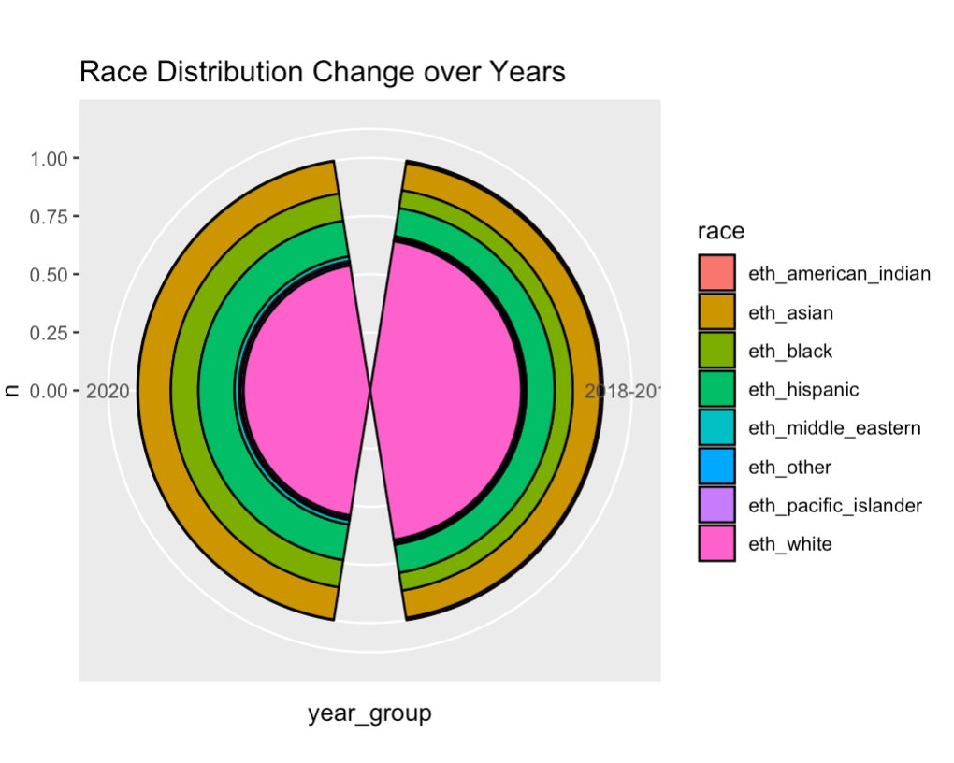
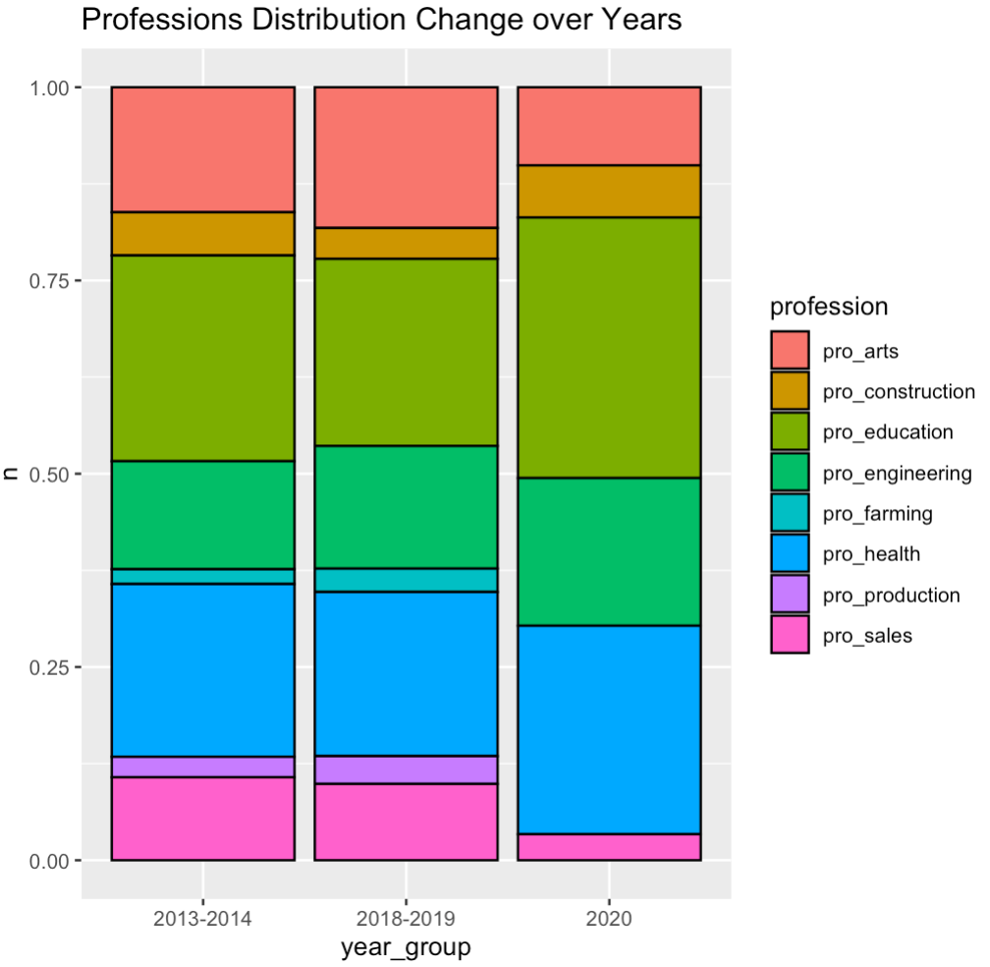
Demographic Change Analysis Visualizations

Slide 8
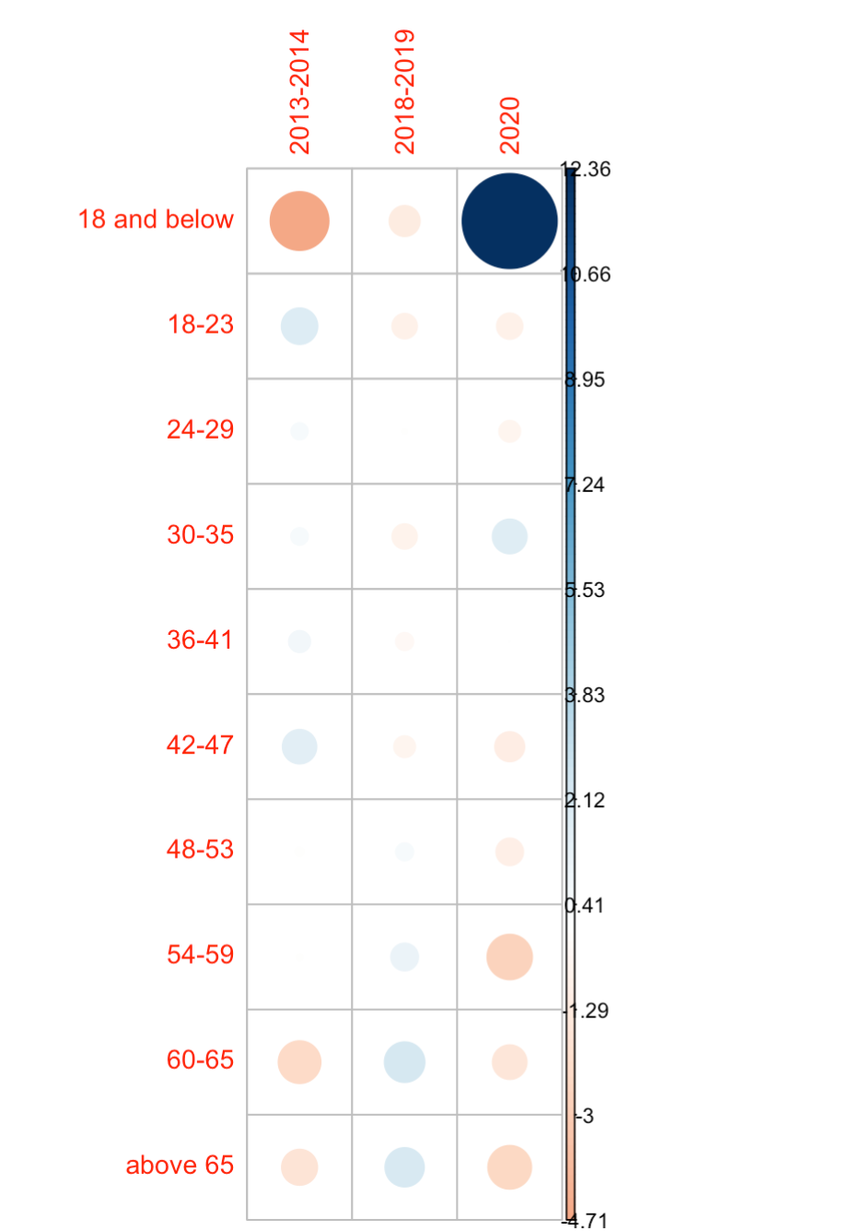
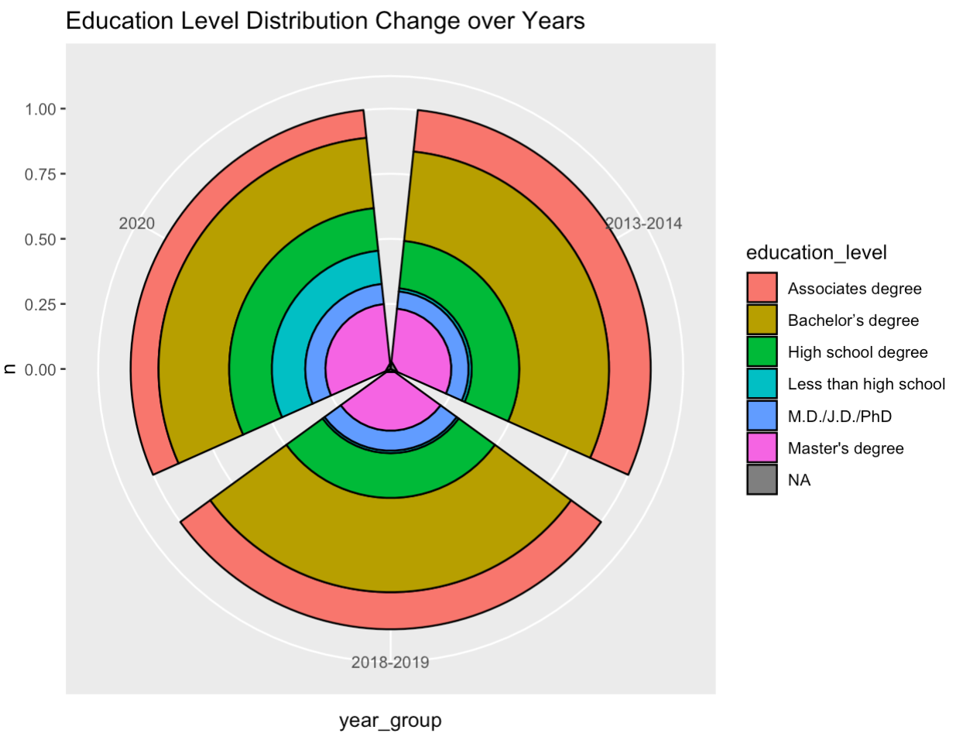
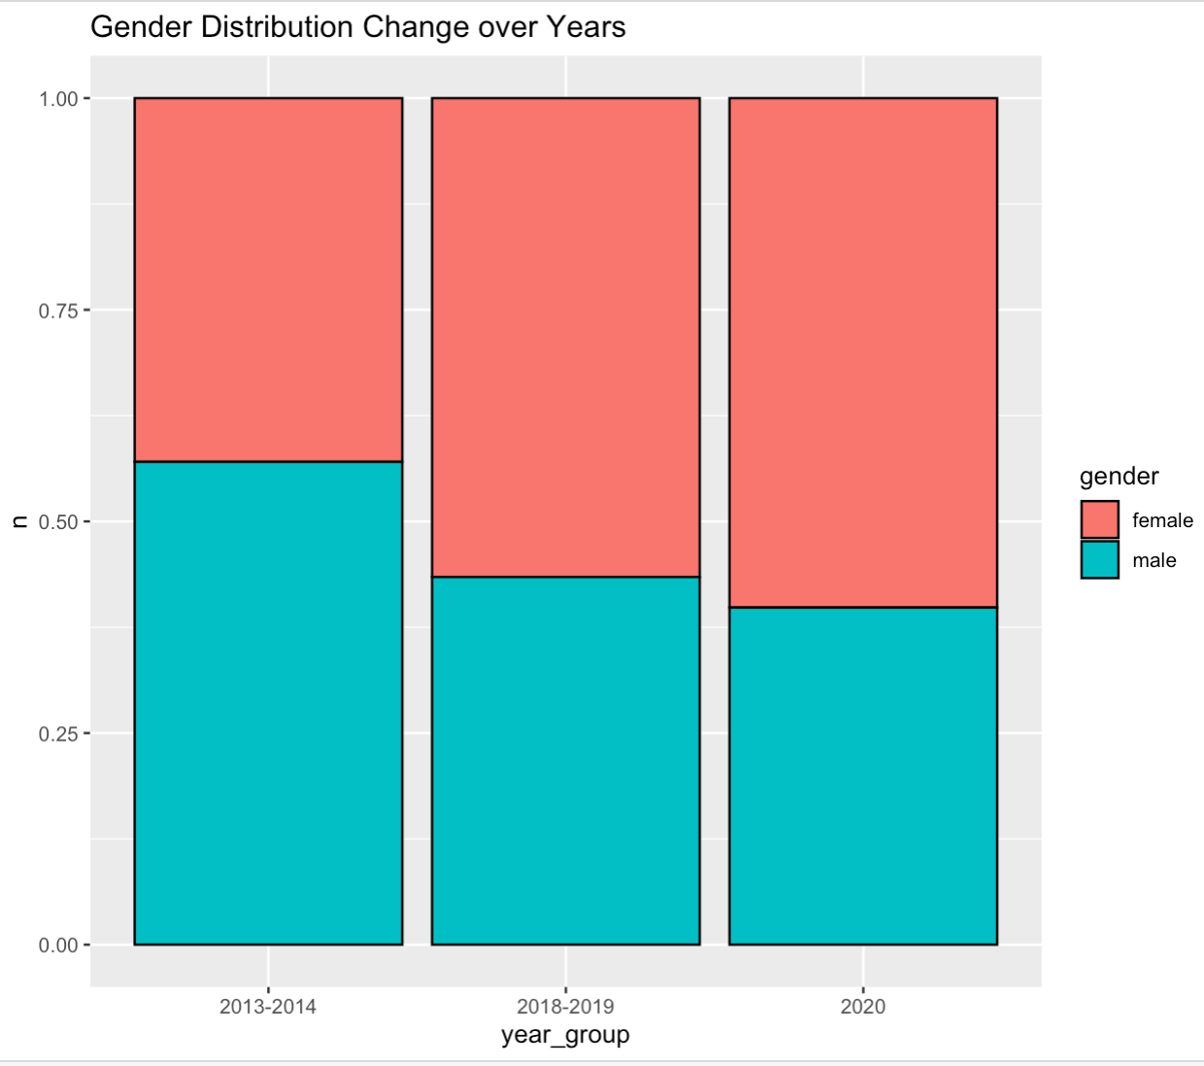
Demographic Change Analysis Visualizations
Chi Square Test Residual Plot

Slide 9
Text Analysis - Word Cloud Visualization:
The R packages used: text mining(tm), textstem, and wordcloud2.
Converted all words into lowercase.
Tokenize all the words and performed lemmatization (Convert a word from variant to original form).
Removed stopwords, punctuation, numbers.
Build a word-frequency table.
Plot a word-cloud visualization

Slide 10
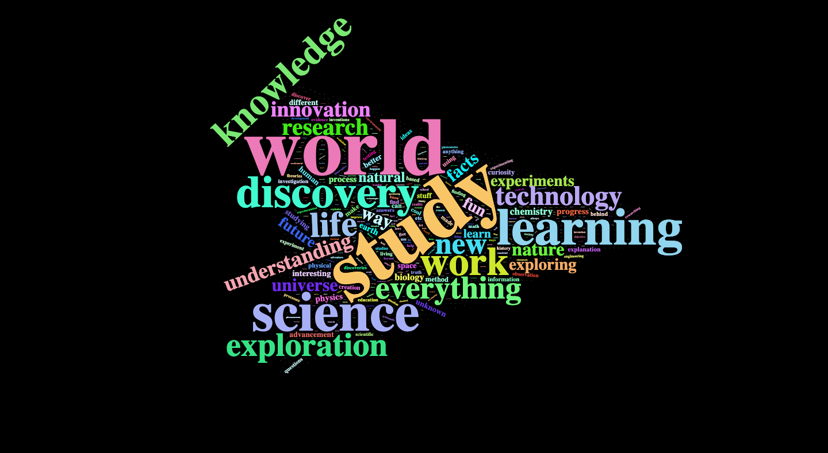
Text Analysis - Word Cloud Visualization:

Slide 11
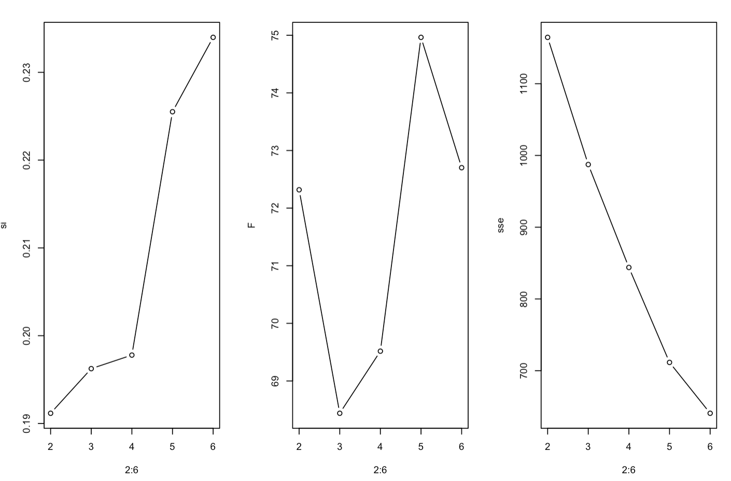
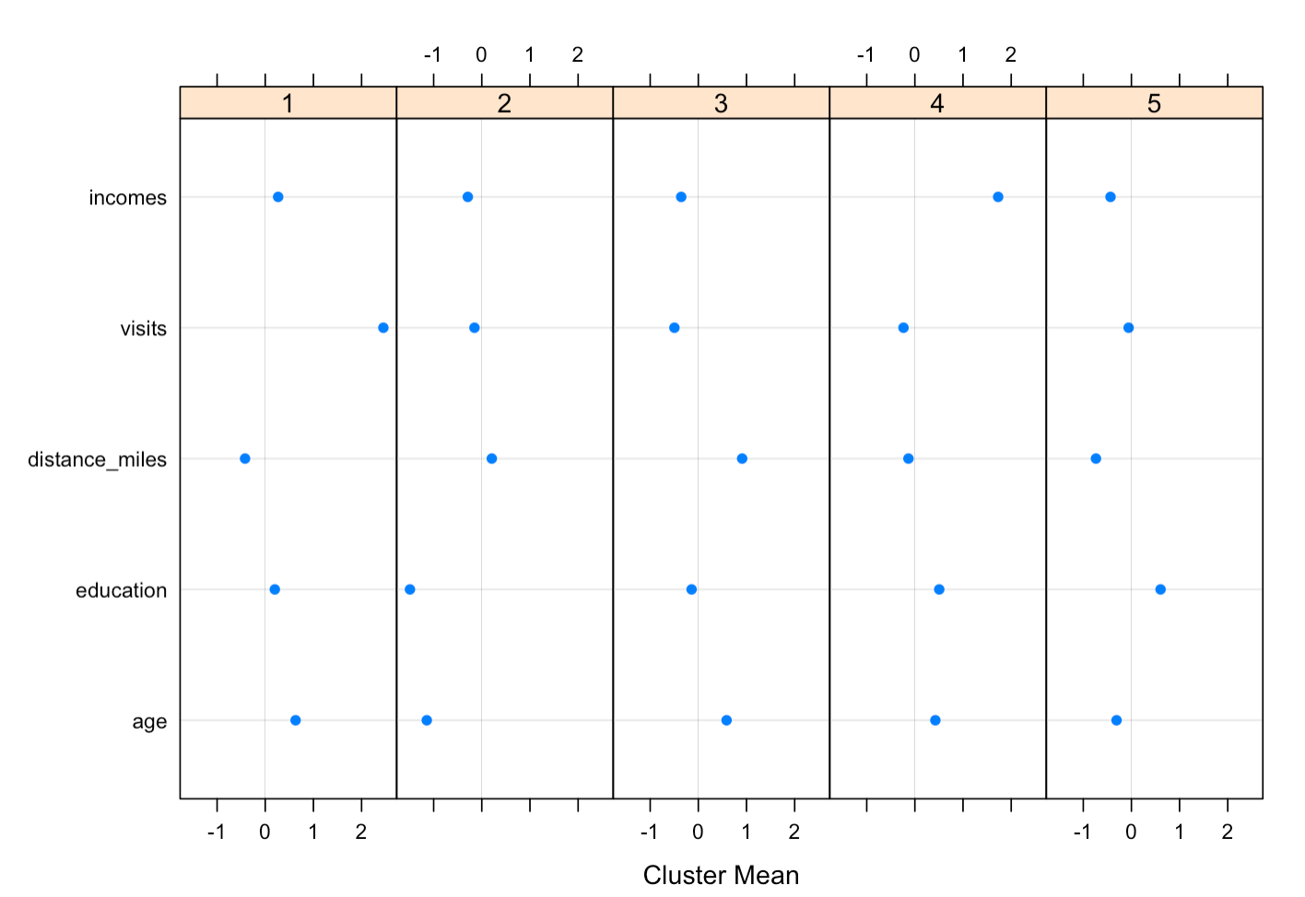
K-Means Clustering Analysis on Members
Select K
Visualize Clusters

Slide 12
K-Means Clustering Takeaway:
Key Findings:
We can divide the museum’s members into five clusters:
Cluster 1: Middle-class, middle-age people, lives in IL, at least associate degree, visit very often.
Cluster 2: Middle-class, young people, lives in IL, have high school or less education, average visit frequency.
Cluster 3: Between lower and middle-class, middle-age people, may not live in IL, at least associate degree,
visit not very often.
Cluster 4: High income class, middle-age people, lives in IL, at least bachelor degree, average visit frequency.
Cluster 5: Between lower and middle-class, 20s-30s people, live in Chicago, at least associate degree,
average visit frequency.

Slide 13
Step 2: Predictive Analysis
Basic feature engineering and rebalance data in training dataset
Benchmark modeling training
Analyze results and further feature engineering
Model selection and tuning
cross validation
regularization
Nonlinear models
Model selection and interpretation

Slide 14
Step 2: Predictive Analysis
Basic feature engineering and rebalance data in training dataset
Create new feature and possible interaction term
Used SMOTE to raise the percentage of minority class in training data from 15% to 30%
Benchmark modeling training
Train a full model with all the predictor using logistic regression
Analyze the result of full model and performance further feature engineering
Pick Evaluation Metric for models
Model Selection with K-fold Cross Validation
Simpler model with less insignificant predictors in the full model
Stepwise regression on full model
Logistic regression with Lasso and Ridge regularization

Slide 15
Predictive Analysis Takeaway:
Key Findings:
It is reasonable for the museum to expect around 20%-25% of its total visitor population to be members.
Use recall as the metric can be misleading sometimes, especially when the museum have a realistic expectation on marketing cost. I suggest to use F-1 score and recall together here.
No big difference between the F-1 score between different logistic models. Logistic model with lasso regularization shows the best recall. However, all models suffer from overfitting.
Predictors of the best model is education, pro_social, pro_education, pro_engineering, pro_financial
pro_health, whether live at Chicago, eth_black, Under 18 , 18-29, and 65+.
After analyzing the coefficients of the best model, we found being young people, elders, black people, professionals in social and education, and Chicago residents are more likely to be a member than Average people. Engineering, financial and health professionals, teenager, are less likely to be a member. Education level has a surprisingly weak influence on the membership

Slide 16
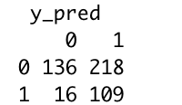
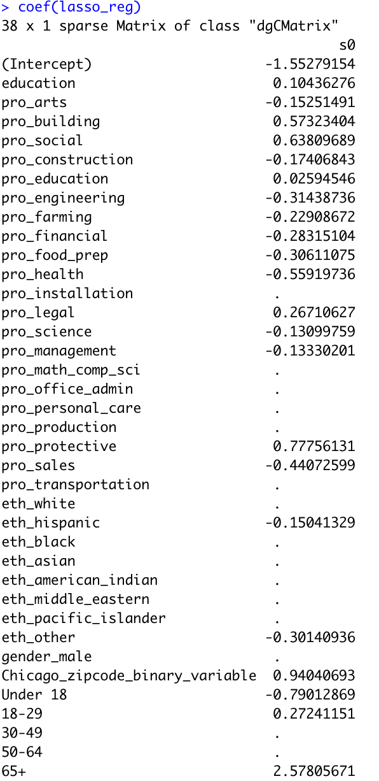
Predictive Analysis Result:
Recall = 109/(16+109) = 0.872
Precision = 109/(218+109) = 0.333
F-1 Score = 2*(Recall*Precision)/ (Precision+Recall) = 0.4823

Slide 17
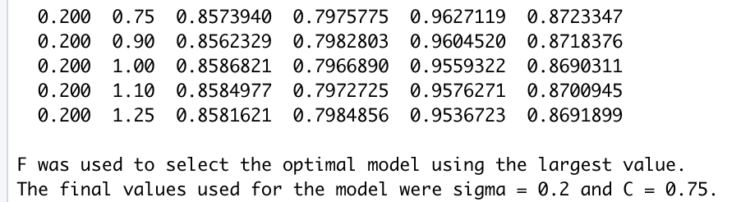
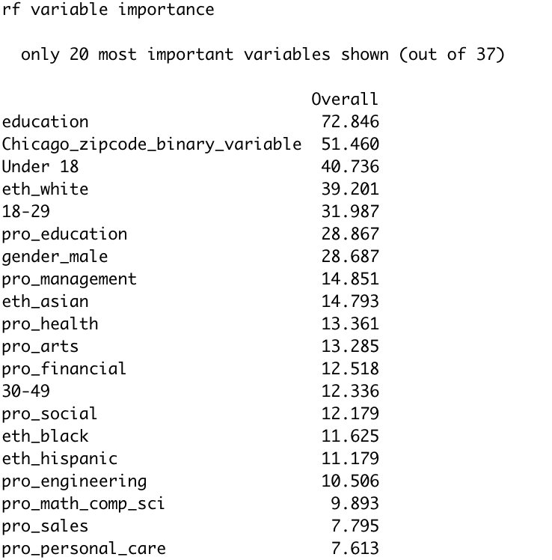
Further Exploration on Models:
SVM:
Use significant predictors in the full model as features
Better Performance with less overfitting
Hard to explain the result
Random Forest:
Use all features in the full model as features
Better Performance but also suffer from overfitting
Feature Importance plot

Slide 18
Concluding thoughts:
From 2013-2014 survey to 2018-2019 survey, the demographics of visitors changed most in gender and Age. After the reopening, there was a significant increase in the teenager visiting group as well as a significant decrease in elders. Much less white people visit the museum after the reopening. Different professionals also showed different tendencies to visit.
The word cloud can be directly used in marketing to stimulate people’s interests in science.
Museum’s members can be segmented into five subgroups.
It is reasonable to estimate about 20-25% of the museum’s total visitors are members.
Logistic regression are very interpretable in predicting customers with member potential. Certain variables will favor or decrease a person’s chance to buy the membership. However, models which can catch non-linear relationship are more robust. On the other hand, those models are harder to interpret. There is a trade-off here.

Slide 19
Thank You!

Slide 20
Q & A

