Slide 1
UniHD at TSAR-2022 Shared Task: Is Compute All We Need for Lexical Simplification?
Dennis Aumiller and Michael Gertz Heidelberg University Institute of Computer Science Database Systems Research Group aumiller@informatik.uni-heidelberg.de

Slide 2
Reading a Simplified Article
Constructing the Klexikon Dataset
Exploratory Analysis
Future Work
Aumiller and Gertz: “Klexikon: A German Dataset for Joint Summarization and Simplification”
<number>

Slide 3
Current Simplification Pipelines

Slide 4
Current Simplification Systems
Paraphrase
Database*
Complex Word
Stemming*
Statistical
Features
Inflection*
Substitute
Generation*
*: requires external knowledge
Source: Qiang et al., 2020: LSBert: A Simple Framework for Lexical Simplification
Aumiller and Gertz: “UniHD at TSAR-2022: Is Compute All We Need for Lexical Simplification?”
2

Slide 5
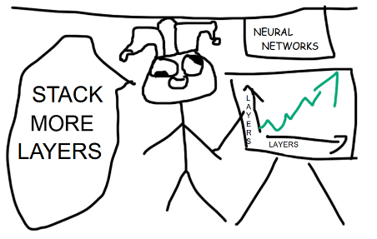
Wishful Thinking
What if: a simple pipeline, that could do all of that (but better)?
Source: https://pbs.twimg.com/media/EKaM6e-XUAATeWx
Aumiller and Gertz: “UniHD at TSAR-2022: Is Compute All We Need for Lexical Simplification?”
4

Slide 6
Contributions
Consider very large LMs as zero-shot recommenders for (contextualized) Lexical Simplification with prompting
Improve prediction diversity and coverage by sampling from multiple system prompts
Aumiller and Gertz: “UniHD at TSAR-2022: Is Compute All We Need for Lexical Simplification?”
5
Notes:
Later point: ”Suitable for summarization”, i.e. their expected input/output lengths are more towards the example that we’ve shown.

Slide 7
The Magical World of Prompt Design

Slide 8
Play around, find out
Started in 2014 as a resource specifically for children (age 6-13)
Each article is internally reviewed before release
Almost 3,300 articles on diverse topic
Crawled during April 2021
Aumiller and Gertz: “UniHD at TSAR-2022: Is Compute All We Need for Lexical Simplification?”
6

Slide 9
Corpus Alignment
Basic idea: Klexikon articles are (summarized) simplifications of the Wikipedia article on the same topic
Find Wikipedia article for each Klexikon entry (alignment)!
Hypothesis: Aligned articles represent a suitable dataset for training a joint summarization/simplification objective
Aumiller and Gertz: “UniHD at TSAR-2022: Is Compute All We Need for Lexical Simplification?”
8

Slide 10


Corpus Alignment
Basic idea: Klexikon articles are (summarized) simplifications of the Wikipedia article on the same topic
Find Wikipedia article for each Klexikon entry (alignment)!
Hypothesis: Aligned articles represent a suitable dataset for training a joint summarization/simplification objective
Adler (Eagle)
Adler (Eagle)
ABBA
ABBA
...
...
Aumiller and Gertz: “UniHD at TSAR-2022: Is Compute All We Need for Lexical Simplification?”
9

Slide 11
Corpus Alignment: Disambiguation
Not always that easy: Only 90% match directly
Requires manual resolution of conflicts
Adler (Eagle)
Adler?
Aumiller and Gertz: “Klexikon: A German Dataset for Joint Summarization and Simplification”
10

Slide 12
Corpus Alignment: Disambiguation
Not always that easy: Only 90% match directly
Requires manual resolution of conflicts
Animal?
Adler (Eagle)
Adler?
Aumiller and Gertz: “Klexikon: A German Dataset for Joint Summarization and Simplification”
11

Slide 13
Corpus Alignment: Disambiguation
Not always that easy: Only 90% match directly
Requires manual resolution of conflicts
Animal?
Adler (Eagle)
Adler?
Family name?
Aumiller and Gertz: “Klexikon: A German Dataset for Joint Summarization and Simplification”
12

Slide 14
Bonus Result: Multilingual Transfer

Slide 15
Bonus Results: beyond English
What if: Minor modifications on prompts and get results in other langugaes?
SotA results in Spanish and Portuguese
Aumiller and Gertz: “Klexikon: A German Dataset for Joint Summarization and Simplification”
13

Slide 16
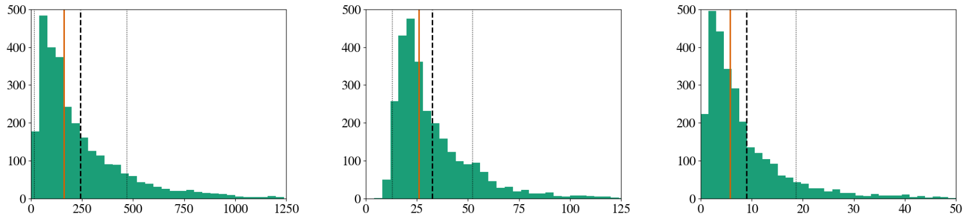
Length Distributions
Wikipedia article length (number of sentences)
Klexikon article length (number of sentences)
Compression ratio
( )
${{len}_{wiki}}/{{len}_{klexikon}}$
Distribution of the dataset including median (red line), mean (dotted black) and standard deviation (thin black line) for both Wikipedia and Klexikon.
Aumiller and Gertz: “Klexikon: A German Dataset for Joint Summarization and Simplification”
15

Slide 17
Suitability for Summarization
How do we know the dataset is appropriate?
Test against (extractive) baselines!
Compared methods:
Lead-3 (first three sentences)
Lead-k (opening paragraph in Wikipedia)
Full article
Luhn’s Algorithm (Luhn, 1958)
LexRank (Erkan and Radev, 2004) (with sentence-transformers embeddings)
Extractive Oracle
Evaluation with ROUGE
Aumiller and Gertz: “Klexikon: A German Dataset for Joint Summarization and Simplification”
15

Slide 18
Suitability for Summarization
How do we know the dataset is appropriate?
Test against (extractive) baselines!
Compared methods:
Lead-3 (first three sentences)
Lead-k (opening paragraph in Wikipedia)
Full article
Luhn’s Algorithm (Luhn, 1958)
LexRank (Erkan and Radev, 2004) (with sentence-transformers embeddings)
Extractive Oracle
Evaluation with ROUGE
Aumiller and Gertz: “Klexikon: A German Dataset for Joint Summarization and Simplification”
17

Slide 19
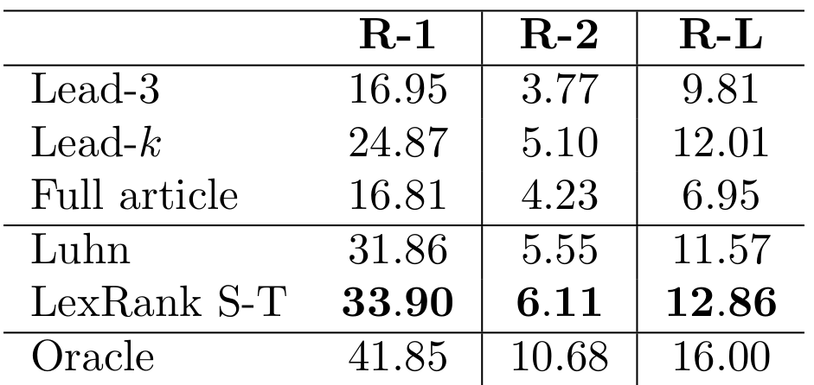
Suitability for Summarization
How do we know the dataset is appropriate?
Test against (extractive) baselines!
Compared methods:
Lead-3 (first three sentences)
Lead-k (opening paragraph in Wikipedia)
Full article
Luhn’s Algorithm (Luhn, 1958)
LexRank (Erkan and Radev, 2004) (with sentence-transformers embeddings)
Extractive Oracle
Evaluation with ROUGE
Table 3: ROUGE F1 scores of baselines.
Aumiller and Gertz: “Klexikon: A German Dataset for Joint Summarization and Simplification”
18

Slide 20
Suitability for Simplification
Use modified Flesch score for German (Amstad, 1978)
Average sentence length in tokens
Average word length in characters
Relative usage of the top 1000 lemmas of each corpus (Wikipedia/Klexikon) in relation to the total number of lemmas
Restrict to nouns, adjectives, verbs or adverbs
Less biased against longer texts
Aumiller and Gertz: “Klexikon: A German Dataset for Joint Summarization and Simplification”
19

Slide 21
Suitability for Simplification
Use modified Flesch score for German (Amstad, 1978)
Average sentence length in tokens
Average word length in characters
Relative usage of the top 1000 lemmas of each corpus (Wikipedia/Klexikon) in relation to the total number of lemmas
Restrict to nouns, adjectives, verbs or adverbs
Less biased against longer texts
Aumiller and Gertz: “Klexikon: A German Dataset for Joint Summarization and Simplification”
20

Slide 22
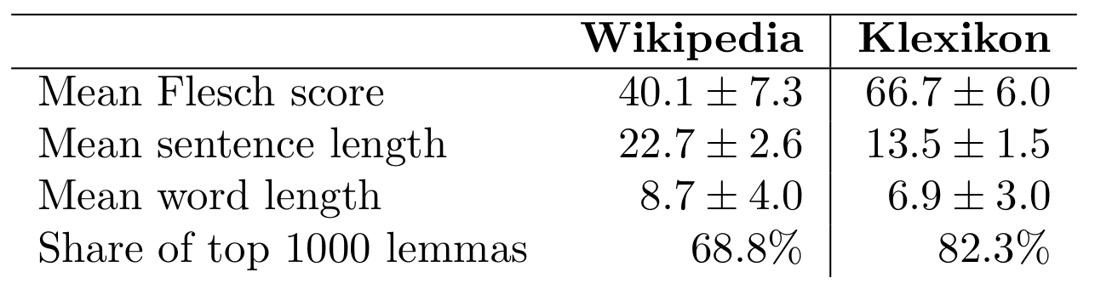
Suitability for Simplification
Table 4: Indicators of simplified texts across all metrics.
Aumiller and Gertz: “Klexikon: A German Dataset for Joint Summarization and Simplification”
21

Slide 23
Open Challenges and Future Work

Slide 24
Open Challenges
No “sophisticated” system that performs both simplification and summarization exists yet
How to integrate simplification as part of summarizers?
Abstractive systems are limited by length
How to align documents on a fine-grained context (sentence/paragraph-level) without manual annotation?
Existing solutions assume linear alignments and English
Aumiller and Gertz: “Klexikon: A German Dataset for Joint Summarization and Simplification”
21

Slide 25
Future Work
Provide additional sentence-level alignments
Hybrid retrieval systems to cut down texts to suitable lengths for abstractive systems
Experiment with regularization to incorporate simplification into neural networks
Aumiller and Gertz: “Klexikon: A German Dataset for Joint Summarization and Simplification”
24

Slide 26
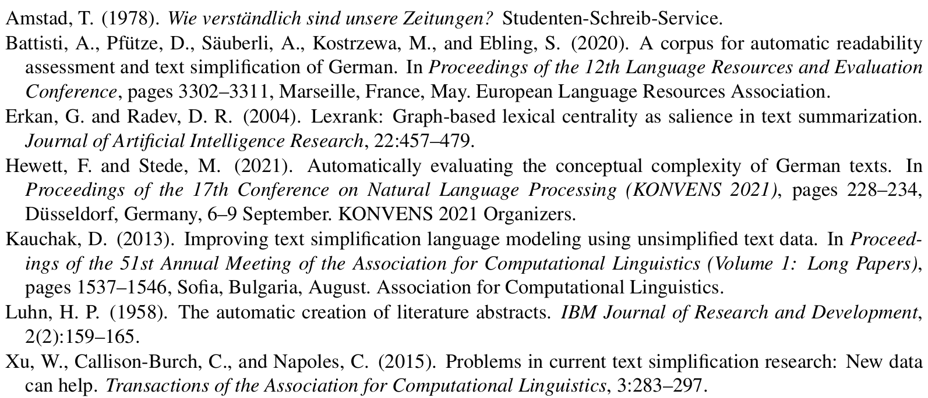
Resources
Aumiller and Gertz: “Klexikon: A German Dataset for Joint Summarization and Simplification”
25

Slide 27

Thank you for your attention!
Check out the dataset on Huggingface: https://huggingface.co/datasets/dennlinger/klexikon
The experimental code is also on Github: https://github.com/dennlinger/klexikon
Any questions?
@d_aumiller ...or send a mail to aumiller@informatik.uni-heidelberg.de

