Slide 1
Starting the right way – a Pecha Kucha
Group 4
Amadou, Anouar, Dennis, Gregor, Linyan, Magdalena, Melina, Nils, Thu, Xiaogang
Notes:
Good morning and welcome to our presentation of how we kick off our project.
My name is Gregor. And my name is Nils.

Slide 2
Outline
Get to know the team
Organizational tools and setup (teamwork, time plan, communication)
Software tools and setup
Notes:
Today we would like to present you our team, as well as how we organise and work.
Therefore we will show you our organizational tools, our software tools and their setup.
We made these choices to guarantee a high level of efficiency within our team and also to provide good code quality which will make our lives easier at some point throughout the project.

Slide 3
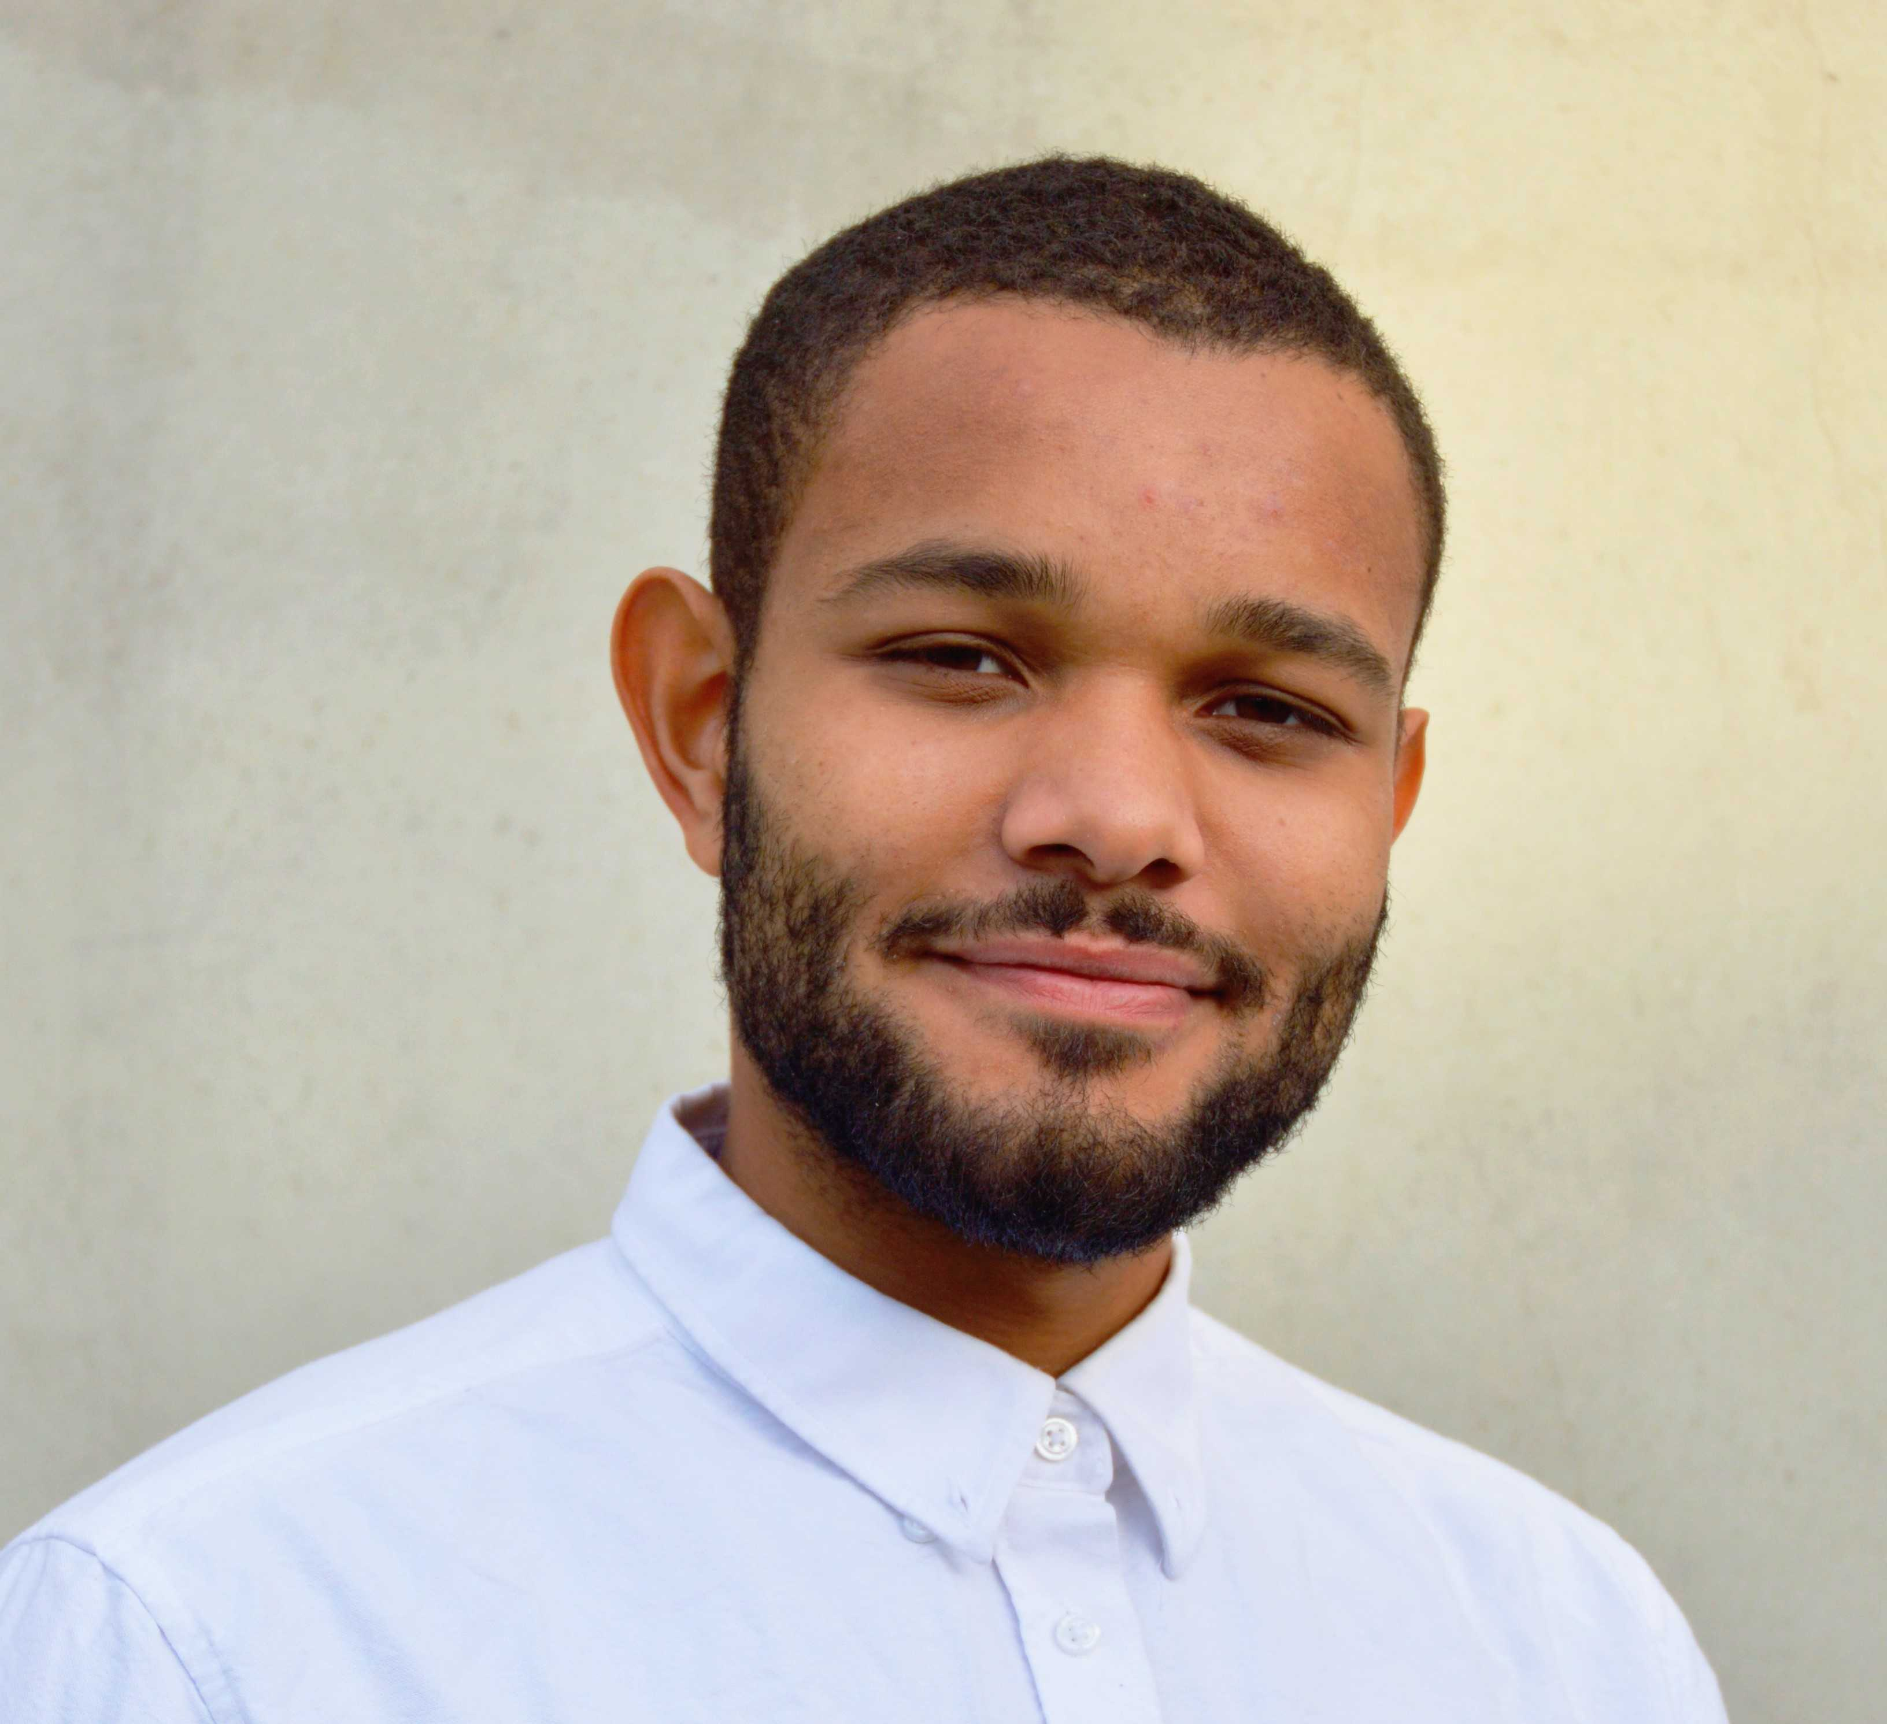
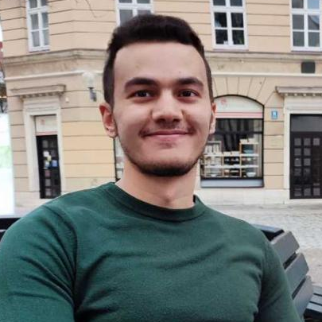





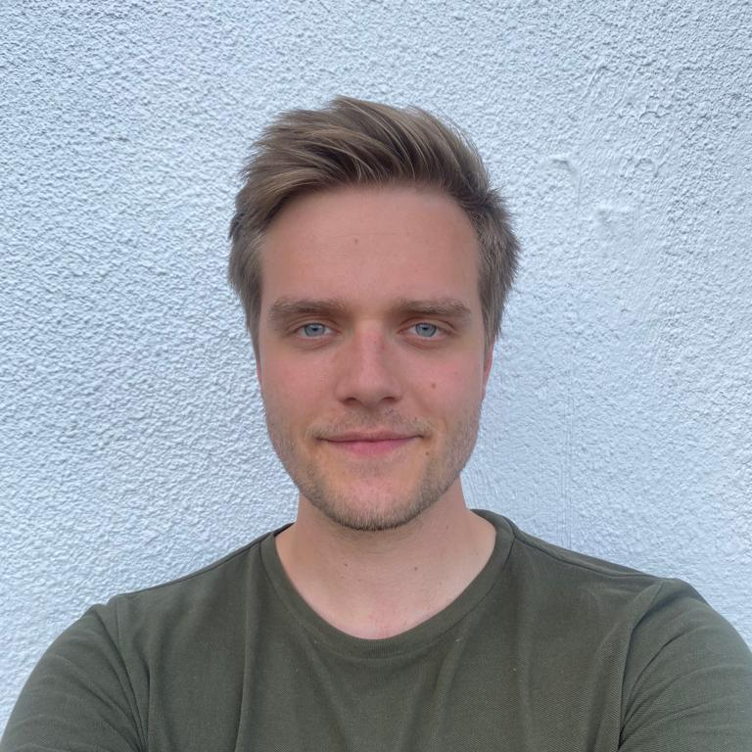




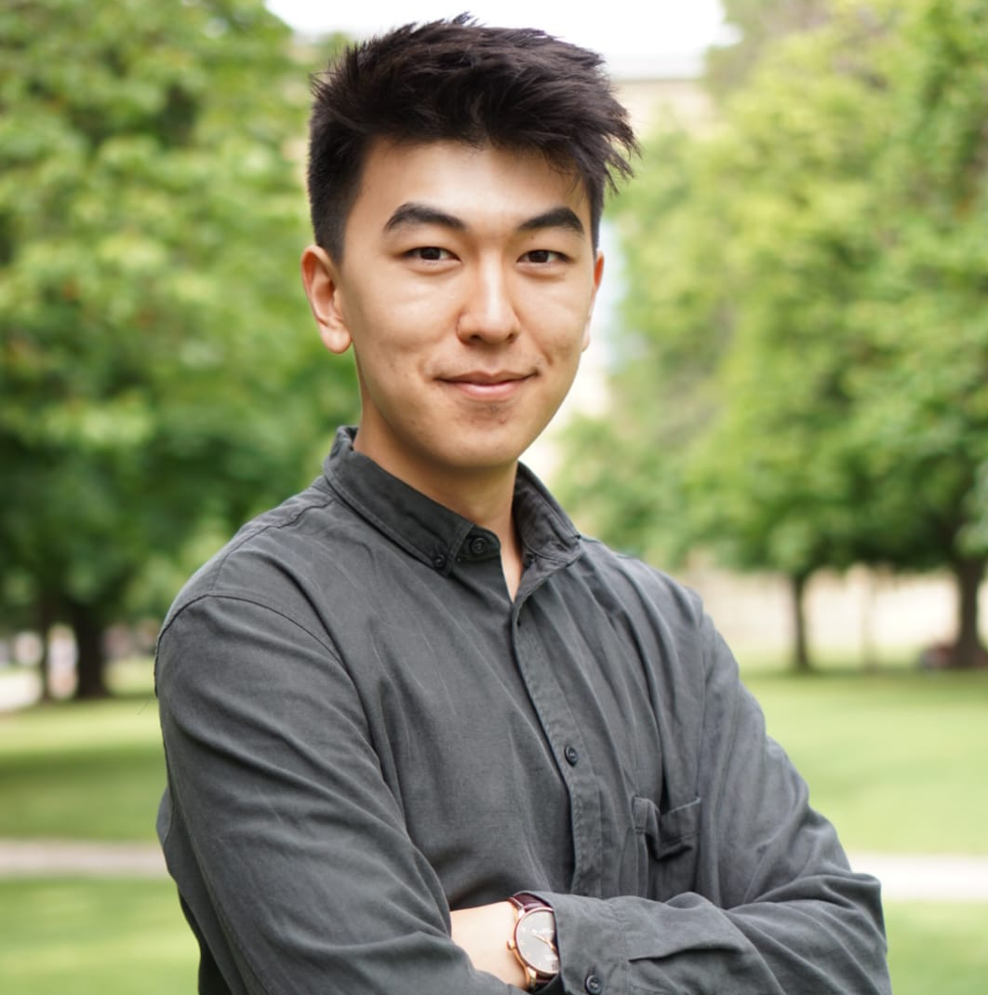




Our team will drive the project with its diverse skill set
Team Skills
Software Skills
Organizational Skills
Other Skills

Slide 4




Elites – Defining specific responsibilities
Elite Head
Elite Head
Elite Head
Elite Head
Amadou
Magdalena
Nils
Melina
Frontend
Quality
Control
Report
Backend
Data Preparation
Modeling
Analysis/Evaluation
Database
Web design
Technical Setup
CI/CD
Testing
Final Report
Video
Notes:
To coordinate such a large group we have decided to define 4 competence groups, the so called elites. Which are backend, frontend, quality control and report.
Each Elite is assigned to one responsible person who coordinates subgroups and overlooks the task assignments.

Slide 5




Tools we use for an efficient setup
Slack
Communication
Project Management
Jira
Gitlab
Version Control
File Sharing
Sharepoint
Text
Notes:
For an efficent productivity we are going to use 4 different tools throughout the whole project.
Jira for project management
Slack for communication purposes
Gitlab for code versioning and code deployment
Sharepoint for simultaneously working on documents

Slide 6




Dividing large work packages
Tracking Progress using JIRA Software
Applied Machine Intelligence Project
Epics
Stories
Tasks
Epic
Definition
A large body of work that can be broken down into several smaller stories.
Story
Definition
A feature or functionality from the user’s point of view
smallest unit of product development
Task
Definition
Smallest piece of work to be tracked
Breaks the work of a Story further down.
Notes:
We use Jira as our Project Management tool where tasks are created and assigned, and progress is tracked.
The Jira structure breaks a problem down into smaller parts to make it easier to tackle. We divide our project into Epics, Stories and Tasks.

Slide 7
Dividing large work packages
Tracking Progress using JIRA Software
Applied Machine Intelligence Project
Epics
Stories
Tasks
Epic
Definition
A large body of work that can be broken down into several smaller stories.
Story
Definition
A feature or functionality from the user’s point of view
smallest unit of product development
Task
Definition
Smallest piece of work to be tracked
Breaks the work of a Story further down.
Notes:
An epic is the larges body of work that can be broken dwon into several smaller stories.
A Story can be a feature or functionality from the user‘s point of view and always has a parent epic.
A Task is the smalles piece of work to be tracked. It breaks a story further down and always has an assignee who is responsible for implementation.

Slide 8
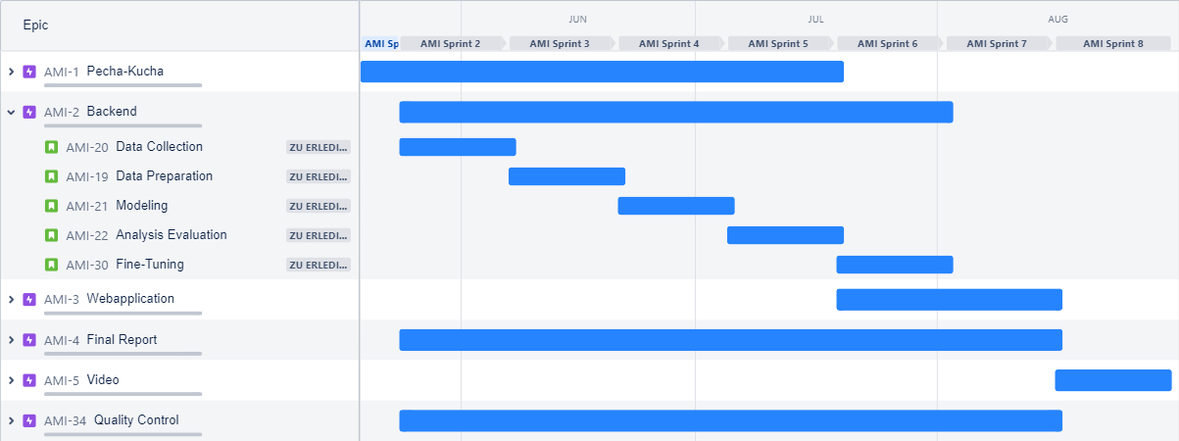
Jira as Project Management Tool
Issue tracking, bug tracking and (agile) project management
Notes:
Here you can see our current JIRA roadmap. The purple squares represent an epic, the green squares represent a story.
The stories then contain multiple tasks which, as mentioned earlier, are always assigned to an assignee and a sprint.

Slide 9
Jira as Project Management Tool
Issue tracking, bug tracking and (agile) project management
Sprint:
Duration: 2 weeks
Defines tasks with assigned persons
Notes:
A sprint is a short, repeating block of time in which key parts, in our case tasks, of the project are completed.
We chose the duration of a sprint to be 2 weeks. Several stories of different or the same epic can be completed in the same sprint period.

Slide 10
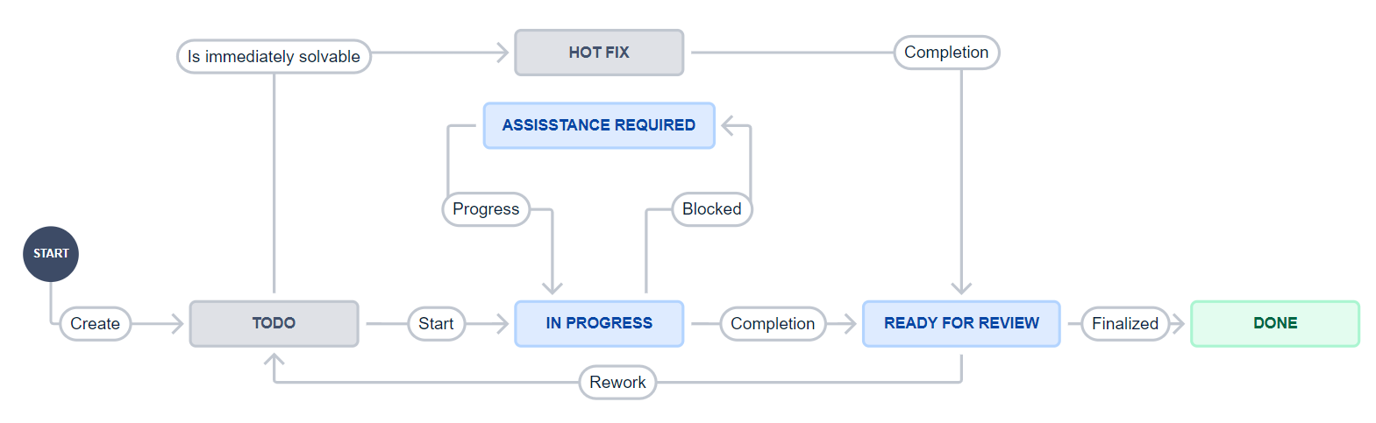
Jira Workflow Model
Notes:
Our basic worklow consists of four steps: todo to, in progress, ready for review and done.
Urgent tasks can be classified as a hotfix and thus be prioritized. If rework is necessary, a task goes from ready for review back to ToDo.

Slide 11

Creating an environment for improvement through code review
Technical:
Adding reinspection
"One code two brains"
Aligning coding styles
Increasing code quality
Interpersonal:
Improving collaboration
Creating a learning opportunity for both parties
Awareness of how feedback is given
Magnifying project knowledge
Notes:
Mention code review

Slide 12
Oh shit – Git?!
Wrong Commit Message
Branch Chaos
…
Merge Conflict
Detached Head
Notes:
Oh shit git!
Who does not know these issues when working in a larger group?
A branch chaos, or merge conflict and thereby maybe also a detatched head.
or simply a wrong commit message?
Well we would like to define a policy of best practices for commits, branching and merging so that we all get better at handling these challenges

Slide 13
Best Practice - Commits, Branching, Merging
feature/fix/change
develop
master
Tag 0.1.0
Git checkout –b fix/[id]_pipeline_issue
Tag 0.1.1
Fixed unhandled expectation pipeline issue (precheck error in build check)
Tag 0.2.0
Notes:
One important thing is, that we want to create a branch for every new feature/fix/change and we want to name that with a certain id.
This id is connected to our jira management tool. so we can keep track of our work.

Slide 14
Best Practice - Commits, Branching, Merging
feature/fix/change
develop
hot-fix
master
Tag 0.1.0
Git checkout –b fix/[id]_pipeline_issue
Severe bug fix for production
Tag 0.1.1
Fixed unhandled expectation pipeline issue (precheck error in build check)
Tag 0.2.0
Notes:
Another important thing is, that we use meaningful commit messages all the time. and if we have more than one commit for a task, we can squash them together so that our master history stays clean
Next to this standard workflow the, we would like to also include a hot-fix branch in our system, so that severe bug fixes for production can be made at all times.

Slide 15
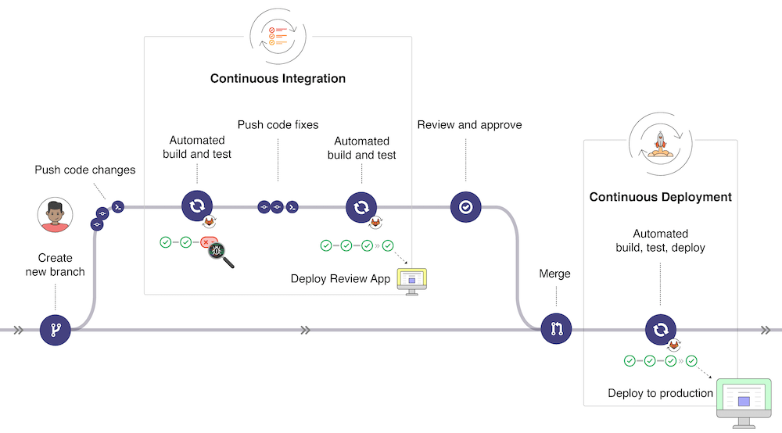
CI/CD as Workflow
Frequent and small code updates
Automated testing
Automated
Practical
Scalable

Slide 16
Why is CI/CD the answer?
Predictable deployment
Streamline development
? Why the hassle?
More effort now, less effort later
Encapsulation
Facilitate testing
Code robustness

Slide 17
Providing test suite as a service
! Achieving our goal!
Test Review
Continuous improvement
Rotating assignment
Low entry barrier
Infrastructure and templates are provided

Slide 18
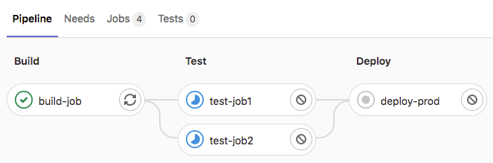



Building CI/CD with the right tools
GitLab CI/CD
Integrated into Gitlab and easy to use
Run test scripts on every push and merge
Runner can be local or in limited fashion remote
Pytest/Unittest
Test individual functions and code chunks in python

Slide 19
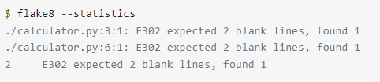

Building CI/CD with the right tools
Docker
Streamlines CD through standardized environment
Flake8
Test the compliance with the code style requirements
Spellchecker
Spellcheck text outputs for GUI, CLI and logs

Slide 20
Thank you for your attention!

