Slide 1
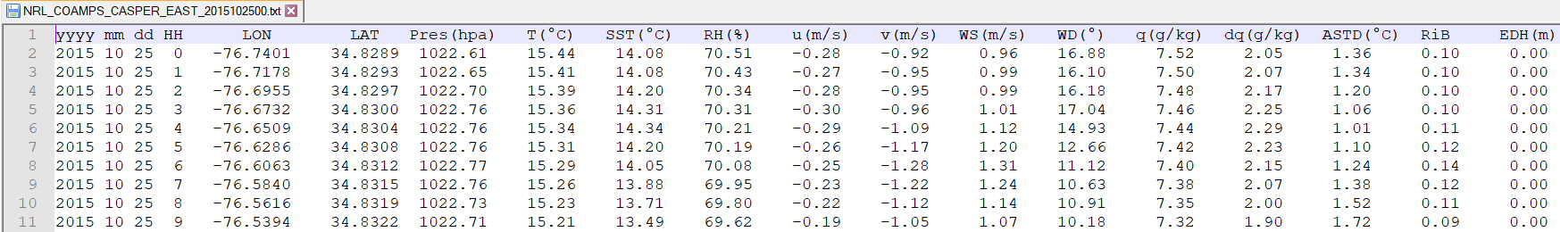
Machine Learning
Data
We used CASPER-East COAMPS simulations data

Slide 2
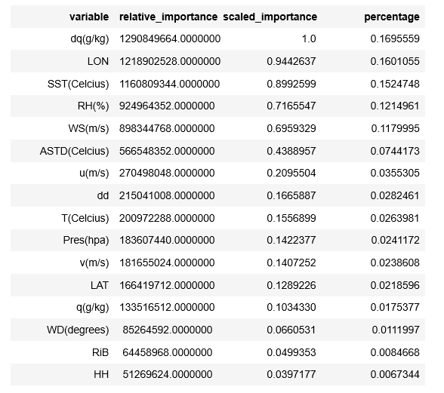
Machine learning models tried on this data
a. H2O Random forest model
b. Increased complexity H2O random forester
c. XGBoost regressor
d. Deep learning using Keras framework
H2O random forest is by far gave the best results
Used a default H2O RF model (used all predictors)
Mean absolute error (MAE) = 0.2 m
Increased the complexity of the RF model (Used all the predictors)
MAE = 0.1 m
3 . Removed q and dq
MAE = 0.2
Model 5 (dq, ASTD & WS) → MAE = 0.96
Model 6 (T, RH, and SST) → MAE 1.7
Model 7 (T, RH, SST and WS)→ MAE 0.63
Model 8 (T, RH, SST, WS & Pres) → MAE 0.4

Slide 3
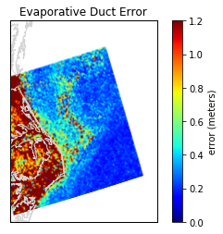
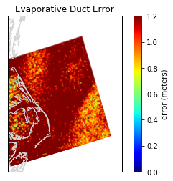
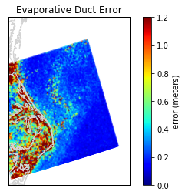
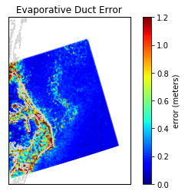
Model 5 (dq, ASTD & WS)
MAE = 0.96
Model 6 (T, RH, and SST)
MAE 1.7
Model 7 (T, RH, SST and WS)
MAE 0.63
Model 8 (T, RH, SST, WS & Pres)
MAE 0.4

Slide 4
Planning a study using Buoy data to sea spatial and temporal influence on the model performance.

