Slide 1
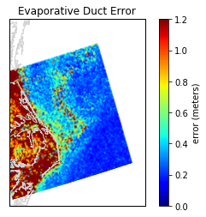
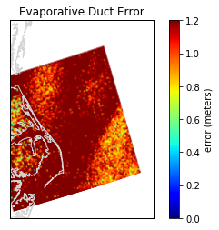
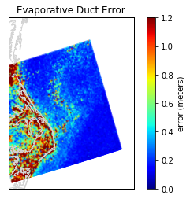
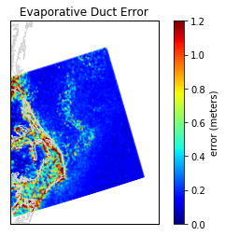
Model 5 (dq, ASTD & WS)
MAE = 0.96
Model 6 (T, RH, and SST)
MAE 1.7
Model 7 (T, RH, SST and WS)
MAE 0.63
Model 8 (T, RH, SST, WS & Pres)
MAE 0.4

