Slide 1
Deliverable 4: Data Mining Techniques for a Healthcare Dataset
Denny Boechat
Advanced Big Data and Data Mining (MSCS-634-B01)
University of the Cumberlands
Dr. Satish Penmatsa August 20, 2025

Slide 2
The dataset
Personal project – healthcare
Medical and dental appointment data for 500+ patients
Demographics: age, gender, date of birth.
Vital signs: weight, height, temperature, pulse, blood glucose, etc.
Appointment info: whether a patient had a general or dental visit.

Slide 3
Data cleaning
Converted date fields into proper datetime format (enabled calculations like patient age)
Standardized text columns by trimming spaces and converting to lowercase
Handled missing values by filling numeric columns with median values (avoids bias)
Removed duplicate rows from the dataset
Ensured consistency in gender values
Created a new column for patient age
Removed sensitive information (full names, phone numbers) to protect privacy

Slide 4
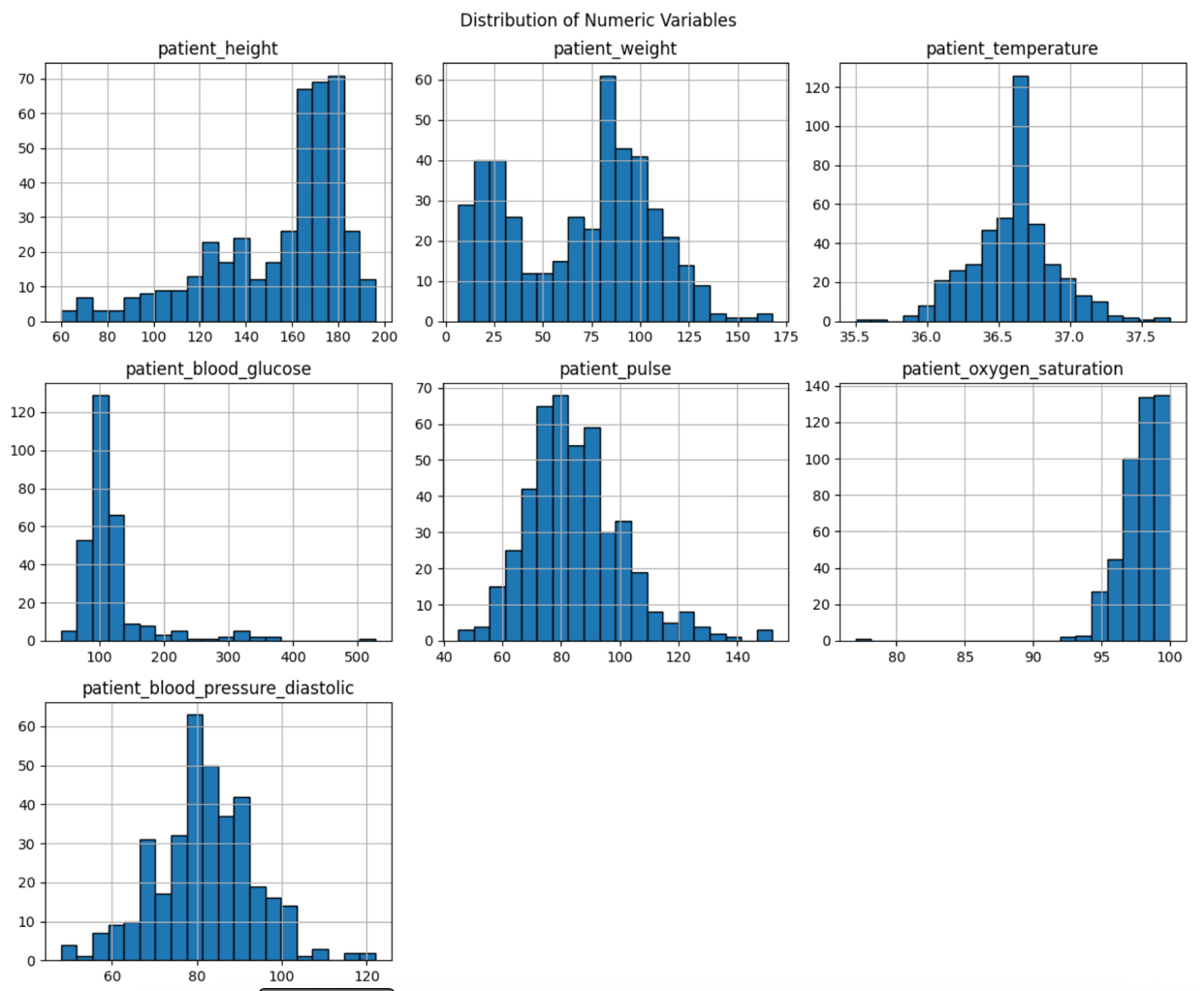
Exploratory data analysis
Most patient variables fall within normal physiological ranges, with height, weight, and temperature showing expected distributions.
Outliers are noticeable in blood glucose, pulse, and blood pressure, suggesting possible cases of diabetes, stress, or hypertension.
Oxygen saturation remains strongly clustered at healthy levels (95–100%), indicating overall stable respiratory health in most patients.

Slide 5
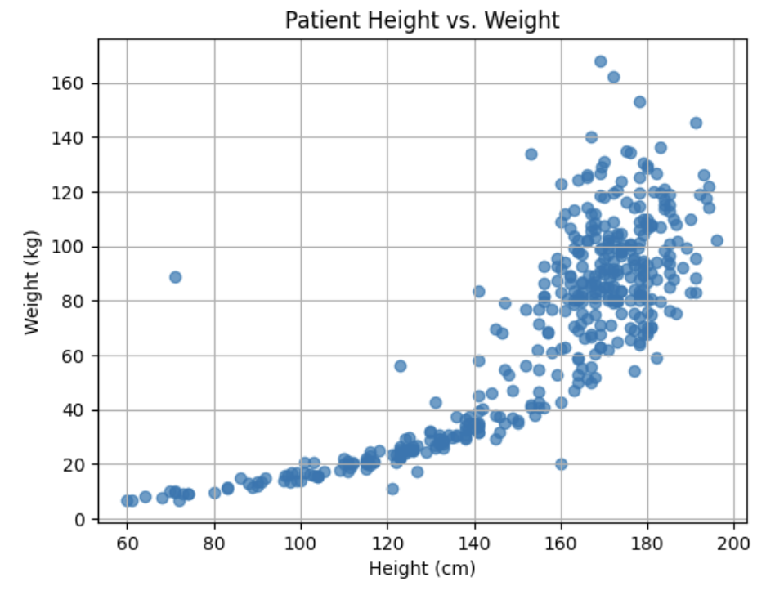
Feature Relationships
Clear positive correlation: taller patients generally weigh more, with most clustering at 160–180 cm and 60–100 kg.
Greater variability in weight observed at taller heights, reflecting differences in body composition (muscle vs. fat).
Outliers show higher weights at shorter heights, potentially indicating obesity or elevated health risks.

Slide 6
Insights from EDA
Most appointments came from young and middle-aged adults; fewer from children and elderly patients. Seasonal variations in appointment frequency suggest links to school breaks and holidays.
Health profiles: Clinical measures (weight, temperature, blood glucose) showed generally normal ranges with some outliers, possibly due to errors or special health conditions.
Feature engineering: Created essential variables such as patient age, BMI, appointment month/weekday/weekend flags, and vitals-based indicators (fever, low oxygen).
Text analysis: Extracted keywords from appointment notes to flag pain and checkup-related visits, providing insights into common reasons for appointments.

Slide 7
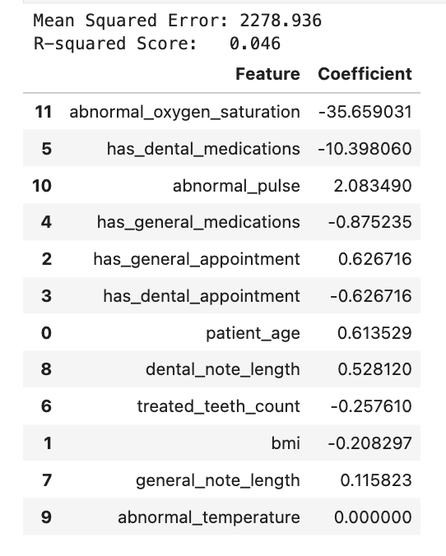
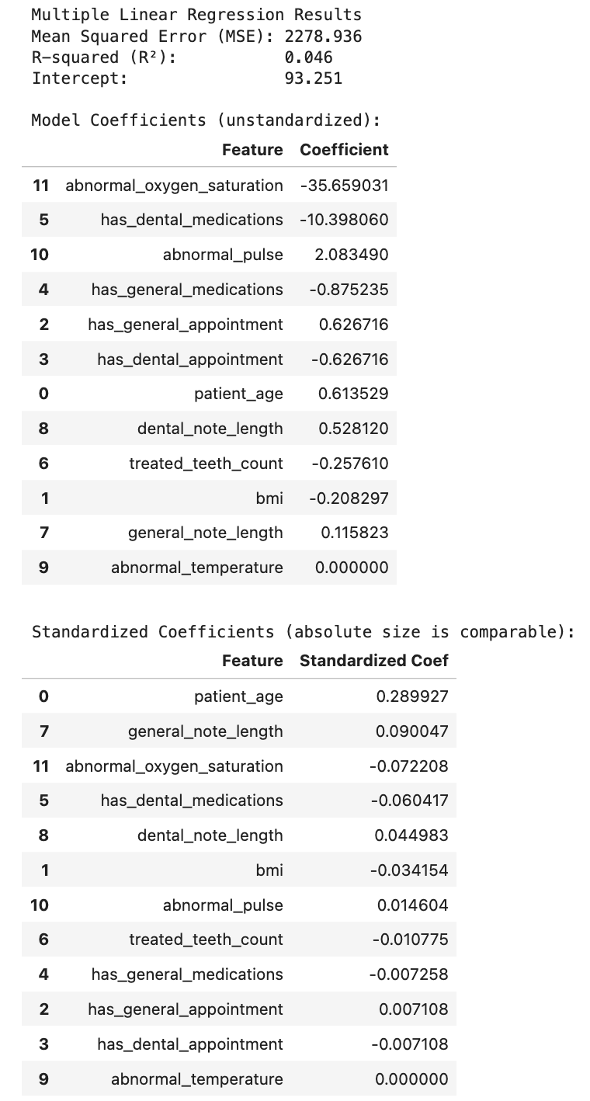
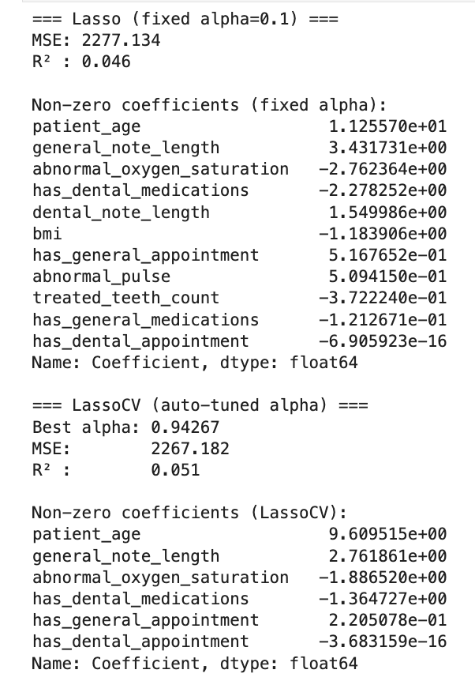
Linear Regression, Multiple Linear Regression and Lasso
Model performance was weak: Both Linear Regression and Lasso Regression explained less than 5% of the variation in blood glucose (low R², high MSE).
Key predictors identified: Patient age, general note length, abnormal oxygen saturation, and dental medications showed the strongest relationships with glucose levels, though overall effects were small.
Need for richer data: Current features are insufficient; incorporating clinically relevant factors like diet, lifestyle, or medical history would likely improve predictive power.

Slide 8
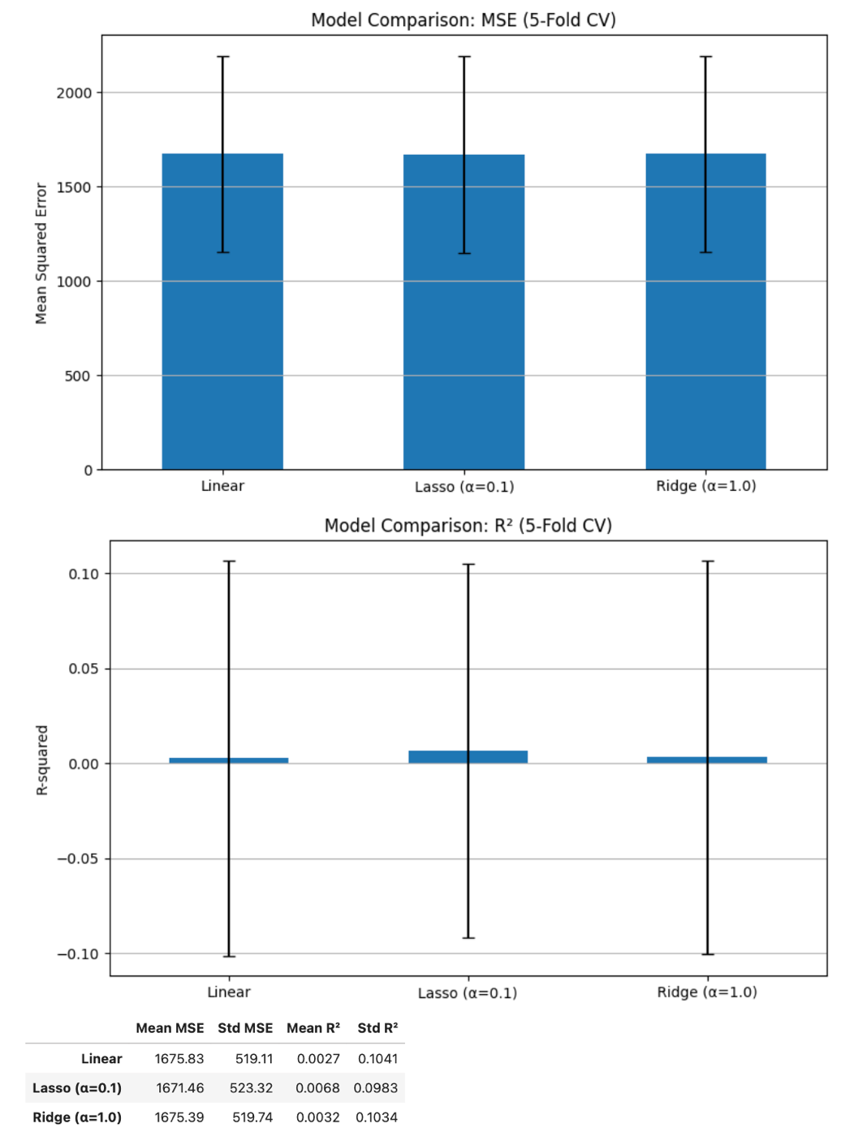
Model performance with 5-fold CV (MSE & R²)
Model comparison: Linear, Lasso, and Ridge regression performed almost identically, with MSE ~1670–1680 and R² scores near zero, showing little ability to explain blood glucose variance.
Main insight: Regularization offered no real advantage, highlighting the need for additional or more relevant features to improve predictive performance.

Slide 9
Ethical Considerations
Privacy & confidentiality: Even de-identified data can pose re-identification risks; applying anonymization, minimization, and compliance with HIPAA/GDPR is essential for safeguarding patient information.
Fairness & bias: Predictive models may reinforce health disparities if datasets are incomplete or biased, especially for underrepresented groups, leading to inaccurate or inequitable outcomes.
Responsible AI practices: Ensuring transparency, explainability, equity, and accountability builds trust in healthcare applications and mitigates ethical risks in data-driven decision-making.

Slide 10
Recommendations
Data & features: Expand the dataset with clinically relevant and lifestyle variables (diet, exercise, medical history) to improve predictive accuracy.
Modeling & methods: Explore advanced models (Random Forests, Gradient Boosting, Neural Networks) and refine clustering with parameter tuning or density-based approaches for better patient segmentation.
Ethics & operations: Apply fairness, transparency, and privacy safeguards while using association rules for proactive scheduling and preventive care validated against real-world outcomes.

