Slide 1
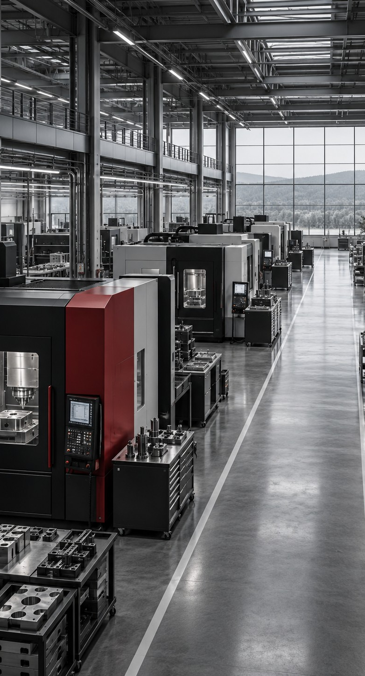
GLINX AI
The self-improving
company
Company self-awareness.
Recursive improvement.
Investor presentation
Denny Garcia
September 2026
Notes:
Glinx has one main directive: make a company self-aware so it can recursively self-improve. In business terms, this means a persistent model of the company that understands its purpose and current condition, proposes changes, and learns from measured results. The owner defines the objectives and permissions. The full platform is a product vision. Today, an installable Company Discovery prototype establishes the first sensing layer. The cover illustration depicts a fictional manufacturing environment and does not represent a customer installation.
Sources
Founder-provided career background and Glinx vision, September 2026.
https://github.com/dennybrig/Glinx.ai/blob/8e49df99fe437d0452892e5034a3c0ca97e56a8c/docs/ARCHITECTURE.md

Slide 2
The Glinx investment thesis
A persistent company model could make each improvement cycle better informed than the last.
01
What Glinx would do
Connect the company’s systems to an evidence-backed model of how the business works.
02
Why it matters
Use that model to diagnose operating problems and learn from the results of approved actions.
03
Where it starts
Enter through Company Discovery, then prove one improvement loop with a manufacturing partner.
Platform thesis. Discovery is the current prototype. Business reasoning, actions and learning remain future work.
GLINX AI
02
Notes:
The investment thesis combines a large ambition with a narrow starting point. Companies already hold operating information in ERP, email, finance and other systems. Glinx would preserve the evidence and connect it to business meaning, then use outcomes to update the next decision. The initial manufacturing focus is a customer hypothesis, supported by the founder’s operating experience. No paying customer, executed pilot, measured savings or financing amount is claimed. The next milestone is customer evidence that a complete loop can improve a real decision.
Sources
Founder-provided career background and Glinx vision, September 2026.
https://github.com/dennybrig/Glinx.ai/blob/8e49df99fe437d0452892e5034a3c0ca97e56a8c/docs/ARCHITECTURE.md
https://github.com/dennybrig/Glinx.ai/blob/8e49df99fe437d0452892e5034a3c0ca97e56a8c/README.md

Slide 3
Decisions depend on evidence across systems
The operating problem often spans several records, several teams and several definitions of the truth.
Business question | Evidence the answer needs
Why did this order lose margin? | Quote, material cost, labor, rework and invoice
Why are deliveries slipping? | Customer promise, production plan, supply and capacity
Where is cash getting trapped? | Inventory, purchase commitments and receivables
Did the last change actually help? | A baseline, the action taken and the later outcome
Glinx aims to make these relationships and their evidence available in one company model
GLINX AI
03
Notes:
These examples describe the customer problem Glinx intends to address. They are operating questions, not quantified survey findings. A manager may have all the necessary systems and still need manual reconciliation to answer a cross-functional question. Discovery establishes what exists. Later connectors and entity resolution would establish what the records mean together. A useful product must also record where it lacks data or where source systems disagree.
Sources
Founder-provided career background and Glinx vision, September 2026.
Founder-supplied operating-model image, C17DB1D4-A31C-4246-8679-988D07947354.jpeg, September 2026.

Slide 4
Company self-awareness
Glinx’s proposed self-model would answer four questions continuously.
01
Purpose
What are we trying to achieve, and what constraints must we respect?
02
Condition
What is happening across the business, and what remains uncertain?
03
Explanation
Which relationships and evidence could explain a performance gap?
04
Memory
What did we change, what happened next, and what should we retain?
“Self-aware” describes an operational capability. Owners retain authority over company objectives and actions.
GLINX AI
04
Notes:
Self-awareness here means a functional business capability, not consciousness or legal personhood. The company model needs explicit objectives, a current state, evidence for its explanations and memory over time. It should know the limits of its knowledge. Human leaders continue to resolve trade-offs among profit, service, quality, safety and other constraints. Recursive improvement means feeding evaluated outcomes into later cycles. It does not mean unconstrained self-modification or permission to pursue a metric at any cost.
Sources
Founder-provided career background and Glinx vision, September 2026.
https://github.com/dennybrig/Glinx.ai/blob/8e49df99fe437d0452892e5034a3c0ca97e56a8c/docs/ARCHITECTURE.md

Slide 5
AI adoption is broad. Agent deployment remains early.
Stanford’s 2026 AI Index describes both momentum and an execution gap.
88%
Single digits
AI agent deployment across
nearly all business functions
of surveyed organizations
used AI in 2025
Glinx’s opportunity
Make company context, controls and outcome measurement usable in a focused operating workflow.
Source: Stanford HAI, 2026 AI Index, Economy chapter. Opportunity statement is the Glinx product thesis.
GLINX AI
05
Notes:
Stanford’s 2026 AI Index reports AI use at 88% of surveyed organizations in 2025, while agent deployment remained in single digits across nearly all business functions. These are survey findings, not estimates of the number of customers Glinx can win. They suggest a context in which AI familiarity is widespread and operational deployment still needs work. The inference for Glinx is to focus on a bounded business workflow where evidence, permissions and a measurable outcome can establish trust. Adoption does not by itself prove demand for Glinx.
Sources
https://hai.stanford.edu/ai-index/2026-ai-index-report/economy

Slide 6
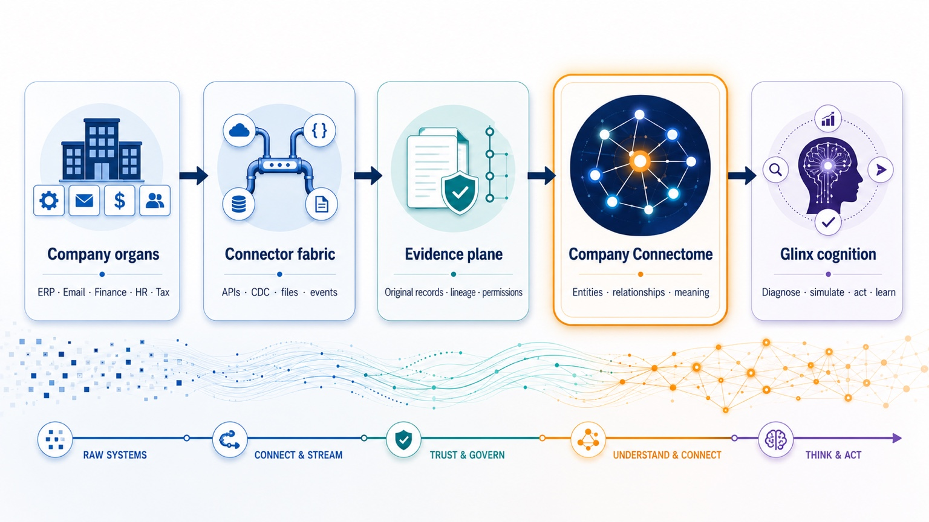
The Glinx operating architecture
Full-platform design. Company Discovery begins the sensing and evidence layers.
GLINX AI
06
Notes:
The founder’s reference image defines five layers. Company organs are the source systems, including ERP, email, finance, HR and tax. Connector fabric acquires permitted records using APIs, change-data capture, files or events. The evidence plane preserves original records, lineage and permissions. The Company Connectome resolves business entities, relationships and meaning. Glinx cognition diagnoses, simulates, acts and learns. The outcome of an action must return as new evidence for the next cycle. Most of this end-state architecture remains to be built. The current prototype identifies approved system metadata and records its evidence.
Sources
Founder-supplied operating-model image, C17DB1D4-A31C-4246-8679-988D07947354.jpeg, September 2026.
https://github.com/dennybrig/Glinx.ai/blob/8e49df99fe437d0452892e5034a3c0ca97e56a8c/docs/ARCHITECTURE.md

Slide 7
The Company Connectome
Illustrative future model for one order. Each relationship retains a link to source evidence.
Customer
places
Sales order
requests
Product
CRM account
ERP promise and price
Item and specification
fulfilled by
Supplier
supplies
Work order
uses
Capacity
Purchase order and receipt
Routing and actual cost
Machine and schedule
Entity matching and relationships require validation. A connection in the model does not prove causation.
GLINX AI
07
Notes:
The Connectome is a proposed persistent model of the company’s entities, relationships, objectives and changing state. This order example links customer, order, product, supplier, work order and capacity across source systems. Each record should retain identifiers, timestamps, provenance and applicable access controls. Entity resolution must distinguish multiple installations and similarly named objects. The graph gives an investigator context, but it does not automatically establish causation. Discovery today only supplies an initial system inventory and separately reported relationships, not this full operating graph.
Sources
Founder-supplied operating-model image, C17DB1D4-A31C-4246-8679-988D07947354.jpeg, September 2026.
https://github.com/dennybrig/Glinx.ai/blob/8e49df99fe437d0452892e5034a3c0ca97e56a8c/docs/ARCHITECTURE.md
https://github.com/dennybrig/Glinx.ai/blob/8e49df99fe437d0452892e5034a3c0ca97e56a8c/docs/REPORT-CONTRACT.md

Slide 8
The recursive self-improvement loop
Proposed behavior: each evaluated outcome updates the company model and the next decision.
1 Sense
2 Understand
3 Decide
Refresh permitted evidence
Explain gaps and uncertainty
Compare bounded options
Human objectives, permissions
and stop controls govern the loop
6 Learn
5 Measure
4 Act
Retain or reject the change
Compare result with baseline
Execute an approved change
A measured failure is useful evidence. Glinx should stop or revise a workflow when results or guardrails deteriorate.
GLINX AI
08
Notes:
This loop operationalizes the main directive. Sense refreshes evidence. Understand forms explanations with uncertainty. Decide compares options against owner-defined objectives and constraints. Act executes only authorized changes. Measure evaluates results against a baseline, including unintended effects. Learn retains or rejects the change and updates the model, playbook or monitoring criteria. An agent may launch a narrowly scoped subtask only under a pre-approved policy with bounded access, budget and duration. It must not grant itself authority, rewrite its objectives or blindly reinforce its earlier answer. Consequential actions require human approval. The full loop is a future product capability.
Sources
Founder-provided career background and Glinx vision, September 2026.
Founder-supplied operating-model image, C17DB1D4-A31C-4246-8679-988D07947354.jpeg, September 2026.
https://github.com/dennybrig/Glinx.ai/blob/8e49df99fe437d0452892e5034a3c0ca97e56a8c/docs/ARCHITECTURE.md

Slide 9
One late-order problem can become a learning cycle
Illustrative future workflow for a manufacturer. No customer result or current capability claim.
“Why are shipments
slipping while
overtime rises?”
Evidence
Order dates, material arrivals, routing times and overtime.
Diagnosis
Test whether shortages, rework or a bottleneck explains the delay.
Action
Propose a limited schedule or purchasing change for owner approval.
The owner sets the goal:
improve delivery while
protecting margin and quality.
Learning
Measure delivery and cost. Update the next review using the result.
GLINX AI
09
Notes:
Walk through one concrete example rather than claiming the platform can optimize everything at once. A manufacturing owner sees worsening delivery performance and rising overtime. The proposed system brings together dated records and tests plausible explanations. It compares a bounded intervention with alternatives, and a person approves the change. It then measures delivery, cost and quality over an agreed window. The next cycle starts with an improved hypothesis or a rejected intervention, not a claim that any observed improvement proves causation. Native ERP access, reasoning, action execution and outcome evaluation remain future work.
Sources
Founder-provided career background and Glinx vision, September 2026.
Founder-supplied operating-model image, C17DB1D4-A31C-4246-8679-988D07947354.jpeg, September 2026.
https://github.com/dennybrig/Glinx.ai/blob/8e49df99fe437d0452892e5034a3c0ca97e56a8c/docs/ARCHITECTURE.md

Slide 10
Who would use Glinx
Proposed first customer: a manufacturer with 100–499 employees, several systems and a costly recurring problem.
Role in the customer | Why they would use it | What they would decide
Owner or CEO Economic buyer | See the condition of the business | Objectives, budget and priorities
COO or plant leader Operating champion | Investigate gaps across functions | Which improvement to test
Finance and process owners Daily users | Validate evidence and track outcomes | Whether the change created value
IT and security Access gatekeeper | Control connections and permissions | Which data and actions are allowed
Initial customer profile is a hypothesis. Adjacent manufacturers and other sectors may qualify by workflow complexity.
GLINX AI
10
Notes:
The proposed buyer is the owner, CEO or general manager responsible for the company’s performance. An operations leader champions the first use case. Finance and process owners validate definitions, operating evidence and the value calculation. IT and security approve integration boundaries and controls. The proposed 100–499 employee manufacturing segment is a starting focus, not a validated market segment or an exclusion of smaller companies. A firm needs enough workflow complexity to justify integration effort, a named owner and accessible source records. Longer-term users could include distribution and service businesses and operating teams managing multiple companies.
Sources
Founder-provided career background and Glinx vision, September 2026.

Slide 11
One company model can support several use cases
Expansion follows verified value in the first workflow.
Business use case | Question Glinx would help answer | Outcome to measure
Delivery reliability | Which constraint threatens the customer promise? | On-time delivery and expediting cost
Margin protection | Where does actual cost diverge from the quote? | Contribution margin and rework
Working capital | Which inventory or receivable needs intervention? | Cash released and service level
Operational change | Did a process or system change improve performance? | Adoption, cycle time and quality
Longer-term users include distribution and service businesses
GLINX AI
11
Notes:
These are potential customer outcomes rather than delivered modules or verified results. Glinx should choose one recurring use case with measurable input and output before expanding. Delivery, margin, working capital and change implementation all depend on relationships across records and teams. Working-capital release must remain separate from recurring profit improvement. HR, payroll, tax and regulated decisions require their own permission boundaries and responsible specialists. Presence of a source connector does not authorize an agent to make a business decision.
Sources
Founder-provided career background and Glinx vision, September 2026.
Founder-supplied operating-model image, C17DB1D4-A31C-4246-8679-988D07947354.jpeg, September 2026.

Slide 12
The Glinx product portfolio
Discovery creates the starting inventory. Subsequent products would turn evidence into evaluated action.
Capability | Customer-facing output | Development stage
Know | System inventory and a persistent company model | Discovery prototype Model planned
Diagnose | Evidence-backed explanations and open questions | Planned
Prioritize | Opportunities ranked by impact and risk | Planned
Plan | Roadmap with owners and approval gates | Planned
Operate and learn | Scoped agents and evaluated outcomes | Planned
The planned capabilities describe product scope, not released features or committed delivery dates.
GLINX AI
12
Notes:
This is the broader Glinx product map. Know combines Discovery with the proposed persistent company model. Diagnose would explain problems with traceable evidence and uncertainty. Prioritize would rank opportunities using costs, expected impact and risk assumptions. Plan would translate a chosen opportunity into an accountable roadmap. Operate and learn would use scoped agents to carry out permitted tasks and evaluate their effects. The architecture would allow appropriate models and tools for each task. Glinx does not need to train its own foundation model to test this thesis. Today’s inventory questions use deterministic rules, and the full reasoning and execution capabilities remain planned.
Sources
Founder-provided career background and Glinx vision, September 2026.
https://github.com/dennybrig/Glinx.ai/blob/8e49df99fe437d0452892e5034a3c0ca97e56a8c/docs/ARCHITECTURE.md
https://github.com/dennybrig/Glinx.ai/blob/8e49df99fe437d0452892e5034a3c0ca97e56a8c/README.md

Slide 13
Company Discovery is the first working product
An installable agent and evidence viewer establish the initial sensing layer.
24
Working today
Approved system discovery
Source evidence and coverage gaps
Local report import and export
A fictional company demo
automated tests passed
17 agent tests
7 dashboard model tests
Next proof
A real company pilot
A native ERP connection
Validation is local engineering evidence. It does not establish customer traction or a complete self-improvement loop.
GLINX AI
13
Notes:
The implementation record reports 17 Python tests and 7 JavaScript model tests. A real Linux run inspected 693 package entries in a development environment and returned one endpoint record, with network sources disabled. A built wheel installed into a clean environment and served local report and dashboard routes. The source types cover local application records, mail-domain clues, Microsoft enterprise-app registrations, approved HTTPS fingerprints and owner inventories. Live Microsoft tenant and real Windows/macOS validation remain ahead. The Alder Forge demonstration is fictional. No customer revenue, measured savings or production security certification is claimed.
Sources
https://github.com/dennybrig/Glinx.ai/blob/8e49df99fe437d0452892e5034a3c0ca97e56a8c/docs/VALIDATION.md
https://github.com/dennybrig/Glinx.ai/blob/8e49df99fe437d0452892e5034a3c0ca97e56a8c/README.md
https://github.com/dennybrig/Glinx.ai/blob/8e49df99fe437d0452892e5034a3c0ca97e56a8c/docs/REPORT-CONTRACT.md

Slide 14
Go-to-market starts with one operating problem
Founder-led design partnerships would establish the evidence needed for repeatable deployment.
01
Paid discovery
Agree scope with an owner. Map systems, confirm access and establish the operating baseline.
02
One improvement loop
Connect the required records and evaluate one human-approved intervention.
03
Workflow expansion
Add recurring monitoring and further use cases after the customer verifies value.
Proposed channels: operator referrals, ERP implementation partners and private-equity operating teams. No partnerships claimed.
GLINX AI
14
Notes:
The recommended go-to-market approach begins with founder-led access to manufacturing operators and a narrow paid diagnostic. A design partner must supply an executive sponsor, a process owner and permission to the needed evidence. The second phase establishes one useful loop, including a baseline and approval. Only after the customer confirms value should Glinx expand the workflow and test an annual software contract. ERP implementation firms and private-equity operating teams are possible future channels, not existing commercial relationships. This approach also tests whether deployment can become repeatable rather than a new consulting project every time.
Sources
Founder-provided career background and Glinx vision, September 2026.
https://github.com/dennybrig/Glinx.ai/blob/8e49df99fe437d0452892e5034a3c0ca97e56a8c/docs/ARCHITECTURE.md

Slide 15
Paid discovery, followed by subscription software
Proposed commercial structure. Scope and pricing need customer validation.
Revenue component | What the customer would buy | Commercial logic
Discovery engagement | System map, baseline and a prioritized use case | One-time fee for a defined scope
Company platform | Persistent model, monitoring and governed access | Annual subscription per company
Workflow capacity | Approved automation within usage and cost limits | Transparent tiers or metered usage
Implementation | Connector configuration and process onboarding | Separately priced deployment work
Renewal should depend on sustained decision value and verified operating outcomes
GLINX AI
15
Notes:
The proposed model separates the diagnostic, recurring platform, variable workflow usage and implementation services. This avoids disguising implementation labor as high-margin software revenue. Pricing must reflect the value to the customer and the cost of connectors, inference, support and evaluation. Later in the deck, $60,000 annual subscription revenue is a scenario input only. It is not a quoted price, committed contract or benchmark. A successful pilot should test willingness to pay as well as technical usefulness. No recurring revenue or gross margin has been established.
Sources
Founder-provided career background and Glinx vision, September 2026.

Slide 16
Manufacturing offers a focused starting market
Illustrative U.S. market calculation, before qualification for access, need and budget.
~12,000
$60,000
×
manufacturing firms with
100–499 employees
assumed annual subscription
revenue per company
~$720M
illustrative annual revenue pool
for this starting segment
Firm estimate derives from rounded 2022 Census figures reported by NAM. Pricing and serviceable demand are unvalidated.
GLINX AI
16
Notes:
NAM reports 239,265 U.S. manufacturing firms in 2022, with 93.1% below 100 employees and 4,177 firms at 500 or more. Approximate firms at 100–499 employees = 239,265 × (1 − 0.931) − 4,177 = 12,332.285. Because the share is rounded, the deck rounds the pool down to about 12,000 rather than claiming precision. The scenario multiplies 12,000 firms by an assumed $60,000 annual subscription to obtain $720 million. This is a gross potential pool for a selected segment, not a validated TAM, SAM, forecast or evidence of willingness to pay. Filtering for data access, workflow fit, budget, geography and channels will reduce the reachable market. Distribution, services and larger firms are potential expansion areas excluded from this calculation.
Sources
https://nam.org/mfgdata/facts-about-manufacturing-expanded/
https://www.census.gov/data/tables/2022/econ/susb/2022-susb-annual.html

Slide 17
Established platforms already connect data and actions
Glinx must win on the economics and usability of a focused customer deployment.
Alternative | Established capability | Glinx hypothesis to test
Palantir | Enterprise ontology with governed actions | A narrower manufacturing deployment
SAP Joule | Business context and agents across workflows | Usefulness across the customer’s mixed systems
Microsoft Copilot Studio | Connected agents and event-triggered work | A maintained company model and outcome loop
Consulting and internal teams | Process knowledge and tailored improvement work | Repeatable software with lower delivery effort
Competitor descriptions use official product sources. Glinx advantages remain hypotheses, not demonstrated superiority.
GLINX AI
17
Notes:
Palantir documents an ontology with actions and organizational controls. SAP describes Joule agents and assistants using business semantics and a trusted data layer. Microsoft Copilot Studio supports agents connected to business data and event-triggered actions. Glinx must not claim that no one has built context, graphs or agents. Its proposed entry point is a focused manufacturing deployment with an operator-readable company model and verified outcomes. Faster setup, lower total cost, customer usability and better results all require comparative pilot evidence. Consulting and internal development remain credible substitutes, including simply improving the existing systems. Product descriptions reflect official pages accessed September 9, 2026.
Sources
https://www.palantir.com/docs/foundry/ontology/overview/
https://www.sap.com/products/artificial-intelligence/ai-agents.html
https://learn.microsoft.com/en-us/microsoft-copilot-studio/authoring-triggers-about
https://www.microsoft.com/en-us/microsoft-365-copilot/microsoft-copilot-studio

Slide 18
Defensibility depends on accumulated evidence
A durable advantage requires more than a connector catalog or access to an AI model.
01
Company context
Validated entities and relationships make the next investigation less costly.
02
Decision memory
An outcome history shows which interventions helped, failed or introduced risk.
03
Repeatable deployment
Reusable mappings and evaluations reduce work for the next similar customer.
04
Operating trust
Reliable permissions, explanations and measured results support broader use.
Defensibility is a thesis to validate. Customer data remains permissioned, and any cross-company reuse requires authorization.
GLINX AI
18
Notes:
The moat hypothesis has four parts: a useful company-specific model, a decision-and-outcome history, reusable deployment work and customer trust in operating controls. None is a current proven moat. Glinx should keep customer records exportable and permissioned. Reusable schemas, code, tests and appropriately authorized patterns can improve delivery without pooling confidential customer data by default. An advantage would show up in declining deployment effort, greater repeat usage, better-calibrated recommendations and retained customers. A generic model wrapper or a large number of connectors alone would be easy for competitors to match.
Sources
Founder-provided career background and Glinx vision, September 2026.
Founder-supplied operating-model image, C17DB1D4-A31C-4246-8679-988D07947354.jpeg, September 2026.
https://github.com/dennybrig/Glinx.ai/blob/8e49df99fe437d0452892e5034a3c0ca97e56a8c/docs/ARCHITECTURE.md

Slide 19
Product expansion follows proof at each stage
Milestones define the proposed build sequence. Timing depends on access, staffing and pilot results.
Stage | Capability | Evidence required to advance
Today | Discovery agent and evidence viewer | Local prototype validation
Next | One ERP connector and a company model | Owner-confirmed records and usable answers
Then | One human-approved improvement loop | Measured outcome with no guardrail breach
Scale | Repeatable deployments and more workflows | Paid continuation and lower setup effort
The critical next proof is a useful, measurable loop in a real operating company
GLINX AI
19
Notes:
The roadmap is deliberately milestone-based rather than a promised launch calendar. Discovery already exists as a local prototype. The next stage requires stable company identities, an ERP connection and reliable retrieval with source permissions. Then the team can trial a limited, human-approved intervention and evaluate its effect. Scale should follow paid customer continuation and evidence that similar installations cost less effort. Continuous monitoring, action approval enforcement, tenant isolation, credentials management and rollback mechanisms need implementation and testing before operational deployment.
Sources
https://github.com/dennybrig/Glinx.ai/blob/8e49df99fe437d0452892e5034a3c0ca97e56a8c/docs/ARCHITECTURE.md
https://github.com/dennybrig/Glinx.ai/blob/8e49df99fe437d0452892e5034a3c0ca97e56a8c/docs/VALIDATION.md

Slide 20
The founder understands the operating problem
Denny Garcia combines manufacturing leadership with ERP implementation and business integration experience.
Denny Garcia
Capabilities needed for the next phase
Co-Founder, Glinx
Enterprise software and connectors
Applied AI and evaluation
Security and permissions
Customer implementation
Manufacturing P&L leadership
Leadership of a 76-person organization
Hands-on ERP implementation
Post-acquisition systems integration
Rice University MBA
Founder background reflects information supplied by Denny Garcia. Roles at right are staffing needs, not a team roster.
GLINX AI
20
Notes:
Denny’s founder-market fit comes from manufacturing operations and P&L accountability, including leadership of a 76-person organization, ERP implementation experience, and post-acquisition systems integration. His Rice University MBA complements that operating perspective. These are founder-provided biographical facts, not independent diligence findings. No cofounder, advisor, engineering team or institutional partnership is represented. The near-term staffing need is enterprise software and connectors, applied AI evaluation, security and customer implementation. The investor conversation should test whether the founder can recruit that capacity and turn domain expertise into repeatable software.
Sources
Founder-provided career background and Glinx vision, September 2026.

Slide 21
A company that can show how it improved
Glinx seeks an early-stage investment partner and manufacturing design partners.
The investment would fund
A reliable company model
One governed improvement loop
Evidence for repeatable paid deployment
The long-term ambition
Every evaluated outcome improves the evidence
available for the next company decision.
GLINX AI
21
Notes:
The proposed investor ask is support for the transition from Discovery to a real, governed improvement loop and repeatable paid deployment. Capital would primarily support the enterprise integration, company model, evaluation and action-control capabilities, plus direct pilot work. The founder has not specified a raise amount, valuation, round instrument or financing terms, so the deck makes no such claim. Those terms should follow a staffed delivery plan and a defined runway. The design-partner ask is access to one useful workflow, a baseline, an executive sponsor and a named process owner. The long-term opportunity is a company whose decisions benefit from what it has already learned.
Sources
Founder-provided career background and Glinx vision, September 2026.
https://github.com/dennybrig/Glinx.ai/blob/8e49df99fe437d0452892e5034a3c0ca97e56a8c/docs/ARCHITECTURE.md

Slide 22
Governance must constrain the improvement loop
Appendix: proposed production controls. The current prototype performs metadata discovery only.
Control boundary | Required behavior
Purpose and authority | People set objectives, constraints and who may approve actions.
Evidence access | Respect source permissions and tenant boundaries. Retain provenance.
Agent scope | Limit tools, budget, duration and delegated subtasks. Log execution.
Consequential changes | Require approval for financial commitments or material operating changes.
Learning and recovery | Test updates before release. Keep stop controls and recovery procedures.
Planned safeguards require implementation and independent testing. This is not a production security certification.
GLINX AI
22
Notes:
Governance is part of the proposed product architecture. Owners set goals and constraints. Data access needs source-native authorization, tenant isolation and auditability. Agents should receive only the tools and time needed for a task, with explicit budgets and controlled delegation. Untrusted documents and emails must remain data rather than agent instructions. Financial commitments, employment decisions, sensitive disclosures and material operational changes require designated human authority and specialist review where appropriate. Versioned workflows, evaluations, stop controls and tested recovery are necessary before deployment. The current metadata-only prototype does not implement the full production control framework.
Sources
https://github.com/dennybrig/Glinx.ai/blob/8e49df99fe437d0452892e5034a3c0ca97e56a8c/docs/ARCHITECTURE.md
Founder-supplied operating-model image, C17DB1D4-A31C-4246-8679-988D07947354.jpeg, September 2026.

Slide 23
Customer economics depend on the verified gain
Appendix: illustrative annual economics, not Glinx results. USD thousands unless stated otherwise.
Assumption / result | Low case | Middle case | High case
Cost base in scope | $3,000 | $3,000 | $3,000
Assumed cost reduction | 2% | 5% | 8%
Gross annual benefit | $60 | $150 | $240
Year-one software + setup | $90 | $90 | $90
Year-one net benefit | −$30 | $60 | $150
Assumes $60k annual software plus $30k setup. Benefit is recurring cost avoided. Attribution and pricing require validation.
GLINX AI
23
Notes:
This sensitivity is an arithmetic illustration, not a customer case, savings commitment or pricing proposal accepted by the founder. It assumes a $3 million annual addressable cost base. A 2%, 5% or 8% recurring reduction yields $60,000, $150,000 or $240,000 annual gross benefit. Assumed year-one cost is $60,000 software plus $30,000 implementation, totaling $90,000. Year-one net benefits are therefore negative $30,000, positive $60,000 and positive $150,000. No timing ramp, taxes or financing effects are modeled. The low case demonstrates that a technically working tool may still fail economically. Cash released from working capital is a separate benefit and must not be counted as recurring cost savings. Agreement on baseline, attribution and adverse effects is essential.

Slide 24
The investment case has clear risks to test
Appendix: success requires useful outcomes and repeatable delivery, not only working AI.
Risk | What would challenge the thesis | Evidence needed
Integration effort | Each customer requires extensive bespoke work | Setup hours fall on similar deployments
Unreliable context | Wrong identities or stale evidence distort answers | Owners verify records and explanations
False improvement | A metric improves while cost or risk worsens | Baseline and counter-metrics hold up
Weak economics | Useful output does not justify the full cost | Customers choose paid continuation
Competitive pressure | An incumbent solves the same problem more easily | A defensible reason to choose Glinx
GLINX AI
24
Notes:
Five risks could invalidate the investment thesis: integration remains bespoke, the company model cannot reliably resolve context, measured outcomes reflect confounding or metric gaming, customers will not pay enough to support the product, or incumbents deliver an easier alternative. A pilot should collect disconfirming evidence as well as positive examples. A useful company model must identify missing coverage and contradictory records. The team should define minimum evidence and guardrails before an intervention and preserve failed experiments. The business needs evidence of retention and repeatability, not only demonstrations. These risks are Glinx planning judgments rather than externally sourced estimates.
Sources
https://github.com/dennybrig/Glinx.ai/blob/8e49df99fe437d0452892e5034a3c0ca97e56a8c/docs/ARCHITECTURE.md
https://www.palantir.com/docs/foundry/ontology/overview/
https://www.sap.com/products/artificial-intelligence/ai-agents.html
https://www.microsoft.com/en-us/microsoft-365-copilot/microsoft-copilot-studio

Slide 25
Selected sources and supporting material
Appendix: source detail and presentation talking points appear in the slide notes.
Glinx architecture and current prototype
Source code, scope and roadmap boundaries
Glinx validation record
Local engineering checks and remaining validation
Stanford HAI, 2026 AI Index
AI adoption and agent-deployment context
NAM manufacturing facts / Census 2022
Firm counts behind the illustrative market calculation
Palantir Ontology
Official description of ontology and actions
SAP Joule
Official description of business-context agents
Microsoft Copilot Studio
Official description of connected agent development
The operating-model image and founder background come from Denny Garcia. External sources accessed September 9, 2026.
GLINX AI
25
Notes:
Supporting sources distinguish current engineering facts, founder-supplied vision, external context and planning assumptions. Product facts refer to the September 9, 2026 software commit. The operating-model image is founder-supplied. Stanford survey figures support the why-now context, while NAM’s presentation of Census data supports an approximate firm pool. Official product documentation supports competitor descriptions. Market revenue, pricing, customer benefits and deployment milestones are explicitly labeled hypotheses or scenarios. None represents a forecast, traction claim or signed financing commitment.
Sources
https://github.com/dennybrig/Glinx.ai/blob/8e49df99fe437d0452892e5034a3c0ca97e56a8c/README.md
https://github.com/dennybrig/Glinx.ai/blob/8e49df99fe437d0452892e5034a3c0ca97e56a8c/docs/ARCHITECTURE.md
https://github.com/dennybrig/Glinx.ai/blob/8e49df99fe437d0452892e5034a3c0ca97e56a8c/docs/VALIDATION.md
https://hai.stanford.edu/ai-index/2026-ai-index-report/economy
https://nam.org/mfgdata/facts-about-manufacturing-expanded/
https://www.census.gov/data/tables/2022/econ/susb/2022-susb-annual.html
https://www.palantir.com/docs/foundry/ontology/overview/
https://www.sap.com/products/artificial-intelligence/ai-agents.html
https://learn.microsoft.com/en-us/microsoft-copilot-studio/authoring-triggers-about
https://www.microsoft.com/en-us/microsoft-365-copilot/microsoft-copilot-studio
Founder-supplied operating-model image, C17DB1D4-A31C-4246-8679-988D07947354.jpeg, September 2026.
Founder-provided career background and Glinx vision, September 2026.

