Slide 1
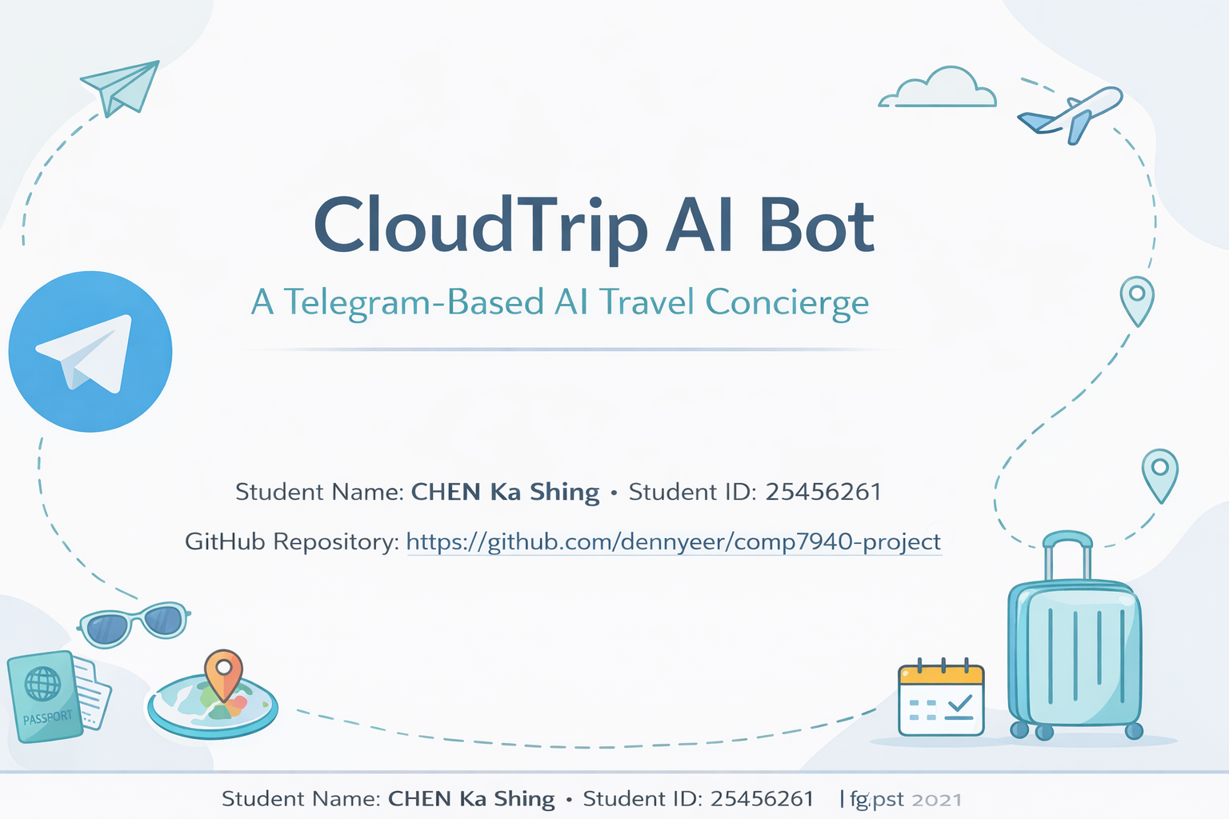

Slide 2
PRODUCT IDEA
What the product does
CloudTrip AI Bot is a Telegram-based travel concierge that gives users practical trip planning and problem-solving support in natural language.
✈️
Plan trips fast
🧭
Solve travel issues
☁️
Run as a cloud service
Generates short itineraries, activity ideas, transport tips, and packing reminders.
Handles flight delays, rain plans, and common travel questions with actionable advice.
Logs interactions, exposes a health endpoint, runs in Docker, and deploys to AWS EC2.
COMP7940 Project

Slide 3
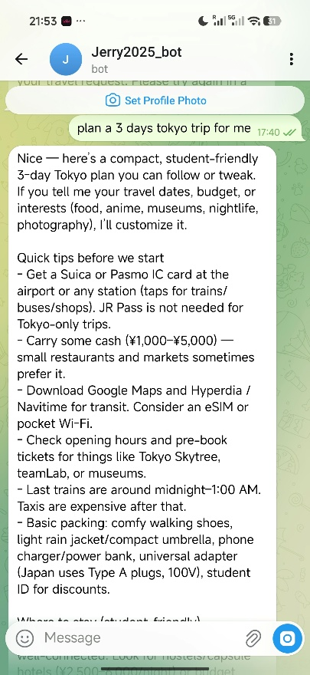
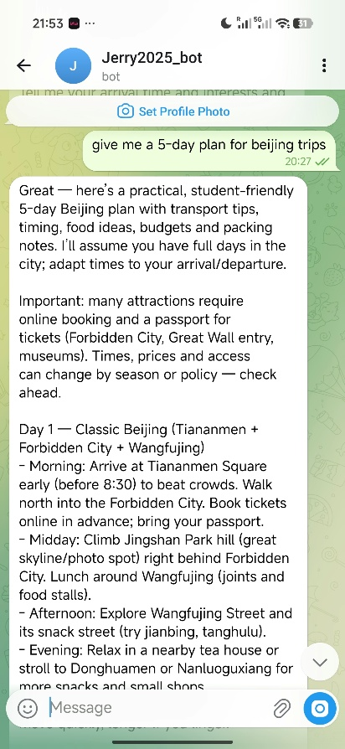
CORE FEATURES
Two meaningful prototype features
The bot demonstrates both travel itinerary planning and travel problem-solving through live Telegram interactions.
Feature 1 — Travel itinerary planning
Feature 2 — Travel problem-solving
Example: “Plan a 3-day Tokyo trip for me.”
Example: “Give me a 5-day plan for Beijing.”
Generates a structured day-by-day itinerary with attractions, food suggestions, and practical travel tips.
The same interface can answer travel questions in context, for example delays, weather changes, or transport choices.
COMP7940 Project

Slide 4
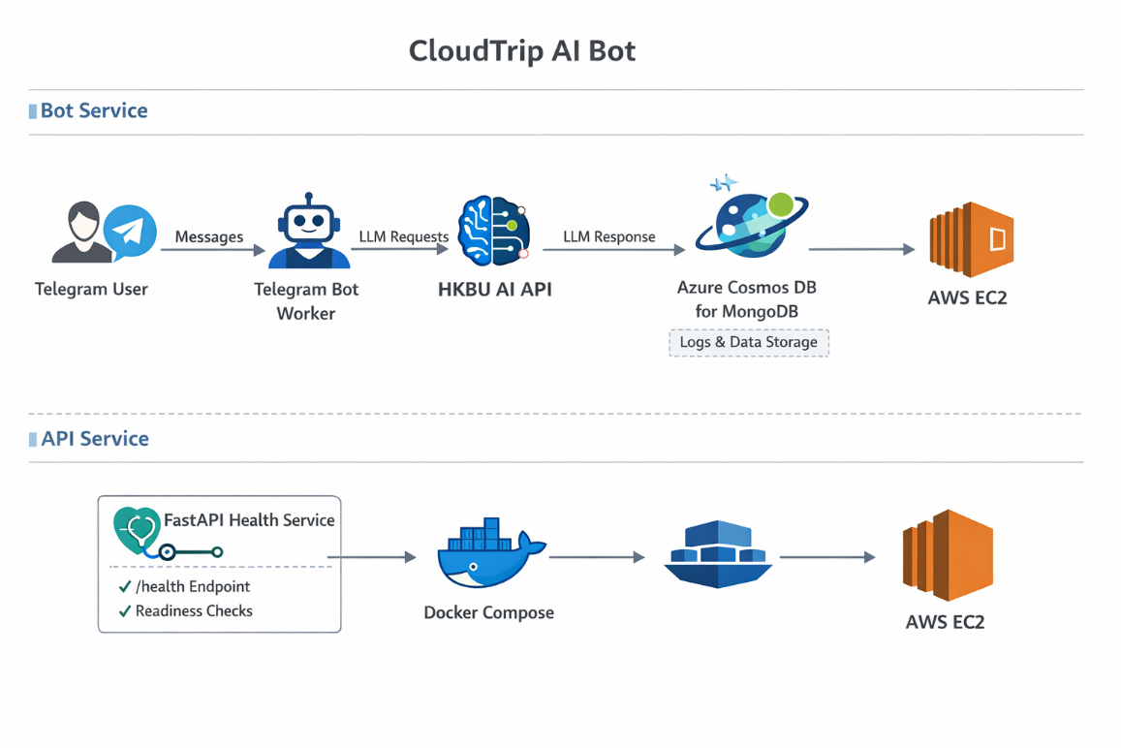
CLOUD WORKFLOW
End-to-end system architecture
A two-service design separates Telegram interaction from health monitoring, while cloud storage and CI/CD complete the deployment loop.
Telegram
User-facing chat channel
HKBU AI API
LLM response generation
Azure Cosmos DB
Cloud interaction logging
FastAPI /health
Basic service monitoring
AWS EC2 + Docker
Cloud hosting and container runtime
GitHub Actions
Automatic redeployment on push
COMP7940 Project

Slide 5
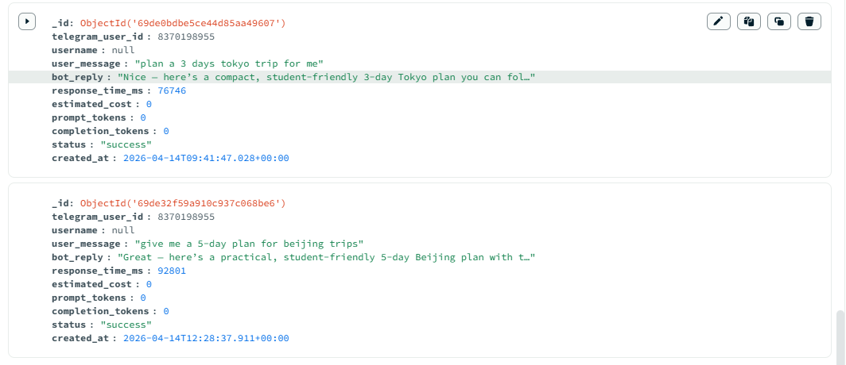
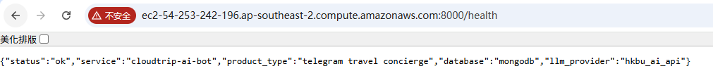
OPERATIONAL VISIBILITY
Logging and monitoring
Every interaction is stored in a cloud database, while a dedicated health endpoint makes the deployed API observable.
Cloud database logging
Service health check
Monitoring signals used in the project:
• /health endpoint for service status
• docker compose logs for runtime issues
• MongoDB records for debugging and traceability
Telegram user ID , username
user message , bot reply
response time , request status
timestamp
COMP7940 Project

Slide 6
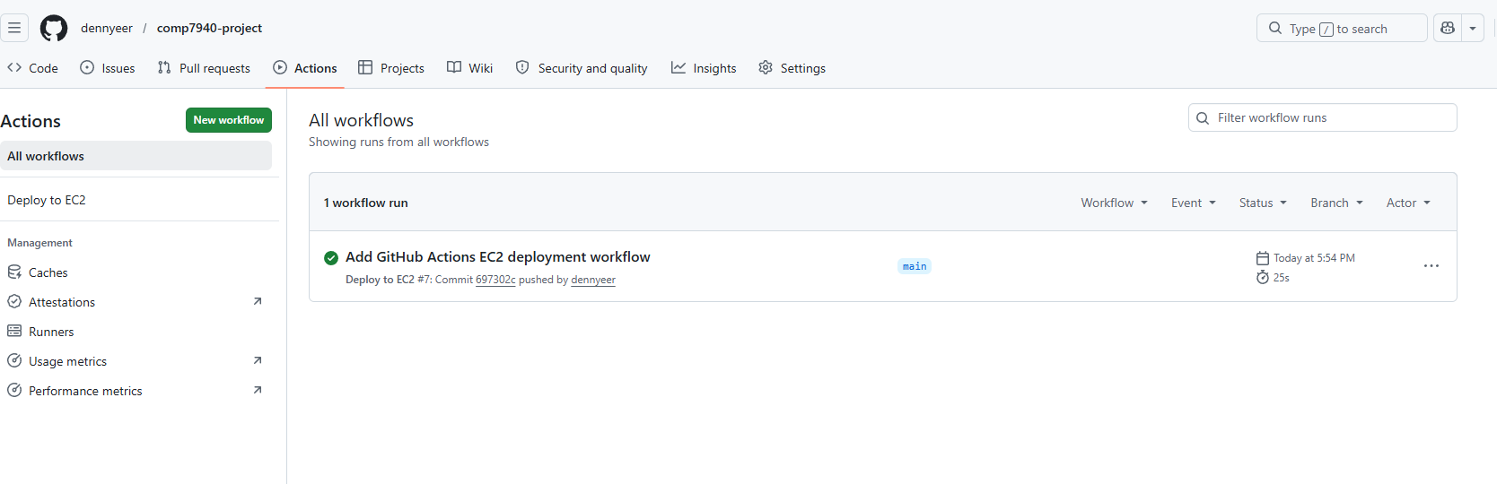
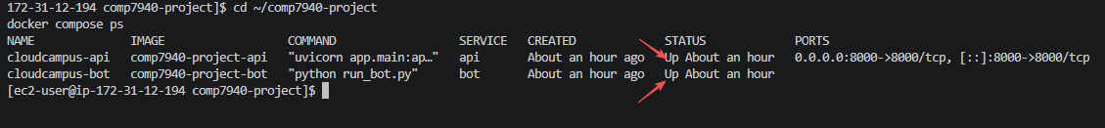
FROM LOCAL PROTOTYPE TO CLOUD SERVICE
Deployment and DevOps
The project runs as two Docker Compose services on EC2 and is redeployed automatically through GitHub Actions after each push to main.
Cloud deployment on EC2
CI/CD automation with GitHub Actions
Evidence that both the API service and bot worker are running in containers on the cloud instance.
Workflow steps: checkout repository, load EC2 key, connect by SSH, pull latest code, rebuild Docker services, and restart the application.
COMP7940 Project

Slide 7
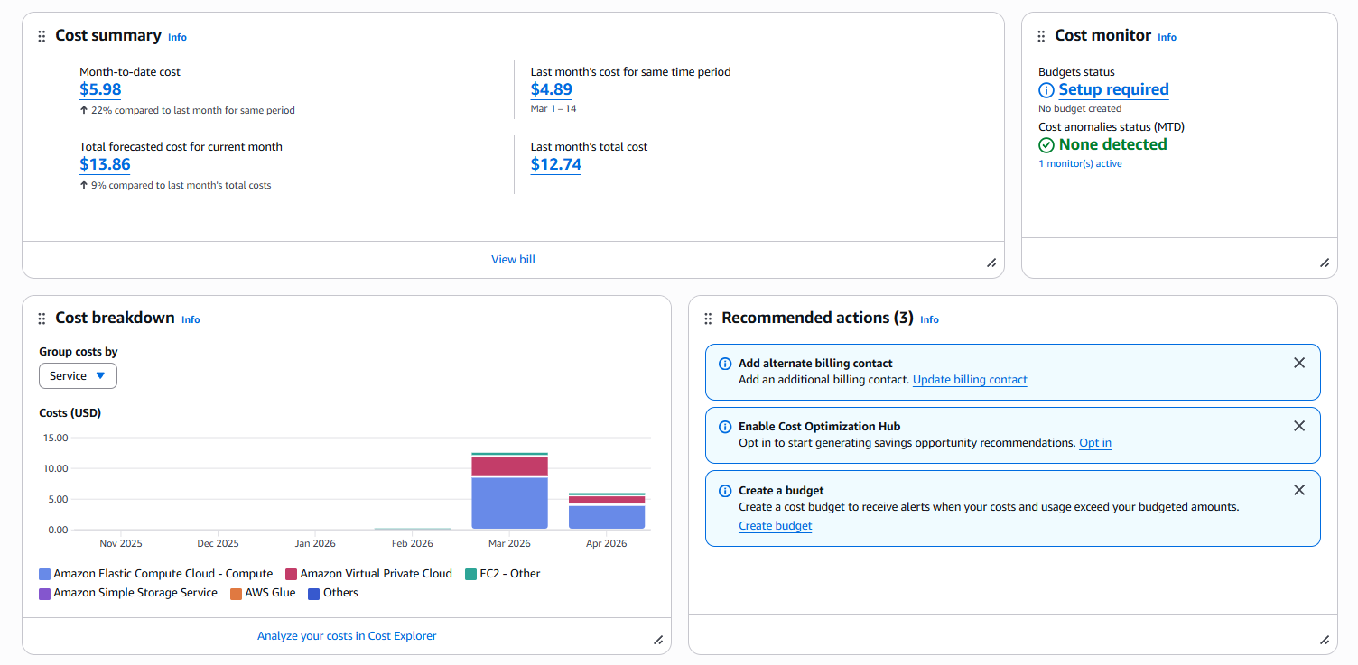
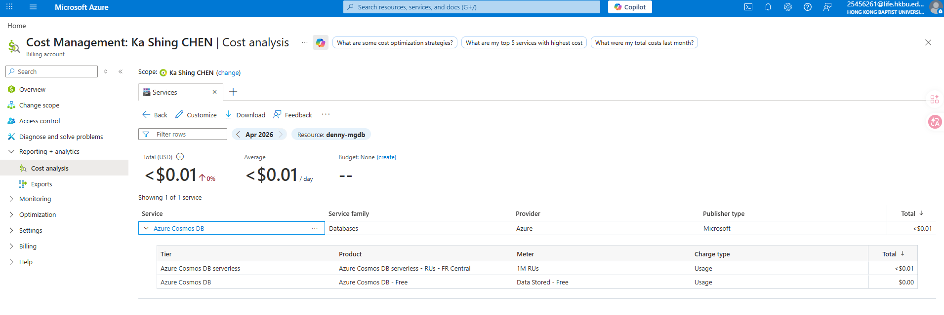
WHY THIS IS A COMPLETE CLOUD PROJECT
Monitoring and cost awareness
The architecture stayed lightweight while still meeting the course requirements for Telegram, cloud logging, cloud hosting, monitoring, containers, and CI/CD.
AWS hosting cost
Azure database cost
Azure Cosmos DB cost remained below USD 0.01 during development and testing.
Month-to-date: USD 5.98
Forecasted monthly total: USD 13.86
Result: CloudTrip AI Bot became a practical cloud-hosted AI travel concierge rather than a local chatbot demo.
CloudTrip AI Bot

