Slide 1


SHOP
CHURNPREDICT
Artificial Intelligence and Data Engineering
Data Mining and Machine Learning project
Denny Meini

Slide 2
PAY
PROJECT GOALS
The goals of this project are to compare a list of classifiers in order to discover which of them gives us the best performance in terms of some parameters (f-score and average accuracy). Another goal is to build an application that uses the classifier which gave the best results. The dataset has some null values and an additional aim is to know if is better to drop the incomplete records or to complete them.

Slide 3


DATASET
I took the dataset from kaggle
Link: https://www.kaggle.com/datasets/ankitverma2010/ecommerce-customer-churn-analysis-and-prediction
5630 records with 19 features and 1 binary target
3774 RECORDS
CLASS 0: 3143 RECORDS
CLASS 1: 631 RECORDS
DROP THE RECORD WITH NULL VALUES
NULL VALUES
2 OPTIONS
FILL THE NULL VALUES WITH THE MEAN VALUE OF THE FEATURE (ONLY SAME CLASS)
5630 RECORDS
CLASS 0: 4682 RECORDS
CLASS 1: 948 RECORDS
IMBALANCED DATASET

Slide 4
DATASET
Numerical feature
Categorical feature
NumberOfDeviceRegistered
PreferredOrderCat
SatisfactionScore
Grade of satisfaction of the customer from 1 (not satisfied) to 5 (very satisfied).
MaritalStatus
NumberOfAddress
Number of address added by a customer.
Complain
If the customer complained or not during the last month [0: no, 1: yes].
OrderAmountHikeFromlastYear
Percentage increase regarding the orders from the previous year.
CouponUsed
Number of coupon the customer used last month.
OrderCount
Number of order the customer placed during last month.
DaySinceLastOrder
CashbackAmount
Average cashback of the customer last month.
CustomerID
Churn
Output class [0: did not left, 1 left].
Tenure
The number of years the customer has been a customer.
PreferredLoginDevice
CityTier
The tier of the city (Chinese model) [1: big, 2: medium, 3: small].
WarehouseToHome
Distance between the warehouse and the customer's house.
PreferredPaymentMode
Gender
HourSpendOnApp
Number of hours the customer has spent on the app.

Slide 5
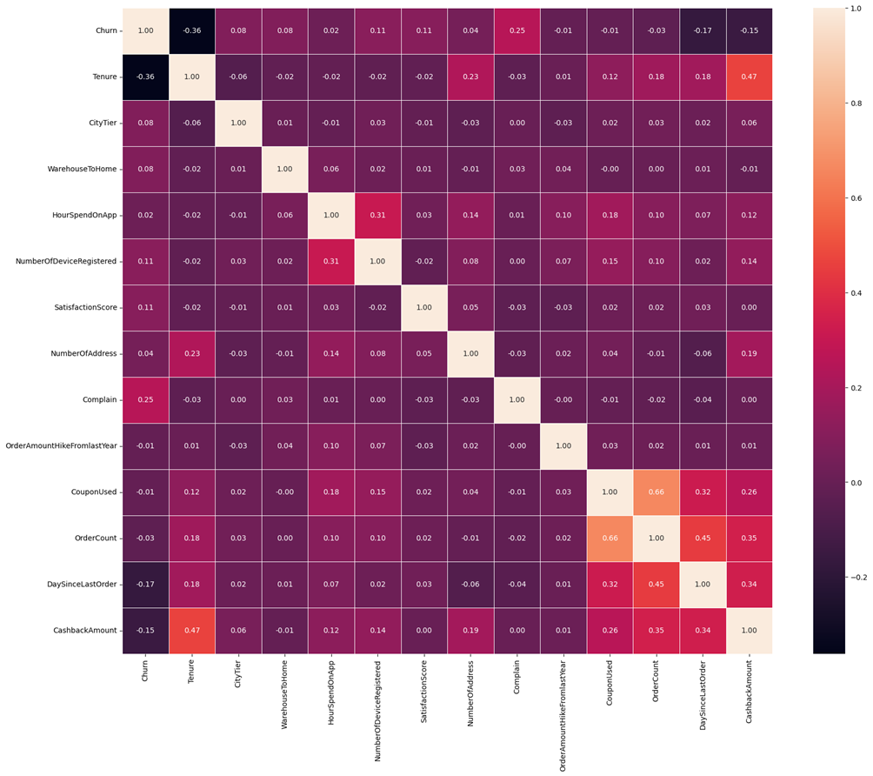
PREPROCESSING
Null values problem:
Creation of the two datasets
Feature extraction:
Obtaining numerical representation of categorical features: getDummies()
Drop of useless features:
CustomerID
Correlation analysis:
no correlated features
Balance analysis:
Imbalanced Dataset

Slide 6
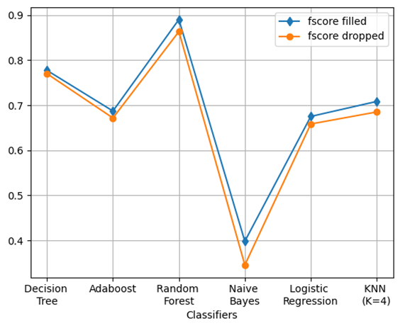
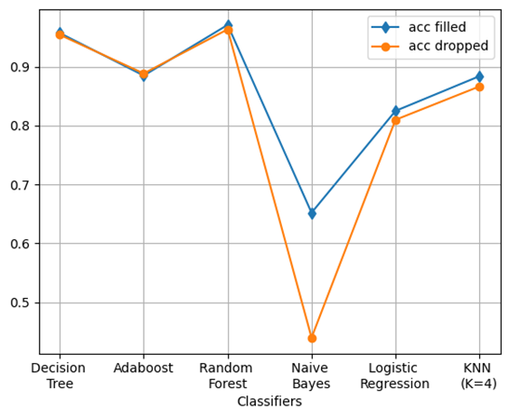
CLASSIFICATION
Cross validation using Stratified K Fold (k=5)
Rebalancing using SMOTE
For each classifier I got f-score and Avg Accuracy
Classifiers |  | f-score | Avg accuracy
Decision Tree | Filled | 0.777 | 0.957
 | Dropped | 0.770 | 0.954
AdaBoost | Filled | 0.687 | 0.885
 | Dropped | 0.672 | 0.888
Random Forest | Filled | 0.890 | 0.971
 | Dropped | 0.864 | 0.963
Gaussian Naive Bayes | Filled | 0.398 | 0.652
 | Dropped | 0.345 | 0.440
Logistic Regression | Filled | 0.675 | 0.825
 | Dropped | 0.658 | 0.810
KNN (K=4) | Filled | 0.708 | 0.884
 | Dropped | 0.685 | 0.866
Wilcoxon test: pvalue=0.0625
↓
No statistical relevance

Slide 7
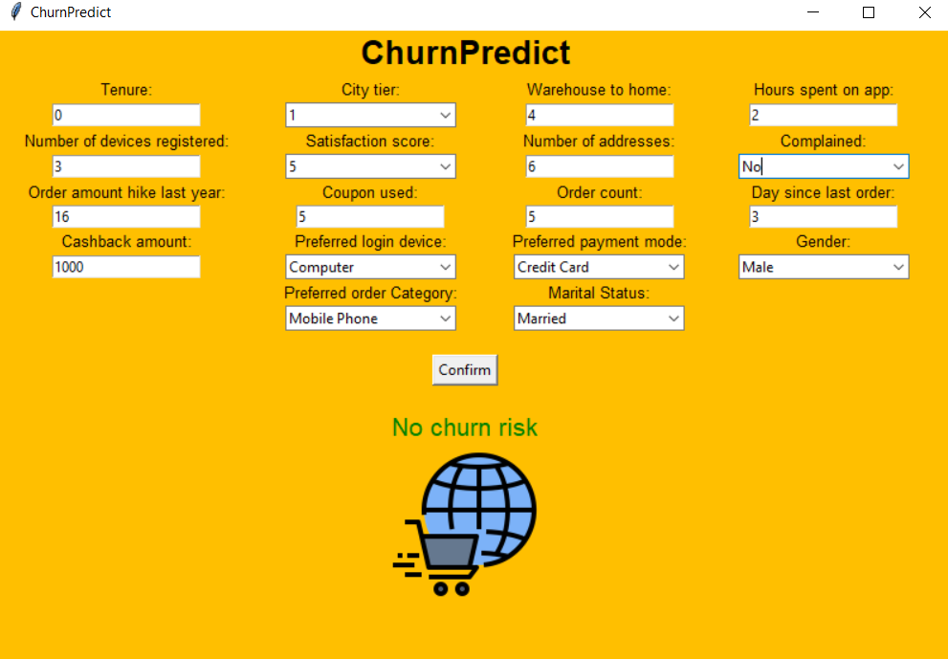
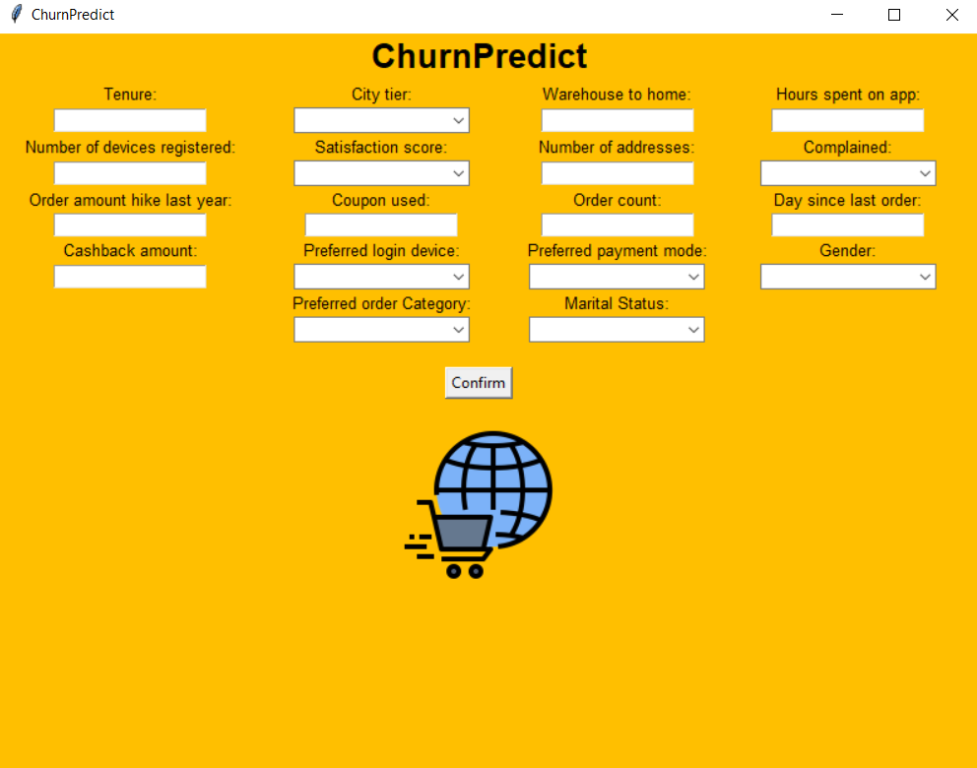
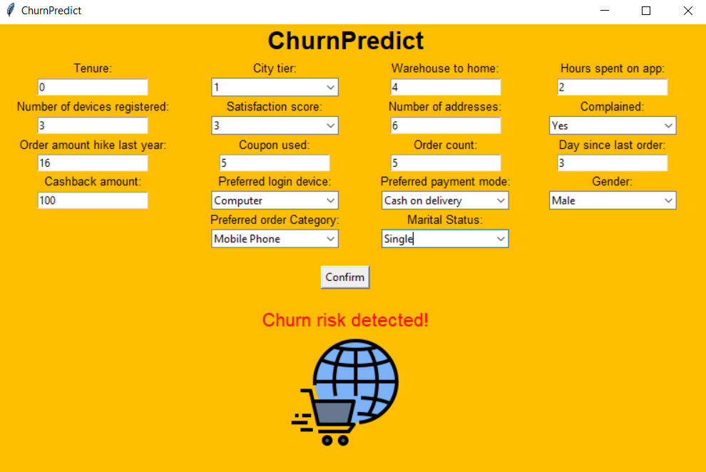
APPLICATION IMPLEMENTATION
Input: The values of the features of the dataset
Output: Presence or not of churn risk
NO RISK
RISK

Slide 8
SHOP
THANK YOU FOR YOUR ATTENTION

