Slide 1

Team vaxtrax
Jeremy Wilson, Matthew Brinkmann, Dennis Dyer

Slide 2


Covid-19 background & CDC Response
First known cases reported in Wuhan, China in late 2019
CDC confirmed the first case in the US in January 2020 and activates its Emergency Response System
January 2020, CDC begins screening passengers on connecting flights from Wuhan
February 2020, CDC develops testing kits for Covid-19
In March 2020, President Trump declares a nationwide emergency, US states begin to shut down
Most US states reported widespread cases by April 2020, CDC announces new mask and social distancing guidelines

Slide 3



Vaccine development
March 2020, first human vaccine trial begins, conducted by Moderna
April 2020, President Trump launches an initiative to produce a vaccine for Covid-19 as quick as possible
December 2020
Food and Drug Administration issues Emergency Use Authorization for the first Covid-19 vaccine, made by Pfizer
First American outside of a clinical trial receives vaccine
FDA issues EUA for the second Covid-19 vaccine, made by Moderna
February 2020, FDA issues EUA for Johnson & Johnson one-shot vaccine
Mid-April 2020, all US adults become eligible to receive Covid-19 vaccines

Slide 4
Meet team vaxtrax
Dennis Dyer
Matthew Brinkman
Jeremy Wilson
Application Development Lead
Handled writing code for the entire application
Designed all User Interfaces in the application
Database Design Lead
Responsible for building and maintaining VaxTrax database and tables
Moved and restored the database through several different iterations of hosting
Documentation Lead
In charge of documenting deliverables and the overall state of the application
Documented current state of application, successes, and failures for every sprint report

Slide 5
Project objective & Deliverables
Objective
Develop an application to be used by the state of Missouri for recording and tracking vaccination records of residents
Deliverables in “User Story” Format
Login Functionality
Adverse Reaction Reporting
Daily Vaccination Report Generation
Ability to input new patient information
Ability to retrieve existing patient information
Vaccination Refusal Logging
Vaccination Event and Dose Tracking

Slide 6
Sprint history
Sprint 1
Sprint 2
Conducted Project Scope Blitz
Assembled List of Business Events to Use as Guideline of Project Deliverables
Created Screen Mock-Ups for the User Interface of the Application
Created an Early Draft of an ERD
Actual Development Begins
Business Events Chosen to be Deliverables:
Vaccinator Logs into the System
Vaccinator reports adverse reactions to the CDC
Login Functionality implemented successfully
Adverse Reaction Reporting implemented successfully
Vaccinator table created in Database

Slide 7
Sprint history
Sprint 3
Sprint 4
Business Events chosen to be Deliverables:
Vaccinator retrieves patient information from the system
Vaccinator inputs patient information
Ability to input new patient information implemented successfully
Ability to retrieve existing patient information implemented successfully
Patient Table created in Database
Business Events chosen to be Deliverables:
Vaccinator asks pre-screening questions and inputs refusal information if needed
Vaccinator inputs vaccine dose information
Ability to log and store vaccine dose information implemented successfully
Ability to input refusal information was not implemented successfully in this sprint
Vaccine Table created in Database
Insurance Table created in Database

Slide 8
Sprint history
Sprint 5
Sprint 6
Business Events chosen to be Deliverables:
Vaccinator asks pre-screening questions and inputs refusal information if needed
Ability to input refusal information implemented successfully
Refusal Table created in Database
Business Events chosen to be Deliverables:
System sends vaccination events to CDC daily
Ability to generate vaccination event reports that are ready to be sent to the CDC implemented successfully

Slide 9
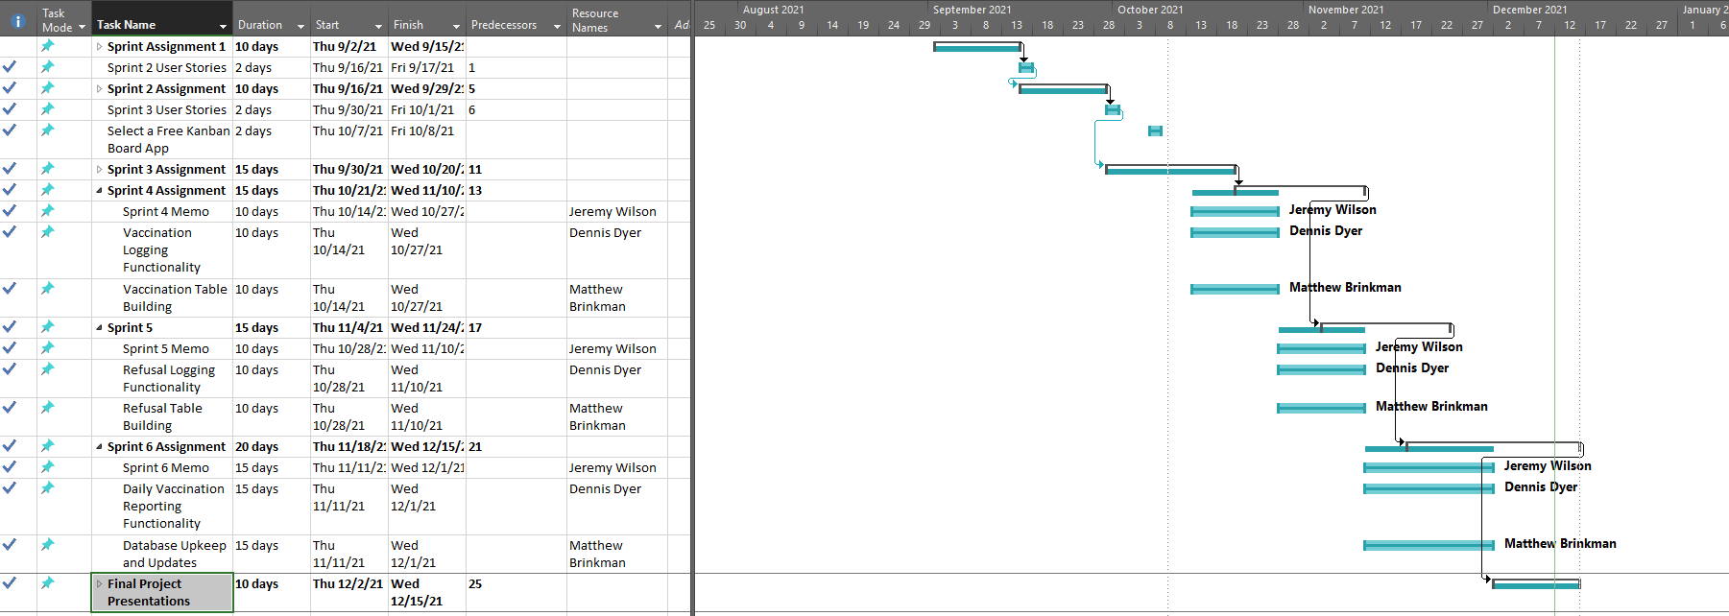
Gantt chart

Slide 10
Class responsibility collaborator cards
Patient CRC Card (FRONT)
Patient CRC Card (BACK)
Patient CRC Card (BACK)
Attributes (Properties)
patient_ID
First_Name
Middle_Name
Last_Name
Date_of_Birth
Sex
Street1
Street2
City
County
State
Zipcode
Ethnicity
Race
Patient CRC Card (FRONT)
Responsibilities (Methods) | Collaborating Classes
AddPatient | Vaccine
GetPatient | Refusal
PatientExists | Insurance
UpdatePatientAddress

Slide 11
Class responsibility collaborator cards
Vaccine CRC Card (FRONT)
Vaccine CRC Card (BACK)
Vaccine CRC Card (BACK)
Attributes (Properties)
patient_ID
NumDose
Vaccinator_Name
Administration_site
Product
Manufacture
Typecvx
LotNum
ExpirationDate
DateAdministered
NumWasted
MissedAppointment
Comorbidity
RevievedEUA
User_ID
Vaccine CRC Card (FRONT)
Responsibilities (Methods) | Collaborating Classes
AddVaccine | Patient
VaccineExists | User
GetVaccines
GetTodaysVaccines
DailyVaccineExists

Slide 12
Class responsibility collaborator cards
Refusal CRC Card (FRONT)
Refusal CRC Card (BACK)
Refusal CRC Card (BACK)
Attributes (Properties)
patient_ID
Refusal_Reason
Date
User_ID
Refusal CRC Card (FRONT)
Responsibilities (Methods) | Collaborating Classes
AddRefusal | Patient
GetTodaysRefusals | User
DailyRefusalExists

Slide 13
Class responsibility collaborator cards
User CRC Card (FRONT)
User CRC Card (BACK)
User CRC Card (BACK)
Attributes (Properties)
User_ID
UserName
Password
User CRC Card (FRONT)
Responsibilities (Methods) | Collaborating Classes
IsValid | Vaccine
GetUserID | Refusal

Slide 14
Class responsibility collaborator cards
Insurance CRC Card (FRONT)
Insurance CRC Card (BACK)
Insurance CRC Card (FRONT)
Responsibilities (Methods) | Collaborating Classes
AddInsurance | Patient
InsuranceExists
GetInsurance
UpdateInsurance
Insurance CRC Card (BACK)
Attributes (Properties)
patient_ID
Insurer
Primary_Holder
Group_ID

Slide 15
Demo time

Slide 16
Expected benefits
Ease of logging vaccination events
Reporting vaccination events to the CDC will be made easier by generated, ready-to-send reports
Centralized database of resident vaccination status, easier for statistical tracking at the state level
Runs on all recent Windows Operating Systems, which many healthcare providers already use throughout the state
Can also be used on tablets that run Windows Operating Systems, which provides a level of portability and ease of use to healthcare providers

Slide 17
Cost-benefit analysis
Costs & Benefits
Cost Chart
The costs for development were calculated at a rate of $30 per billable hour for all three people on the development team
Total Billable Hours: 132 hours at $30/hour
Total Cost of Development: $3,960
As of right now, there are no expected financial benefits, but the outlined benefits stated on the previous slide should be taken into consideration

Slide 18
In summary
Team VaxTrax strongly believes that our VaxTrax application would be extremely helpful to the state of Missouri for recording and storing vaccination events
The application would be available to all healthcare providers to implement as needed, but we assume that a state-sponsored application would be favored by many providers, and thus would be quickly implemented by a majority of them
The application also provides a great starting place for future functionality to be built upon, such as implementing vaccine event logging for children, who are now approved to receive vaccinations. More information on this potential expansion can be found on the next slide.

Slide 19
Proposed expansion to track child vaccinations
Costs
Benefits
Continued rate of $30/hour
Expected development time of 60 hours to implement new functionalities
60 hours at $30/hour = $1800
Previous Development Costs: $3960
Total Development Costs after Expansion: $5760
No Financial Benefits
Tracking Child Vaccination Status in Missouri
Easy reporting for all age groups
Centralized Database that records vaccination status for all age groups

Slide 20

Thank you for listening
Questions?

